Slide 1
Chapter 7: IP Addressing
CCNA Routing and Switching
Introduction to Networks v6.0
Notes:
Cisco Networking Academy Program
Introduction to Networks v6.0
Chapter 7: IP Addressing

Slide 2
7.2 IPv4 Network Addresses
Notes:
7 – IP Addressing
7.1 – IPv4 Network Addresses

Slide 3
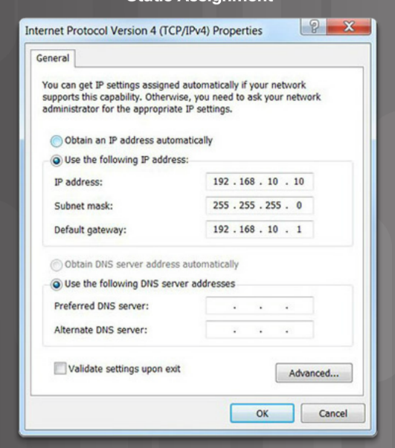
IPv4 Unicast, Broadcast, and Multicast Static IPv4 Address Assignment to a Host
Some devices like printers, servers and network devices require a fixed IP address.
Hosts in a small network can also be configured with static addresses.
Notes:
7.1 – IPv4 Network Addresses
7.1.3 – IPv4 Unicast, Broadcast, and Multicast
7.1.3.1 - Static IPv4 Address Assignment to a Host

Slide 4
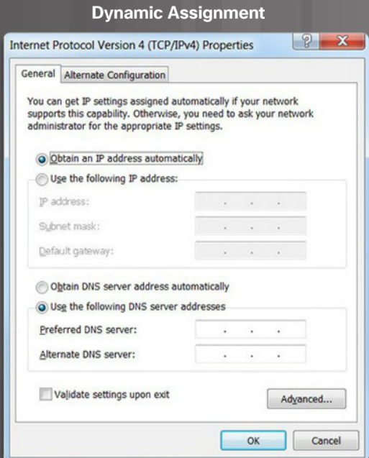
IPv4 Unicast, Broadcast, and Multicast Dynamic IPv4 Address Assignment to a Host
Most networks use Dynamic Host Configuration Protocol (DHCP) to assign IPv4 addresses dynamically.
The DHCP server provides an IPv4 address, subnet mask, default gateway, and other configuration information.
DHCP leases the addresses to hosts for a certain length of time.
If the host is powered down or taken off the network, the address is returned to the pool for reuse.
Notes:
7.1 – IPv4 Network Addresses
7.1.3 – IPv4 Unicast, Broadcast, and Multicast
7.1.3.2 - Dynamic IPv4 Address Assignment to a Host

Slide 5
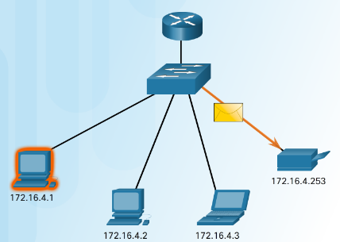
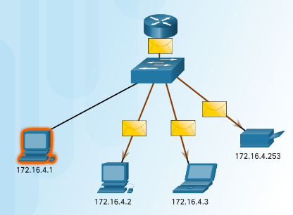
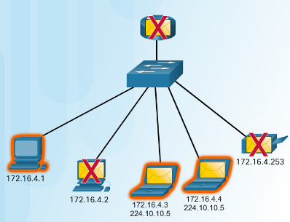
IPv4 Unicast, Broadcast, and Multicast IPv4 Communication
Unicast – one to one communication.
Broadcast– one to all.
Multicast – one to a select group.
Notes:
7.1 – IPv4 Network Addresses
7.1.3 – IPv4 Unicast, Broadcast, and Multicast
7.1.3.3 – IPv4 Communication

Slide 6
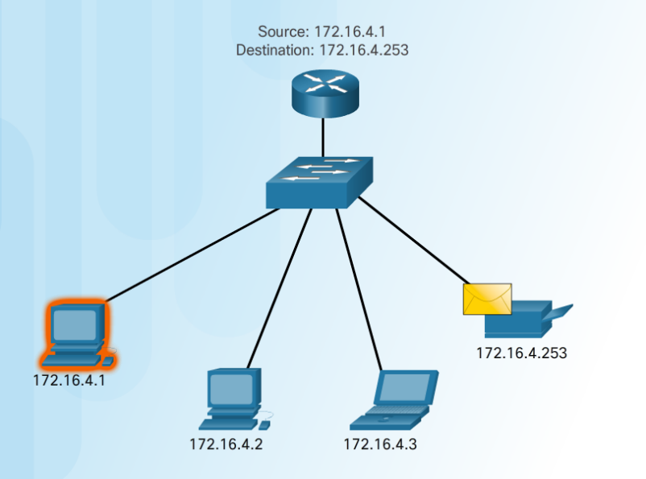
IPv4 Unicast, Broadcast, and Multicast Unicast Transmission
Unicast – one to one communication.
Use the address of the destination device as the destination address.
Notes:
7.1 – IPv4 Network Addresses
7.1.3 – IPv4 Unicast, Broadcast, and Multicast
7.1.3.4 – Unicast Transmission

Slide 7
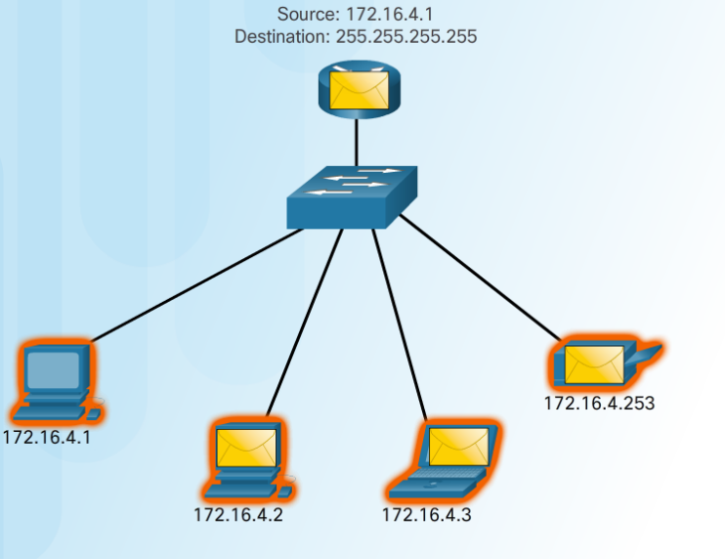
IPv4 Unicast, Broadcast, and Multicast Broadcast Transmission
Broadcast– one to all
Message sent to everyone in the LAN (broadcast domain.)
destination IPv4 address has all ones (1s) in the host portion.
Notes:
7.1 – IPv4 Network Addresses
7.1.3 – IPv4 Unicast, Broadcast, and Multicast
7.1.3.5 – Broadcast Transmission

Slide 8
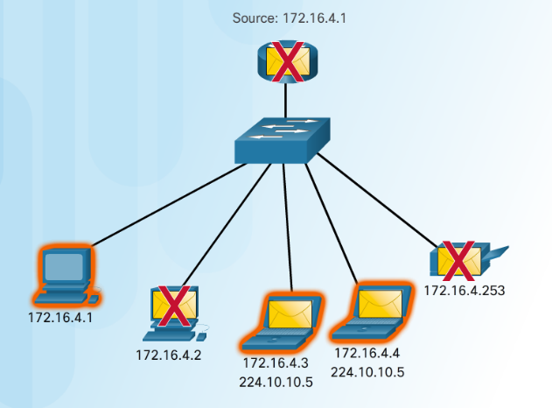
IPv4 Unicast, Broadcast, and Multicast Multicast Transmission
Multicast– one to a select group.
224.0.0.0 to 239.255.255.255 addresses reserved for multicast.
routing protocols use multicast transmission to exchange routing information.
Notes:
7.1 – IPv4 Network Addresses
7.1.3 – IPv4 Unicast, Broadcast, and Multicast
7.1.3.6 – Multicast Transmission

Slide 9
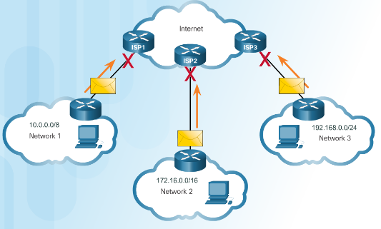
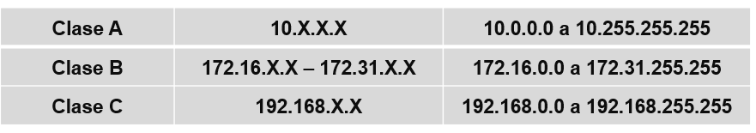
Types of IPv4 Addresses Public and Private IPv4 Addresses
Private Addresses
Not routable
Introduced in mid 1990s due to depletion of IPv4 addresses
Used only in internal networks.
Must be translated to a public IPv4 to be routable.
Private Address Blocks
Notes:
7.1 – IPv4 Network Addresses
7.1.4 – Types of IPv4 Addresses
7.1.4.1 – Public and Private IPv4 Addresses

Slide 10
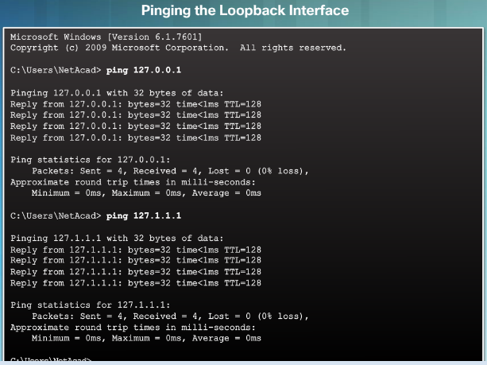
Types of IPv4 Addresses Special User IPv4 Addresses
Loopback addresses (127.0.0.0 /8 or 127.0.0.1)
Used on a host to test if the TCP/IP configuration is operational.
Link-Local addresses (169.254.0.0 /16 or 169.254.0.1)
Commonly known as Automatic Private IP Addressing (APIPA) addresses.
Used by Windows client to self configure if no DHCP server available.
Notes:
7.1 – IPv4 Network Addresses
7.1.4 – Types of IPv4 Addresses
7.1.4.3 – Special User IPv4 Addresses

Slide 11
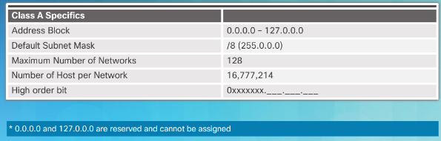
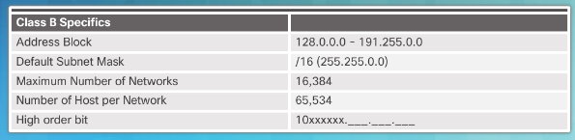
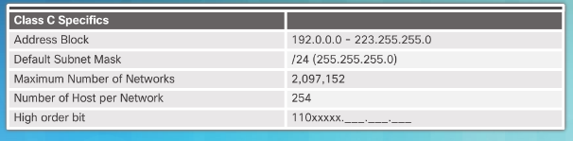
Types of IPv4 Addresses Legacy Classful Addressing
In 1981, Internet IPv4 addresses were assigned using classful addressing (RFC 790)
Network addresses were based on 3 classes:
Class A (0.0.0.0/8 to 127.0.0.0/8) – Designed to support extremely large networks with more than 16 million host addresses.
Class B (128.0.0.0 /16 – 191.255.0.0 /16) – Designed to support the needs of moderate to large size networks up to approximately 65,000 host addresses.
Class C (192.0.0.0 /24 – 223.255.255.0 /24) – Designed to support small networks with a maximum of 254 hosts.
Notes:
7.1 – IPv4 Network Addresses
7.1.4 – Types of IPv4 Addresses
7.1.4.4 – Legacy Classful Addressing

Slide 12
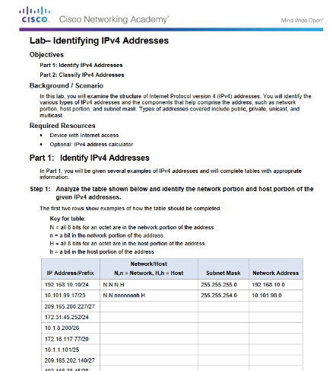
Types of IPv4 Addresses Lab – Identifying IPv4 Addresses
Notes:
7.1 – IPv4 Network Addresses
7.1.4 – Types of IPv4 Addresses
7.1.4.9 – Lab – Identifying IPv4 Addresses

Slide 13
7.2 IPv6 Network Addresses
Notes:
7 – IP Addressing
7.2 – IPv6 Network Addresses

Slide 14
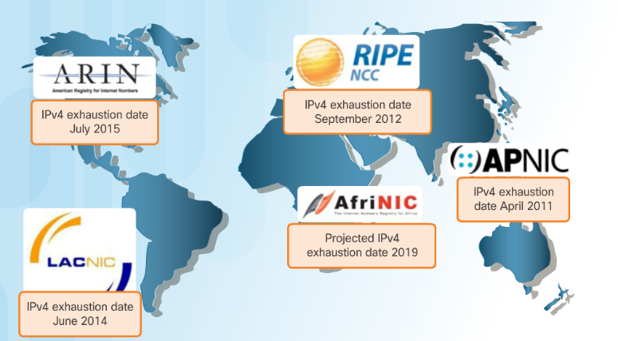
IPv4 Issues The Need for IPv6
Why IPv6 is needed:
Rapidly increasing Internet population
Depletion of IPv4
Issues with NAT
Internet of Things
Notes:
7.2 – IPv6 Network Addresses
7.2.1– IPv4 Issues
7.2.1.1 – The Need for IPv6

Slide 15
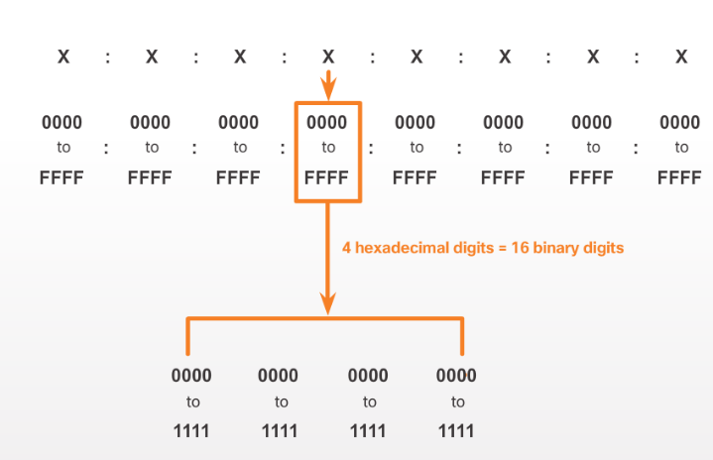
IPv6 Addressing IPv6 Address Representation
IPv6 Addresses:
128 bits in length
Every 4 bits is represented by a single hexadecimal digit
Hextet - unofficial term referring to a segment of 16 bits or four hexadecimal values.
Notes:
7.2 – IPv6 Network Addresses
7.2.2– IPv6 Addressing
7.2.2.1 – IPv6 Address Representation

Slide 16
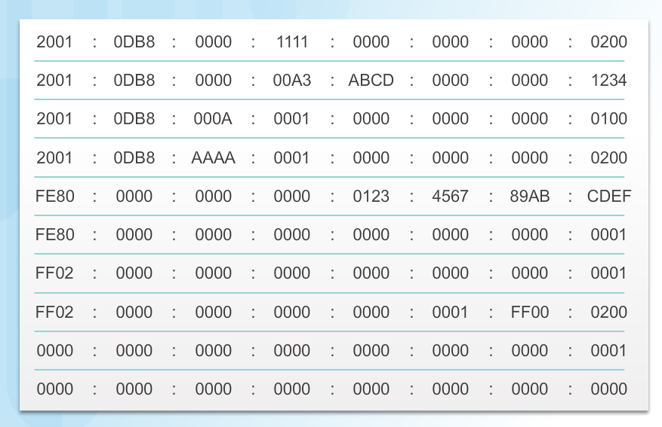
IPv6 Addressing IPv6 Address Representation (Cont.)
Preferred format for IPv6 representation
Notes:
7.2 – IPv6 Network Addresses
7.2.2– IPv6 Addressing
7.2.2.1 – IPv6 Address Representation (Cont.)

Slide 17
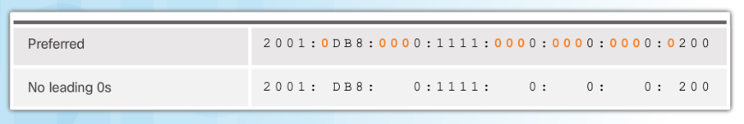
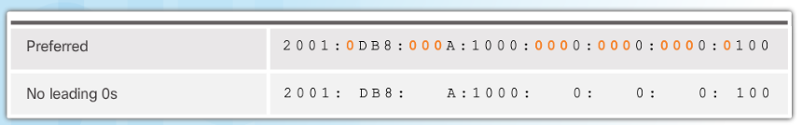
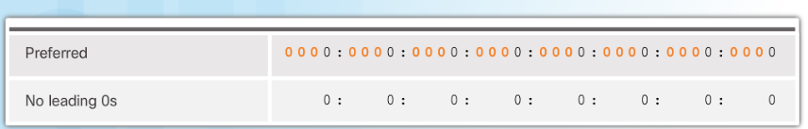
IPv6 Addressing Rule 1 – Omit Leading 0s
In order to reduce or compress IPv6
First rule is to omit leading zeros in any hextet.
Notes:
7.2 – IPv6 Network Addresses
7.2.2– IPv6 Addressing
7.2.2.2 – Rule 1 – Omit Leading 0s

Slide 18
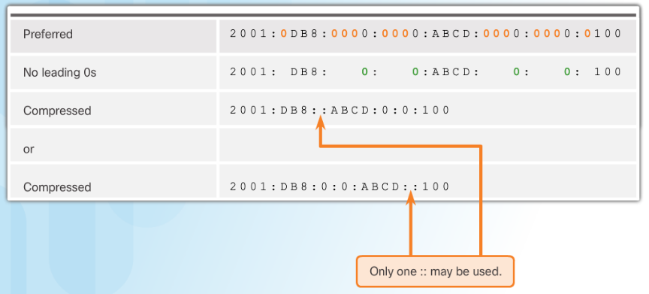
IPv6 Addressing Rule 2 – Omit All 0 Segments
Rule 2 – Omit All 0 Segments
A double colon (::) can replace any single, contiguous string of one or more 16-bit segments (hextets) consisting of all 0s.
Notes:
7.2 – IPv6 Network Addresses
7.2.2– IPv6 Addressing
7.2.2.3 – Rule 2 – Omit All 0 Segments

Slide 19
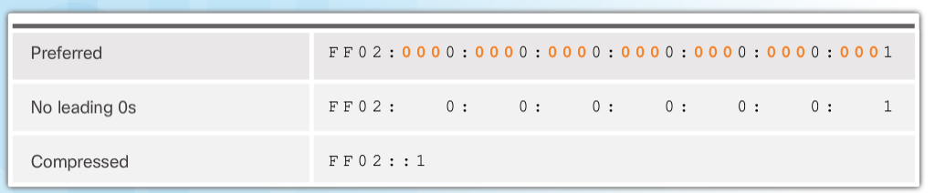
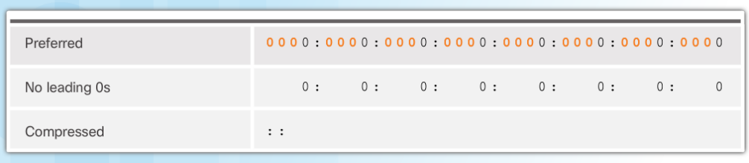
IPv6 Addressing Rule 2 – Omit All 0 Segments (Cont.)
Rule 2 – Omit All 0 Segments
A double colon (::) can replace any single, contiguous string of one or more 16-bit segments (hextets) consisting of all 0s.
Notes:
7.2 – IPv6 Network Addresses
7.2.2– IPv6 Addressing
7.2.2.3 – Rule 2 – Omit All 0 Segments (Cont.)

Slide 20
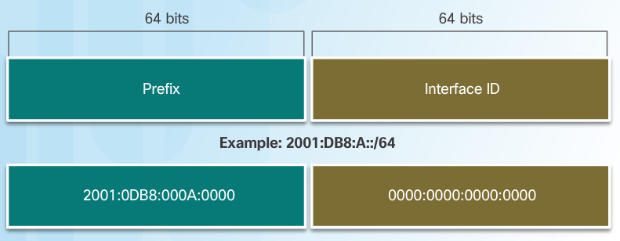
Types of IPv6 Addresses IPv6 Prefix Length
The IPv6 prefix length is used to indicate the network portion of an IPv6 address:
The prefix length can range from 0 to 128.
Typical IPv6 prefix length for most LANs is /64
Notes:
7.2 – IPv6 Network Addresses
7.2.3 – Types of IPv6 Addresses
7.2.3.2 – IPv6 Prefix Length

Slide 21
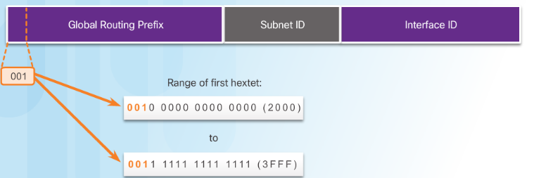
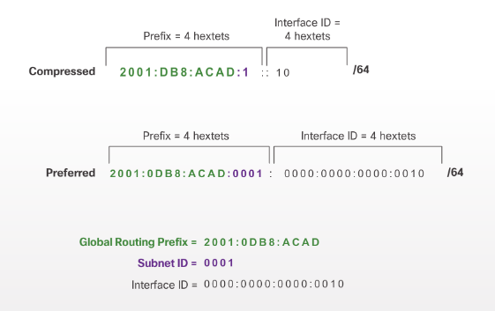
IPv6 Unicast Addresses Structure of an IPv6 Global Unicast Address
A global unicast address has three parts:
Global routing prefix - network, portion of the address that is assigned by the provider. Typically /48.
Subnet ID – Used to subnet within an organization.
Interface ID - equivalent to the host portion of an IPv4 address.
Notes:
7.2 – IPv6 Network Addresses
7.2.4 – IPv6 Unicast Addresses
7.2.4.1 – Structure of an IPv6 Global Unicast Address

Slide 22
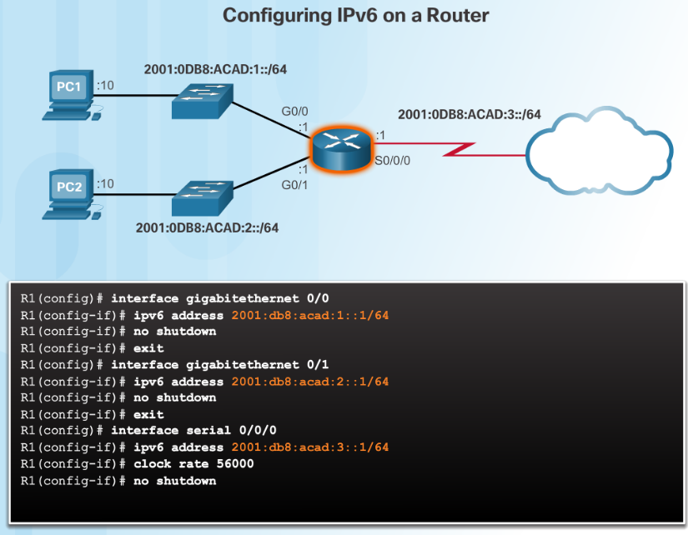
IPv6 Unicast Addresses Static Configuration of a Global Unicast Address
Router Configuration:
Similar commands to IPv4, replace IPv4 with IPv6
Command to configure andIPv6 global unicast on an interface is ipv6 address ipv6-address/prefix-length
Notes:
7.2 – IPv6 Network Addresses
7.2.4 – IPv6 Unicast Addresses
7.2.4.2 - Static Configuration of a Global Unicast Address

Slide 23
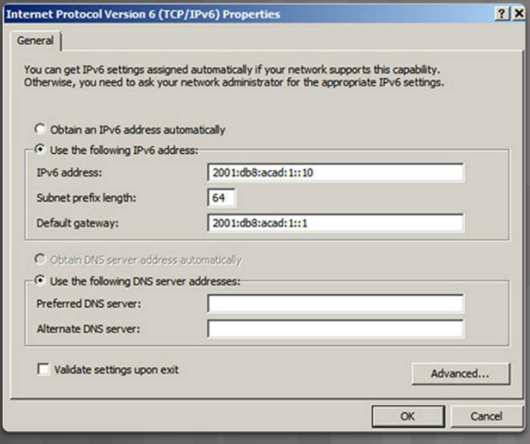
IPv6 Unicast Addresses Static Configuration of a Global Unicast Address (Cont.)
Host Configuration:
Manually configuring the IPv6 address on a host is similar to configuring an IPv4 address
Default gateway address can be configured to match the link-local or global unicast address of the Gigabit Ethernet interface.
Dynamic assignment of IPv6 addresses:
Stateless Address Autoconfiguration (SLAAC)
Stateful DHCPv6
Notes:
7.2 – IPv6 Network Addresses
7.2.4 – IPv6 Unicast Addresses
7.2.4.2 - Static Configuration of a Global Unicast Address (Cont.)

Slide 24
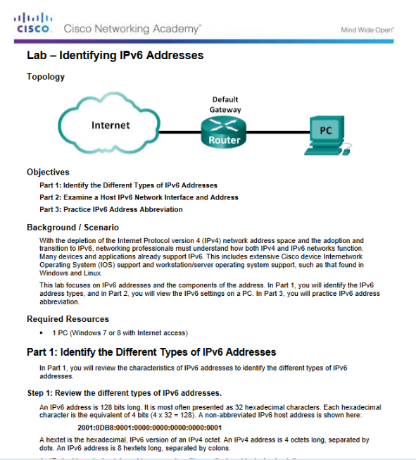
IPv6 Multicast Addresses Lab – Identifying IPv6 Addresses
Notes:
7.2 – IPv6 Network Addresses
7.2.5 – IPv6 Multicast Addresses
7.2.5.3 - Lab – Identifying IPv6 Addresses

Slide 25
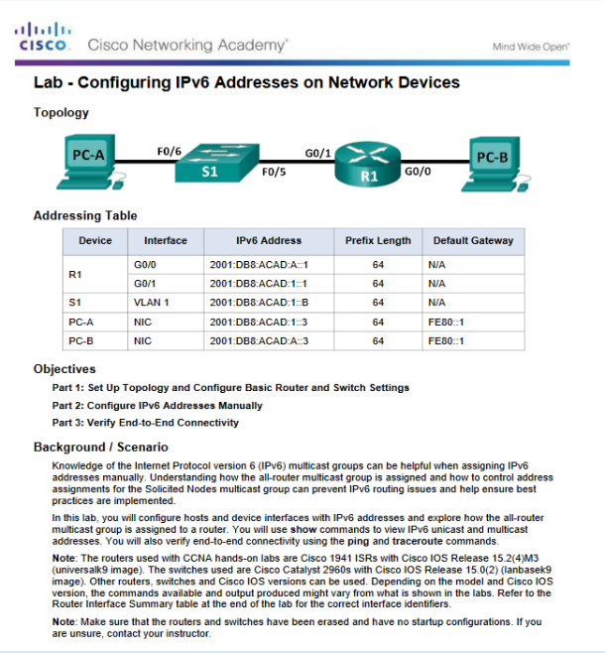
IPv6 Multicast Addresses Lab – Configuring IPv6 Addresses on Network Devices
Notes:
7.2 – IPv6 Network Addresses
7.2.5 – IPv6 Multicast Addresses
7.2.5.4- Lab – Configuring IPv6 Addresses on Network Devices

