Slide 1
9.1 Transport Layer Protocols
Notes:
9 – Transport Layer
9.1 – Transport Layer Protocols

Slide 2
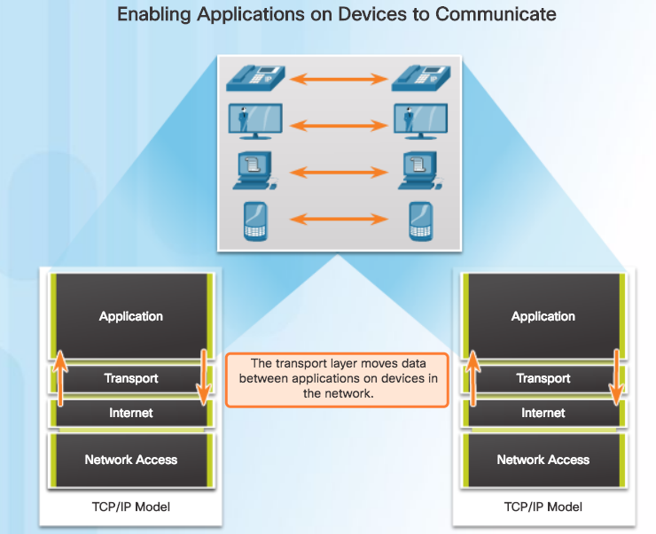
Transportation of Data Role of the Transport Layer
Responsible for establishing a temporary communication session between two applications and delivering data between them.
Link between the application layer and the lower layers that are responsible for network transmission.
Notes:
9.1 – Transport Layer Protocols
9.1.1 – Transportation of Data
9.1.1.1 – Role of the Transport Layer

Slide 3
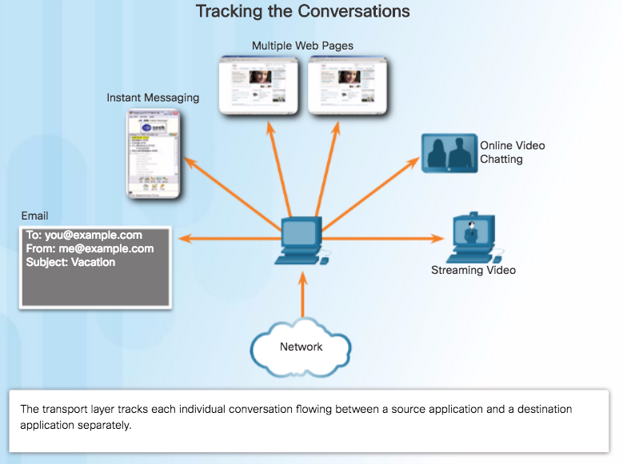
Transportation of Data Transport Layer Responsibilities
Tracking the Conversation - Tracks each individual conversation flowing between a source and a destination application.
Segmentation - Divides the data into segments that are easier to manage and transport. Header used for reassembly is used for tracking.
Identifying the Application - Ensures that even with multiple applications running on a device, all applications receive the correct data via port numbers.
Notes:
9.1 – Transport Layer Protocols
9.1.1 – Transportation of Data
9.1.1.2 – Transport Layer Responsibilities

Slide 4
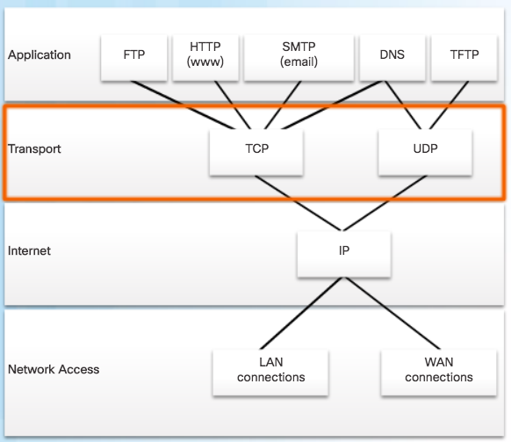
Transportation of Data Transport Layer Reliability
TCP/IP provides two transport layer protocols:
Transmission Control Protocol (TCP)
Considered reliable which ensures that all of the data arrives at the destination.
Additional fields needed in header which increases size and delay.
User Datagram Protocol (UDP)
Does not provide for reliability.
Fewer fields and is faster than TCP.
Notes:
9.1 – Transport Layer Protocols
9.1.1 – Transportation of Data
9.1.1.4 – Transport Layer Reliability

Slide 5
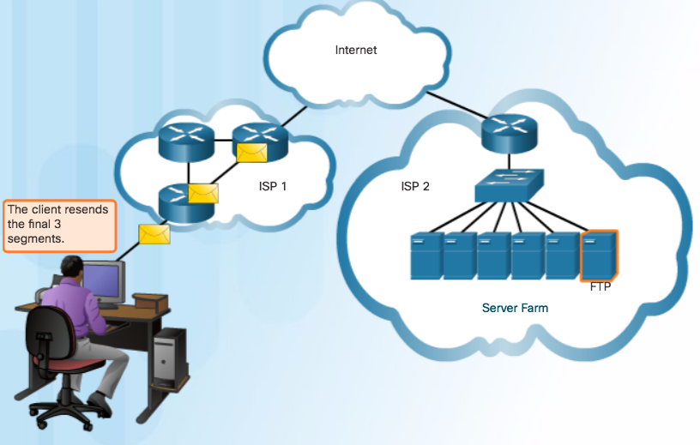
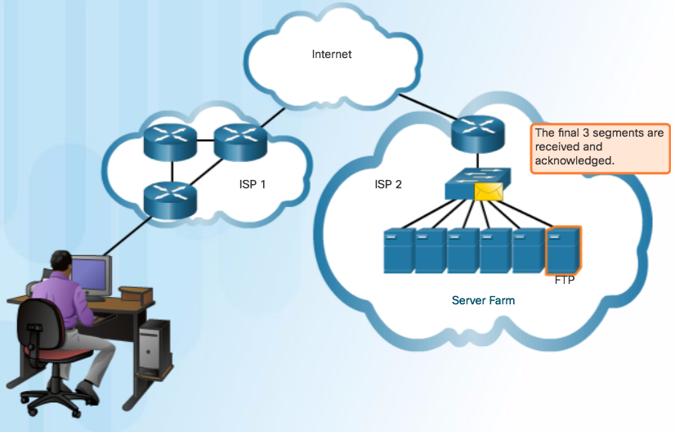
Transportation of Data TCP
TCP Three Responsibilities:
Numbering and tracking data segments
Acknowledging received data
Retransmitting any unacknowledged data after a certain period of time
Notes:
9.1 – Transport Layer Protocols
9.1.1 – Transportation of Data
9.1.1.5 – TCP

Slide 6
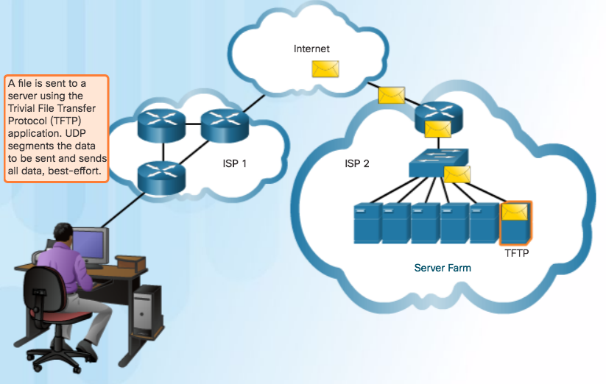
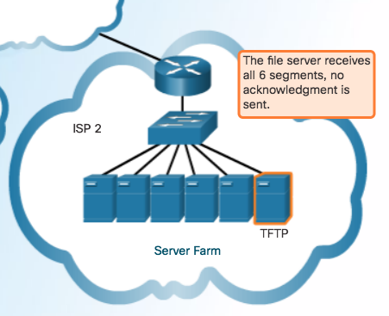
Transportation of Data UDP
Use UDP for less overhead and to reduce possible delays.
Best-effort delivery (unreliable)
No acknowledgment
Similar to a non-registered letter
Notes:
9.1 – Transport Layer Protocols
9.1.1 – Transportation of Data
9.1.1.6 – UDP

Slide 7
TCP and UDP Overview TCP Features
Establishing a Session
Connection-oriented protocol
Ensures the application is ready to receive the data
Negotiate the amount of traffic that can be forwarded at a given time
Reliable Delivery
Ensuring that each segment that the source sends arrives at the destination
Same-Order Delivery
Numbering & Sequencing the segments guarantees reassembly into the proper order
Flow Control
Regulate the amount of data the source transmits
Notes:
9.1 – Transport Layer Protocols
9.1.2 – TCP and UDP Overview
9.1.2.1 – TCP Features

Slide 8
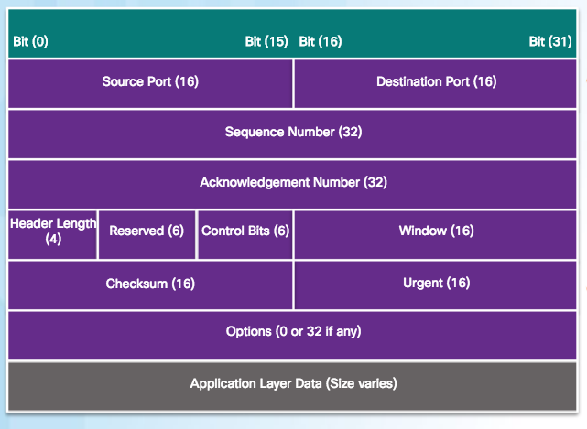
TCP and UDP Overview TCP Header
20 Bytes Total
Source and Destination Port used to identify application
Sequence number used for data reassembly
Acknowledgement number indicates data has been received and ready for next byte from source
Header length – length of TCP segment header
Control bits – purpose and function of TCP segment
Window size – number of bytes that can be accepted at one time
Checksum – Used for error checking of segment header and data
Notes:
9.1 – Transport Layer Protocols
9.1.2 – TCP and UDP Overview
9.1.2.2 – TCP Header

Slide 9
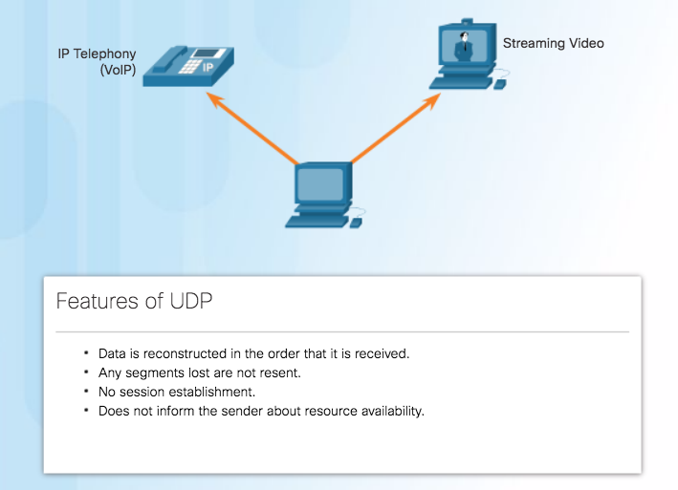
TCP and UDP Overview UDP Features
Notes:
9.1 – Transport Layer Protocols
9.1.2 – TCP and UDP Overview
9.1.2.3 – UDP Features

Slide 10
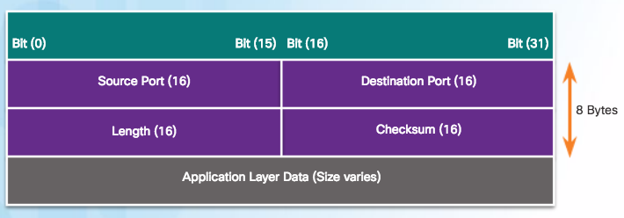
TCP and UDP Overview UDP Header
UDP is a stateless protocol – no tracking
Reliability handled by application
Notes:
9.1 – Transport Layer Protocols
9.1.2 – TCP and UDP Overview
9.1.2.4 – UDP Header

Slide 11
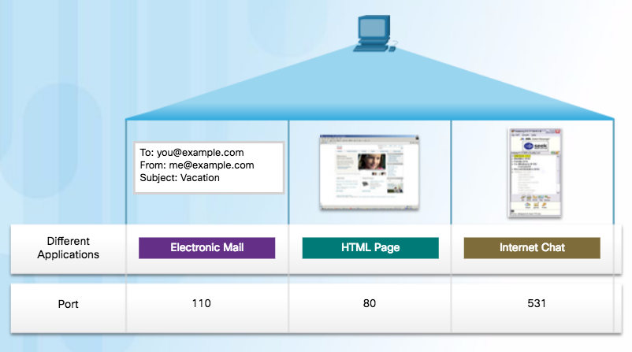
TCP and UDP Overview Multiple Separate Communications
Users expect to simultaneously receive and send email, view websites and make a VoIP phone call
TCP and UDP manage multiple conversations by using unique identifiers called port numbers
Notes:
9.1 – Transport Layer Protocols
9.1.2 – TCP and UDP Overview
9.1.2.5 – Multiple Separate Communications

Slide 12
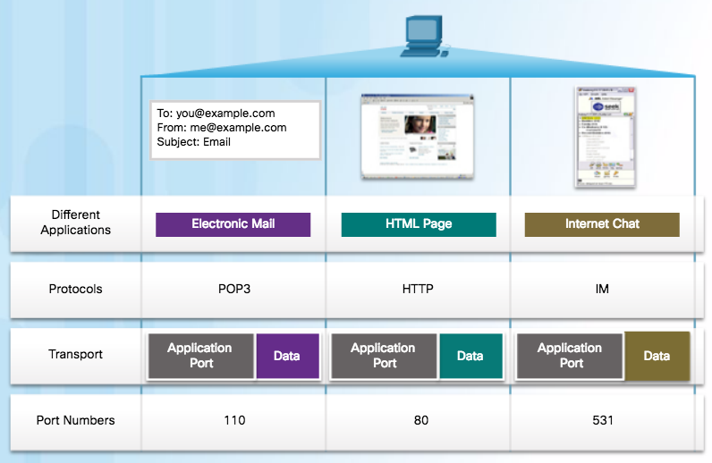
TCP and UDP Overview Port Numbers
Source Port
Originating application port that is dynamically generated by sending device
Example: Each separate HTTP conversation is tracked based on the source ports.
Destination Port
Tell the destination what service is being requested
Example: Port 80 web services are being requested
Notes:
9.1 – Transport Layer Protocols
9.1.2 – TCP and UDP Overview
9.1.2.6 – Port Numbers

Slide 13
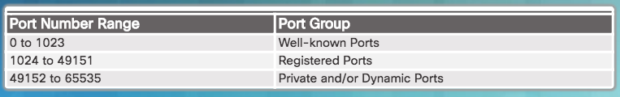
TCP and UDP Overview Port Number Groups
Well-known Ports (Numbers 0 to 1023) - These numbers are reserved for services and applications.
Registered Ports (Numbers 1024 to 49151) - These port numbers are assigned by IANA to a requesting entity to use with specific processes or applications.
Dynamic or Private Ports (Numbers 49152 to 65535) - Usually assigned dynamically by the client’s OS and used to identify the client application during communication.
Notes:
9.1 – Transport Layer Protocols
9.1.2 – TCP and UDP Overview
9.1.2.8 – Port Number Groups

Slide 14
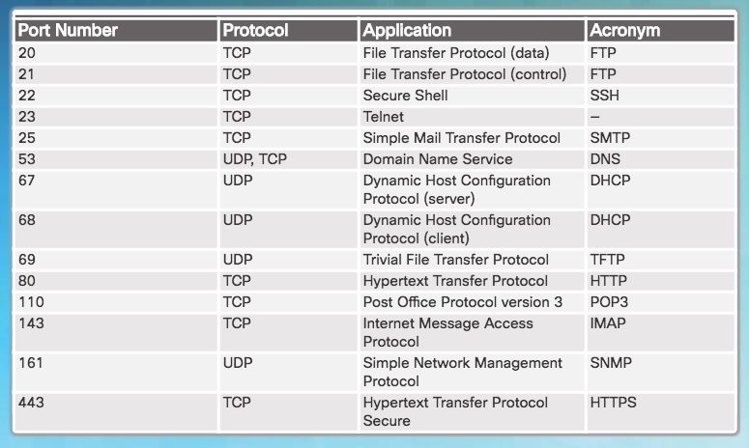
TCP and UDP Overview Port Number Groups (Cont.)
Well Known Port Numbers
Notes:
9.1 – Transport Layer Protocols
9.1.2 – TCP and UDP Overview
9.1.2.8 – Port Number Groups

Slide 15
9.2 TCP and UDP
Notes:
9 - Configure a Network Operating System
9.2 – Basic Device Configuration

Slide 16
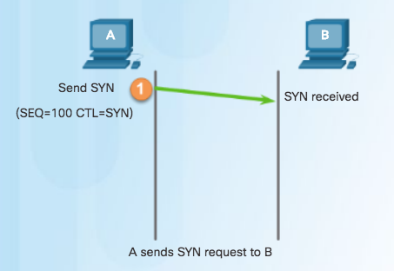
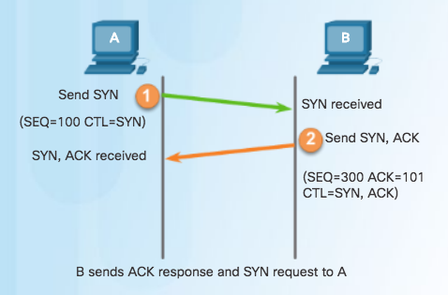
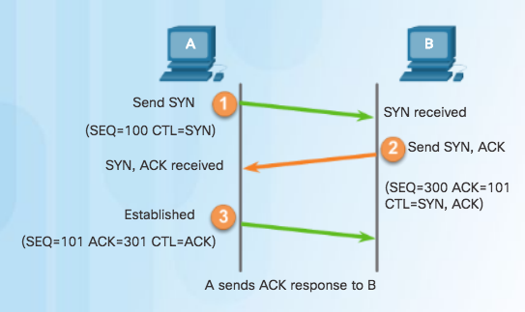
TCP Communication Process TCP Connection Establishment
Step 3 – Client acknowledges communication session with server.
Step 1 – Initiating client requests a session with server.
Step 2 – Server acknowledges and requests a session with client.
Notes:
9.2 – TCP and UDP
9.2.1 – TCP Communication Process
9.2.1.2 – TCP Connection Establishment

Slide 17
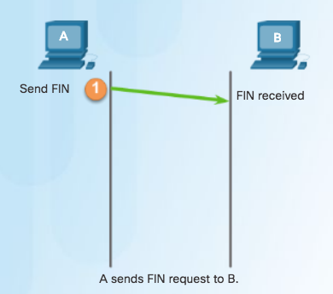
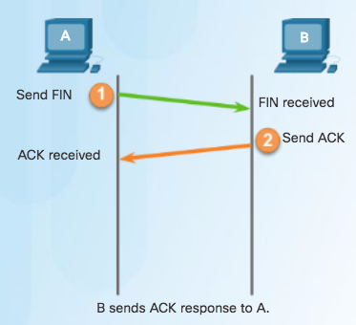
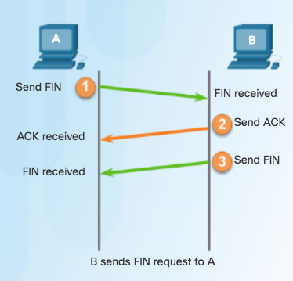
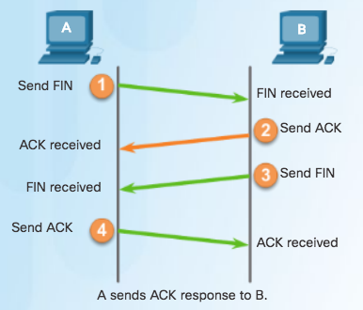
TCP Communication Process TCP Session Termination
To close a connection, the Finish (FIN) control flag must be set in the segment header.
To end each one-way TCP session, a two-way handshake, consisting of a FIN segment and an Acknowledgment (ACK) segment, is used.
To terminate a single conversation supported by TCP, four exchanges are needed to end both sessions.
Notes:
9.2 – TCP and UDP
9.2.1 – TCP Communication Process
9.2.1.3 – TCP Session Termination

Slide 18
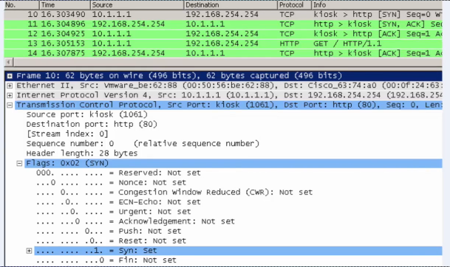
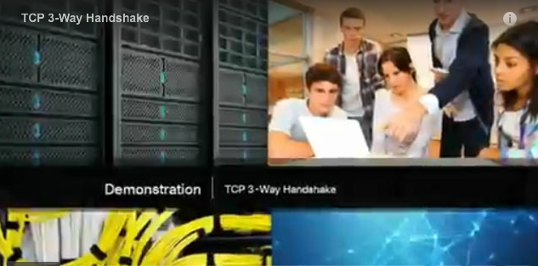
TCP Communication Process Video Demonstration - TCP 3-Way Handshake
SYN
SYN, ACK
ACK
Notes:
9.2 – TCP and UDP
9.2.1 – TCP Communication Process
9.2.1.5 – Video Demonstration - TCP 3-Way Handshake

Slide 19
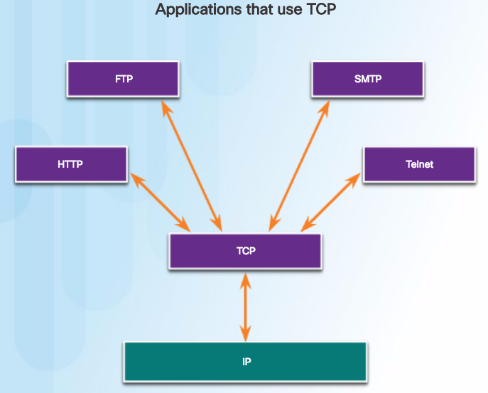
TCP or UDP Applications that use TCP
TCP frees applications from having to manage reliability
Notes:
9.2 – TCP and UDP
9.2.4 – TCP or UDP
9.2.4.1– Applications that use TCP

Slide 20
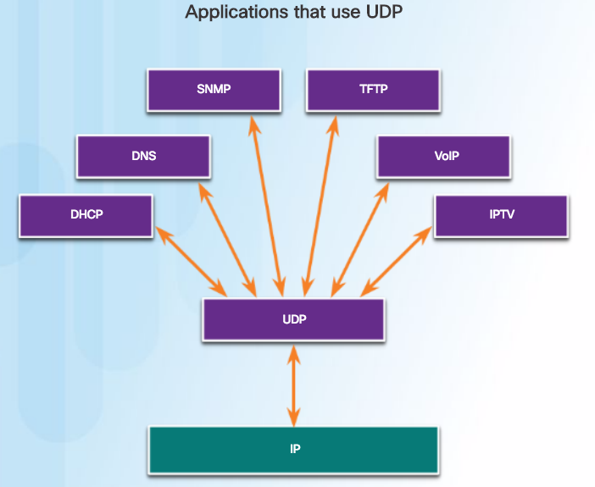
TCP or UDP Applications that use UDP
Three types of applications best suited for UDP:
Live video and multimedia
Simple request and reply
Handle reliability themselves
Notes:
9.2 – TCP and UDP
9.2.4 – TCP or UDP
9.2.4.2 – Applications that use UDP

