Slide 1
Chapter 7: IP Addressing
CCNA Routing and Switching
Introduction to Networks v6.0
Notes:
Cisco Networking Academy Program
Introduction to Networks v6.0
Chapter 7: IP Addressing

Slide 2
7.1 IPv4 Network Addresses
Notes:
7 – IP Addressing
7.1 – IPv4 Network Addresses

Slide 3
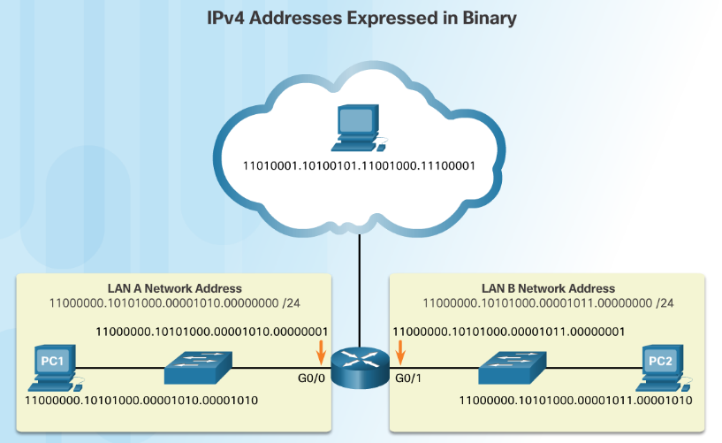
Binary and Decimal Conversion IPv4 Addresses
Binary numbering system consists of the numbers 0 and 1 called bits
IPv4 addresses are expressed in 32 binary bits divided into 4 8-bit octets
Notes:
7.1 – IPv4 Network Addresses
7.1.1 – Binary and Decimal Conversion
7.1.1.1 IPv4 Addresses

Slide 4
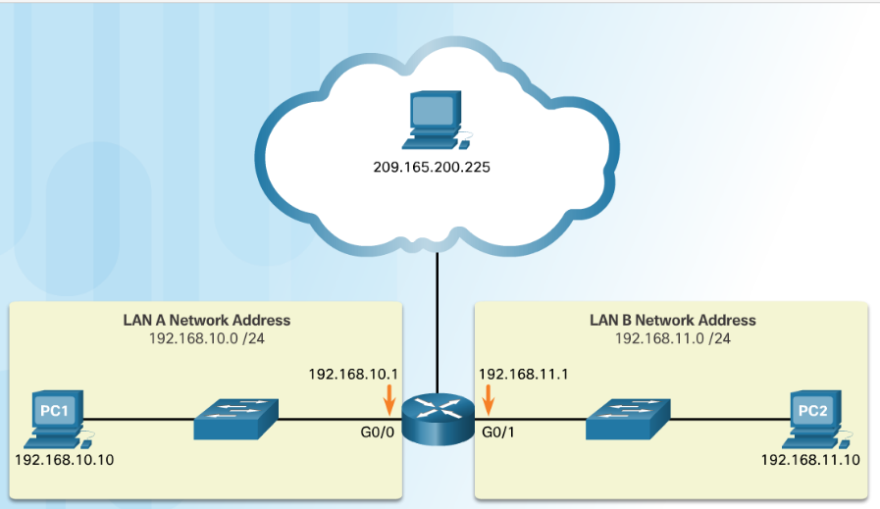
Binary and Decimal Conversion IPv4 Addresses (Cont.)
IPv4 addresses are commonly expressed in dotted decimal notation
Notes:
7.1 – IPv4 Network Addresses
7.1.1 – Binary and Decimal Conversion
7.1.1.1 IPv4 Addresses (Cont.)

Slide 5
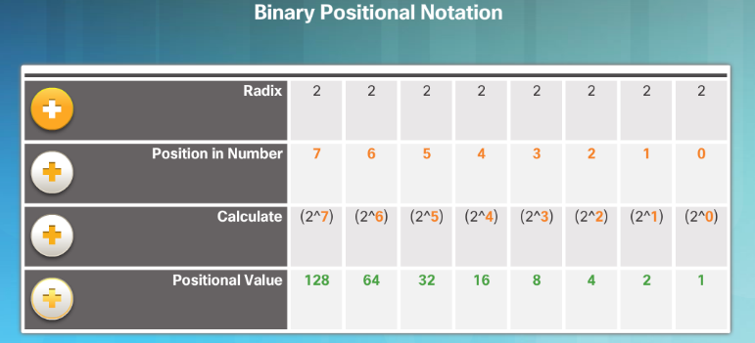
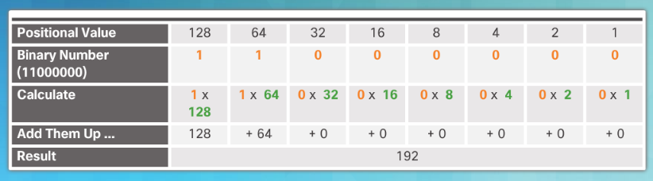
Binary and Decimal Conversion Positional Notation (Cont.)
Applying binary positional notation.
Notes:
7.1 – IPv4 Network Addresses
7.1.1 – Binary and Decimal Conversion
7.1.1.3 Positional Notation (Cont.)

Slide 6
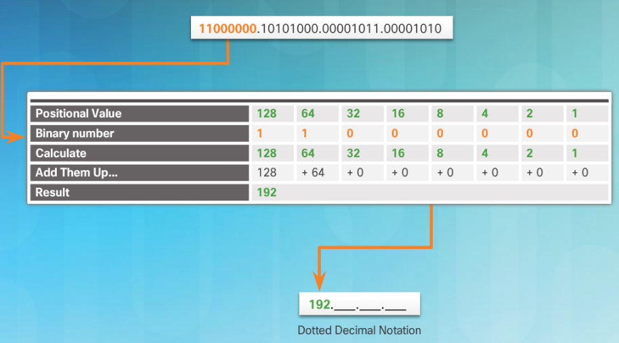
Binary and Decimal Conversion Binary to Decimal Conversion
To convert a binary IPv4 address to decimal enter the 8-bit binary number of each octet under the positional value of row 1 and then calculate to produce the decimal.
Notes:
7.1 – IPv4 Network Addresses
7.1.1 – Binary and Decimal Conversion
7.1.1.4 Binary to Decimal Conversion

Slide 7
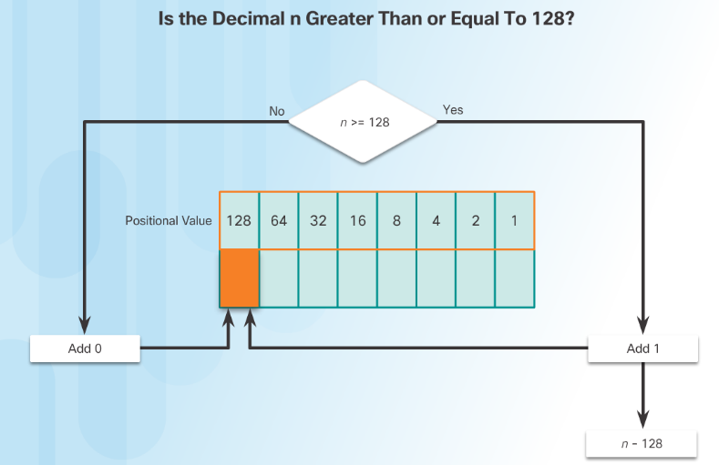
Binary and Decimal Conversion Decimal to Binary Conversion
To convert a decimal IPv4address to binary use the positional chart and check first if the number is greater than the 128 bit. If no a 0 is placed in this position. If yes then a 1 is placed in this position.
128 is subtracted from the original number and the remainder is then checked against the next position (64) If it is less than 64 a 0 is placed in this position. If it is greater, a 1 is placed in this position and 64 is subtracted.
The process repeats until all positional values have been entered.
Notes:
7.1 – IPv4 Network Addresses
7.1.1 – Binary and Decimal Conversion
7.1.1.6 Decimal to Binary Conversion

Slide 8
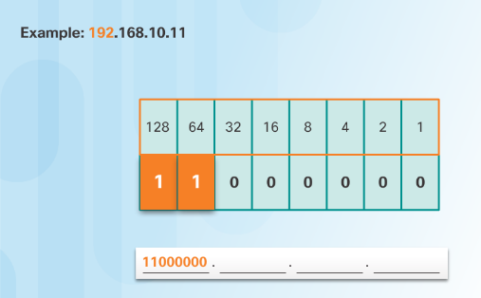
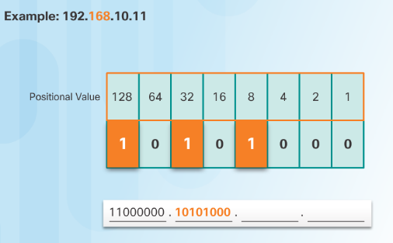
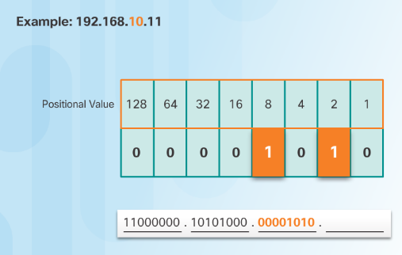
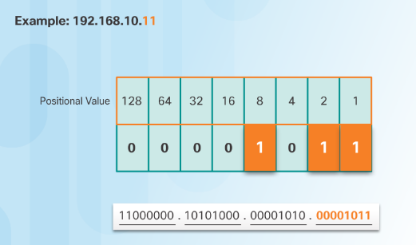
Binary and Decimal Conversion Decimal to Binary Conversion Examples
Notes:
7.1 – IPv4 Network Addresses
7.1.1 – Binary and Decimal Conversion
7.1.1.7 Decimal to Binary Conversion Examples

Slide 9
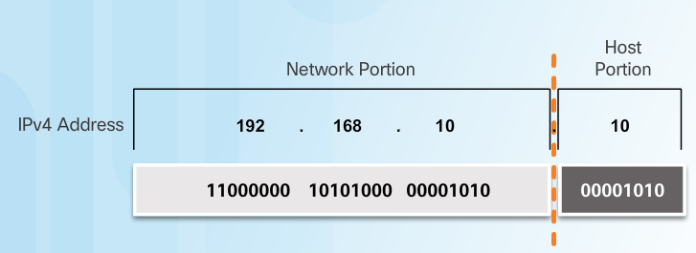
IPv4 Address Structure Network and Host Portions
An IPv4 address is hierarchical.
Composed of a Network portion and Host portion.
All devices on the same network must have the identical network portion.
The Subnet Mask helps devices identify the network portion and host portion.
Notes:
7.1 – IPv4 Network Addresses
7.1.2 – IPv4 Address Structure
7.1.2.1 Network and Host Portions

Slide 10
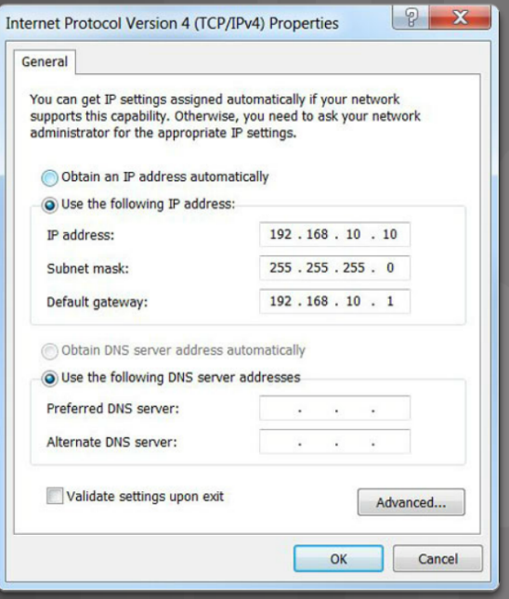
IPv4 Address Structure The Subnet Mask
Three IPv4 addresses must be configured on a host:
Unique IPv4 address of the host.
Subnet mask - identifies the network/host portion of the IPv4 address.
Default gateway -IP address of the local router interface.
Notes:
7.1 – IPv4 Network Addresses
7.1.2 – IPv4 Address Structure
7.1.2.2 -The Subnet Mask

Slide 11
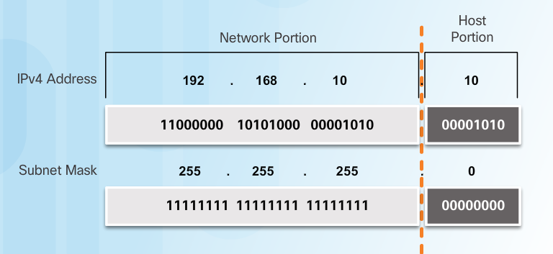
IPv4 Address Structure The Subnet Mask (Cont.)
The IPv4 address is compared to the subnet mask bit by bit, from left to right.
A 1 in the subnet mask indicates that the corresponding bit in the IPv4 address is a network bit.
Notes:
7.1 – IPv4 Network Addresses
7.1.2 – IPv4 Address Structure
7.1.2.2 -The Subnet Mask (Cont.)

Slide 12
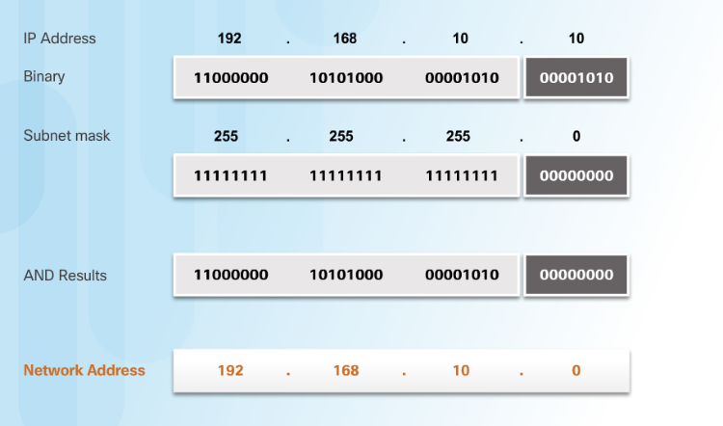
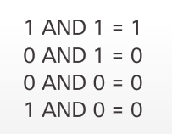
IPv4 Address Structure Logical AND
A logical AND is one of three basic binary operations used in digital logic.
Used to determine the Network Address
The Logical AND of two bits yields the following results:
Notes:
7.1 – IPv4 Network Addresses
7.1.2 – IPv4 Address Structure
7.1.2.3 -Logical AND

Slide 13
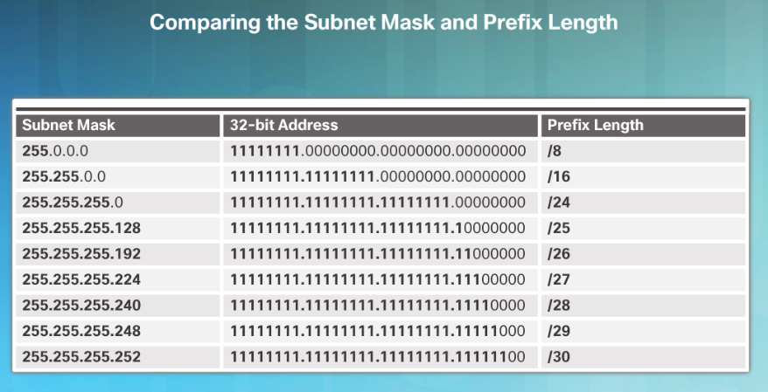
IPv4 Address Structure The Prefix Length
The Prefix Length:
Shorthand method of expressing the subnet mask.
Equals the number of bits in the subnet mask set to 1.
Written in slash notation, / followed by the number of network bits.
Notes:
7.1 – IPv4 Network Addresses
7.1.2 – IPv4 Address Structure
7.1.2.5 - The Prefix Length

Slide 14
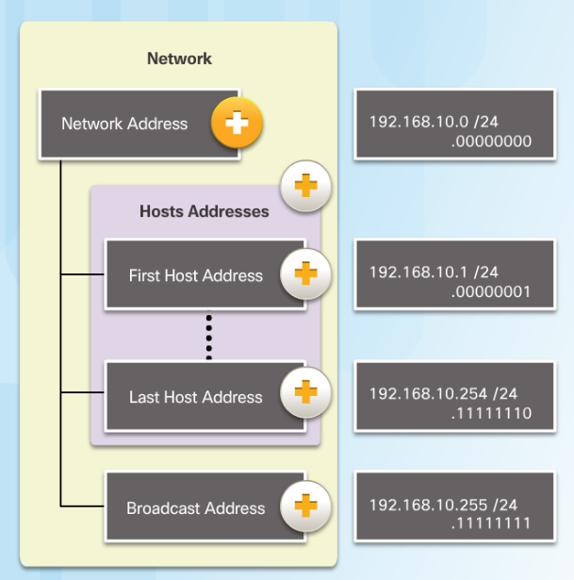
IPv4 Address Structure Network, Host, and Broadcast Addresses
Types of Addresses in Network 192.168.10.0/24
Network Address - host portion is all 0s (.00000000)
First Host address - host portion is all 0s and ends with a 1 (.00000001)
Last Host address - host portion is all 1s and ends with a 0 (.11111110)
Broadcast Address - host portion is all 1s (.11111111)
Notes:
7.1 – IPv4 Network Addresses
7.1.2 – IPv4 Address Structure
7.1.2.6 - Network, Host, and Broadcast Addresses

Slide 15
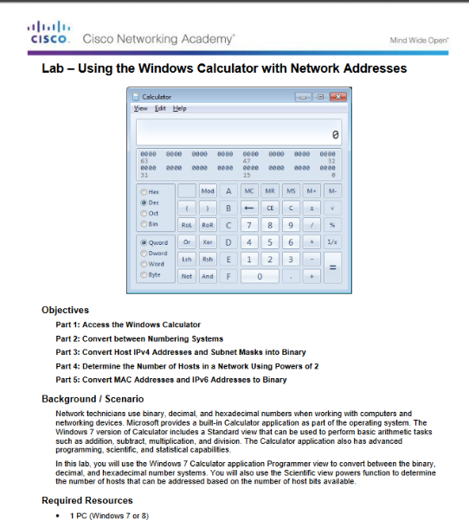
IPv4 Address Structure Lab – Using the Windows Calculator with Network Addresses
Notes:
7.1 – IPv4 Network Addresses
7.1.2 – IPv4 Address Structure
7.1.2.8 - Lab – Using the Windows Calculator with Network Addresses

Slide 16
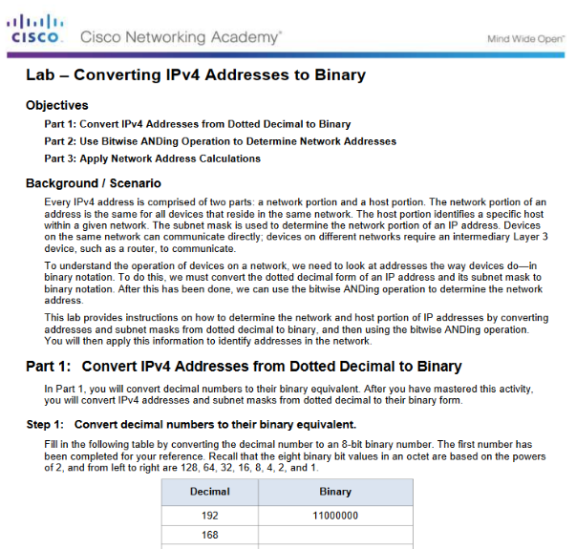
IPv4 Address Structure Lab – Converting IPv4 Addresses to Binary
Notes:
7.1 – IPv4 Network Addresses
7.1.2 – IPv4 Address Structure
7.1.2.9 - Lab – Converting IPv4 Addresses to Binary

