Slide 1
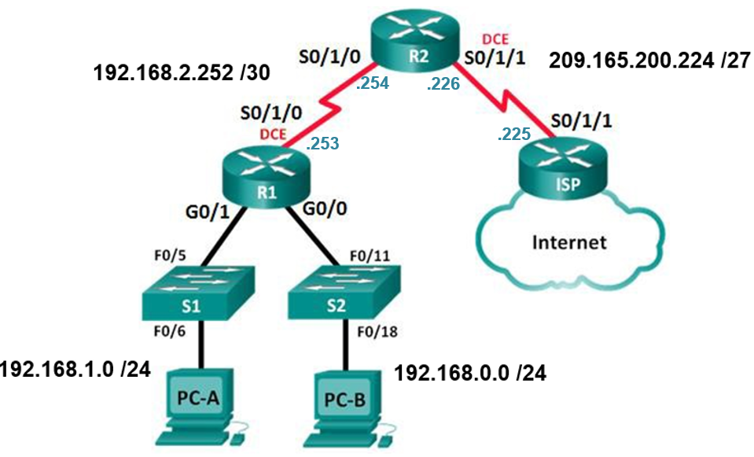
Lab 8.1.2.4 - Configuring Basic DHCPv4 on a Router

