Slide 1
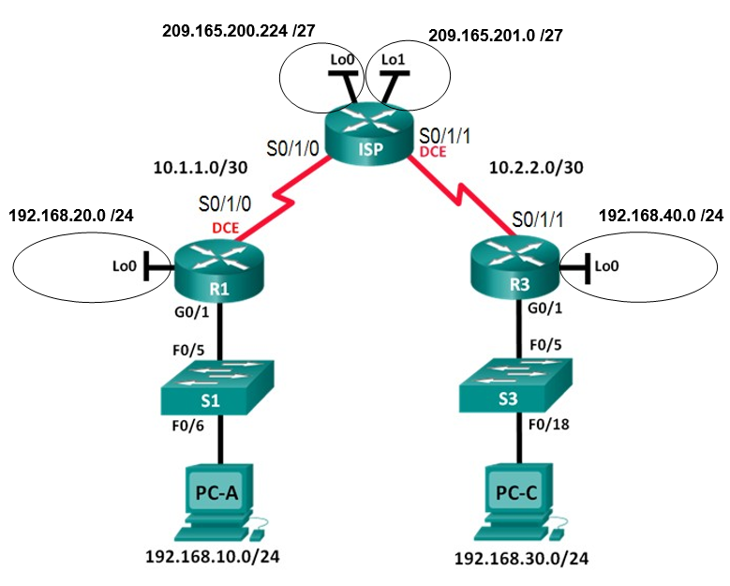
Lab 9.3.2.13 – Configuring and Verifying Extended ACLs
209.165.200.225
209.165.201.1
10.1.1.1
10.2.2.1
192.168.20.1
192.168.40.1
G0/0/1
G0/0/1
192.168.10.3
192.168.30.3

