Slide 1
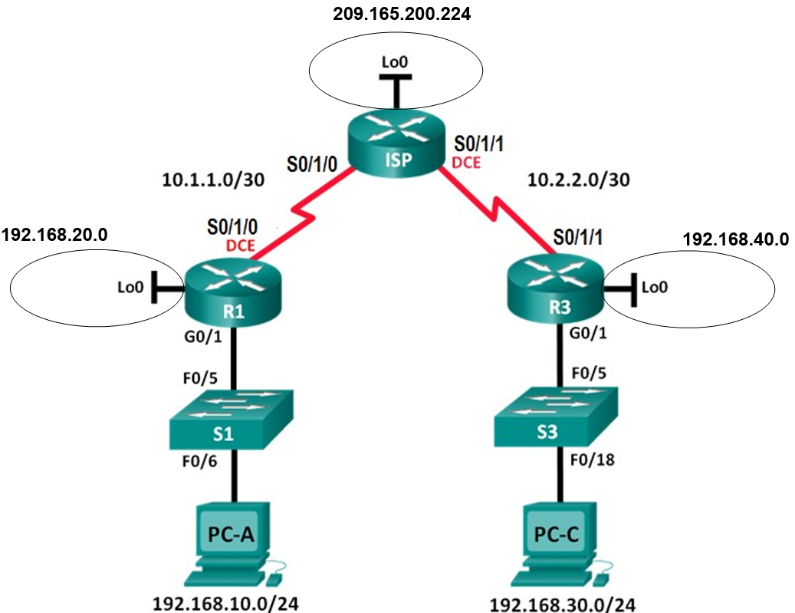
209.165.200.225
10.1.1.1
192.168.20.1
192.168.40.1
192.168.30.1
192.168.10.3
192.168.30.3

