Slide 1
Week 1: Welcome to SI 618: Data Manipulation and Analysis
Instructor: Ceren Budak (cbudak@umich.edu)
Assistant Professor, School of Information
GSI: Deahan Yu (deahanyu@umich.edu )
Some material courtesy of: Kevyn Collins-Thompson, Yuhang Wang, Qiaozhu Mai, Charles Severance, Patrick Dudas

Slide 2
About your instructor
Ceren Budak
Assistant Professor, School of Information
Assistant Professor, Electrical Engineering & Computer Science
My research interests are in the area of computational social science
Notes:
Broad idea: 1 slide, 1 minute. Detail: 4 slides, 8 minutes

Slide 3
How fast is information being created every minute?
How many queries does Google process?
How many tweets?
How many Facebook updates?
How many new hours of YouTube video?

Slide 4
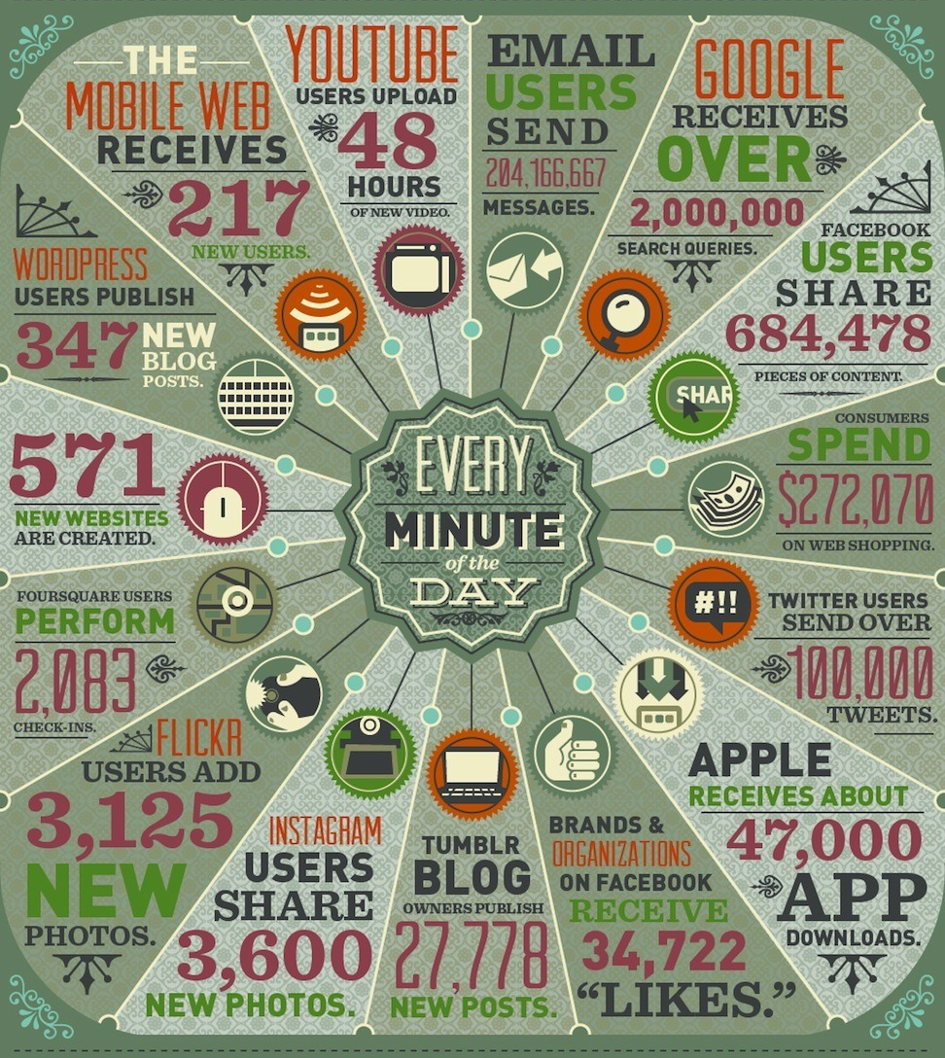
How fast is information being created every minute?
2012
Sources: http://www.domo.com/blog/2012/06/how-much-data-is-created-every-minute/
http://www.domo.com/blog/2014/04/data-never-sleeps-2-0/

Slide 5
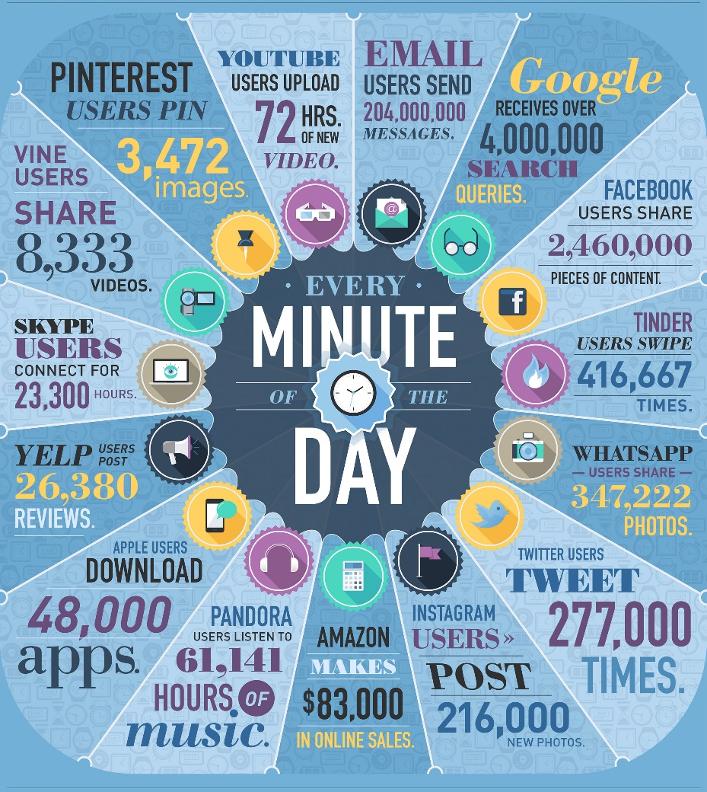
How fast is information being created every minute?
2012
2014
Sources: http://www.domo.com/blog/2012/06/how-much-data-is-created-every-minute/
http://www.domo.com/blog/2014/04/data-never-sleeps-2-0/
Notes:
Google searches, tweets have doubled in volume since 2012.
Represents text, apps, pictures, music, video, …

Slide 6
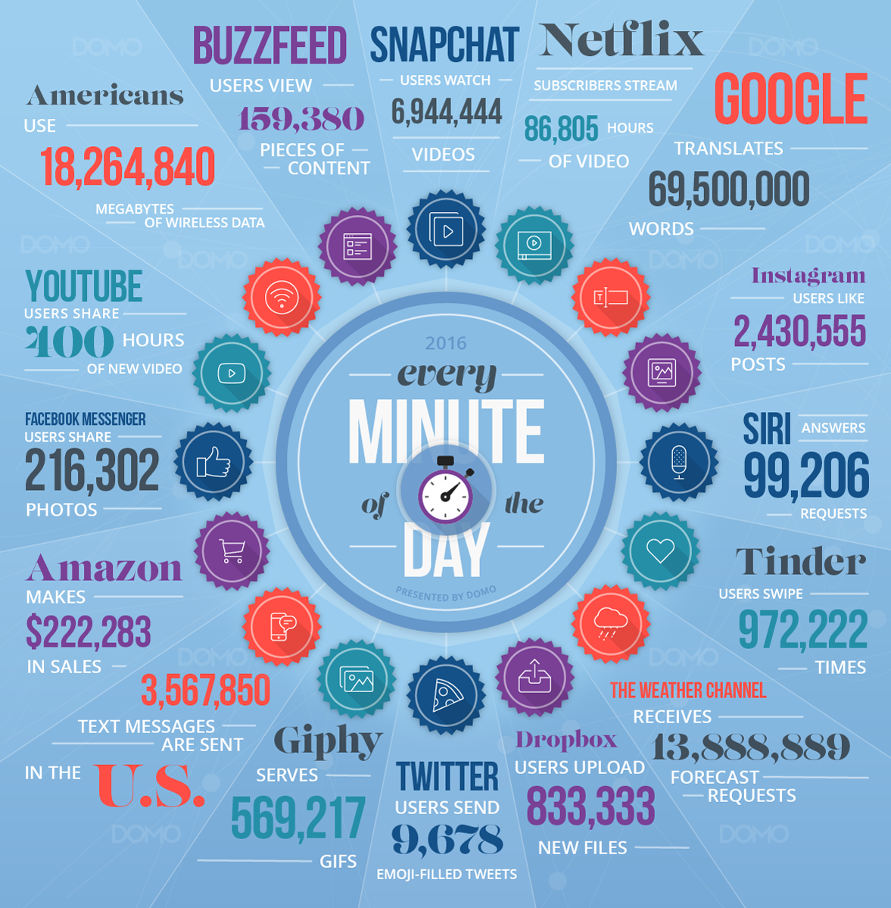
How fast is information being created every minute?
2014
2016
Sources: http://www.domo.com/blog/2014/04/data-never-sleeps-2-0/
https://www.domo.com/blog/data-never-sleeps-4-0/
Notes:
Google searches, tweets have doubled in volume since 2012.
Represents text, apps, pictures, music, video, …

Slide 7
How much new information is produced in the world every day?
Web pages, photos, instant messages, phone calls, search logs, sensor signals, social media, GPS location data, genomics, surveillance video,…
What’s the total volume of global information production from all sources?
1 exabyte = 1 quintillion bytes = 1,000,000,000,000,000,000 (18 zeros)
2002: 23 exabytes in a year. 2010: 23 exabytes in a week.
The data surge just keeps rising, doubling in volume every two years.
Sources: http://bits.blogs.nytimes.com/2013/06/19/sizing-up-big-data-broadening-beyond-the-internet/
http://www.emc.com/collateral/analyst-reports/idc-digital-universe-are-you-ready.pdf
http://blog.rjmetrics.com/2011/02/07/
http://www2.sims.berkeley.edu/research/projects/how-much-info-2003/

Slide 8
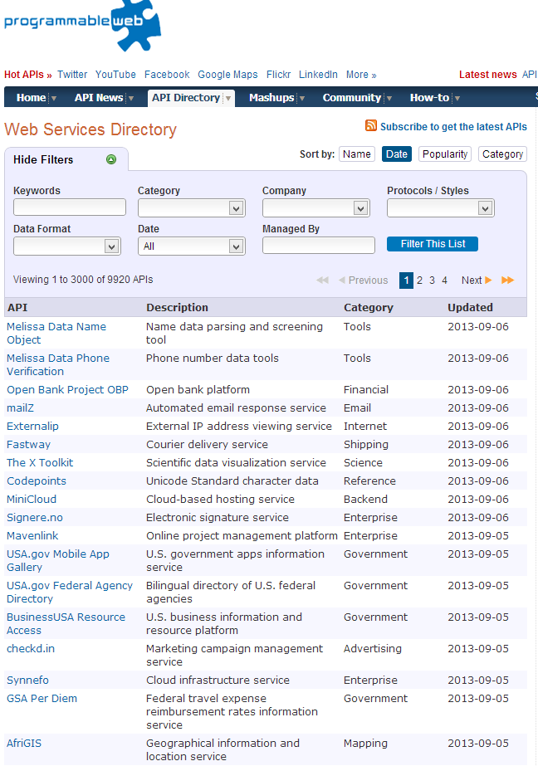
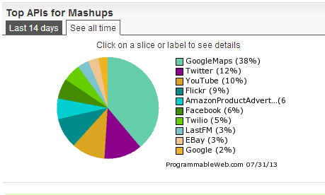
16,459=
Number of different Web services listed at programmableweb.com, Dec 2016 (Winter 2014: 10,760)
Source: http://www.programmableweb.com/apis/directory (*Not all these API services are still active, but still impressive)

Slide 9
Why/How Data Matters
Sheer volume and growth of data is impressive…
But clever software to make sense of all that data is critical
And clever people to use the software even more critical
40,000 - 190,000 more workers with “deep analytical” expertise needed in U.S. (McKinsey)
Data manipulation and analysis is becoming central to managing organizations
Data-driven insights are fueling a shift in decision making: Away from standard experience and intuition, or relying on a single source or piece of information
“You can’t manage what you can’t measure” Erik Brynjolfsson. Director of MIT Center for Digital Business

Slide 10
In this course, we will learn…
How to gather and store data – Part 1
How to explore data & extract insights – Part 2

Slide 11
Part 1

Slide 12
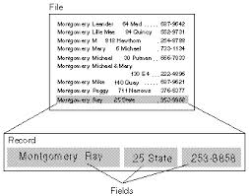
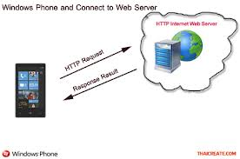
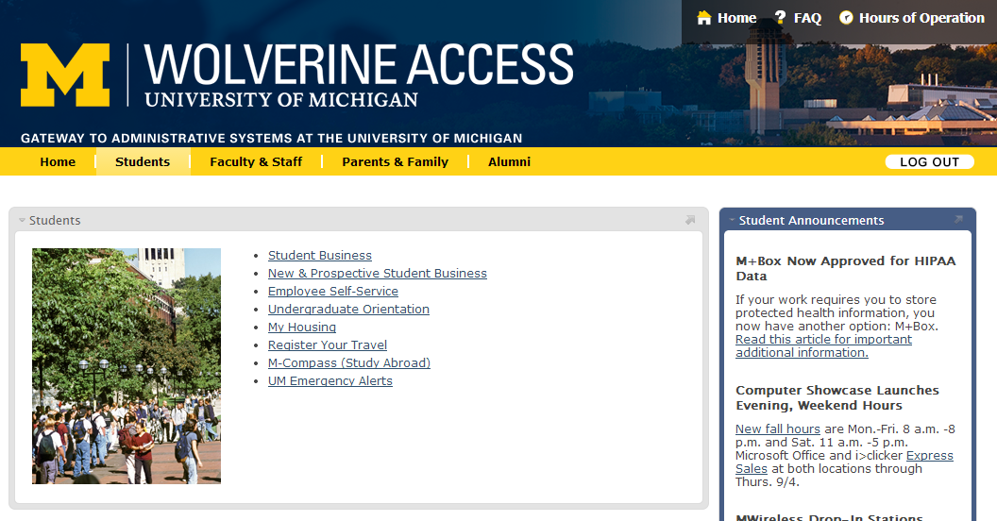
618 – Part 1: Progress thru different ‘flavors’ of data based on structure
Most of these you learned in 507, we will have a quick refresher on the concepts you covered before…
The language used in Shakespeare’s day is slightly different to today’s modern English, which is reflected in the text. Our article on Shakespeare & early modern English, or our Shakespeare dictionary, will help you to understand the language as you read through the original textAnother thing to bear in mind as you read the Hamlet text are Shakespeare’s stage directions, which are italicised. Stage directions are instructions and direction to the actors, and not spoken lines. Some stage directions can be a little confusing, so have a read of our understanding Shakespeare’s stage directions article.
The language used in Shakespeare’s day is slightly different to today’s modern English, which is reflected in the text. Our article on Shakespeare & early modern English, or our Shakespeare dictionary, will help you to understand the language as you read through the original textAnother thing to bear in mind as you read the Hamlet text are Shakespeare’s stage directions, which are italicised. Stage directions are instructions and direction to the actors, and not spoken lines. Some stage directions can be a little confusing, so have a read of our understanding Shakespeare’s stage directions article.
Databases
Text
Structured (tagged) documents
Web API
Unstructured
Semi-structured
Structured
Multi-facet
Web APIs

Slide 13
What you’ll learn in 618 – Part 1
Skills we will add:
A refresher on APIs and SQL
Large-scale computation
Mrjob
Spark
SparkSQL
Crowdsourcing

Slide 14
Texts
Required:
Charles Severance (2010). Python for Informatics: Exploring Information. (http://open.umich.edu/education/si/resources/python-opentextbook/winter2010)
Code and data files: http://www.py4inf.com/code/
Free MOOC: https://www.coursera.org/course/pythonlearn
Python Software Foundation (2015). "Python Documentation.” (http://docs.python.org/2/)
Recommended: Wes McKinney (2012). Python for Data Analysis. O'Reilly Media. ISBN: 978-1-4493-1979-3, Ebook ISBN: 978-1-4493-1978-6
Multiple other sources will be used throughout the course, but I’ll note them in the slides.

Slide 15
Part 2

Slide 16
What you’ll learn in 618 – Part 2
Skills:
Import messy data into a form that can be analyzed in R
Compute and visualize a dataset's key summary statistics
Explore relationships between variables
Find trends over time
Discover clusters and outliers
Use factors to analyze underlying variables in data
Produce polished presentations for publication/display
How to apply R coding and packages to solve the above problems
.. And much more!
Tools:
The R language
RStudio integrated development environment
RMarkdown authoring tool
ggplot2 visualization package
Several other useful R packages

Slide 17
Texts
Required:
Hadley Wickham, ggplot2: Elegant graphics for data analysis Springer. ISBN 978-0-387-98140-6
http://amzn.to/16sbHWt
Recommended:
Zuur et al., A Beginner's Guide to R, Springer http://amzn.to/1a6Bx3a
Phil Spector, Data Manipulation with R, Springer (2008) http://bit.ly/1cW6JRe
Robert Knell, Introductory R: A Beginner's Guide to Data Visualization and Analysis Using R
http://amzn.to/1dhxGBB
Guy Lebanon (textbook draft)
http://www.theanalysisofdata.com/computing/graphics.pdf
Supplemental:
Exploratory Data Analysis. Tukey. Addison-Wesley.
Grammar of Graphics, Leland Wilkinson. http://amzn.to/18I3VZw

Slide 18
Prerequisites for this course
At least some Python experience is required (SI 507). Don’t have it? This is not the course for you!
How many people have lots of experience writing programs in Python?
Familiarity with core math/statistics, e.g.:
Logs, exponential, linear and quadratic functions
Mean, variance, probability distribution

Slide 19
Grading
Homework (50 %) - There will be 9-10 homework assignments
Assignments will be posted on Canvas.
Lab (20 %) - There will be 9-10 in-class lab assignments
Lowest lab score will be dropped.
Labs will be posted on Canvas.
Need to submit initial answers in class at the end of the lab, then you have time until next class to update if you were not able to finish
Projects (30 %) – This will involve retrieving data and doing something cool with it.
Something you can add to your portfolio to show off your skills
Proposal, midpoint evaluations, final report, short presentation

Slide 20
Lab & Homework Grading
Deahan Yu (your GSI) and Yize Zang (your instructional aide) will grade Labs and Homeworks
Grades will be posted in about a week
Grade questions: e-mail Deahan (deahanyu@umich.edu) and cc: cbudak@umich.edu and yizezang@umich.edu

Slide 21
Projects
Projects will also have two components.
Part 1: Identify sources to extract data from and gather them (demonstrate your knowledge of data gathering and manipulation techniques taught in the first half of this course)
Part 2: Perform analysis to extract insights from this data. (You can choose a different dataset for Part 2, if you want)
Evaluation points per project:
Project proposals (%20), Project reports and presentations (%80) (note that these will be done for Part 1&2)

Slide 22
Online Discussions
Enroll in our Piazza page!
Signup link: piazza.com/umich/fall2017/si618001fa2017
Peer help is fantastic! And fast.
And those that are active in helping others (answering questions, help identify good answers) will get small bonus points.
What not to do: share or request homework/lab answers. You can ask clarifying questions though

Slide 23
Late Policy
You have 5 penalty-free late days
One late day = one 24hr period after due date
No fractional late days: all or nothing
20% penalty per day after late days used up
You don’t need to explain late days, we track them for you
Submit late assignments via Canvas

Slide 24
Original work policy
Unless otherwise specified in an assignment, all submitted work must be your own, original work.
You may discuss general approaches with others on individual assignments, but you may not copy code or other work and must indicate on your turned-in assignment who you worked with.
Any excerpts from the work of others must be clearly identified as a quotation, and a proper citation provided.
Any violation of the School’s policy on Academic and Professional Integrity (stated in the Master’s and Doctoral Student Handbooks) will result in severe penalties, which might range from:
failing an assignment
failing the course
being expelled from the program
at discretion of the instructor & Assoc Dean for Academic Affairs.

Slide 25
Short version
Any code and writing must be your creation, and yours alone
Discuss high-level approaches with classmates
But: do the programming on your own.

Slide 26
Class Format
Lecture (65-85 min)
10 min break
Lab (75 min)
Goal: start applying what was covered in lecture
Deahan and I will be available to help you
Lecture/lab ratio may vary depending on topic

Slide 27
Waiting List
Give me your names so I can add you to canvas
Keep on showing up – those who attend will be prioritized in the wait list
You need to work on homeworks and labs and will have the same deadline as others – those who do the assignments will be prioritized in the wait list
There will be no make-up assignments.

Slide 28
Instructor contact details
Instructor: Ceren Budak
Email: cbudak@umich.edu
Office hours: Wednesday 9:30-11:30am 3336 NQ
GSI: Deahan Yu (deahanyu@umich.edu) - Office hours: Mondays 4-6pm (NQ1277), Fridays 1-2pm (NQ1270)
Instructional Aide: Yize Zang (yizezang@umich.edu) – Office hours: Thursdays 2-4pm NQ1277
Questions?
For (personal) questions about course materials, assignments, or anything else related to the course, come talk to me during my office hours. You can also send email. Please include 618 in subject line.
For technical help with assignments or lecture material, Deahan and Yize are also available during their office hours.
For general questions about assignments or other questions that your classmates would benefit from, use the discussion forum.

