Slide 1
SI 618: Week 4 Large-scale distributed computation
Winter 2017
Ceren Budak
Some slides courtesy of Kevyn Collins-Thompson and Yuhang Wang

Slide 2
What is big data?
Volume
Velocity
Variety

Slide 3
What is big data?
Volume
Dramatic reduction in cost:
Terabytes (1,000 Gigabytes) to Petabytes (1,000 Terabytes)
Challenges and opportunities
$100,000 per GB in 1980
<$0.1 per GB in 2013
Notes:
Terabytes – 10¹²
Petabytes – 10¹⁵

Slide 4
What is big data?
Velocity
Data are not just large but also being produced (and need to be processed) in fast pace
Consider ads for instance. The moment you visit a site or google a query, the best ads to serve need to be decided
Growing exponentially
Both incoming and outgoing
Notes:
Terabytes – 10¹²
Petabytes – 10¹⁵

Slide 5
What is big data?
Variety
You already learned about RDBMs. What do you need to store and process data in such management systems?
Schema
In real world scenarios we deal with various sources of data. Three types:
Structured data : Relational data.
Semi Structured data : XML data.
Unstructured data : Word, PDF, Text, Media Logs.
Examples:
Ancestry.com claims approximately 600 TB of genealogical data with the inclusion of US Census data from 1790 to 1930.
The Hubble Space Telescope has collected more than 45 terabytes of data in its first 20 years of observations.
Internet Archive: Collections of digitized materials, including web sites, software applications/games, music, movies/videos, moving images, and nearly three million public-domain books. As of May 2014, its collection topped 15 petabytes.
Notes:
Terabytes – 10¹²
Petabytes – 10¹⁵

Slide 6
What is big data?
Big data involves the data produced by different devices and applications. Given below are some of examples:
Social Media Data : Social media such as Facebook and Twitter hold information and the views posted by millions of people across the globe.
Stock Exchange Data : The stock exchange data holds information about the ‘buy’ and ‘sell’ decisions made on a share of different companies made by the customers.
Power Grid Data : The power grid data holds information consumed by a particular node with respect to a base station.
Transport Data : Transport data includes model, capacity, distance and availability of a vehicle.
Search Engine Data : Search engines retrieve lots of data from different databases.

Slide 7
Two aspects we will cover
Programming paradigm. Examples:
Serial Programming
Multithreading
MapReduce
Spark
Etc.
Storage and processing systems underlying. Examples:
HDFS
We will first focus on the programming paradigm, ignoring the underlying support for it. We will return to this later.

Slide 8
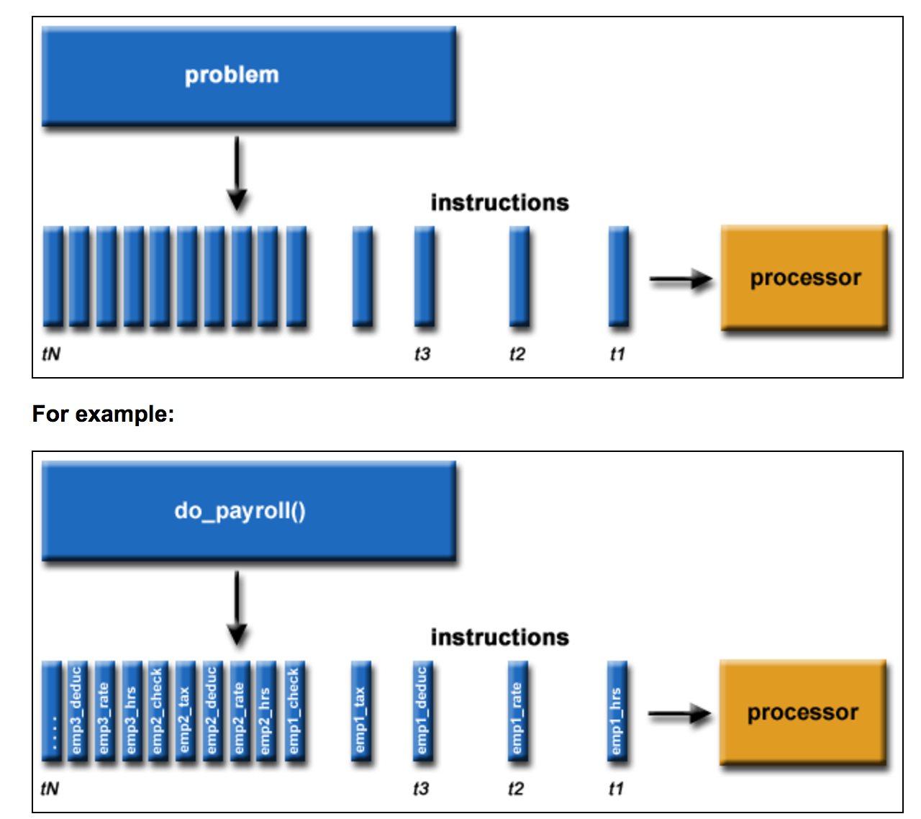
Serial Programming
Traditionally, software has been written for serial computation:
A problem is broken into a discrete series of instructions
Instructions are executed sequentially one after another
Executed on a single processor
Only one instruction may execute at any moment in time
https://computing.llnl.gov/tutorials/parallel_comp/

Slide 9
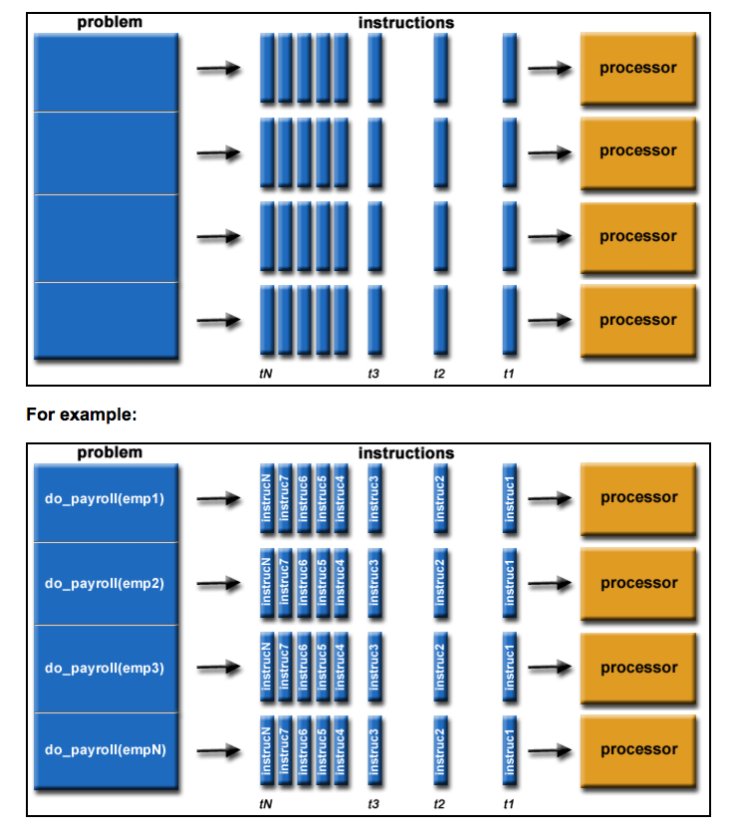
Parallel Programming
In the simplest sense, parallel computing is the simultaneous use of multiple compute resources to solve a computational problem:
A problem is broken into discrete parts that can be solved concurrently
Each part is further broken down to a series of instructions
Instructions from each part execute simultaneously on different processors
An overall control/coordination mechanism is employed
Python solutions: https://wiki.python.org/moin/ParallelProcessing
https://computing.llnl.gov/tutorials/parallel_comp/

Slide 10
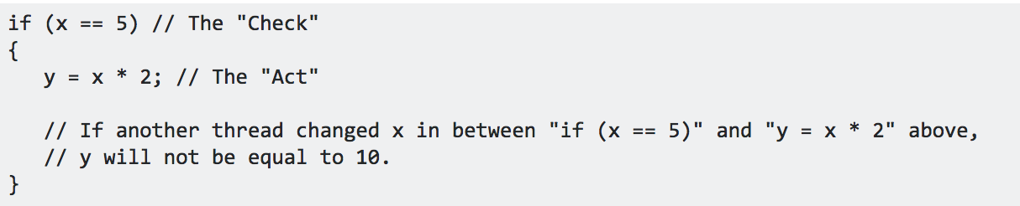
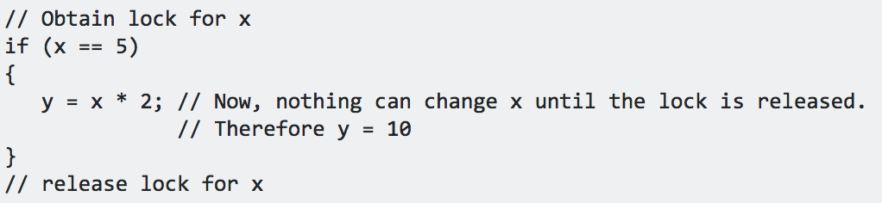
Parallel Programming Models 1 – Shared Memory Model
Processes/tasks share a common address space, which they read and write to asynchronously.
Mechanisms such as locks/semaphores are used to control access to the shared memory, resolve contentions and to prevent race conditions and deadlocks. => can be very hard!
Race condition:
https://computing.llnl.gov/tutorials/parallel_comp/

Slide 11
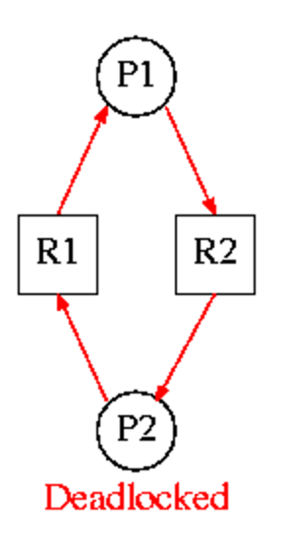
Parallel Programming Models 1 – Shared Memory Model
Processes/tasks share a common address space, which they read and write to asynchronously.
Mechanisms such as locks/semaphores are used to control access to the shared memory, resolve contentions and to prevent race conditions and deadlocks. => can be very hard!
Deadlock:
Resource R1 and resource R2 are used by process P1 and process P2
P1 starts to use R1.
P1 and P2 try to start using R2
P2 'wins' and gets R2 first
Now P2 needs to use R1
R1 is locked by P1, which is waiting for R2

Slide 12
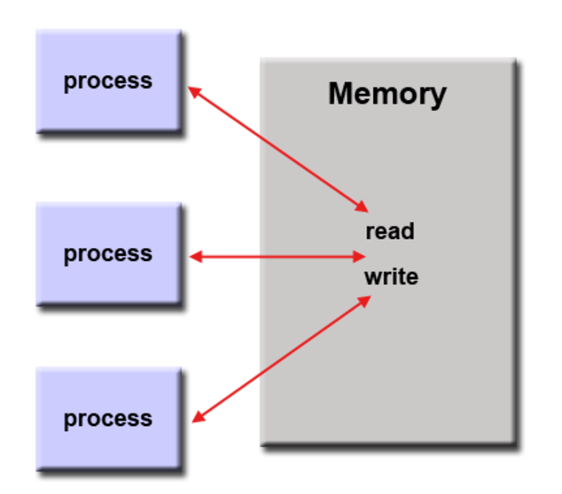
Parallel Programming Models 1 – Shared Memory Model
Processes/tasks share a common address space, which they read and write to asynchronously.
Mechanisms such as locks/semaphores are used to control access to the shared memory, resolve contentions and to prevent race conditions and deadlocks. => can be very hard!
An advantage for programmers: there is no need to specify explicitly the communication of data between tasks.
Disadvantage: difficult to understand and manage data locality
Keeping data local to the process that works on it conserves memory accesses, cache refreshes and bus traffic that occurs when multiple processes use the same data. Very hard in this model.
On distributed memory machines, memory is physically distributed across a network of machines, but made global through specialized hardware and software. Examples: http://en.wikipedia.org/wiki/SHMEM.
https://computing.llnl.gov/tutorials/parallel_comp/

Slide 13
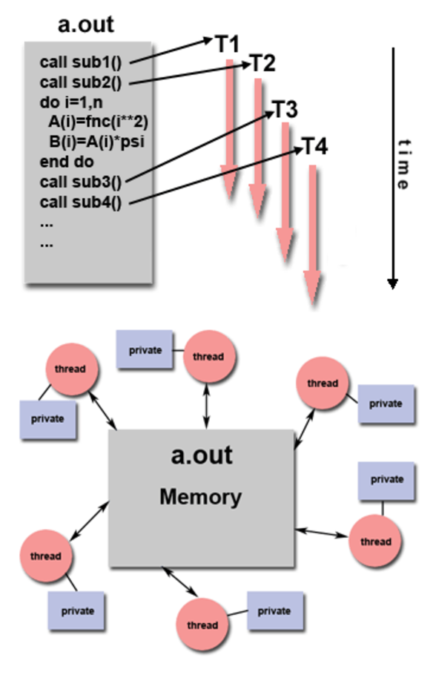
Parallel Programming Models 2 – Threads Model
A type of shared memory programming.
A single "heavy weight" process can have multiple "light weight", concurrent execution paths.
Any thread can execute any subroutine at the same time as other threads.
Threads communicate with each other through global memory (updating address locations). Synchronization constructs needed to ensure that more than one thread is not updating the same global address at any time.
Programmer is responsible for determining the parallelism
Multiple Python libraries:
https://www.tutorialspoint.com/python/python_multithreading.htm
http://chriskiehl.com/article/parallelism-in-one-line/
https://computing.llnl.gov/tutorials/parallel_comp/
Notes:
For example:
a.out is scheduled to run by the native operating system. a.out loads and acquires all of the necessary system and user resources to run.
a.out performs some serial work, and then creates threads that can be scheduled and run by the operating system concurrently.
Each thread has local data, but also, shares the entire resources of a.out.
a.out remains present to provide the necessary shared resources until the application has completed.

Slide 14
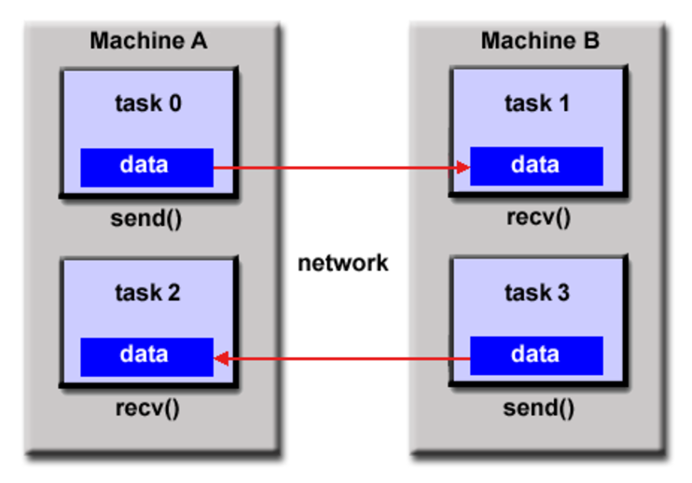
Parallel Programming Models 3 -Distributed Memory/Message Passing Model
Tasks that use their own local memory during computation. Multiple tasks can reside on the same physical machine and/or across different machines.
Tasks exchange data through communications by sending and receiving messages.
Data transfer usually requires cooperative operations to be performed by each process. For example, a send operation must have a matching receive operation.
Historically, a variety of message passing libraries have been available since the 1980s. These implementations differed substantially from each other making it difficult for programmers to develop portable applications.
Message Passing Interface (MPI) is the "de facto" industry standard for message passing, replacing virtually all other message passing implementations used for production work.
MPI tutorial: computing.llnl.gov/tutorials/mpi
https://computing.llnl.gov/tutorials/parallel_comp/
Notes:
For example:
a.out is scheduled to run by the native operating system. a.out loads and acquires all of the necessary system and user resources to run.
a.out performs some serial work, and then creates threads that can be scheduled and run by the operating system concurrently.
Each thread has local data, but also, shares the entire resources of a.out.
a.out remains present to provide the necessary shared resources until the application has completed.

Slide 15
Parallel Computing Models
And many more…
What are the challenges?
Computers must communicate and coordinate
Load balancing
Network and disk optimization
How to recover from computer failure (1000 CPU = 1 per day)
How to optimize? Debug?
Data locality
All left to the programmer and need to be figured out for each new task!
Google realized that finding a large number of programmers skilled in such complex tasks was hard. So they went back to one of the foundations of computer science and create a simple programming language that abstracts all these messy details away.

Slide 16
Parallel Computing Models – MapReduce
A simple programming model that applies to many large-scale computing problems
Hide messy details in MapReduce runtime library:
automatic parallelization
load balancing
network and disk transfer optimization
handling of machine failures
Robustness
improvements to core library benefit all users of library!

Slide 17
Problem: I give you a 400 terabyte log file to process for your next homework
Or perhaps a Web crawl:
20 billion Web pages x 20 Kb > 400 terabytes
Computer can read 35Mb/sec from hard drive
Four months to scan the Web!
Hundreds of hard drives needed
Source: http://static.googleusercontent.com/media/research.google.com/en/us/pubs/archive/32721.pdf

Slide 18
Potential Solutions?
Buy 1,000 computers
Have each computer scan its own piece of the 400 terabyte dataset
Done in < 3 hours
New issues:
1. This requires programming work
Computers must communicate and coordinate
Load balancing
Network and disk optimization
How to recover from computer failure (1000 CPU = 1 per day)
How to optimize? Debug?
Data locality
2. You need to repeat this for every type of problem you want to solve.
Source: http://static.googleusercontent.com/media/research.google.com/en/us/pubs/archive/32721.pdf

Slide 19
A better solution: Divide and conquer
A technique we use everyday!
Split the task in sub-tasks
Put resources to handle subtasks in parallel
Combine the results
This is a simple example of distributed computing
We are distributing the workload across different CPUs

Slide 20
Divide and conquer
Word count as an example:
deahan 2
is 2
618 1
experienced 1
gsi 1
at 1
python 1
the 1
Deahan is the 618 GSI
Deahan is experienced at Python
Notes:
Get student’s algorithm
What if each document has 500 words

Slide 21
Divide and conquer
Conceptual model 1
deahan 1
is 1
the 1
618 1
gsi 1
deahan 2
is 2
618 1
experienced 1
gsi 1
at 1
python 1
the 1
Deahan is the 618 GSI
1
deahan 1
is 1
experienced 1
at 1
python 1
Deahan is experienced at python
2
Notes:
How are you going to put results together?

Slide 22
Divide and conquer
Conceptual model 2: words get "clustered" to particular CPUs
deahan 1
is 1
the 1
6181
gsi 1
deahan 1
is 1
the 1
deahan 1
is 1
deahan 2
is 2
the 1
Deahan is the 618 GSI
1
deahan 2
is 2
experienced 1
gsi 1
at 1
618 1
python 1
the 1
3
deahan 1
is 1
experienced 1 at 1
python 1
618 1
gsi 1
experienced 1
at 1
python 1
Deahan is experienced at Python
2

Slide 23
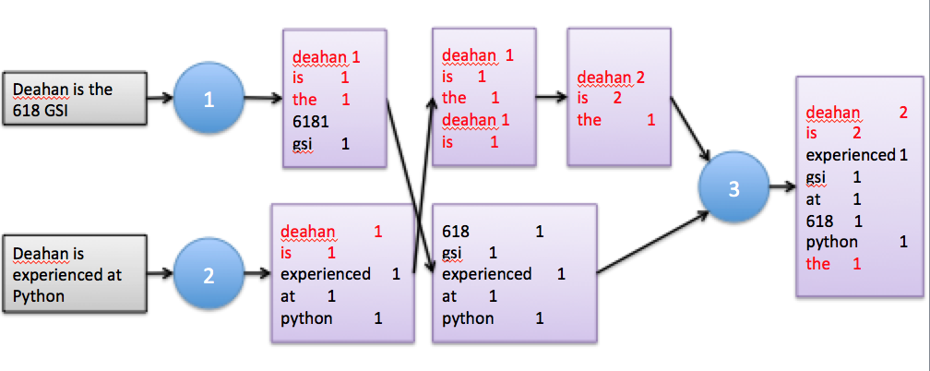
A typical MapReduce problem
This framework is the same for all problems:
We just change Map and Reduce steps to fit the problem
Read a bunch of data (set of records)
Map: for each record,
Extract something you care about.
Sort and group the extracted records
Reduce: For all groups:
Summarize, filter, transform, aggregate
Collapse the group into a result row
Write out the results

Slide 24
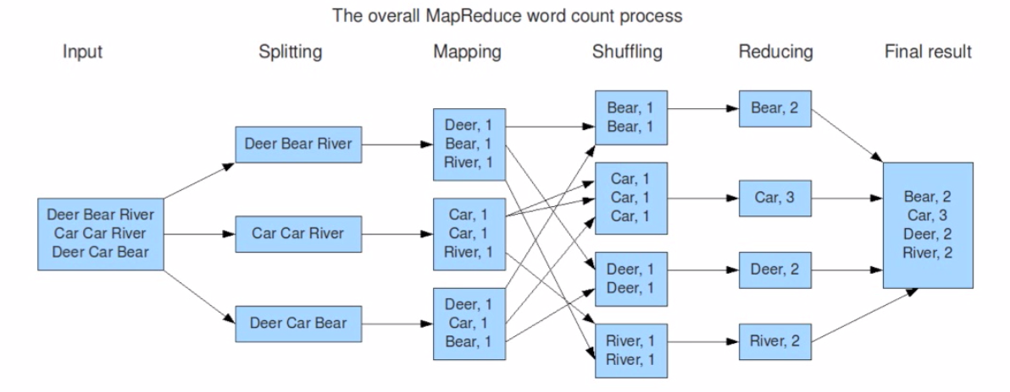
MapReduce – Word Count
Copy data between nodes based on the keys
Slide from Basic Introduction to Apache Hadoop
http://www.youtube.com/watch?v=OoEpfb6yga8

Slide 25
Assumptions of MapReduce
The task can be broken into multiple pieces
Pieces can be processed in parallel with minimal communication between pieces
Results of each piece can be combined in the end to produce final result

Slide 26
Two views of MapReduce programming
Step-level view
You supply the mapper and reducer functions
Python MRJob (Lab)
Table-level view
Load -> Transforms -> Dump
High-level table operations like SQL
Group records, compute aggregate function
Can still define custom mappers, reducers if needed
Hadoop + PySpark (coming up)

Slide 27
MRJob
Different backends possible
Test on your local machine
Or Run on a Hadoop cluster
Or use Amazon Elastic MapReduce
Base class: MRJob
You create your own subclass inheriting from MRJob with your desired mapper and reducer methods
You must define at least one of:
mapper, reducer, combiner
Install package "mrjob"
Documentation: http://pythonhosted.org/mrjob/

Slide 28
You plug in a mapper and reducer: MRJob framework does the rest
Mapper
Goal: Break input line into a set of key, value pairs
Input: single line from text file
Output: zero or more (key, value) pairs
Reducer
Goal: Take all (key, value) pairs with the same key, and compute an aggregate function over those values
Input: a key and a list of all values seen for that key
Output: zero or more (key, value) pairs
Most typically, the values are from an aggregation function over value_list, e.g. sum(value-list)
The MRJob framework takes care of the rest:
Sorting the mapper output. Invoking reduce tasks
Assembling reduce outputs into final result
Scheduling, monitoring all tasks, re-starting failed tasks

Slide 29
A basic MRJob Map-Reduce program
#!/usr/bin/python
from mrjob.job import MRJob
import re
class MRWordFrequencyCount(MRJob):
### input: self, in_key, in_value
def mapper(self, _, line):
yield "chars", len(line)
yield "words", len(line.split())
yield "lines", 1
### input: self, in_key from mapper, in_value from mapper
def reducer(self, key, values):
yield key, sum(values)
if __name__ == '__main__':
MRWordFrequencyCount.run()

Slide 30
Mapper example: "To be or not to be"
def mapper(self, _, line):
yield "chars", len(line)
yield "words", len(line.split())
yield "lines", 1
Input: "To be or not to be”
Output: ("chars", 18), ("words", 6), ("lines", 1)
Input: "That is the question”
Output: ("chars", 20), ("words", 4), ("lines", 1)

Slide 31
Reducer example: "To be or not to be"
def reducer(self, key, values):
yield key, sum(values)
Input: "chars": [18, 20]
Output: ("chars", 38)
Input: "words" : [6, 4]
Output: ("words", 10)
Input: ”lines" : [1, 1]
Output: (”lines", 2)

Slide 32
The output of all mappers is sorted by key, then given to the reducer
Mappers
Reducer
Sort
By
Key
Input: "chars": [18, 20]
Output: ("chars", 38)
Input: "words" : [6, 4]
Output: ("words", 10)
…
Input: "To be or not to be"
Output:
("chars", 18), ("words", 6), ("lines", 1)
Input: "That is the question"
Output:
("chars", 20), ("words", 4), ("lines", 1)
chars
words lines
("chars", 38), ("words", 10), ("lines", 2)

Slide 33
Digression: iterators, generators and the yield keyword
A for loop doesn't know what kind of object it's dealing with…
Lists, dictionaries, files, …
It just assumes the object is an iterator
It gets item after item as it calls the next() method on that object.
Examples of iterators in Python:
Built-in lists and tuples return their items one by one
Dictionaries return the keys one by one
Files return the lines one by one
Strings return characters one by one
A generator is a lazy iterator
In computer science, being lazy is often a good thing..

Slide 34
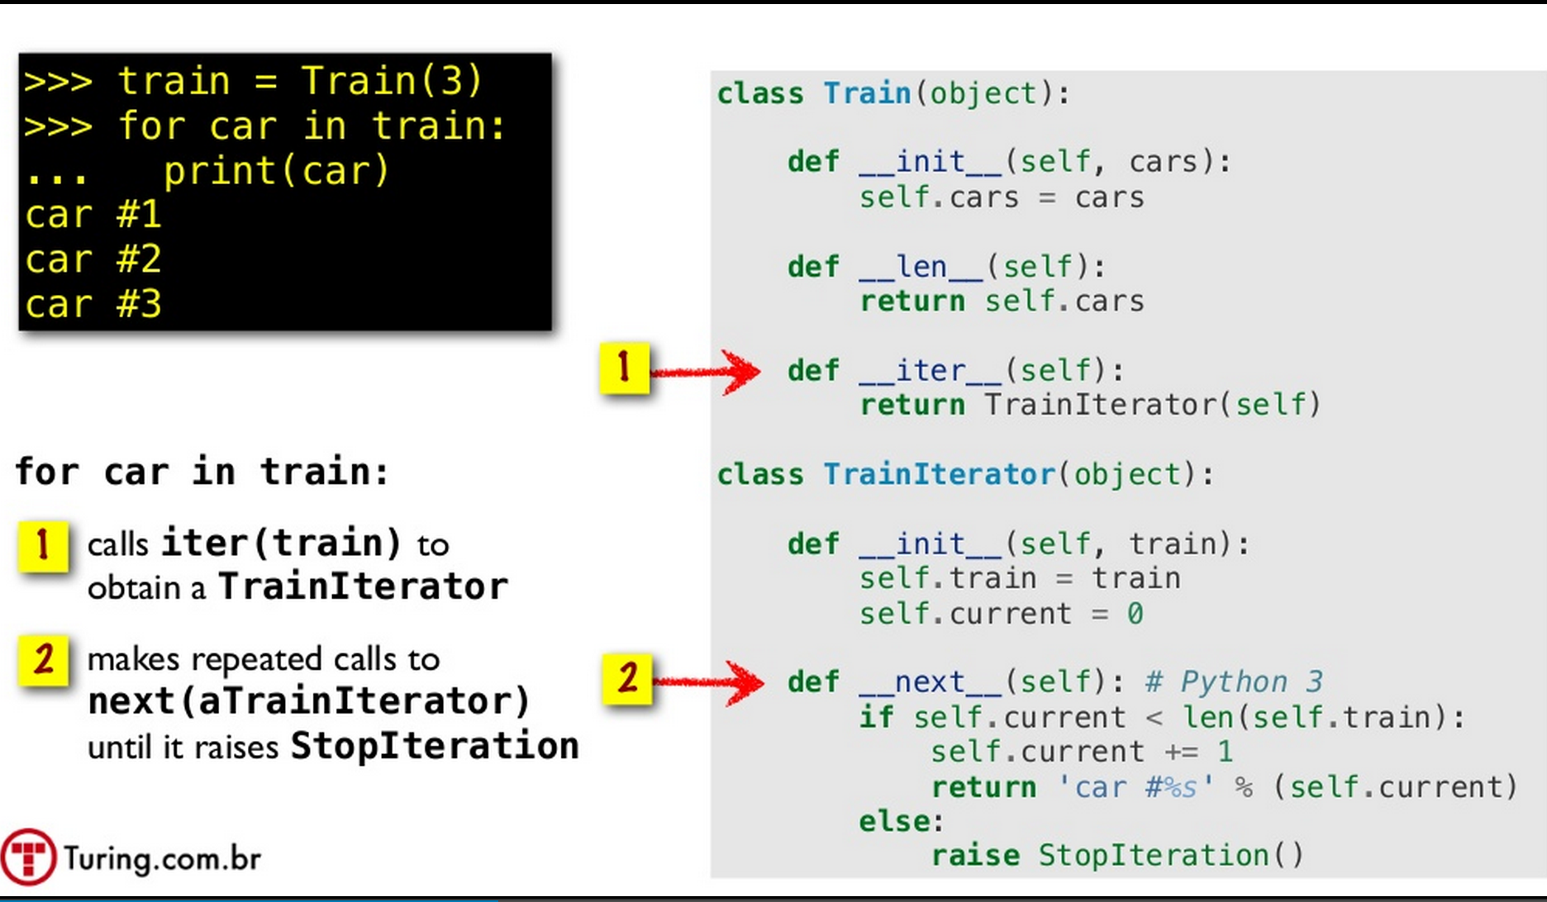

Slide 35
Digression: Iterators are an example of a subclass that has a specific interface.
Iterator example:
An iterator is a concrete subclass of type Iterable that implements the __iter__ method, which returns an iterator object.
The iterator object must implement the next method
Having an iterator interface/protocol provides a way to access the elements of an object sequentially without exposing the underlying representation
The Iterable and Iterator types are examples of abstract base classes that define a contract /expected behavior of a data object a.k.a. interface a.k.a. protocol

Slide 36
Digression: generators and the yield keyword
def f123():
yield 1
yield 2
yield 3
for item in f123():
print item
A GENERATOR is a lazy iterable object: lazy objects wait to produce results only when they absolutely have to.
When f123() is called, it does not return any of the values in the yield statements.
It returns a generator object. Also, the function does not really exit - it goes into a suspended state.
When the for loop tries to loop over the generator object, the function:
Resumes from its suspended state
Runs until the next yield statement
Returns that yield result as the next item.
This happens until the function exits
At which point the generator raises StopIteration, and the loop exits.

Slide 37
The MRJob mapper and reducer are generators… provided by you
#!/usr/bin/python
from mrjob.job import MRJob
import re
class MRWordFrequencyCount(MRJob):
def mapper(self, _, line):
yield "chars", len(line)
yield "words", len(line.split())
yield "lines", 1
def reducer(self, key, values):
yield key, sum(values)
if __name__ == '__main__':
MRWordFrequencyCount.run()
for line in input_file:
for map_result in mapper(line):
// add key, value pairs to reduce_dict
for key in reduce_dict:
print reducer(key, key_value_list)

Slide 38
Example: MRJob program for counting characters, words, and lines
#!/usr/bin/python
from mrjob.job import MRJob
class MRWordFrequencyCount(MRJob):
# mapper: key _ is always None and ignored
def mapper(self, _, line):
yield "chars", len(line)
yield "words", len(line.split())
yield "lines", 1
def reducer(self, key, values):
yield key, sum(values)
if __name__ == '__main__':
MRWordFrequencyCount.run()
$ python word_count.py my_file.txt
[…a bunch of log output…]
"chars" 3654
"lines" 123
"words" 417

Slide 39
MRJob: protocols
By default, we use one protocol for reading input, one internal protocol for communication between steps, and one protocol for final output (which is usually the same as the internal protocol). Protocols can be controlled by setting INPUT_PROTOCOL, INTERNAL_PROTOCOL, and OUTPUT_PROTOCOL in the mrjob.conf file
class MyMRJob(mrjob.job.MRJob):
# these are the defaults
INPUT_PROTOCOL = mrjob.protocol.RawValueProtocol
INTERNAL_PROTOCOL = mrjob.protocol.JSONProtocol
OUTPUT_PROTOCOL = mrjob.protocol.JSONProtocol

Slide 40
Questions
Is using a reducer always necessary?
No, if there are no sorting or grouping tasks
Example: change all words into upper case
Shuffle seems like it passes a lot of data around! How can we reduce that?
Add a combiner after mapping

Slide 41
MapReduce – Word Count
Car, 2
Car, 1
Car, 2
River, 1
Slide from Basic Introduction to Apache Hadoop
http://www.youtube.com/watch?v=OoEpfb6yga8
Notes:
If your algorithm involves computing aggregates of any sort, chances are you can use a Combiner in order to perform some kind of initial aggregation before the data hits the reducer. The MapReduce framework runs combiners intelligently in order to reduce the amount of data that has to be written to disk and transfered over the network in between the Map and Reduce stages of computation.

Slide 42
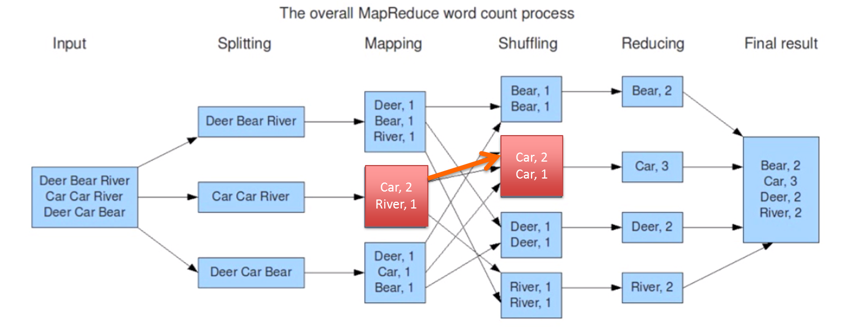
Adding a combiner can increase efficiency
Run immediately after each mapper
Used to decrease total data transfer
Input: key, and a subset of values for that key
Output: zero or more (key, value) pairs
Example:
mapper: splits line into words
"the", 1
"wheels", 1
"of", 1
"the ", 1 ...
combiner: sums word counts over mapper output
"the", 2
"wheels", ..
reducer: sums words counts over combiner outputs

Slide 43
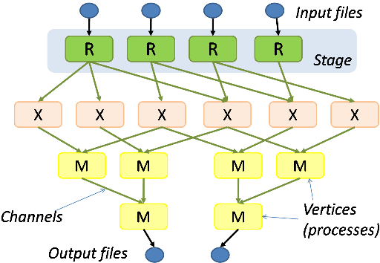
Beyond MapReduce: Other distributed computing models
A more sophisticated computation flow (Microsoft Dryad)

Slide 44
When should we use MapReduce?
Good MapReduce scenarios?
Data can be trivially partitioned in parallel
Few/no dependencies between the pieces
Results can be trivially recombined
Have lots of parallel CPUs w/ good bandwidth
Processing speed matters
e.g. feature extraction
Bad MapReduce scenarios?
Lots of dependencies between data elements
e.g. need similarity between every pair of tweets
Instead, use graph (network)-based computation:
Spark, GraphLab and other graph-based or more flexible frameworks
http://graphlab.com/products/create/technology.html
Order of magnitude speedup over MapReduce in such cases

Slide 45
Implications for Multi-Core Processors
Multi-core processors require parallelism, but many programmers are uncomfortable writing parallel programs
MapReduce provides an easy-to-understand programming model for a very diverse set of computing problems
users don’t need to be parallel programming experts
system automatically adapts to number of cores & machines available
Optimizations useful even in single machine, multi-core environment
locality, load balancing, status monitoring, robustness,...
Source: http://static.googleusercontent.com/media/research.google.com/en/us/pubs/archive/32721.pdf

Slide 46
MapReduce
MapReduce has proven to be a remarkably-useful abstraction
Greatly simplifies large-scale computations
Fun to use: focus on problem, let library deal with messy details
Many thousands of parallel programs written by hundreds of different programmers in last few years
Many had no prior parallel or distributed programming experience
Source: http://static.googleusercontent.com/media/research.google.com/en/us/pubs/archive/32721.pdf

