Slide 1
SI 618: Large-scale distributed computation 2
Fall 2017
Instructor: Ceren Budak
Some slides courtesy of Kevyn Collins-Thompson and Yuhang Wang

Slide 2
Announcements
Homeworks&Labs: Your programs are auto-graded, please follow instructions. If you don’t follow the instructions:
Minimum of 1) 10 points and 2) Half of the points for the relevant part will be deducted
Need solutions for homeworks or labs? Come to office hours
You should keep track of your late days. If you want to know, contact Deahan and Yize

Slide 3
Project I
Proposals due October 3, the project itself is due October 24
Proposal Guidelines (100 points):
(20 points) Summarize and motivate your proposed project.
(20 points) Choose and describe (at least) two different datasets.
(20 points) Describe how you might manipulate and join the two datasets.
(30 points) Describe at least three map-reduce tasks you will perform to gain insights from the datasets (you can use mrjob, spark or sparksql)
(10 points) Describe at least one visualization you might create that highlights insights you hope to gain
You can propose an alternative project structure with prior approval (you need to contact me for this)

Slide 4
Last week
Distributed large-scale computing
Divide and Conquer:
Split the task in sub-tasks
Put resources to handle subtasks in parallel
Combine the results
We are distributing the workload across different CPUs
Quick overview of the Map-Reduce programming paradigm:
Read a bunch of data (set of records)
Map: for each record, extract something you care about.
Sort and group the extracted records
Reduce: For all groups:
Summarize, filter, transform, aggregate
Collapse the group into a result row
Write out the results

Slide 5
This week
HDFS and MapReduce
Flux
Spark

Slide 6
How does the MapReduce framework fit in a large-scale architecture?

Slide 7

Hadoop: architecture
The Apache™ Hadoop® project develops open-source software for reliable, scalable, distributed computing.

Slide 8

Leading framework: Hadoop
A software framework for distributed computing
Take 100 'commodity' machines that don't share memory or disk storage
Turn commodity machines into a cluster
Redundant and Reliable
Powerful and Scalable
Cost-effective
Java-based APIs to Hadoop services
But calling these directly is tedious and error-prone so people use programming languages like pig or spark to perform Hadoop jobs
Notes:
Commodity does not mean consumer-class, but just not specialized enterprise machines

Slide 9


Leading framework: Hadoop
Google File System (GFS)
Hadoop Distributed File System (HDFS)
http://research.google.com/archive/gfs.html
MapReduce
Hadoop MapReduce
http://research.google.com/archive/mapreduce.html
BigTable
Hadoop HBase
http://research.google.com/archive/bigtable.html
Originally developed at Google. See paper links.
Notes:
From Google white papers

Slide 10

Leading framework: Hadoop
Major components
MapReduce (algorithm)
A programming model for large-scale data processing
Hadoop Distributed File System (data storage)
Stores and aggregates data on cluster machines
Hardware Architecture
Networked machines
Cluster of machines running Hadoop at Yahoo! (Source: Yahoo!) via
http://www.michael-noll.com/tutorials/running-hadoop-on-ubuntu-linux-multi-node-cluster/

Slide 11
Hadoop MapReduce v1 Architecture
Job Tracker
Name Node
Task
Tracker
Task
Tracker
Task
Tracker
Data Node
Data Node
Data Node

Slide 12
Hadoop Distributed File System (HDFS)
Also need a mechanism to support the process at the data level.
HDFS is designed to be…
Scalable in storage and I/O bandwidth
Highly fault-tolerant (check periodically)
Optimized for commodity machines
Typical Settings:
Save a file into blocks (128MB)
Replicate 3 times
Notes:
http://www.youtube.com/watch?v=1_ly9dZnmWc

Slide 13
Hadoop Distributed File System (HDFS)
Client
Name Node
Namespace metadata
Know where the data pieces are
Single point of availability failure
Data Node
Data Node
Data Node
Data Node
Responsible for actual read and write
Notes:
Secondary name node is not a demon. It pull the metadata from master name node and save it as a file image, then feed back to the master node fro persistence.

Slide 14
Hadoop Distributed File System (HDFS)
File1: 1,2,3,4
File2: 5,6,7
Name node keeps track of where these chunks are and Name node also has a simple webpage that lists some basic details
Client
Name Node
1
2
3
4
1
2
3
4
1
2
1
2
2
1
3
4
3
4
3
4
Hadoop Tutorial: Intro to HDFS
http://www.youtube.com/watch?v=ziqx2hJY8Hg
Notes:
Secondary name node is not a demon. It pull the metadata from master name node and save it as a file image, then feed back to the master node fro persistence.
Tolerance = 2 nodes
Highly available and self healing

Slide 15
Hadoop MapReduce
In large configurations, there might be multiple racks with multiple nodes.
Name node is rack-aware (what if an entire rack goes down? We need to be resilient to this case)
Job Tracker
Name Node
Name Node2
1
1
1
1
What happens if rack 1 goes offline?

Slide 16
Hadoop MapReduce
In large configurations, there might be multiple racks with multiple nodes.
Name node is rack-aware (what if an entire rack goes down? We need to be resilient to this case)
Job Tracker
Name Node
Name Node2
1
1
1
1
What happens if rack 1 goes offline?

Slide 17
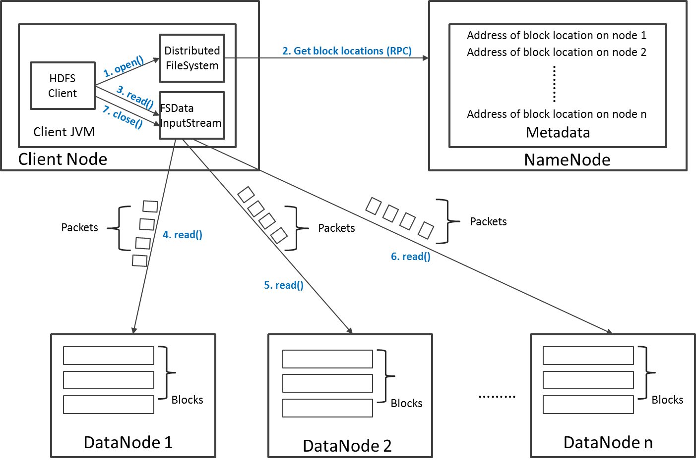
Read Operation in HDFS
Say that the client is looking for a block that is replicated on three datanodes. Namenode gives a sorted listed of datanodes to contact. Client will contact the second datanode only if it does not receive a response from the first
Why does the client go to the name node only to get the list and communicate with the data nodes directly? We don’t want name node to be a single point of failure

Slide 18
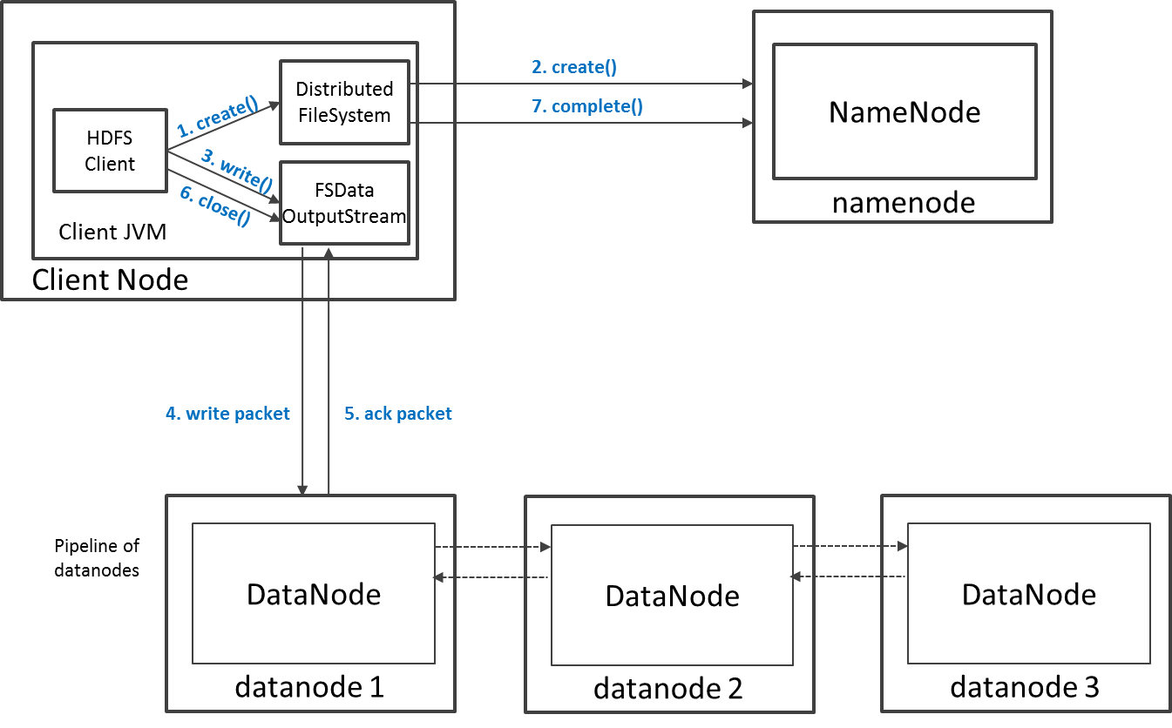
Write Operation in HDFS
Say your replication is 3, two of those are generally saved on two different datanodes on the same rack? Why?

Slide 19
Job Scheduling – Resource Allocation I
A single master JobTracker: is responsible for resource management, tracking resource consumption/availability and scheduling the jobs component tasks on the slaves, monitoring them and re-executing the failed tasks.
TaskTrackers execute the tasks as directed by the master and provide task-status information to the master periodically.
The JobTracker is a single point of failure for the Hadoop MapReduce service which means if JobTracker goes down, all running jobs are halted.

Slide 20
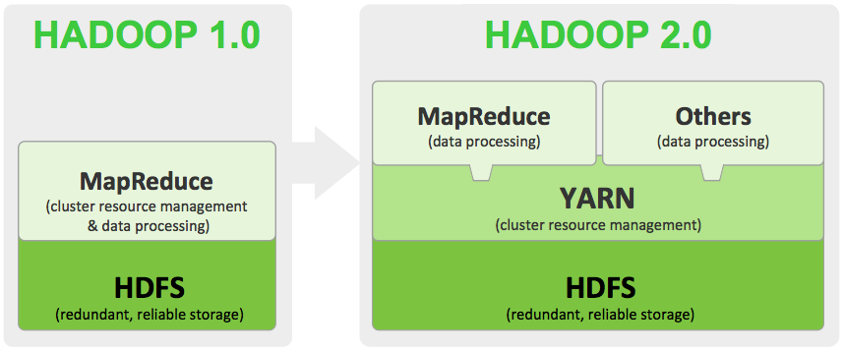
Hadoop MapReduce v1 vs. v2 Architecture

Slide 21
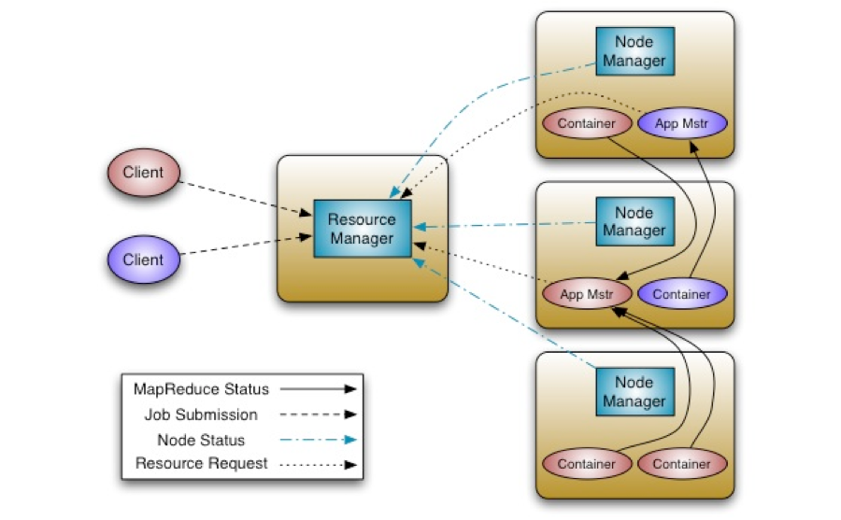
Hadoop MapReduce v2 Yarn Architecture
Purely a scheduler
All the complexity is shifted to the Application Master, that’s app specific
http://hortonworks.com/blog/apache-hadoop-yarn-concepts-and-applications/
Notes:
The ResourceManager and the NodeManager formed the new generic system for managing applications in a distributed manner. The ResourceManager is the ultimate authority that arbitrates resources among all applications in the system. The ApplicationMaster is a framework-specific entity that negotiates resources from the ResourceManager and works with the NodeManager(s) to execute and monitor the component tasks.
The ResourceManager has a scheduler, which is responsible for allocating resources to the various applications running in the cluster, according to constraints such as queue capacities and user limits. The scheduler schedules based on the resource requirements of each application.
Each ApplicationMaster has responsibility for negotiating appropriate resource containers from the scheduler, tracking their status, and monitoring their progress. From the system perspective, the ApplicationMaster runs as a normal container.
The NodeManager is the per-machine slave, which is responsible for launching the applications’ containers, monitoring their resource usage (cpu, memory, disk, network) and reporting the same to the ResourceManager.

Slide 22
Unix command line refresher
ls : list contents of a directory
pwd : print working directory
Paths
/home/<youruniqname>
Special directory names:
. Current directory
.. Parent directory
cd <directory> : change directory
cat <filename> : dump contents of a file
rm <filename> : remove a file

Slide 23
Hadoop file system follows the Unix command line conventions
hadoop fs –ls
hadoop fs –ls <directory>
hadoop fs -cat <filename>
hadoop fs -rm <filename>

Slide 24
How to write data processing code that uses Hadoop MapReduce?
Plain Java MapReduce code
In any language with Hadoop Streaming (http://hadoop.apache.org/docs/r1.1.1/streaming.html)
Pig (http://pig.apache.org/)
Hive (http://hive.apache.org/)
Java with Cascading (http://www.cascading.org/)
Scala with Scalding (https://github.com/twitter/scalding)
Python with mrjob (https://github.com/Yelp/mrjob)

Slide 25
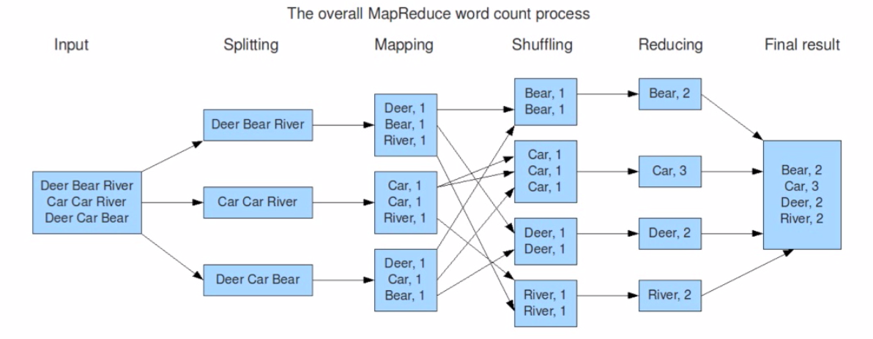
MapReduce – Word Count
Map
Write Results
Reduce
Copy data between nodes based on the keys

Slide 26
MapReduce
Users specify:
a map function that processes a key/value pair to generate a set of intermediate key/value pairs
a reduce function that merges all intermediate values associated with the same intermediate key.
Programs written in this functional style are automatically parallelized and executed on a large cluster of commodity machines.
The run-time system takes care of the details:
partitioning the input data
scheduling the program's execution across a set of machines
handling machine failures
managing the required inter-machine communication.
This allows programmers without any experience with parallel and distributed systems to easily utilize the resources of a large distributed system.
Source: http://research.google.com/archive/mapreduce.html

Slide 27
A basic MRJob Map-Reduce program – Count characters, words and lines in a document
#!/usr/bin/python
from mrjob.job import MRJob
import re
class MRWordFrequencyCount(MRJob):
### input: self, in_key, in_value
def mapper(self, _, line):
yield "chars", len(line)
yield "words", len(line.split())
yield "lines", 1
### input: self, in_key from mapper, in_value from mapper
def reducer(self, key, values):
yield key, sum(values)
if __name__ == '__main__':
MRWordFrequencyCount.run()

Slide 28
MapReduce – Adding a combiner
Car, 2
Car, 1
Car, 2
River, 1
Notes:
If your algorithm involves computing aggregates of any sort, chances are you can use a Combiner in order to perform some kind of initial aggregation before the data hits the reducer. The MapReduce framework runs combiners intelligently in order to reduce the amount of data that has to be written to disk and transfered over the network in between the Map and Reduce stages of computation.

Slide 29
So far
Hadoop: open-source framework for reliable, scalable, distributed computing.
MapReduce (algorithm)
A programming model for large-scale data processing
Hadoop Distributed File System (data storage)
Stores and aggregates data on cluster machines
Hardware Architecture
Networked machines
Yet, we did everything locally. Now we go to the cluster!

Slide 30
Flux
Flux is the shared, Linux-based high-performance computing (HPC) cluster available to all researchers at the University of Michigan. (http://arc-ts.umich.edu/systems-and-services/flux/)
Flux consists of approximately 27,000 cores – including 1,372 compute nodes composed of multiple CPU cores, with at least 4 GB of RAM per core, interconnected with InfiniBand networking.
Flux provides, among other services, the Data Science Platform which is an upgraded Hadoop cluster currently available as a technology preview with no associated charges to U-M researchers (http://arc-ts.umich.edu/systems-and-services/hadoop/). The cluster provides 112TB of total usable disk space, 40GbE inter-node networking, Hadoop version 2.6.0, and several additional data science tools.
We will exclusively use the Hadoop cluster in this class

Slide 31
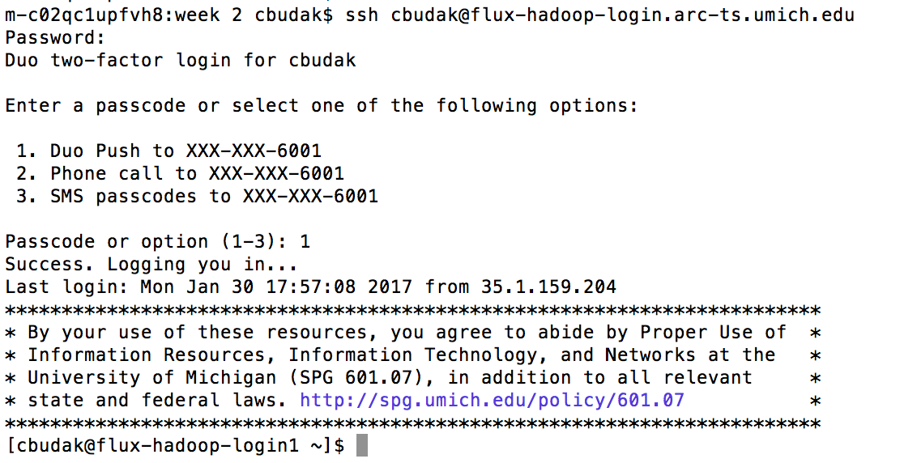
Working on a remote server: logging in

Slide 32
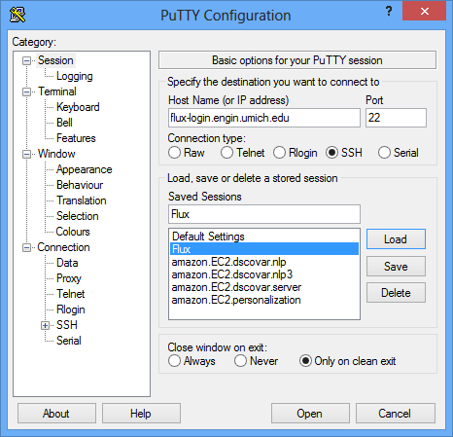
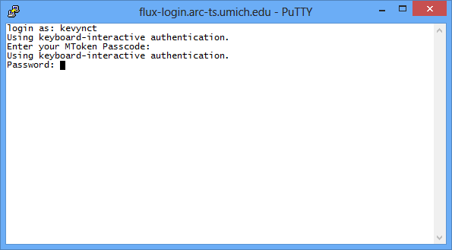
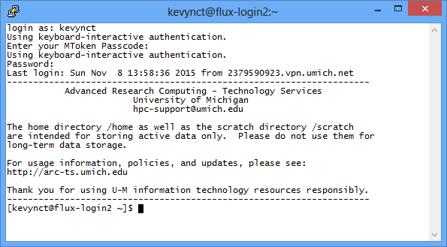
Working on a remote server: logging in
flux-hadoop-login.arc-ts.umich.edu

Slide 33
Working on a remote server: copying files between your laptop and the remote account
Option 1: Use scp
Copy from local to server:
scp localfile uniqname@flux-xfer.arc-ts.umich.edu:remotefile (copy a file)
scp -r localdir uniqname@flux-xfer.arc-ts.umich.edu:remotedir (copy an entire directory)
Copy from server to local
scp uniqname@flux-xfer.arc-ts.umich.edu:remotefile localfile
Option 2: Use CyberDuck (on Mac)

Slide 34
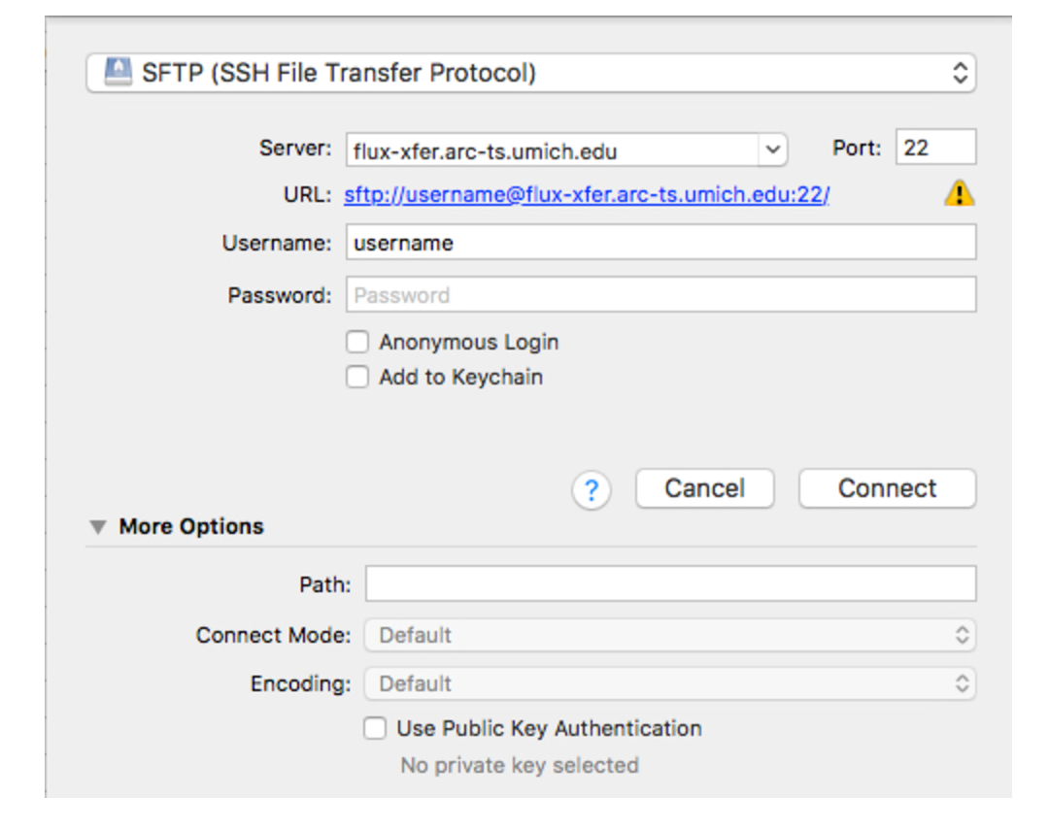
Working on a remote server: copying files between your laptop and the remote account

Slide 35
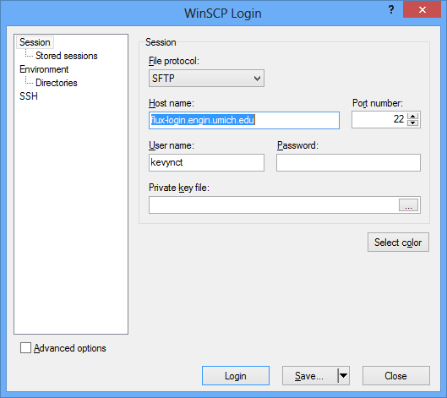
Working on a remote server: copying files between your laptop and the remote account
Use WinSCP (on windows)

Slide 36
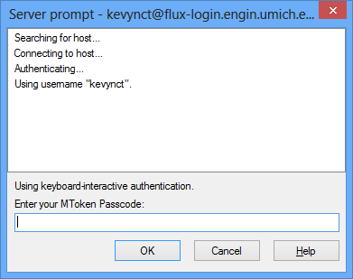
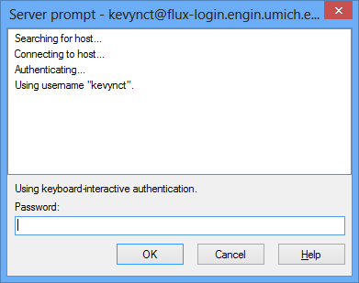
Working on a remote server: copying files between your laptop and the remote account

Slide 37
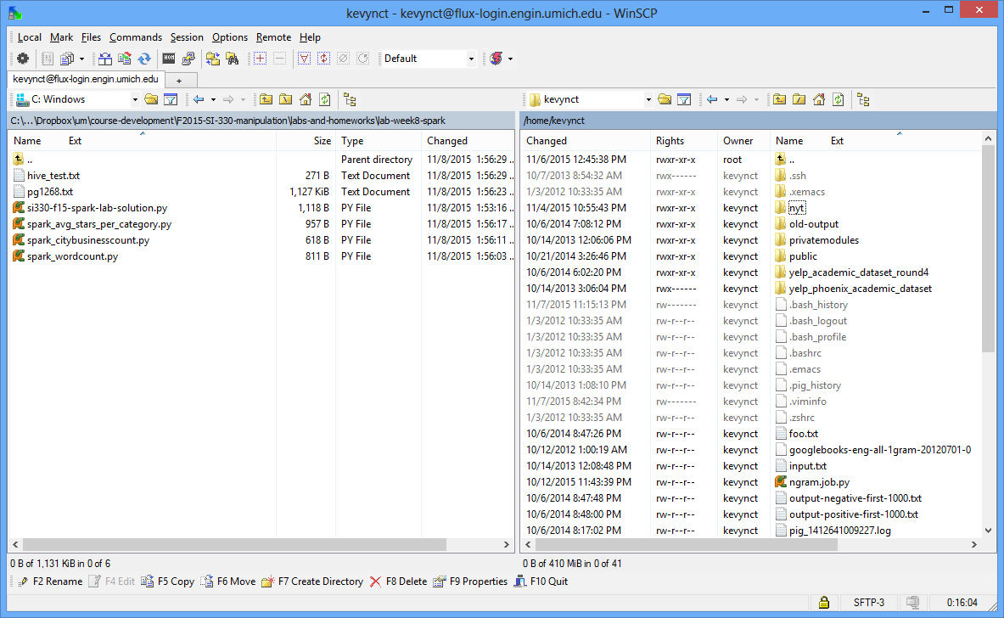
Working on a remote server: copying files between your laptop and the remote account

Slide 38
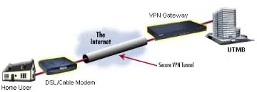

Working off-campus: VPN (Virtual Private Network)
VPN: uses encryption and tunneling to establish secure private connections over third-party networks
See http://www.itcom.itd.umich.edu/vpn/ for details on how to install VPN software for UM.

Slide 39
Unix command line refresher
ls : list contents of a directory
pwd : print working directory
Paths
/home/<youruniqname>
Special directory names:
. Current directory
.. Parent directory
cd <directory> : change directory
cat <filename> : dump contents of a file
rm <filename> : remove a file

Slide 40
Hadoop file system follows the Unix command line conventions
hadoop fs –ls
hadoop fs –ls <directory>
hadoop fs -cat <filename>
hadoop fs -rm <filename>

Slide 41
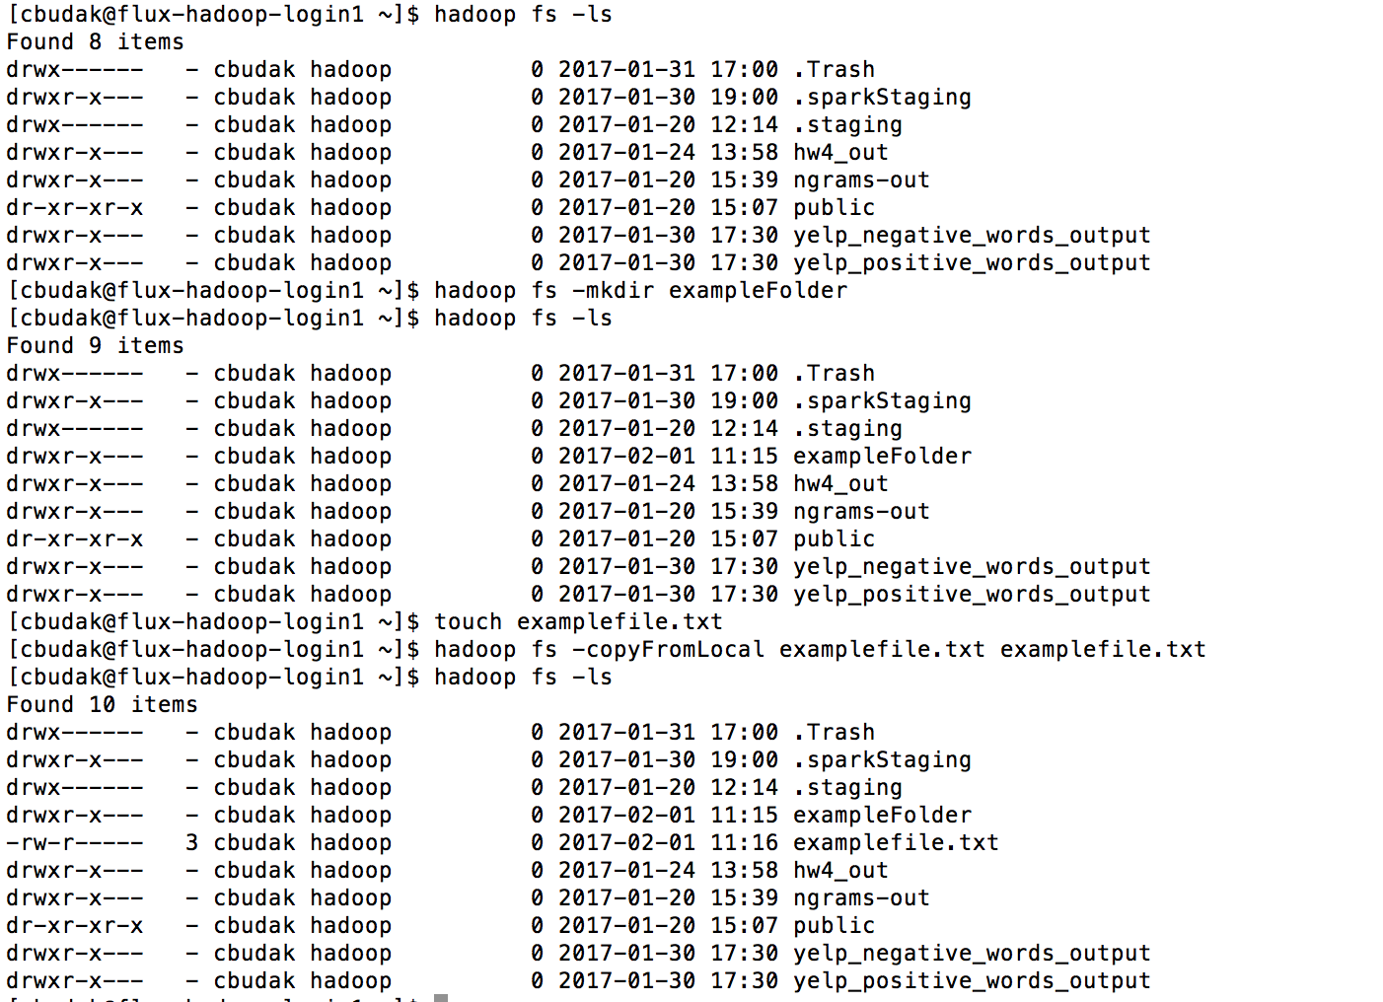

Slide 42
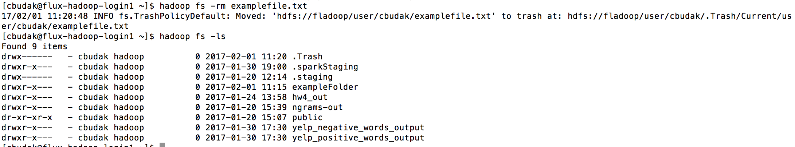
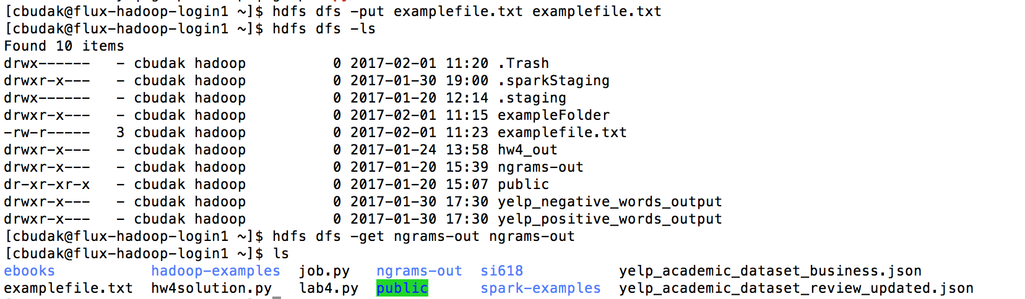
This is the HDFS folder through which I will be sharing content with you

Slide 43
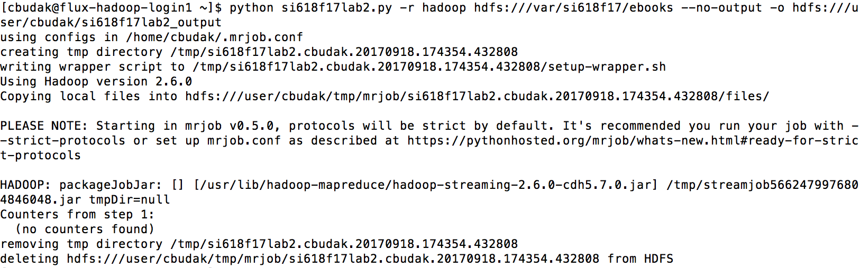
Running Mrjob on the cluster

Slide 44
The Fladoop Cluster at UM
The Flux Hadoop cluster consists of 12 nodes offering 100TB of HDFS space. The software available is:
Hadoop – 2.6.0 – Documentation
Hive – 1.1.0 – Documentation
Sqoop – 1.4.6 – Documentation
Pig – 0.12.0 – Documentation
R + rmr2 + rhdfs – 3.0.3 – Documentation
Spark – 1.5.0 – Documentation
mrjob – 0.4.3-dev, commit 226a741548cf125ecfb549b7c50d52cda932d045 – Documentation

Slide 45
Spark - Fast and general engine for large-scale data processing
Up to 100 times faster than Hadoop MapReduce
Written in Scala, providing Scala, Java and Python APIs
Supports both batch mode and real-time data stream processing
Write once, run everywhere
Spark runs on Hadoop, Mesos, standalone, or in the cloud. It can access diverse data sources including HDFS, Cassandra, HBase, S3.
Spark has over 465 contributors in 2014, making it the most active project in the Apache Software Foundation and among Big Data open source projects.
http://spark.apache.org/docs/latest/quick-start.html
Sources: https://spark.apache.org, http://en.wikipedia.org/wiki/Apache_Spark

Slide 46
Basic Spark Concepts
SparkContext
represents the connection to a Spark cluster, and can be used to create RDDs, accumulators and broadcast variables on that cluster.
Resilient Distributed Dataset (RDD)
RDDs have actions, which return values,
and transformations, which return new RDDs
Two code execution modes:
Interactive Python shell: PySpark
Running standalone applications: spark-submit
Notes:
Broadcast variables − used to efficiently, distribute large values.
Accumulators − used to aggregate the information of particular collection.
Broadcast variables allow the programmer to keep a read-only variable cached on each machine rather than shipping a copy of it with tasks. They can be used, for example, to give every node, a copy of a large input dataset, in an efficient manner. Spark also attempts to distribute broadcast variables using efficient broadcast algorithms to reduce communication cost.
Spark actions are executed through a set of stages, separated by distributed “shuffle” operations. Spark automatically broadcasts the common data needed by tasks within each stage.
The data broadcasted this way is cached in serialized form and is deserialized before running each task. This means that explicitly creating broadcast variables, is only useful when tasks across multiple stages need the same data or when caching the data in deserialized form is important.
Broadcast variables are created from a variable v by calling SparkContext.broadcast(v). The broadcast variable is a wrapper around v, and its value can be accessed by calling the value method. The code given below shows this −
scala> val broadcastVar = sc.broadcast(Array(1, 2, 3))
Accumulators are variables that are only “added” to through an associative operation and can therefore, be efficiently supported in parallel. They can be used to implement counters (as in MapReduce) or sums. Spark natively supports accumulators of numeric types, and programmers can add support for new types. If accumulators are created with a name, they will be displayed in Spark’s UI. This can be useful for understanding the progress of running stages (NOTE − this is not yet supported in Python).
An accumulator is created from an initial value v by calling SparkContext.accumulator(v). Tasks running on the cluster can then add to it using the add method or the += operator (in Scala and Python). However, they cannot read its value. Only the driver program can read the accumulator’s value, using its value method.

Slide 47
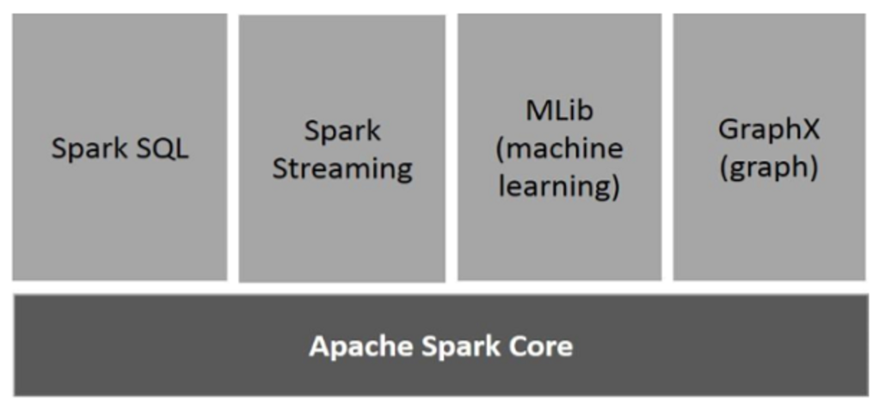
Spark Components
https://www.tutorialspoint.com/apache_spark/apache_spark_introduction.htm
Notes:
Apache Spark Core
Spark Core is the underlying general execution engine for spark platform that all other functionality is built upon. It provides In-Memory computing and referencing datasets in external storage systems.
Spark SQL
Spark SQL is a component on top of Spark Core that introduces a new data abstraction called SchemaRDD, which provides support for structured and semi-structured data.
Spark Streaming
Spark Streaming leverages Spark Core's fast scheduling capability to perform streaming analytics. It ingests data in mini-batches and performs RDD (Resilient Distributed Datasets) transformations on those mini-batches of data.
MLlib (Machine Learning Library)
MLlib is a distributed machine learning framework above Spark because of the distributed memory-based Spark architecture. It is, according to benchmarks, done by the MLlib developers against the Alternating Least Squares (ALS) implementations. Spark MLlib is nine times as fast as the Hadoop disk-based version of Apache Mahout (before Mahout gained a Spark interface).
GraphX
GraphX is a distributed graph-processing framework on top of Spark. It provides an API for expressing graph computation that can model the user-defined graphs by using Pregel abstraction API. It also provides an optimized runtime for this abstraction.

Slide 48
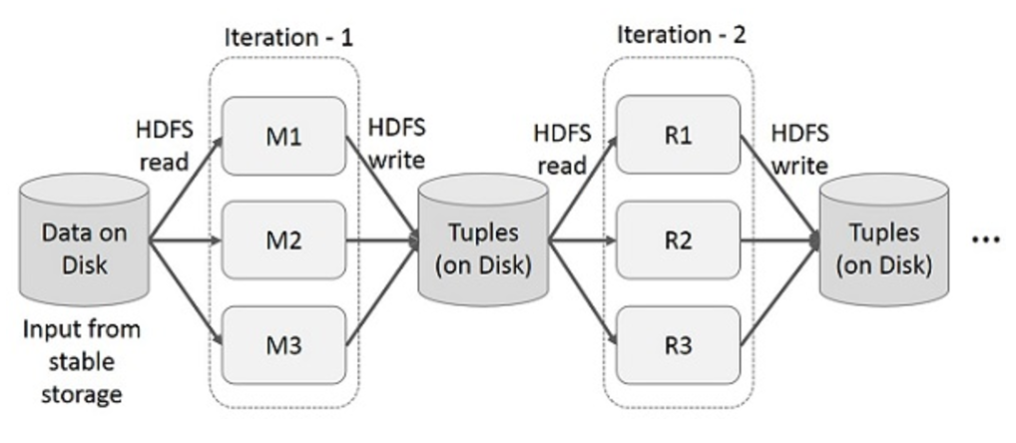
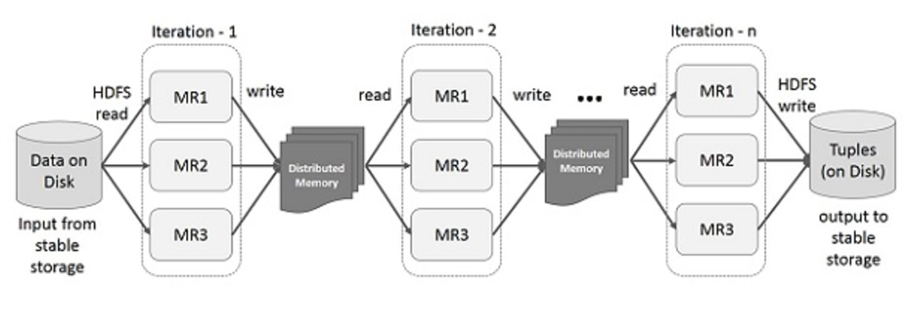
Traditional MapReduce vs. Spark: iterative operations
MapReduce
Spark
https://www.tutorialspoint.com/apache_spark/apache_spark_introduction.htm

Slide 49
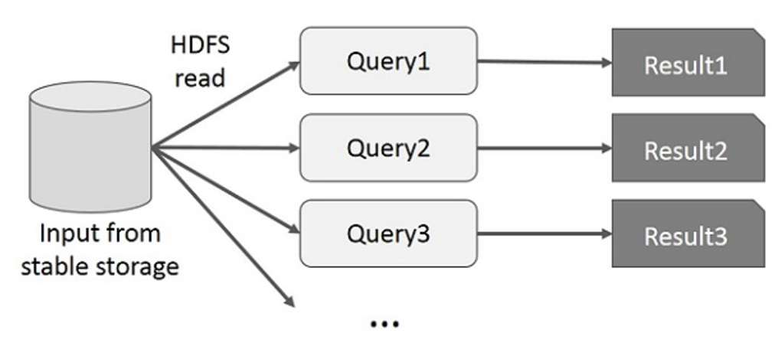
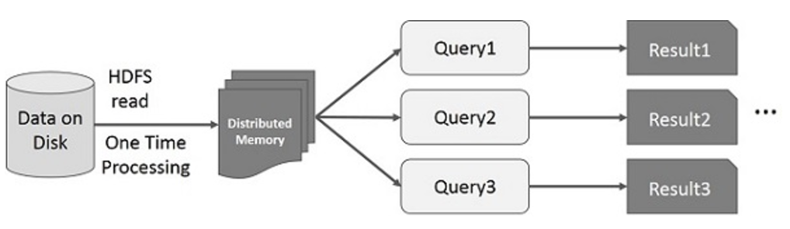
Traditional MapReduce vs. Spark: interactive operations
MapReduce
Spark
https://www.tutorialspoint.com/apache_spark/apache_spark_introduction.htm

Slide 50
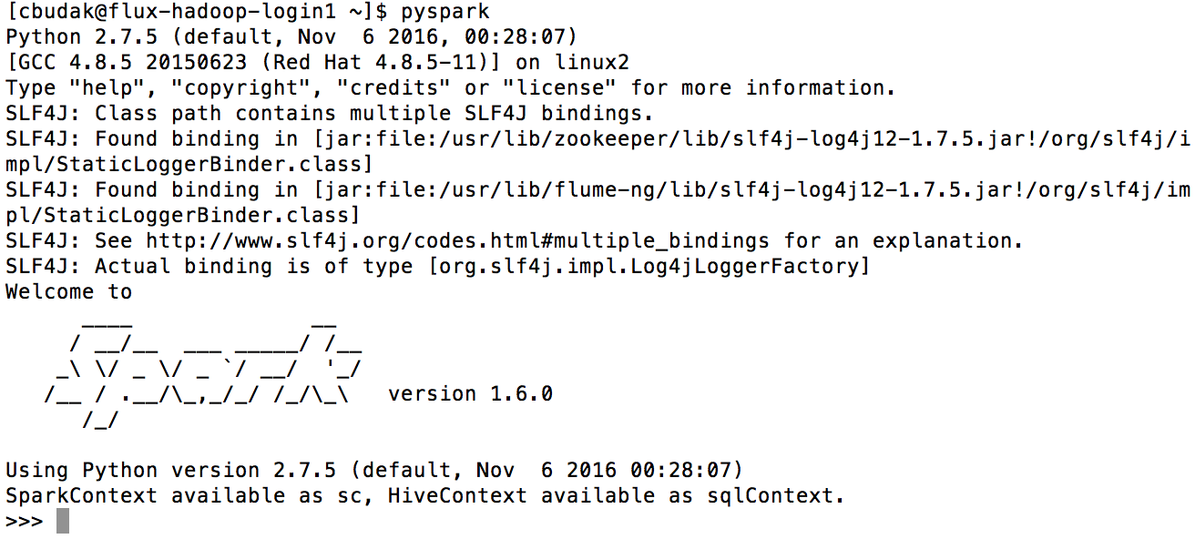
Pyspark: an interactive Python shell running on top of Spark

Slide 51
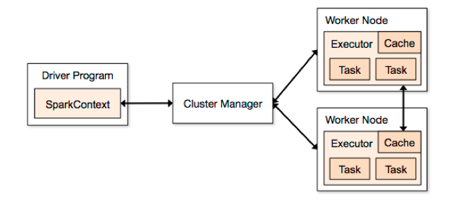
SparkContext
Represents a connection to a computing cluster
In PySpark, a SparkContext is auto-created for you in a variable called sc
Source: https://spark.apache.org/docs/1.1.1/cluster-overview.html

Slide 52
Resilient Distributed Dataset (RDD)
The fundamental abstraction for distributed data computation
An RDD is:
A immutable (read-only) collection of items
Partitioned across computing nodes
That can be manipulated in parallel
Once you have a SparkContext you can create RDDs
Example: A collection of lines from a text file
>>> lines = sc.textFile("input.txt") # Create an RDD called lines
>>> lines.count() # Count the number of items in this RDD
3
>>> lines.first() # First item in this RDD, i.e. first line of input.txt
u'summer school 2012 in indiana'

Slide 53
Example Spark API operation on an RDD: filter
>>> lines = sc.textFile("input.txt")
>>> pigLines = lines.filter(lambda line: "pig" in line)
>>> pigLines.first()
u'pig tutorial for summer school 2012'
The magic of Spark: operations like 'filter' are parallelized across the cluster.

Slide 54
In Spark, all work involves one of three kinds of operations on RDDs
Creating new RDDs
e.g. lines = sc.textFile("input.txt")
Input: various. Output: new RDD
2. Transforming existing RDDs
e.g. pigLines = lines.filter(lambda line: "pig" in line)
Input: one or more RDDs. Output: new RDD
3. Computing actions on RDDs to get a result
e.g. pigLines.first()
Input: one or more RDDs. Output: various non-RDD

Slide 55
Creation method 1: load data from external storage
lines = sc.textFile('./nyt/1985.txt')

Slide 56
Creation method 2: parallelize an existing data structure
lines = sc.parallelize(["pandas", "i like pandas"])

Slide 57
Element-wise transformations: filter and map
The map() transformation takes in a function and applies it to each element in the RDD with the result of the function being the new value of each element in the resulting RDD. The filter() transformation takes in a function and returns an RDD that only has elements that pass the filter() function.
nums = sc.parallelize([1, 2, 3, 4])
squared = nums.map(lambda x: x * x).collect()
for num in squared:
print "%i " % (num)
def containsError(s):
return "error" in s
word = rdd.filter(containsError)
Notes:
To print all elements on the driver, one can use the collect() method to first bring the RDD to the driver node

Slide 58
Element-wise transformations: filter and map
The map() transformation takes in a function and applies it to each element in the RDD with the result of the function being the new value of each element in the resulting RDD. The filter() transformation takes in a function and returns an RDD that only has elements that pass the filter() function.
def containsError(s):
return "error" in s
word = rdd.filter(containsError)

Slide 59
Element-wise transformations: flatMap
Sometimes we want to produce multiple output elements for each input element. The operation to do this is called flatMap(). As with map(), the function we provide to flatMap() is called individually for each element in our input RDD. Instead of returning a single element, we return an iterator with our return values. Rather than producing an RDD of iterators, we get back an RDD that consists of the elements from all of the iterators.
lines = sc.parallelize(["hello world", "hi"])
words = lines.flatMap(lambda line: line.split(" "))
words.first() # returns "hello"

Slide 60
Set-like transformations
errorsRDD = inputRDD.filter(lambda x: "error" in x)
warningsRDD = inputRDD.filter(lambda x: "warning" in x)
badLinesRDD = errorsRDD.union(warningsRDD)
rdd1.union(rdd2)
rdd1.intersection(rdd2)
rdd1.subtract(rdd2)
rdd1.distinct()

Slide 61
Actions
take(n)
for line in lines.take(10):
print line
collect()
Take an RDD and turn it into a local list
Be careful when using on a large RDD

Slide 62
Pair RDDs: collections of (key, value) pairs
reduceByKey(func)
sortByKey()
groupByKey()
mapValues(func)
flatMapValues(func)
keys()
values()

Slide 63
Pair RDDs: sortByKey()
Just like the Python sorted() function: sort (key, value) pairs alphabetically
word_counts_sorted = word_counts.sortByKey()

Slide 64
Pair RDDs: sortBy()
Just like the Python sorted() using a key= function
word_counts_sorted = word_count3.sortBy(lambda x: x[1], ascending = False)

Slide 65
Pair RDDs: reduceByKey(func)
Takes a function that operates on the values of two elements with the same key and returns a new RDD.
sumRDD = rdd.reduceByKey(lambda x, y: x + y)

Slide 66
Pair RDDs: reduce(func)
Reduce is an action that aggregates all the elements of the RDD using some function and returns the final result to the driver program
sumRDD = rdd.reduce(lambda x, y: x + y)

Slide 67
Example: Word Count
Goal: Count words in a document (or groups of documents)
import re
from pyspark import SparkContext
sc = SparkContext(appName="WordCount")
WORD_RE = re.compile(r"\b[\w']+\b")
input_file = sc.textFile("hdfs:///var/si618w17/ebooks/ebooks*")
word_counts = input_file.flatMap(lambda line: WORD_RE.findall(line)) \
.map(lambda word: (word, 1)) \
.reduceByKey(lambda a, b: a + b)
word_counts_sorted = word_counts.sortBy(lambda x: x[1], ascending = False)
word_counts_sorted.take(5)
word_counts_sorted.saveAsTextFile("hdfs:///user/cbudak/spark_wordcount_output") #replace cbudak with your uniqname
word_counts_sorted.map(lambda t : t[0] + '\t' + str(t[1])).saveAsTextFile('spark_wordcount_output2')

Slide 68
RDD operations we have learned:
map(f, preservesPartitioning=False)
flatMap(f, preservesPartitioning=False)
filter(f)
sortBy(keyfunc, ascending=True, numPartitions=None)
reduceByKey(func, numPartitions=None)
take(num)
collect()
saveAsTextFile(path, compressionCodecClass=None)

Slide 69
More about Spark
Basic statistic of RDDs:
max(key=None)
min(key=None)
mean()
count()
sum()
stdev()
How to join RDDs:
join(other, numPartitions=None)
leftOuterJoin(other, numPartitions=None)
rightOuterJoin(other, numPartitions=None)
fullOuterJoin(other, numPartitions=None)
https://spark.apache.org/docs/1.3.0/api/python/pyspark.html#pyspark.RDD

Slide 70
Resources: Spark Documentation
https://spark.apache.org/docs/latest/quick-start.html
https://spark.apache.org/docs/latest/programming-guide.html
https://spark.apache.org/docs/latest/api/python/index.html

Slide 71
Resources: Spark on Fladoop
http://arc-ts.umich.edu/hadoop-user-guide/

