Slide 1
SI 601
Text Encodings and Finding Patterns in Text with Regular Expressions
Chris Teplovs (cteplovs@umich.edu)
Lead Developer, Digital Innovation Greenhouse
Adjunct Lecturer, School of Information
Some material courtesy of: Kevyn Collins-Thompson, Yuhang Wang, Qiaozhu Mai, Charles Severance, Patrick Dudas

Slide 2
Announcements
MOOC beta testing opportunity (see Canvas)
MIDAS Annual Symposium
“Big Data: Advancing Science, Changing the World”

Slide 3
Let’s Talk About Assignments
How many hours you spent working on assignments
4 10 6 1 3 20 4
8
Higher or Lower?

Slide 4
Extension: Just this time
I am willing to extend the deadline for Lab and Homework #1 to Monday, 1:00pm
If you have already submitted your assignment, you will receive a 5% point bonus, up to the maximum of the assignment
For example, on the Lab, which is worth 20 points, if you submitted by the deadline and you would have received 19 points, you will get 20. If you would have gotten 20, you will still get 20
For example, on the Homework, which is worth 100 points, if you submitted by the deadline and you would have received 85/100 you would get 90/100
This is mostly to accommodate late enrollment in a way that does not untowardly penalize those who completed the assignment on time
No further extensions will be granted: you may use your own “free” late days if you want
This is only for Lab #1 and Homework #1

Slide 5
Lab & Homework Grading
SungJin Nam will grade Lab and Homework Assignments
Grades will be posted in about a week
Grade questions: e-mail SungJin (sjnam@umich.edu) cc: cteplovs@umich.edu

Slide 6
Individual project: 1-page proposal
Initial one-page proposal due Friday, September 23rd, 1:00 pm
20% of project grade (Overall, project is worth 30% of grade)
One page
I will provide feedback by the following class, and may meet in person.
Proposal Guidelines (60 points):
1. (10 points) Summarize and motivate your proposed project.
2. (20 points) Choose and describe two different datasets.
3. (20 points) Describe how you might manipulate and join the two datasets.
4. (10 points) Describe one interesting visualization that you might perform with the joined data.
You can propose an alternative project structure with prior approval

Slide 7
Piazza
Ask questions, get help!

Slide 8
SI 601 Data Manipulation: Class Schedule (Some details may change)
Date | Topic | Assignments Due (before start of class)
Sep 9 | Course introduction Basics of Programming with Python | Install software as described in welcome email
Sep 16 | Text Processing and Pattern Extraction with Regular Expressions | Homework 1, Lab 1
Sep 23 | Fetching and Parsing Web content: HTML, JSON, XML | Homework 2, Lab 2 1-page Project Proposal Due
Sep 30 | Fetching data from Large Online Services Querying data in a SQL Database | Homework 3, Lab 3
Oct 7 | Large-scale data manipulation with MapReduce and Hadoop | Homework 4, Lab 4
Oct 14 | Advanced topics: learning analytics, synthetic data | Homework 5, Lab 5
Oct 21 | Course Review, Final project presentations | Project report due

Slide 9
Previous class: Python basics
Strings, numbers
Lists, sets, and dictionaries
Sorting
Basic control flow
File read/write
This class:
Building on this, to call the python re regular expression module to find and extract text patterns

Slide 10
Text is a fundamental data type Text encodes language and other critical information types
Text (unstructured)
Structured text
Structured data (+ text)
Graphics: images
Video, multimedia
Understanding text encoding and pattern matching is critical to data manipulation.
Log file analysis: extract IP addresses, user IDs, etc.
Parsing and extracting text fields for import to a database.
Cleaning or normalizing text for further processing.

Slide 11
Today's Class Roadmap
1. Text encodings and Unicode
Regex: Wildcards and other basics
Regex: Sets, ranges and alternatives
Regex: Advanced operations
Lab 2: Regular expressions

Slide 12
So you’re handed a huge text file… how should you interpret its contents?
Storage medium (physical bits: disk, memory)
Character encoding: 8 bits → 1 letter*
Character meaning: letters → words
Delimited stream: lines, documents
Structured content: tags, fields
Files:
Individual
Archive (.zip, .gz, ….)
Directories, collections
Today's lecture
Increasing levels of structure
Next lecture

Slide 13
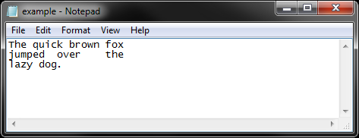
How is plain text stored in a file?
The text is encoded as a stream of numbers. Each number represents
a letter, symbol, or special character like tab or space.
Byte 00 84 104 101 32 113 117 105 99 107 32 98 114 111 119 110 32
T h e q u i c k b r o w n
Byte 16 102 111 120 10 106 117 109 112 101 100 9 111 118 101 114 9
f o x \n j u m p e d \t o v e r \t
Byte 32 116 104 101 10 108 97 122 121 32 100 111 103 46 10
t h e \n l a z y d o g . \n
Delimiter: a sequence of one or more characters used to specify the boundary between
separate, independent regions in plain text or other data streams
Special whitespace delimiters:
\t Tab = 9
\n End-of-line = 10
‘ ‘ Space = 32

Slide 14
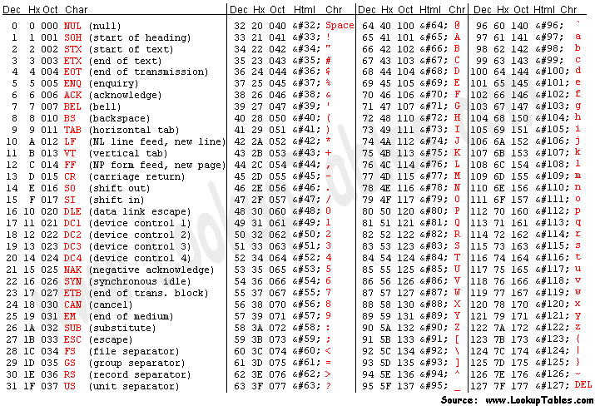
Who decided this? Enter the ASCII encoding from 1963
0000000 84 104 101 32 113 117 105 99 107 32 98 114 111 119 110 32
T h e q u i c k b r o w n
0000016 102 111 120 10 106 117 109 112 101 100 9 111 118 101 114 9
f o x \n j u m p e d \t o v e r \t
0000032 116 104 101 10 108 97 122 121 32 100 111 103 46 10
t h e \n l a z y d o g . \n
* ASCII = American Standard Code for Information Interchange

Slide 15
Be aware: A text file created on one platform (e.g. Windows) may use slightly different convention than another platform (e.g. Unix)
File saved with Windows/MS-DOS convention:
input_file = open('inputfile.txt', 'rU')
0000000 84 104 101 32 113 117 105 99 107 32 98 114 111 119 110 32
T h e q u i c k b r o w n
0000016 102 111 120 13 10 106 117 109 112 101 100 9 111 118 101 114
f o x \r \n j u m p e d \t o v e r
0000032 9 116 104 101 13 10 108 97 122 121 32 100 111 103 46 13
\t t h e \r \n l a z y d o g . \r
0000048 10
\n
File saved with Unix convention:
0000000 84 104 101 32 113 117 105 99 107 32 98 114 111 119 110 32
T h e q u i c k b r o w n
0000016 102 111 120 10 106 117 109 112 101 100 9 111 118 101 114 9
f o x \n j u m p e d \t o v e r \t
0000032 116 104 101 10 108 97 122 121 32 100 111 103 46 10
t h e \n l a z y d o g . \n

Slide 16
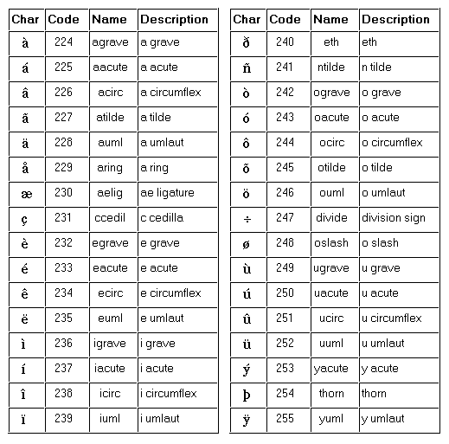
A character set specifies how numbers should be interpreted as character symbols
ASCII
7 bits per character (0-127) = 1 byte
Since 1960, from telegraph codes
ISO-Latin-1 (ISO-8859-1)
“Code page”
8-bit (0-255) = 1 byte
Superset of ASCII
Basis for original Web standard for HTTP and HTML
High-bit characters add e.g. accented characters for most ‘Western’ languages
Microsoft Windows ANSI similar variant
The last 32 characters of the ISO-Latin-1 encoding

Slide 17
There is no such thing as plain text.*
We live in a multilingual world
It doesn't make sense to have a string without knowing what encoding it uses.
To deal with textual data, you first have to know how to decode the text!
Every working programmer must know the basics of character sets, encodings.
Enter… Unicode.
*Source: http://www.joelonsoftware.com/articles/Unicode.html

Slide 18
Unicode
Encoding standard that covers more than 110,000 characters and more than 100 human languages.
Contains ISO-Latin-1: first 256 characters the same
First draft standard 1991: owned by Unicode Consortium
Beginning to replace ASCII and ISO character sets
In theory, 0x0 to 0x10FFFF (1,114,112 characters)
Almost every language and past/present symbol you can think of
Coming soon: Star Trek languages, e.g. Klingon: private use area
Implemented in most modern operating systems programming languages, and software
Including XML, Java, .NET framework, etc.
Source: http://www.joelonsoftware.com/articles/Unicode.html

Slide 19
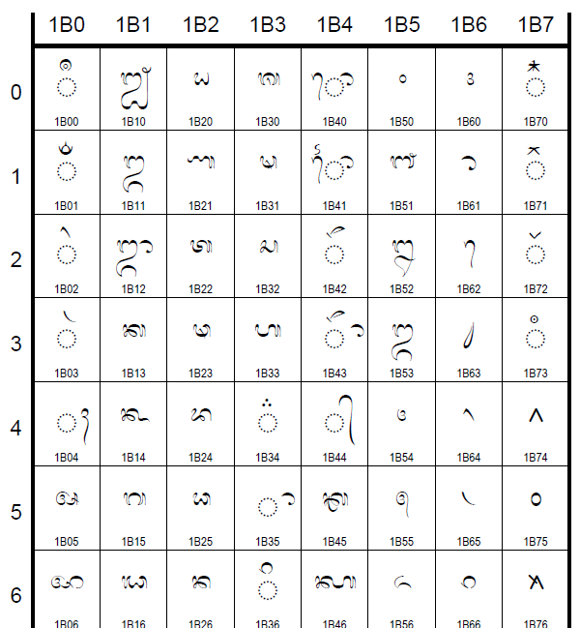
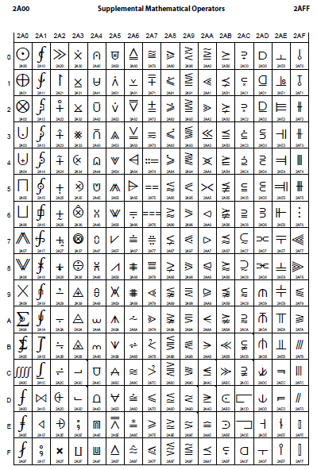
In case you needed convincing that Unicode is serious about being a universal encoding…
[Source: http://www.unicode.org/charts/PDF/U1B00.pdf http://www.unicode.org/charts/PDF/U2A00.pdf]

Slide 20
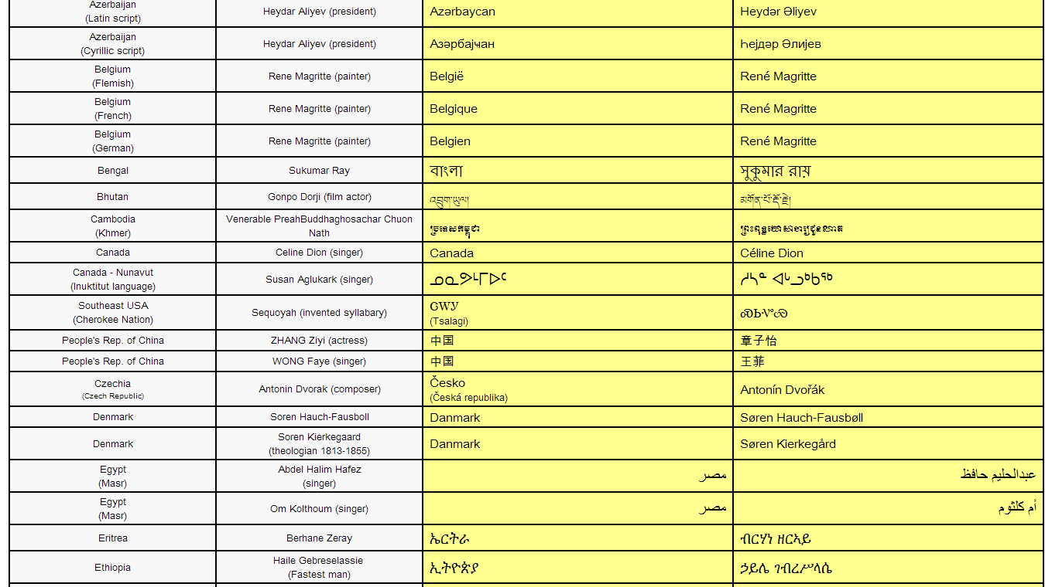
Unicode support in a correctly-implemented Web browser

Slide 21
Unicode characters: 'code points'
Every letter in every alphabet is assigned a magic number by the Unicode consortium, like this: U+0639. This magic number is called a code point.
The U+ means "Unicode" and the numbers are hexadecimal (base 16)
They’re all listed on the Unicode web site. (charmap utility in Windows)
HELLO
U+0048 U+0065 U+006C U+006C U+006F
Unicode can be stored in a file or string in many different ways, depending on efficiency considerations.
UTF-8 Encoding:
In UTF-8, every code point from 0-127 is stored in a single byte.
Only code points 128 and above are stored using 2, 3, in fact, up to 6 bytes.
Neat side effect: English text looks exactly the same in UTF-8 as it did in ASCII
Others include UTF-7, UCS-4
Encodings:
UTF-16: 00 48 00 65 00 6C 00 6C 00 6F (two bytes/char)
UTF-8: 48 65 6C 6C 6F
H E L L O
H E L L O

Slide 22
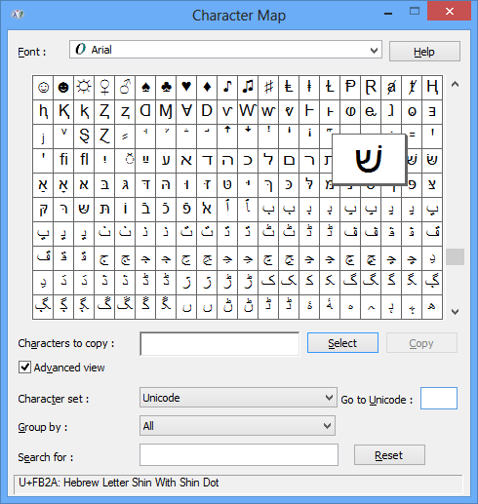
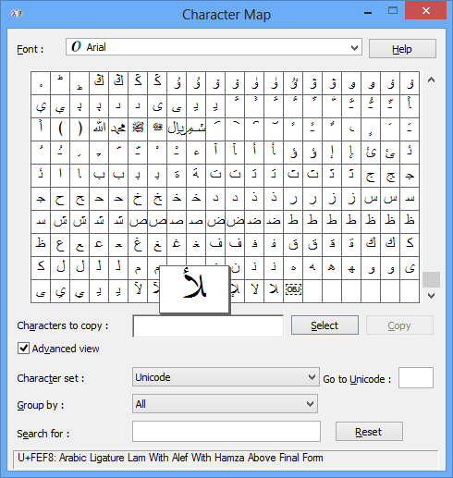
The Windows charmap utility

Slide 23
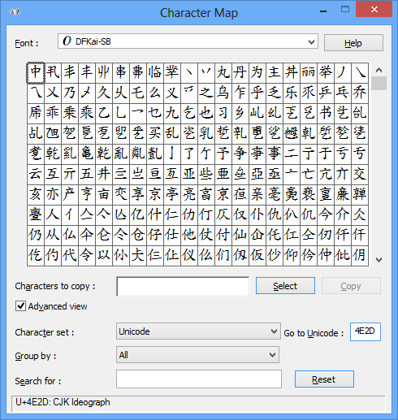
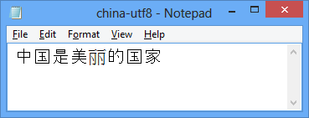
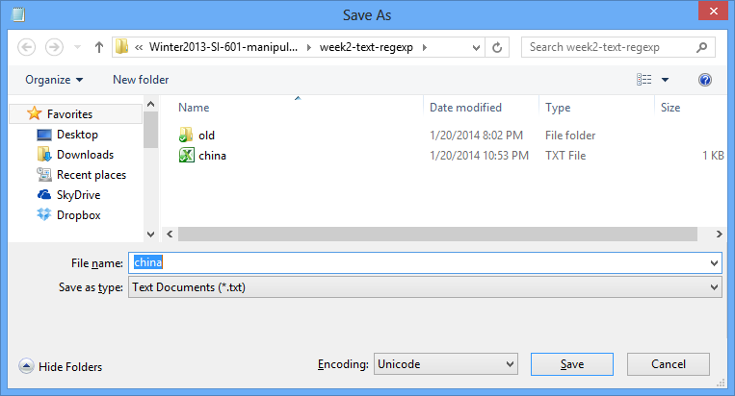
Special 16 bits flagging this as a Unicode file
中 国 是 美 丽
0000000 feff 4e2d 56fd 662f 7f8e 4e3d
0000016 7684 56fd 5bb6 3002
的 国 家 。

Slide 24
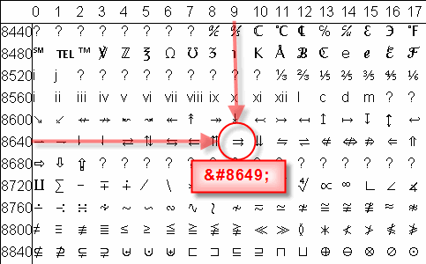
Unicode entities in HTML

Slide 25
Someone gives you a document. How do you know the encoding?
Email:
Content-Type: text/plain; charset="UTF-8"
HTML:
<html><head> <meta http-equiv="Content-Type" content="text/html; charset=utf-8">
Often missing, so clever browsers will try to figure out the language and encoding from the frequency distribution of byte patterns
Python scripts: First line special comment, e.g.
# -*- coding: utf-8 -*-
or
# -*- coding: latin-1 -*-

Slide 26
Python 2.x support for Unicode
In Python 2.5+, the default encoding for scripts is ASCII. (In Python 3, default is Unicode.)
Unicode strings prefixed with ‘u’ or ‘U’ : foo = u'abcdefghijk'
Unicode string constructor:
s = unicode('foo') # foo is an 8-bit string
Unicode strings have same 8-bit string methods for searching, formatting, e.g. s.find('bird')
Specific code points are written using the \u escape sequence, which is followed by four hex digits giving the code point.
>>> s = u'\u4e2d\u56fd'
>>> print s
中国
Source: http://docs.python.org/2/howto/unicode.html

Slide 27
Converting from Unicode to 8-bit strings in Python 2.x
The .encode method of a Unicode string converts it to an 8-bit string in the requested encoding
>>> s = u'\u4e2d\u56fd'
>>> s.encode('utf-8')
'\xe4\xb8\xad\xe5\x9b\xbd'
>>> print s.encode('utf-8')
中国
>>> s.encode('ascii') # what now?
Traceback (most recent call last):
...
UnicodeEncodeError: 'ascii' codec can't encode character u'\u4e2d' in position 0: ordinal not in range(128)
Reference: http://docs.python.org/2/howto/unicode.html

Slide 28
Converting from 8-bit strings to Unicode strings
Python 8-bit strings have a .decode method that converts to Unicode given the original encoding
>>> s = u'\u4e2d\u56fd' # original 16-bit unicode string
>>> utf8_version = s.encode('utf-8')
>>> type(utf8_version), utf8_version
(<type 'str'>, '\xe4\xb8\xad\xe5\x9b\xbd')
>>> u2 = utf8_version.decode('utf-8') # Convert UTF-8 to Unicode
>>> u == u2 # The two strings match
True

Slide 29
Regular expressions: Basics

Slide 30
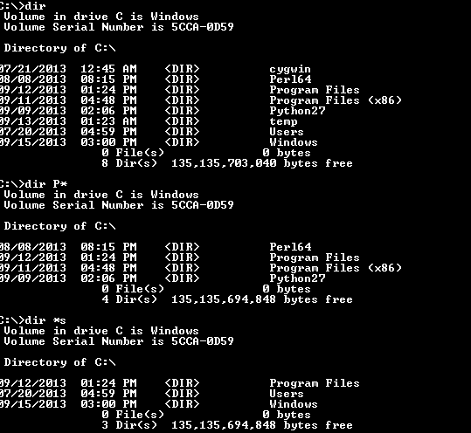
You may have seen some kinds of regular expressions before

Slide 31
Regular Expressions
A concise and flexible means to "match" (specify and recognize) strings of text, such as particular characters, words, or patterns of characters.
Similar regular expression syntax appears in many other tools
grep, flex, editors, ….
So you'll be able to re-apply most of what you learn here to other settings
Light bedtime reading:
Unicode standard regular expression guidelines
http://unicode.org/reports/tr18/

Slide 32
Python raw string notation: r'text'
Keeps regular expressions sane
Without it, every backslash '\' in a regexp would need '\' prefix
r'\n' is a two-character string containing '\' and 'n'
'\n' is a one-character string containing newline character
Use r'\\' instead of '\\\\'
Can be combined with Unicode 'u' prefix
>>> b = ur'\n'
>>> b
u'\\n'
>>> b.encode('utf-8')
'\\n'
>>> b.encode('utf-16')
'\xff \xfe \\ \x00n \x00' [ff fe \ 00 n 00]

Slide 33
The Python re module
Three Python functions:
re.match()checks for a match only at beginning of string
re.search()finds first occurrence of a pattern anywhere in string
re.findall()finds all occurrences of a pattern, not just first one
Some other regexp-enabled text operations:
re.split()
entries = re.split("\n+", text)
re.sub()
re.sub(r"(\w)(\w+)(\w)", repl, text)

Slide 34
help(re.match)
match(pattern, string, flags=0)
Try to apply the pattern at the start of the string, returning a match object, or None if no match was found.
Flag will be covered later.

Slide 35
help(re.search)
search(pattern, string, flags=0)
Scan through string looking for the first match to the pattern anywhere in the string, returning a match object, or None if no match was found.

Slide 36
A simple example
import re
str = 'a simple example!'
# want to see if ‘simple’ appears in the # test string match = re.search(r'simple', str)
if match: print 'found', match.group()
else: print 'did not find'

Slide 37
Basic Patterns
Ordinary characters just match themselves.
match = re.search(r'dog','The lazy dog went to sleep.') will match 'dog' in the right-hand string.
Special characters:
\t, \n, \r tab, newline, return
The meta-characters which do not match themselves because they have special meanings are:
. ^ $ * + ? { }[ ] \ | ( )
What fancier patterns can we put in here?
https://developers.google.com/edu/python/regular-expressions

Slide 38
Very important single-character regular expression symbols
^ Beginning of the line '^From: '
Yes: From: Kevyn No: It said, 'From:…
$ End of the line (just before newline) 'Michigan$'
Yes: Michigan\n No: Michigan, U.S.A.\n
. Matches any char except newline \n 'F..m:'
Yes: Farm: Yes: Foom: No: Firm.
\s matches whitespace 'Pine\sapple'
Yes: Pine apple No: Pinesapple
\S matches non-whitespace 'Pine\Spple'
Yes: Pineapple No: Pine pple

Slide 39
Escape character
What if we really want to look for '$'?
Use an escape character: BACKSLASH
Examples:
'\$19\.99' will match $19.99
'\\folder' will match \folder

Slide 40
More useful special commands
\d Decimal digit, 0-9
\D Matches any non-digit character.
\w Matches a 'word' character: a letter or digit or underscore.
Note that although "word" is the mnemonic for this, it
only matches a single word char, not a whole word.
\W Matches any non-word character.
\b Matches boundary between word \w and non-word \W chars: r'py\b' matches 'py', 'py.', or 'py!'
but not 'python', 'py3', 'py2'
\B Matches NOT at beginning or end of a word.
r'py\B' matches 'python', 'py3', 'py2'
but not 'py', 'py.', or 'py!'
https://developers.google.com/edu/python/regular-expressions

Slide 41
Wildcards and matching repetitions
* Zero or more of the previous thing
+ One or more of the previous thing
? Zero or one of the previous thing
{3} Matches exactly 3 of the previous thing
{3,6} Matches between 3 and 6 of the previous thing
{3,} Matches 3 or more of the previous thing

Slide 42
Wildcard examples
ab* will match ‘a’, ‘ab’, or ‘a’ followed by any number of ‘b’s.
ab+ will match ‘a’ followed by at least one ‘b’; It will not match just ‘a’.
ab? will match either ‘a’ or ‘ab’.

Slide 43
Sets, ranges and alternatives

Slide 44
Set of characters
[aeiou] Matches a single character in the given set {a, e, i, o, u}
[^aeiou] Matches a single character NOT in the given set {a, e, i, o, u}
Example:
What substrings does[aeiou]{2,} match in
The eerie wind said "Oooo" and "Rrr".
The eerie wind said "Oooo" and "Rrr".
Why not O?

Slide 45
How you would use this in Python with findall
>>> import re
>>> s = "The eerie wind said Oooo and Rrrr"
>>> match = re.findall(r'[aeiou]{2,}', s)
>>> match
['ee', 'ie', 'ai', 'ooo']

Slide 46
Ranges of characters can be defined using […] and combined with sets
Valid:
[A-Z] Upper Case Roman Alphabet
[a-z] Lower Case Roman Alphabet
[A-Za-z] Upper/Lower Case
[A-F] Upper Case (only A – F)
[0-9] All Digits \d
[a-zA-Z0-9_] \w
Invalid:
[a-Z]
[F-A]
[9-0]

Slide 47
Example using multiple operators
ˆX-.*:\s[0-9.]+
What does this say?
We want strings that start ('^') with X-
Followed by zero or more of any character '.*'
Then a colon (':') and a whitespace \s char.
After the whitespace, look for one or more characters
That are either a digit (0-9) or a period
Note that special characters are not active inside ranges, so '.' is treated as a period.

Slide 48
Example using multiple operators
ˆX-.*:\s[0-9.]+
Match? xX-abd:_487.3
Match? X-abd:_487.34.2
Match? X-:_.
Match? X-abd:_iii.3
No
Yes
Yes
No

Slide 49
Negation of Ranges of Regular Expressions
[^0-9] Anything BUT digits
[^a] Anything BUT a lower case a
[^A-Z] Anything BUT upper case letters
[^,] Anything BUT ,
What kind of strings does this match?
^[^^]
Match? ^foo
Match? foo^
Strings that start with a character that is NOT '^'
No
Yes

Slide 50
Defining alternatives using the pipe | metacharacter
th(is|at|e other)
matches 'this', 'that', or 'the other'
tha[nt]|re
matches 'than' 'that' or 're'
Each alternative can be a regular expression
(success | failure code: [0-9]+ | maybe[!?]*)
Pipe is never greedy. As the target string is scanned:
REs separated by '|' are tried from left to right.
When one pattern completely matches, that branch is accepted.
This means that once A matches, B will not be tested further.
Even if it would produce a longer overall match.
What does this match?
^(T|t)oday

Slide 51
Group Extraction
Problem:
Often you want to extract parts of the matching text for later use. e.g. find email addresses, and extract user and hostname.
Solution: Use parentheses to create groups showing the parts you want to save for later.
str = 'My email address is santa@umich.edu. Hohoho.'
match = re.search(r'([\w.-]+)@([\w.-]+)', str)
if match:
print match.group() # the whole match
print match.group(1) # the username part
print match.group(2) # the hostname part
Group 1
Group 2

Slide 52
Help(re.findall)
findall(pattern, string, flags=0)
Return a list of all non-overlapping matches in the string.
If one or more groups are present in the pattern, return a list of groups.
This will be a list of tuples if the pattern has more than one group.
Empty matches are included in the result.

Slide 53
findall() Example
str = 'I have two email addresses: santa@umich.edu \ and santa@northpole.org. Hohoho.'
# Here re.findall() returns a list of all the found # email strings
emails = re.findall(r'[\w\.-]+@[\w\.-]+', str)
['santa@umich.edu', 'santa@northpole.org']

Slide 54
findall() and Group Extraction
str = 'I have two email addresses: santa@umich.edu \ and santa@northpole.org. Hohoho.'
# Here re.findall() returns a list of all the found # email strings
emails = re.findall(r'([\w\.-]+)@([\w\.-]+)', str)
email[0] = ('santa', 'umich.edu')
email[1] = ('santa', 'northpole.org')

Slide 55
Very useful power: You can refer back to an earlier group match within the same regular expression. How?
\N where N is the group number
\1 matches group 1 result
Example:
r'<(.*?)>(.*?)</\1>'
Matches tag pairs with matching begin/end tags
<X>foobar</X> <ABCD>baz</ABCD>

Slide 56
Advanced matching: more subtle ways to modify *
Greedy vs. non-greedy matching
Zero-width lookahead

Slide 57
Options
The option flag can be added as an extra argument to search(), findall() etc.,
e.g. re.search(pat, str, re.IGNORECASE)
re.IGNORECASE Ignore upper/lowercase differences for matching, so 'a' matches both 'a' and 'A'.
re.DOTALL Make the '.' special character match any character at all, including a newline; without this flag, '.' will match anything except a newline.
re.MULTILINE Within a string made of many lines, allow ^ and $ to match the start and end of each line. Normally ^/$ would just match the start and end of the whole string.
re.UNICODE Match against Unicode strings: invoke Unicode character properties for word-vs-nonword characters, etc.

Slide 58
Greedy Matching is the Default
Python always tries to match as much as possible.
Example:
str = 'the cat in the hat'
match = re.search(r'^(.*)(at)(.*)$', str)
Now, what do we have in
match.group(1), match.group(2), match.group(3)?
'the cat in the h'
'at'
''

Slide 59
Non-greedy Matching: Add an extra ? To your wildcard
Non-greedy versions try to match as minimally as possible.
?? ,*? , +?, and {}?
Example 1:
x = 'the cat in the hat';
match = re.search(r'^(.*?)(at)(.*)$', str)
Now, what do we have in
match.group(1), match.group(2) and match.group(3)?
'the c' 'at' ' in the hat'
Example 2: <H1>title</H1> <.*> will match the whole string. <.*?> will match <H1>

Slide 60
Stop and look ahead: zero-width matching
Problem:
We want to match any single character q that is not followed by u?
Why not use q[^u]
Means: q followed by a character that is not a u
Iraqi population
q[^u] returns qi (q followed by i). This is two characters.
What's the problem?
The regexp matcher has just 'used up' the i as part of this match and is now looking past it, at the 'space' character.
But the 'i' may be important in an upcoming regexp match
Solution: check for the presence of 'not u' without letting regexp 'eat' it…
You do this by using a zero-width negative lookahead assertion q(?!u)
Assertions do not 'use up' characters: they are zero-width, like start/end of line, or start/end of word
This will match the single character q only, not trailing letters

Slide 61
Other types of zero-width assertions
Negative lookbehind assertion:
(?<!abc)def will not match abcdef, but will match acbdef
Positive lookbehind assertion(?<=abc)def will first match def, then back up 3 characters and check for the contained pattern abc.
What does (?<=-)\w+ do?
Matches a word preceded by a hyphen
m = re.search('(?<=-)\w+','hard-boiled')
m.group(0): 'boiled'

Slide 62
What you should know
How to write useful types of text matching patterns as regular expressions
How to specify and extract groups in a match
How to use the python re library functions to search and extract all matches in a text

Slide 63
Week 2 Review Resources
Readings:
Severance, Chapter 11
Excellent free online tool for debugging your tricky regexps:
http://gskinner.com/RegExr/
http://www.gskinner.com/RegExr/desktop/
Other references:
https://developers.google.com/edu/python/regular-expressions
http://docs.python.org/2/howto/regex.html
http://docs.python.org/2/library/re.html

Slide 64
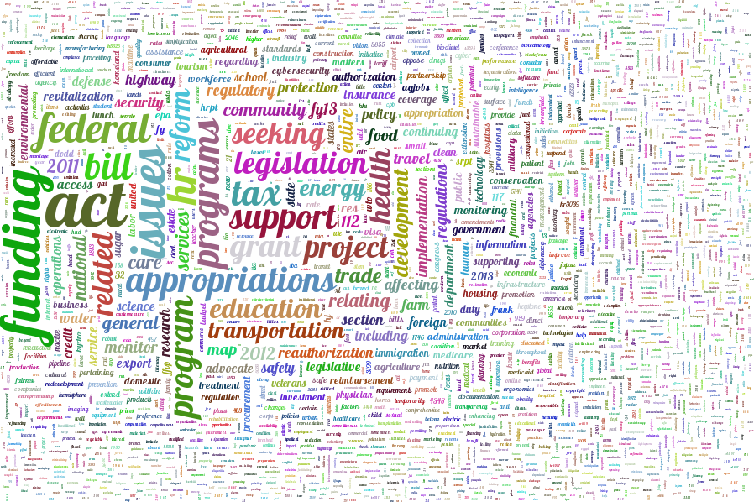
Next week sneak peak: XML, JSON, Web APIs
<?xml version='1.0' encoding='UTF-16'?>
<PublicFilings>
<Filing ID="306B3144-3E4F-48CF-98F1-C6BF455B6A6B" Year="2012" Received="2013-01-01T00:58:03.067" Amount="15000" Type="FOURTH QUARTER REPORT" Period="4th Quarter (Oct 1 - Dec 31)"><Registrant xmlns="" RegistrantID="6848" RegistrantName="Marshall Brachman" GeneralDescription="lobbyist" Address="634 A Street, NE&#xD;&#xA;Washington, DC 20002" RegistrantCountry="USA" RegistrantPPBCountry="USA" /><Client xmlns="" ClientName="ADAMS COUNTY COLORADO" GeneralDescription="" ClientID="12" SelfFiler="FALSE" ContactFullname="MARSHALL BRACHMAN" IsStateOrLocalGov="TRUE" ClientCountry="USA" ClientPPBCountry="USA" ClientState="" ClientPPBState="" /><Lobbyists><Lobbyist xmlns="" LobbyistName="BRACHMAN, MARSHALL A" LobbyistCoveredGovPositionIndicator="NOT COVERED" OfficialPosition="" /></Lobbyists><GovernmentEntities><GovernmentEntity xmlns="" GovEntityName="SENATE" /><GovernmentEntity xmlns="" GovEntityName="Federal Aviation Administration (FAA)" /><GovernmentEntity xmlns="" GovEntityName="HOUSE OF REPRESENTATIVES" /></GovernmentEntities><Issues><Issue xmlns="" Code="BUDGET/APPROPRIATIONS" SpecificIssue="DERA funding regarding Rocky Mountain Arsenal&#xA;DoD Appropriations for the above&#xA;TTHUD funding for railroad grade separation&#xA;funding for contract tower program and commercial flight program" /><Issue xmlns="" Code="DEFENSE" SpecificIssue="DERA funding regarding Rocky Mountain Arsenal&#xA;DoD Authorization" /><Issue xmlns="" Code="NATURAL RESOURCES" SpecificIssue="land trade issues regarding the Rocky Mountain Arsenal NWP" /></Issues></Filing>

Slide 65
Lab 2: Regular expressions

Slide 66
Additional slides

Slide 67
Substitution
sub(pattern, repl, string, count=0, flags=0)
Return the string obtained by replacing the leftmost non-overlapping occurrences of the pattern in string by the replacement repl.
repl can be either a string or a callable.
If a string, backslash escapes in it are processed.
If it is a callable, it's passed the match object and must return a replacement string to be used.

Slide 68
Substitution Example
str = 'My email is santa@umich.edu. Hohoho.'
print re.sub(r'@[\w\.-]+', '@northpole.org', str)
# prints out My email is santa@northpole.org Hohoho.

Slide 69
Compile regex Patterns
If a regex pattern is going to be reused, it is a good idea to compile it first.
Example:
p = re.compile('\d+')
# search demo
m = p.search('12 drummers drumming, 11 pipers piping, 10 lords a-leaping')
if m:
print 'Match found: ', m.group()
else:
print 'No match'
# findall demo
print p.findall('12 drummers drumming, 11 pipers piping, 10 lords a-leaping')

