Slide 1
SI 618: Large-scale distributed computation 2
Fall 2017
Instructor: Ceren Budak
Some slides courtesy of Kevyn Collins-Thompson and Yuhang Wang

Slide 2
Reminder: Project I Proposal due next week
Proposals due October 3, the project itself is due October 24
Proposal Guidelines (100 points):
(20 points) Summarize and motivate your proposed project.
(20 points) Choose and describe (at least) two different datasets.
(20 points) Describe how you might manipulate and join the two datasets.
(30 points) Describe at least three map-reduce tasks you will perform to gain insights from the datasets (you can use mrjob, spark or sparksql)
Clarification since last week: Each task should result in one meaningful analysis.
(10 points) Describe at least one visualization you might create that highlights insights you hope to gain
You can propose an alternative project structure with prior approval (you need to contact me for this)

Slide 3
Lecture Plan
Go over a Spark example together
SparkSQL

Slide 4
Spark Example: Yelp Sentiment Analysis
Goal: identify words that are indicative of positive or negative reviews
Input: yelp reviews data
Output: A list of most positive and most negative words

Slide 5
How to find positive words
Any ideas?
We will compute the following "positivity" score for each word w.
Positivity(w) = log P(w in PositiveReviews) – log P(w in AllReviews)
where P(·) denotes probability
log(x) is the natural logarithm of x.
P(w in PositiveReviews) means the probability that a word occurs, given we are looking at the set of positive reviews.
P(w in AllReviews) means the probability of a word occurring, given that we are looking at all
Same formula for negative words

Slide 6
Finding positive words
Say, ‘awesome’ appears 10 times in positive reviews, and all positive reviews together contain 10000 words. Furthermore, say, ‘awesome’ appears 20 times in all reviews, and there are 100000 words in all reviews, Then, positivity score of ‘awesome’ is:
Positivity(awesome) = log P(awesome in PositiveReviews) – log P(awesome in AllReviews) = log(0.001) – log(0.0002) = -6.9 – (-8.51) = 1.61
Words that are more neutral, like ‘the’, that have similar probability given a positive review compared to any review, should have a positivity score close to zero.
How to define positive reviews (and similarly negative reviews)?

Slide 7
Let’s code together…

Slide 8
More about Spark
Tired of using tuple indices? Use DataFrames instead of RDDs and find fields by their names
We can also run SQL queries on the DataFrames
DataFrames can be created from RDDs, or loaded from data fileshttps://spark.apache.org/docs/1.3.0/sql-programming-guide.html
DataFrame operations:https://spark.apache.org/docs/1.3.0/api/python/pyspark.sql.html#pyspark.sql.DataFrame

Slide 9
Spark Components
Spark SQL (SQL)
Spark Streaming
(real-time)
GraphX
(graph)
MLlib
(machine learning)
Spark SQL(SQL on Spark)
Spark Streaming (stream processing)
GraphX (graph processing)
MLlib (machine learning library)
…
Spark Core

Slide 10
Spark vs. SQL
Two Paradigms
MapReduce
+ parallelism abstractions make it easy to run distributed computation
+ flexible, complete programming language
-programmer responsible for optimizations
-difficult/inefficient for many queries (join)
SQL
+ Easy for certain operations like filter, join
+ Optimizations built-in
+ Simple, declarative query statements
-must perform ETL on data
-doesn't scale well
-hard to perform iteration, row-by-row

Slide 11
SparkSQL
What is Spark SQL?
Tries to allow users to have the advantages of both without the disadvantages of either
Make it easier to construct a “pipeline” or mix of SQL queries fed into procedural constructs, similar to FlumeJava or DryadLINQ
Transforms SQL operations into RDD operations
Data can be loaded from HDFS
Stores data in memory
Supports both relational and Spark-style queries
Provides a configurable optimization engine

Slide 12
SparkSQL predecessor
Shark: Spark SQL predecessor
+ Extended Hive to run on top of Spark
+ Implemented optimizations that are common in RDBMS
- only worked with external data stored in HDFS, not on native RDDs
-optimizations were limited to those for MapReduce
-only usable through forming SQL queries

Slide 13
Datasets and DataFrames
A Dataset is a distributed collection of data
A Dataset can be constructed from JVM objects and then manipulated using functional transformations (map, flatMap, etc.)
The Dataset API is available in Scala and Java
A DataFrame is a Dataset organized into named columns
It is conceptually equivalent to a table in a relational database or a data frame in R/Python, but with richer optimizations
An abstraction for selecting, filtering, aggregating and plotting structured data

Slide 14
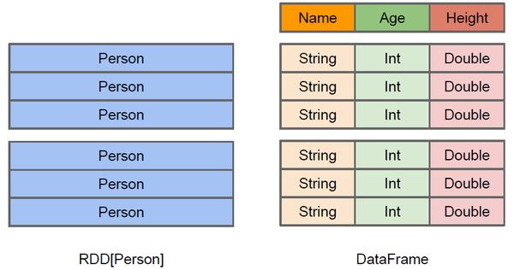
Difference between DataFrame and RDD
DataFrame more like a traditional database of two-dimensional form, in addition to data, but also to grasp the structural information of the data, that is, schema
RDD[Person] although with Person for type parameters, but the Spark framework itself does not understand internal structure of Person class
DataFrame has provided a detailed structural information, making Spark SQL can clearly know what columns are included in the dataset, and what is the name and type of each column. Thus Spark SQL query optimizer can target optimization

Slide 15
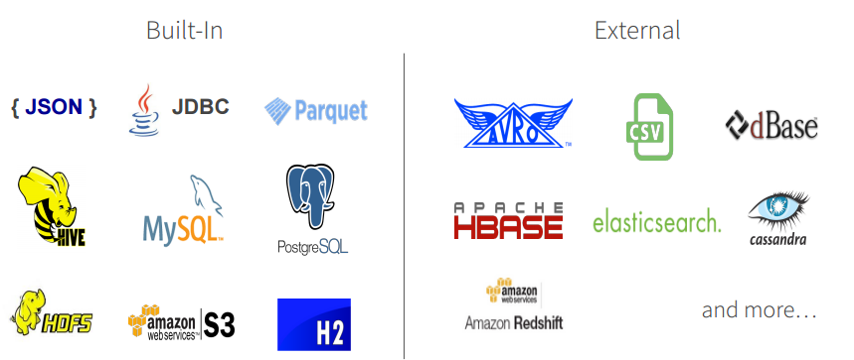
DataFrame Data Sources
Spark SQL’s Data Source API can read and write DataFrames using a variety of formats.
E.g., structured data files, tables in Hive, external databases, or existing RDDs

Slide 16
DataFrames
Can embed relational style queries inside of a non-declarative language
Allows use of things like loop constructs and conditionals surrounding SQL-style queries
Can access, name, and use intermediate results of those queries
Spark-style lazy-eval allows optimization (more on this later)
Immediate error detection and response despite lazy-evaluation

Slide 17
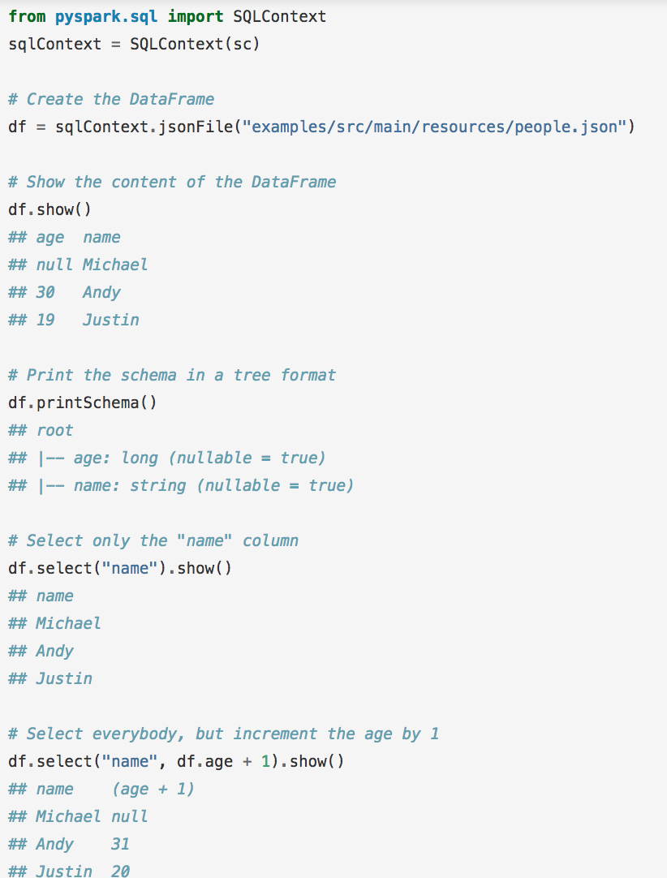
Spark SQL

Slide 18
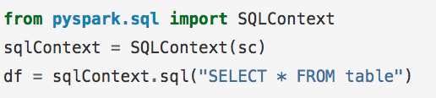
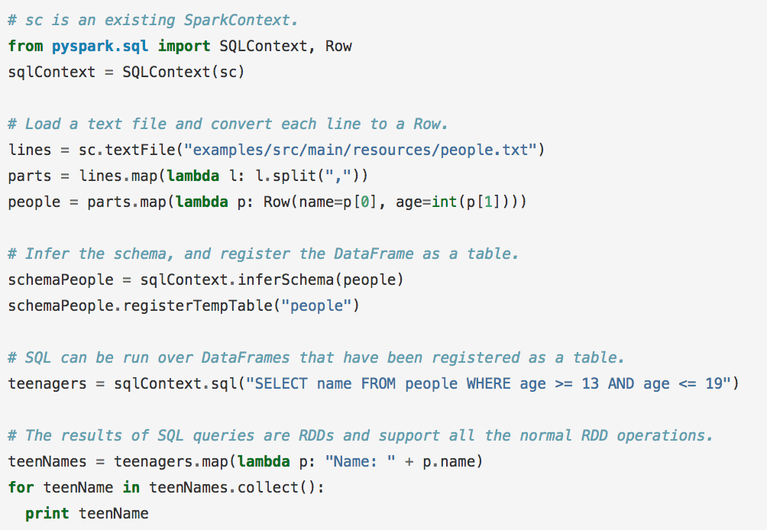
Spark SQL
Can infer a schema from semi-structured data (neat!)
Passes over data, finds the most specific but sufficient Spark SQL data-type that covers all instances of a field
Find all instances of field, find largest matching data type, and set that as the “type” of that column

Slide 19
Query Execution
Catalyst Optimizer
“At its core, Catalyst contains a general library for representing trees and applying rules to manipulate them.”
Trees consist of nodes, which have a type and 0+ children.
Rules are functions that transform a tree from one state to another, usually using pattern matching native to functional languages.

Slide 20
Execution stages
Four Stages
Analysis
Takes a query, finds the matching relation from the Catalog, performs type matching, and resolves aliases
Logical optimization
Performs basic rule-based optimization to transform the tree (for example, simplifying a boolean expression)
Physical planning
generates plans based on the physical layout of the data and the costs of those plans
Code Generation
uses quasiquotes to generate Java bytecode

Slide 21
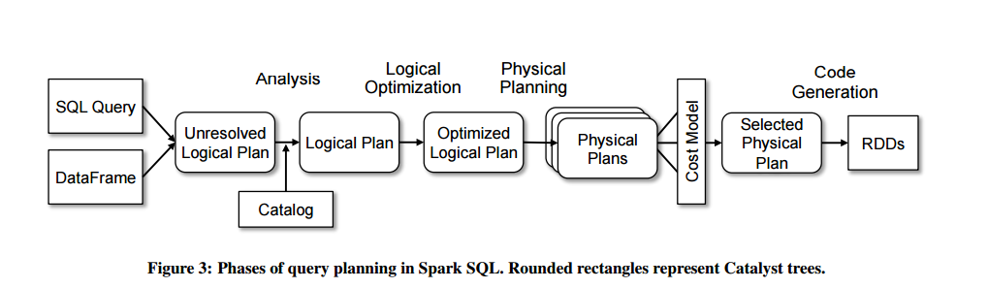
Execution stages
Query Planning Diagram

Slide 22
Resources: Spark Documentation
https://spark.apache.org/docs/latest/quick-start.html
https://spark.apache.org/docs/latest/programming-guide.html
https://spark.apache.org/docs/latest/api/python/index.html

Slide 23
Resources: Spark on Fladoop
http://arc-ts.umich.edu/hadoop-user-guide/

Slide 24
Now lets go through a SparkSQL example

