Slide 1
T-Time v.s. D-Time

Slide 2
Machine Learning

Slide 3
In 2006, the online movie company Netflix held the first "Netflix Prize" competition to find a program to better predict user preferences and improve the accuracy on its existing Cinematch movie recommendation algorithm by at least 10%. A joint team made up of researchers from AT&T Labs-Research in collaboration with the teams Big Chaos and Pragmatic Theory built an ensemble model to win the Grand Prize in 2009 for $1 million.

Slide 4
关联规则
Apriori

Slide 5
关联规则的目的在于在一个数据集中找出项之间的关系，也称之为购物蓝分析 (market basket analysis)。例如，购买鞋的顾客，有10%的可能也会买袜子，60%的买面包的顾客，也会买牛奶。这其中最有名的例子就是"尿布和啤酒"的故事了。
关联规则的应用场合。在商业销售上，关联规则可用于交叉销售，以得到更大的收入；在保险业务方面，如果出现了不常见的索赔要求组合，则可能为欺诈，需要作进一步的调查。在医疗方面，可找出可能的治疗组合；在银行方面，对顾客进行分析，可以推荐感兴趣的服务等等。

Slide 6
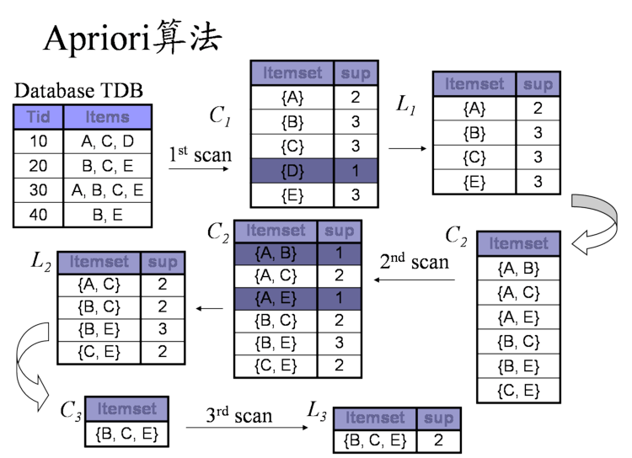

Slide 7
Demo

Slide 8
遗传算法

Slide 9
Genetic algorithm
In the computer science field of artificial intelligence, genetic algorithm (GA) is a search heuristic that mimics the process of natural selection. This heuristic (also sometimes called a metaheuristic) is routinely used to generate useful solutions to optimization and search problems. Genetic algorithms belong to the larger class of evolutionary algorithms (EA), which generate solutions to optimization problems using techniques inspired by natural evolution, such as inheritance, mutation, selection, and crossover.
Genetic algorithms find application in bioinformatics, phylogenetics, computational science, engineering, economics, chemistry, manufacturing, mathematics, physics, pharmacometrics and other fields.

Slide 10
Bayesian inference

Slide 12
支撑向量机

