Slide 1
T-Time v.s. D-Time

Slide 2
Machine Learning

Slide 3
关联规则
Apriori

Slide 4
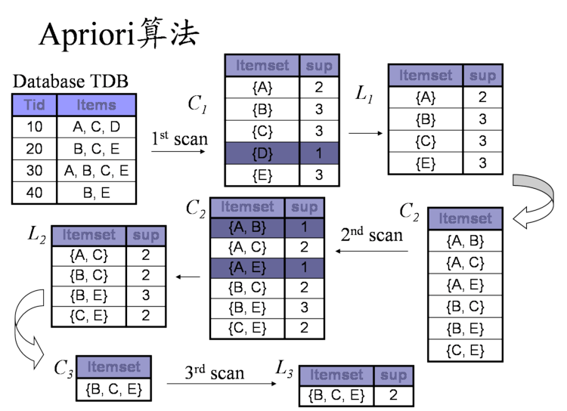

Slide 5
Demo

Slide 6
遗传算法

Slide 7
Genetic algorithm
In the computer science field of artificial intelligence, genetic algorithm (GA) is a search heuristic that mimics the process of natural selection. This heuristic (also sometimes called a metaheuristic) is routinely used to generate useful solutions to optimization and search problems. Genetic algorithms belong to the larger class of evolutionary algorithms (EA), which generate solutions to optimization problems using techniques inspired by natural evolution, such as inheritance, mutation, selection, and crossover.
Genetic algorithms find application in bioinformatics, phylogenetics, computational science, engineering, economics, chemistry, manufacturing, mathematics, physics, pharmacometrics and other fields.

Slide 8
回归分析

Slide 10
支撑向量机

