Slide 1
What the ODyn data can actually support
An exploratory pass over 44 sessions of bulbar dopaminergic imaging, run to decide what is worth reporting before the figures are built.
404,415 unit–odor rows · 6 cohorts, 13 mice · 16-odor panel, pre/post ket-xyl · 2026-08-30
Notes:
Coverage, signed responses, population geometry and arousal coupling. Everything here is descriptive; the conclusions are now implemented in the figure code.

Slide 2
The design decides what can carry weight
The animal-level structure inverts the intuitive ordering of the comparisons.
4
2
1–11
TH mice, each with 10x, superficial and deep 20x
DAT mice at 10x and 2 Thy1 mice
trials per odor within a single session
• TH superficial vs deep is a within-mouse contrast in all four TH animals, and pre/post ket-xyl is within-session and within-field. Those two carry the weight.
• The headline TH vs DAT line comparison rests on two DAT animals, so it stays descriptive.
• Depth is not confounded with line: TH deep 110–200 um, TH superficial 54–103, DAT superficial 53–77.
Notes:
Reported between-line contrasts descriptively with every mouse shown; inferential effort went to the paired designs.

Slide 3
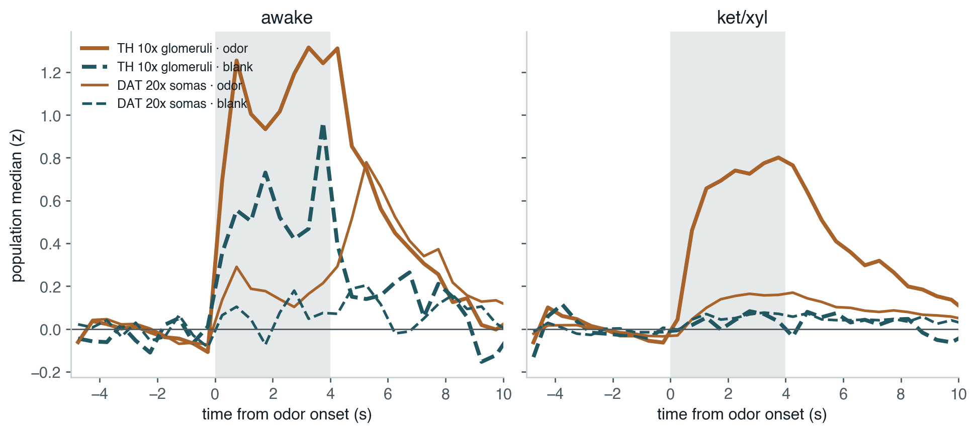
Mineral oil is not a null stimulus
It crosses an excitation threshold in 16–87% of unit–odor pairs, where the nominal rate is 5%.
Population median response, blank against real odors. The pre-odor baseline is flat, so this is not drift. Awake, the blank drives TH glomeruli to roughly two thirds of the real-odor response; at 20x it sits near zero.
Notes:
Consequence: thresholds referenced to mineral oil shift between conditions for reasons unrelated to odor coding, and the blank response is strongly session-dependent. Detection now references pre-odor excursions instead.

Slide 4
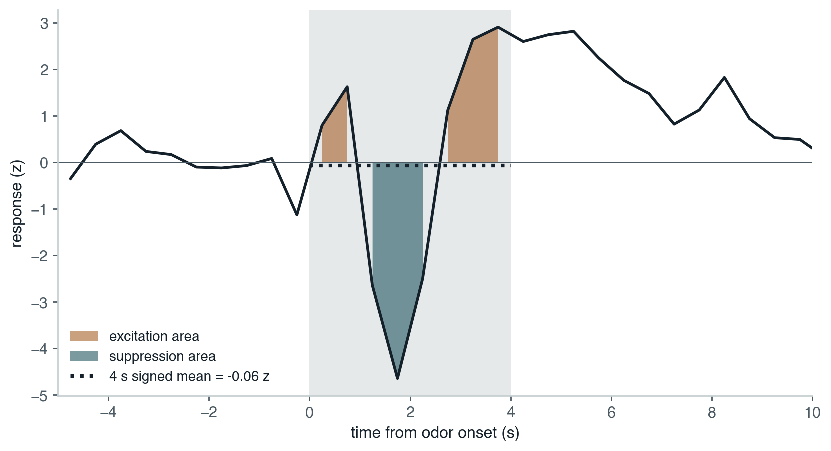
The four-second mean hides most of the structure
Of genuinely bidirectional unit–odor pairs, the signed mean misses 69–88% awake.
One real TH 10x unit. Within the odor window the response goes +1.6, then −4.7, then +2.9 — and its signed four-second mean is −0.06 z. Excitation and suppression are now integrated separately.
Notes:
Across all pairs the trace method finds a response in 54-96% where the mean-based call finds one in 12-66%.

Slide 5
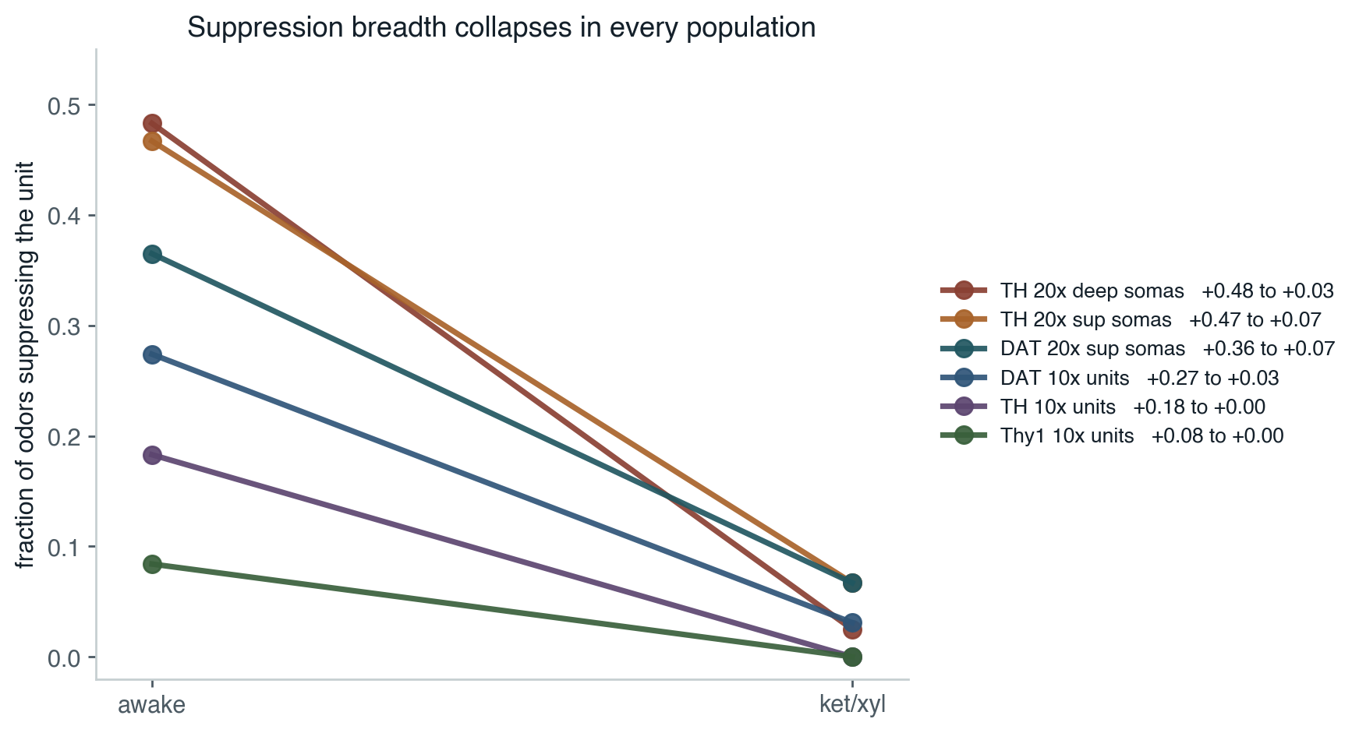
Anesthesia abolishes suppression, everywhere
The largest and most consistent effect in the dataset, and a within-session contrast.
Suppression breadth, mice as sampling units. Every cohort and both compartments move the same way.
Notes:
This independently confirms the qualitative read of the group-202 z-score movies.

Slide 6
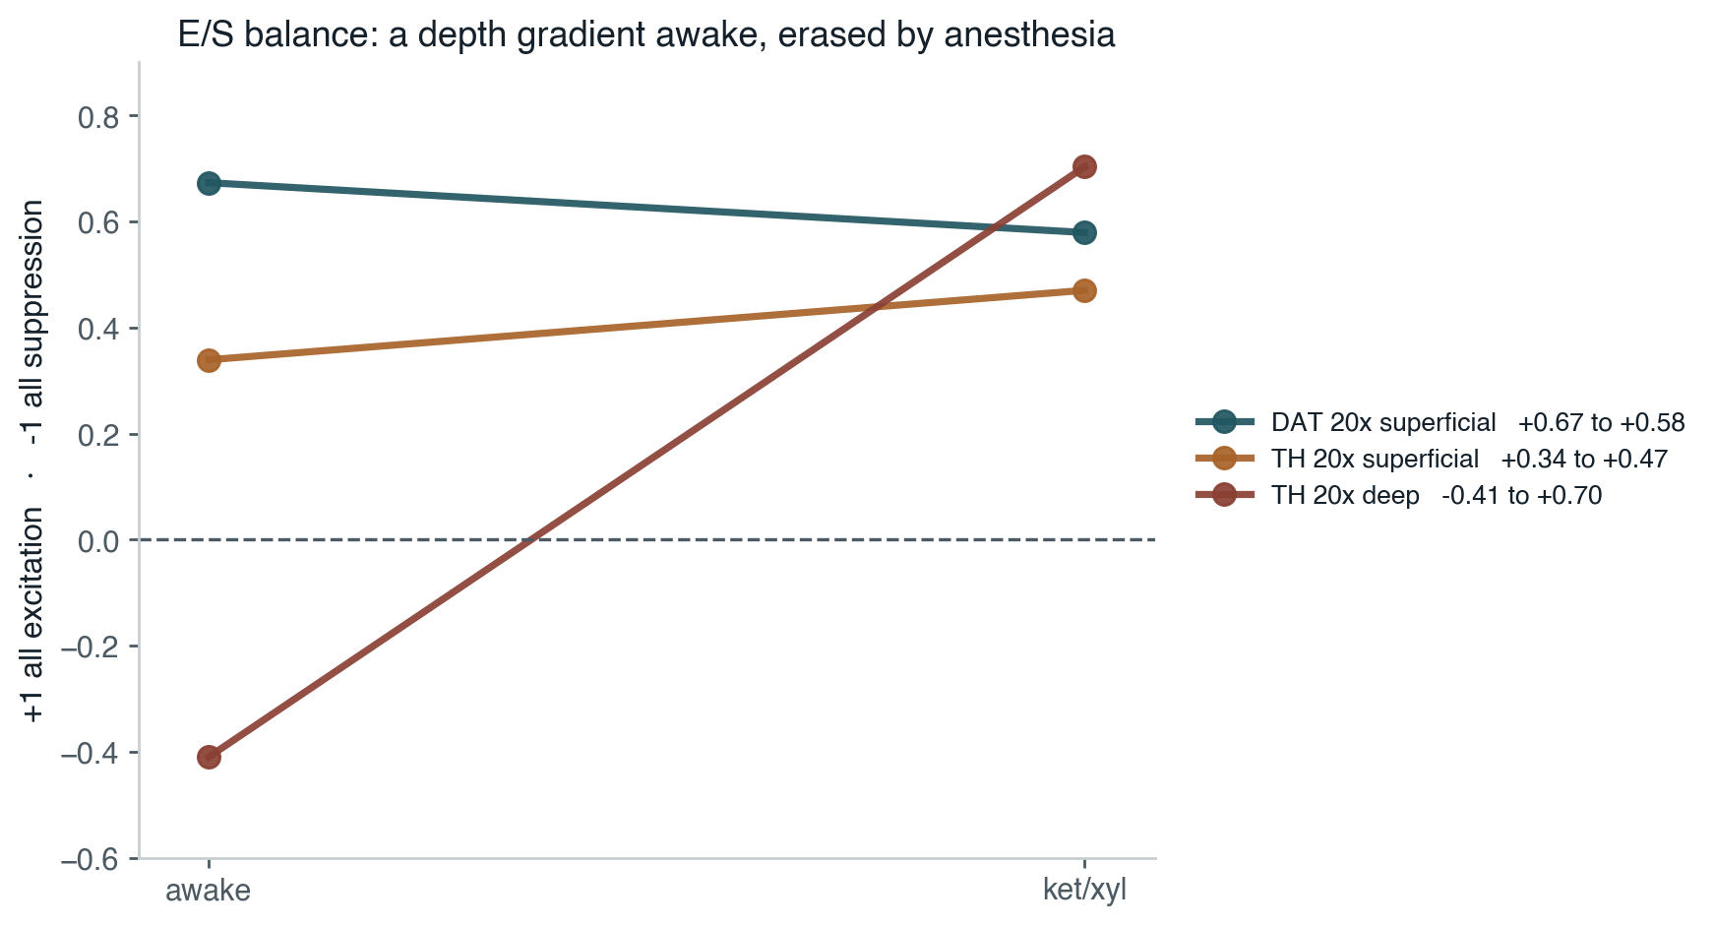
A depth gradient in excitation/suppression balance
TH deep is the only suppression-dominated population awake — and the most excitatory under ket/xyl.
Awake somatic balance orders monotonically: DAT superficial +0.67, TH superficial +0.34, TH deep −0.41. Awake TH deep somata have a median odor response of −0.19 z.
Notes:
The TH superficial vs deep contrast is within-mouse in all four TH animals, so this is the strongest between-population claim available.

Slide 7
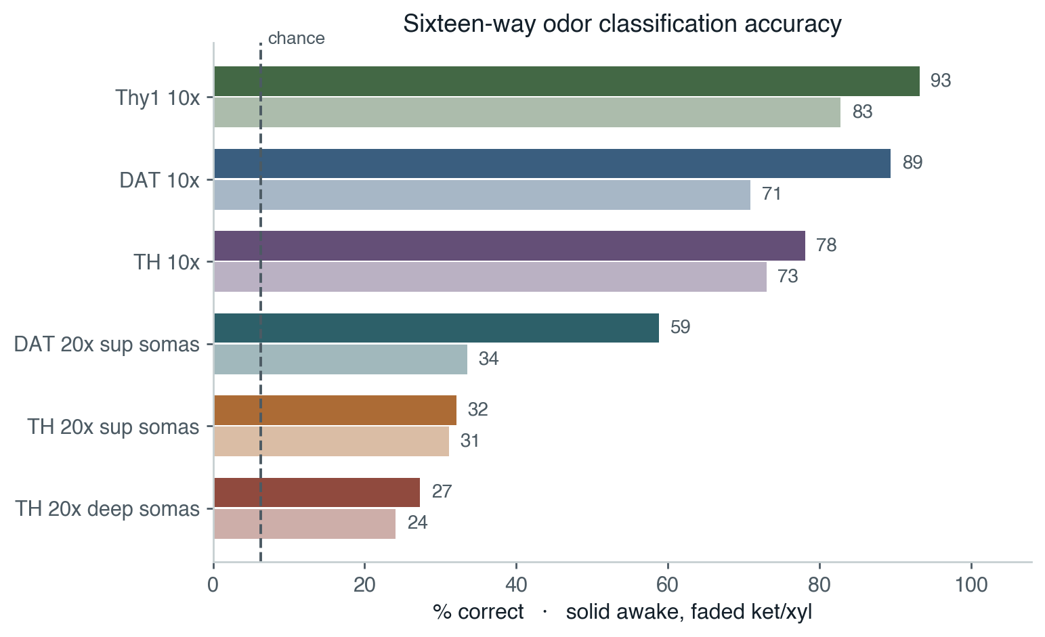
How much odor information each population carries
Every population is well above chance — TH deep still classifies 16 odors at four times chance.
Leave-one-trial-out nearest centroid across the whole panel. The 10x/20x gap is expected: 20x samples a small subset of spatially distributed labeled-line input channels.
Notes:
Thy1 is the most informative population in the dataset, which supports using it as the 10x anchor.

Slide 8
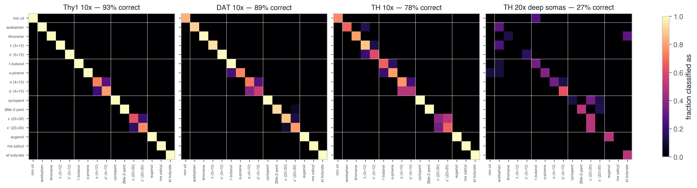
What gets mistaken for what
Mixtures are confused with their reciprocal partner, never with their components.
Odors ordered so each mixture sits beside its two components. In Thy1 the only off-diagonal mass is alpha vs alpha-prime and epsilon vs epsilon-prime; lambda/lambda-prime is fully resolved.
Notes:
Ratio is the only failure mode, and it fails for two of the three pairs.

Slide 9
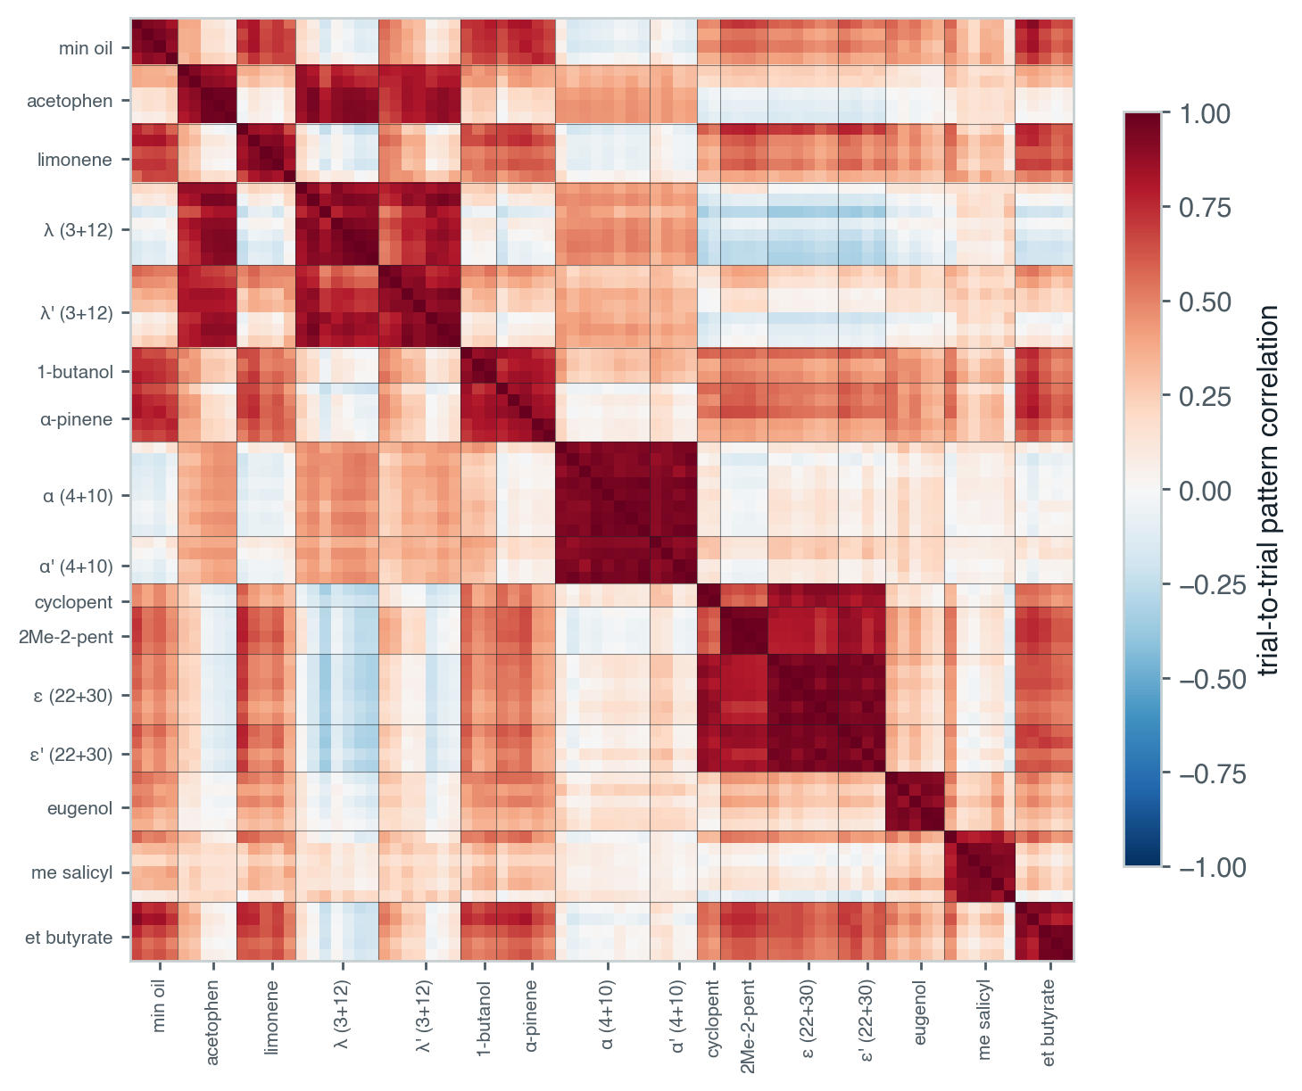
The three mixture families are not alike
Whether ratios are discriminable may be downstream of how a mixture relates to its components.
Every awake trial against every other, one Thy1 session. Alpha is a novel pattern unlike either component; epsilon forms one block with its components; lambda sits between and is the pair whose ratios separate.
Notes:
Testable without more data. This is the most hypothesis-generating view of the three.

Slide 10
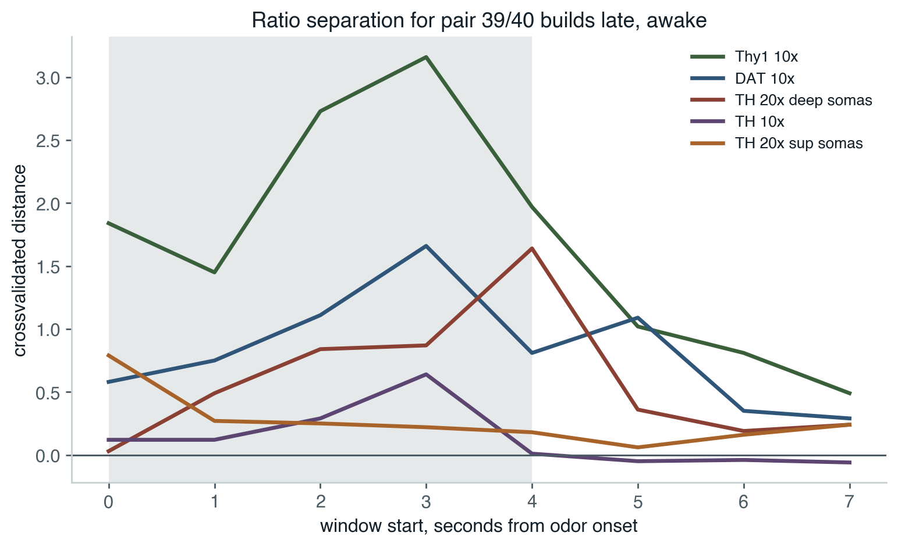
Ratio separation builds late
Only pair 39/40 separates above chance, and a 0–4 s integral dilutes it.
Pair 39/40, awake. Separation peaks in the final second, and for TH deep somata after offset entirely. Pairs 17/18 and 31/32 sit at the noise floor in every window. Mixture work is parked until there is more data.
Notes:
Permutation p<0.05 rate pooled over windows and cohorts: 39/40 at 0.276, 17/18 at 0.090, 31/32 at 0.055 against 0.05 expected.

Slide 11
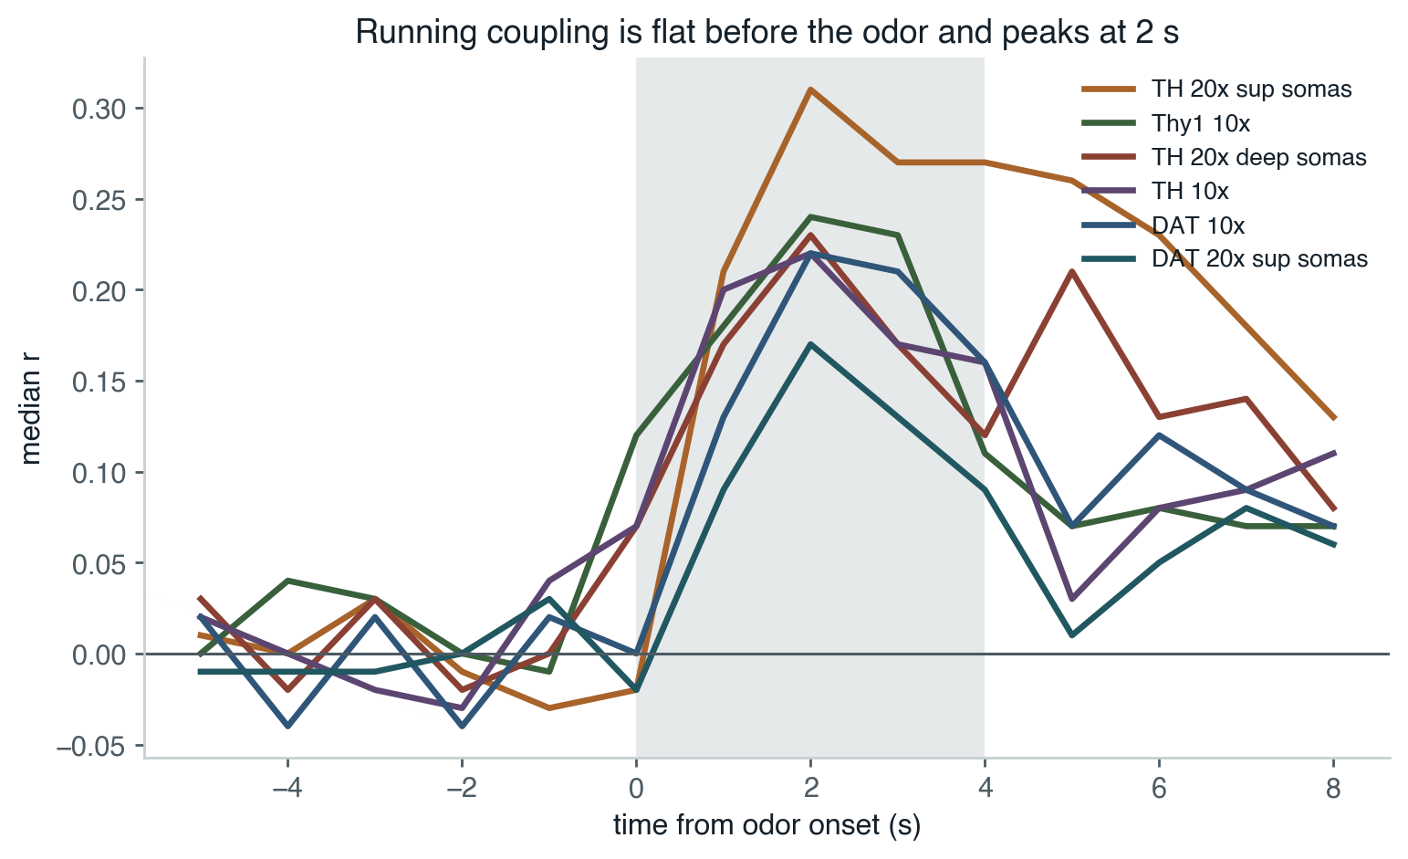
Arousal amplifies responses, it does not suppress them
Opposite sign to the NE-suppression hypothesis, and not motion artifact.
Running coupling is flat across the whole pre-odor window, rises 1 s after onset and peaks at 2 s. Running occurs in the baseline window too, so an artifact would appear there. It does not.
Notes:
Baseline coupling -0.002 against +0.190 in the odor window; only 4 of 57 cases have baseline >= odor, p<0.0001. Split by response sign: excited +0.287, suppressed +0.063.

Slide 12
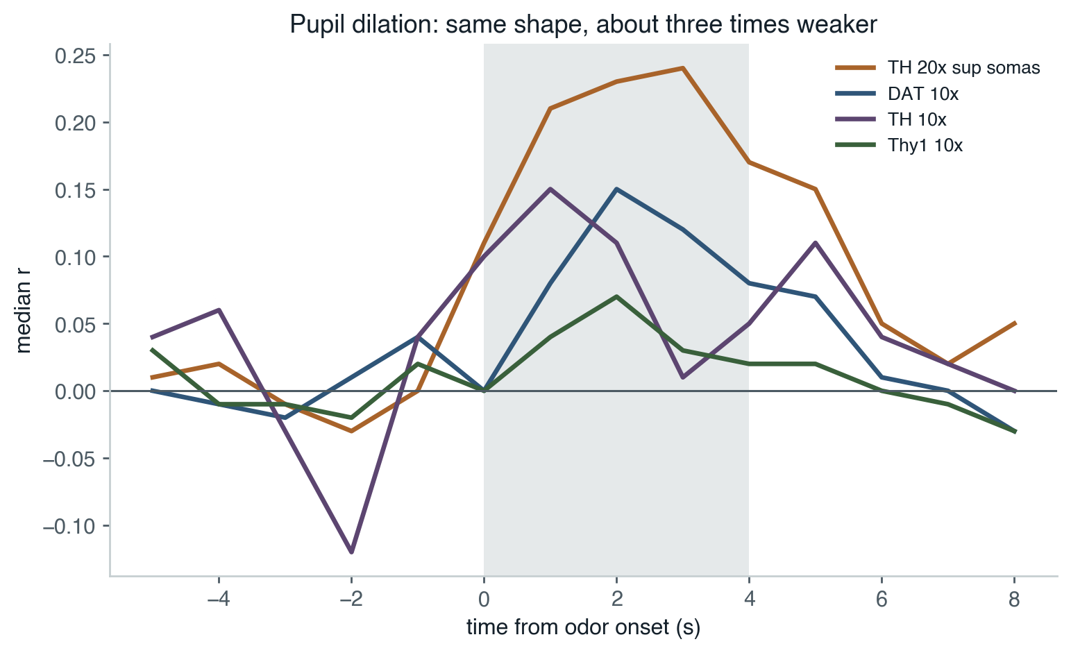
Pupil says the same thing, more weakly
Running dominates, but pupil carries a small independent contribution.
Pupil controlling for running +0.055 (p=0.003); running controlling for pupil +0.189 (p<0.0001). Carried by dilations, not constrictions. Absent under ket/xyl, where locomotion is zero and pupil quality is best.
Notes:
Awake pupil coverage is lost mainly to clipping, up to 41% of samples, and clipping happens when the pupil is large. The ROI or fit bounds are worth fixing before pupil carries weight in a figure.

Slide 13
What changed in the code
The 10x and 20x paths now share one implementation, so the scales are measured identically.
• Responder calls reference pre-odor excursions, stratified by trial count, replacing the mineral-oil cutoff everywhere.
• Excitation and suppression are integrated separately over the waveform, with early/late windows and peak latencies. Biphasic responses are detectable for the first time.
• Lifetime sparseness comes from continuous AUC rather than thresholded excess, removing a bias where non-responsive units dropped out in a state-dependent way.
• Whole-panel confusion matrices and RDMs are generated alongside the pairwise geometry.
• Joins use the source round's database trial ids; states resolve through each file's own levels.
• One crossnobis implementation, with a permutation null that flags underpowered rather than emitting a z score.
Notes:
155 tests pass across the repo.

Slide 14
Open questions
• What changed around 2026-08-03? It is the largest single source of 10x session variance, and it survives within line.
• Lagged and FIR models of the arousal coupling; respiration-phase regressors.
• The z-stack soma-size by depth model.
• Awake pupil clipping, before pupil carries weight in a figure.
• Continuous inter-trial auxiliary data, if the spontaneous-event analysis is worth recovering.
Notes:
Mixture work is parked pending more data.

