Slide 1
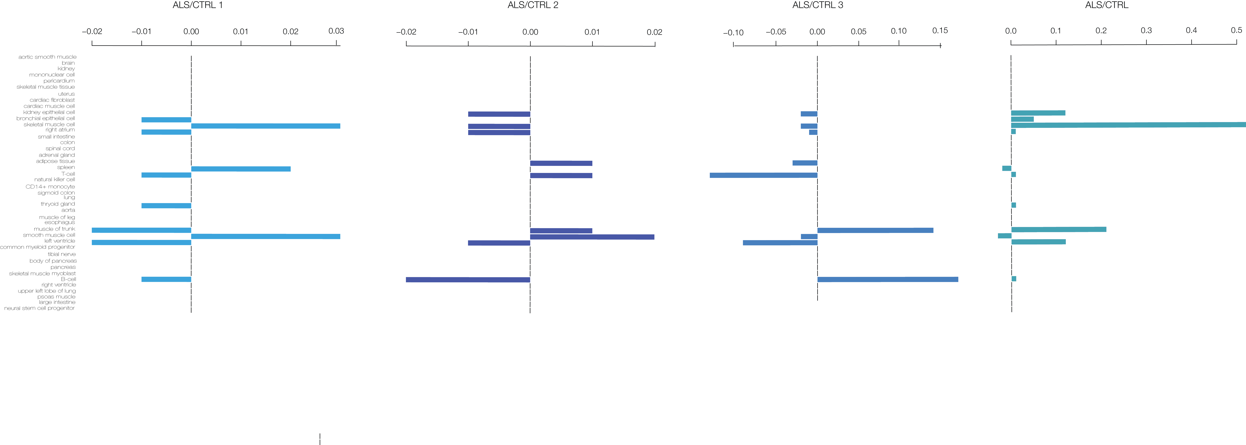

Slide 2
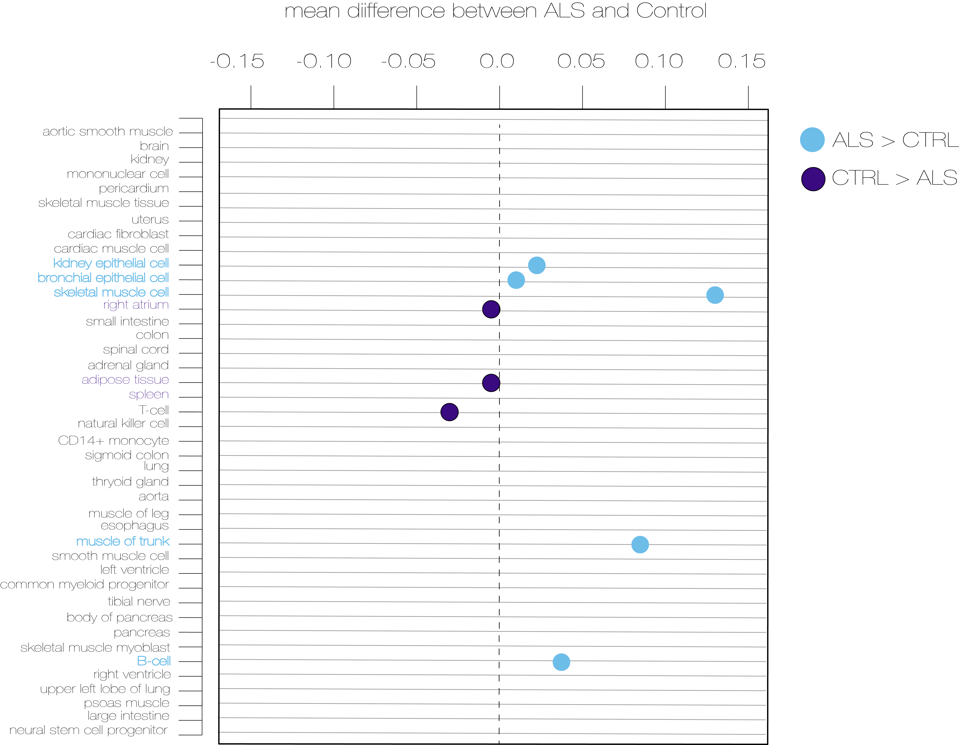

Slide 3
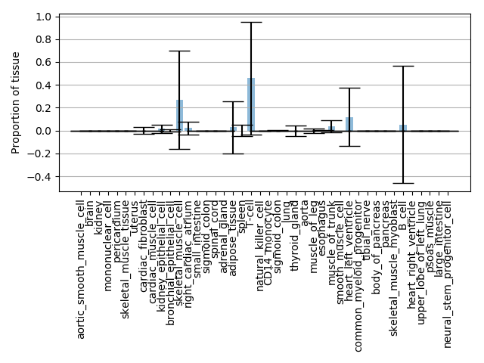

Slide 4
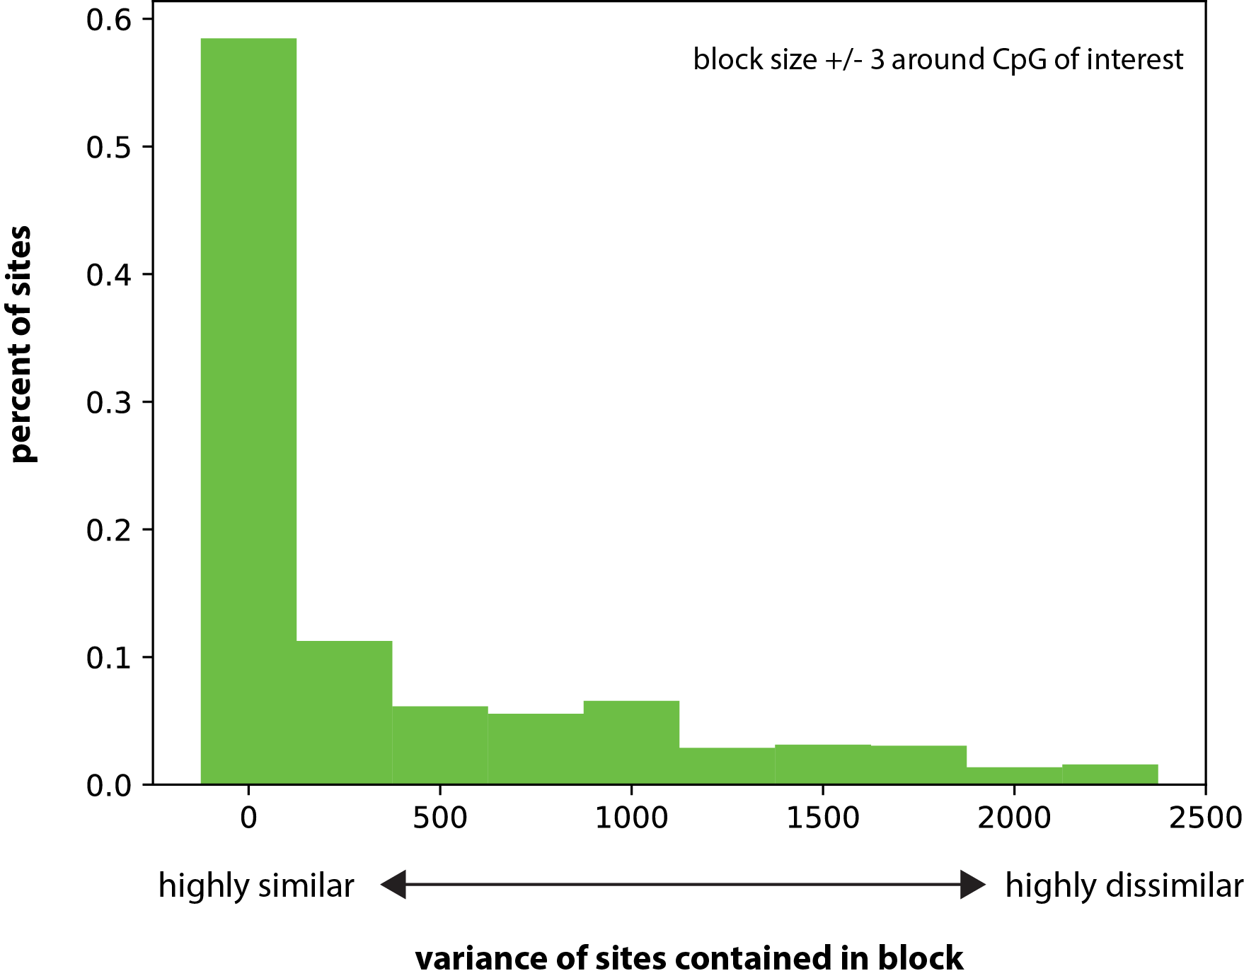

Slide 5
Summed PC’s (all CpGs +/- 250bp of PCA CpG)
common_myleoid_progenitor | 1.00 | 1.00 | 1.00 | 1.00 | 1.00 | 1.00 | 1.00 | 1.00

