Slide 1
Project-Seed
Team LaForge
Zhimu Li, Jiabo Zhang, Xufeng Liu

Slide 2
Project Background
Because of the less stressful living environment, there are also many gardening enthusiasts in the city. And our website can provide customers with a quantity and diverse supply of seeds. Due to the long winters in Canada, the diversity of climatic conditions and soil types, planting will not be easy for gardeners, so the our websites also can provide detailed information about all kinds of seeds. Customers can search for their favorite seed types and learn related planting conditions and methods on the website.

Slide 3
Why
Even people can buy seeds from other places, like Superstore. However, the diversity of seeds is limited and it cannot satisfy people who really love planting and gardening. Our sale website can provide customers with a quantity and diverse supply of seeds and detailed information about all kinds of seeds. Customers can search for their favorite seed types and learn related planting conditions and methods on the website.

Slide 4
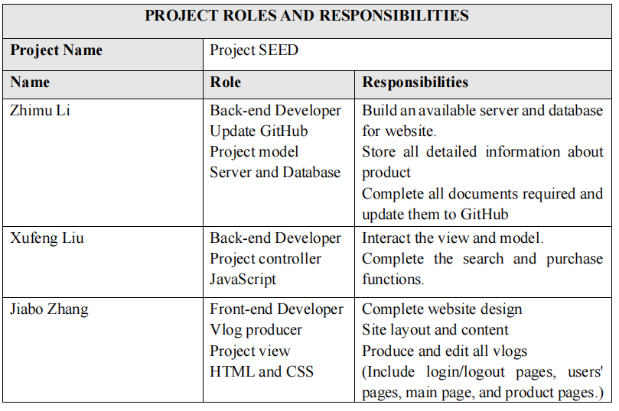
Our team and Project roles

Slide 5
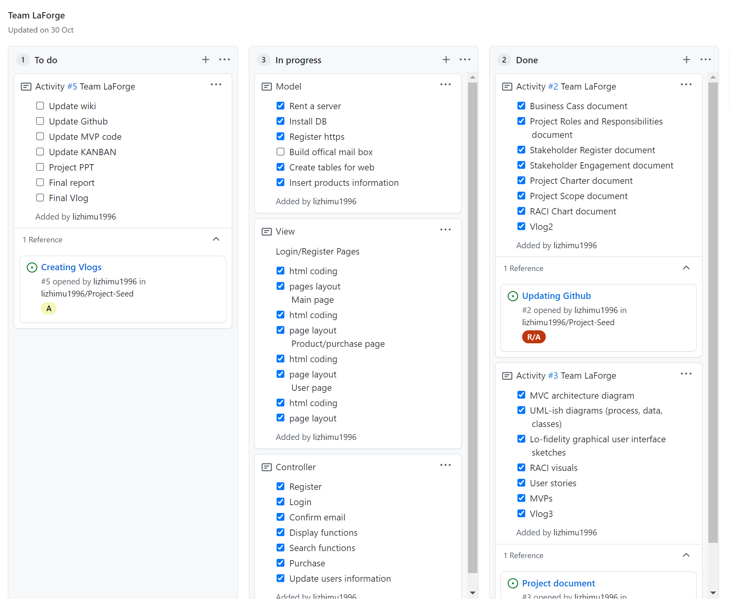
Project KANBAN

Slide 6
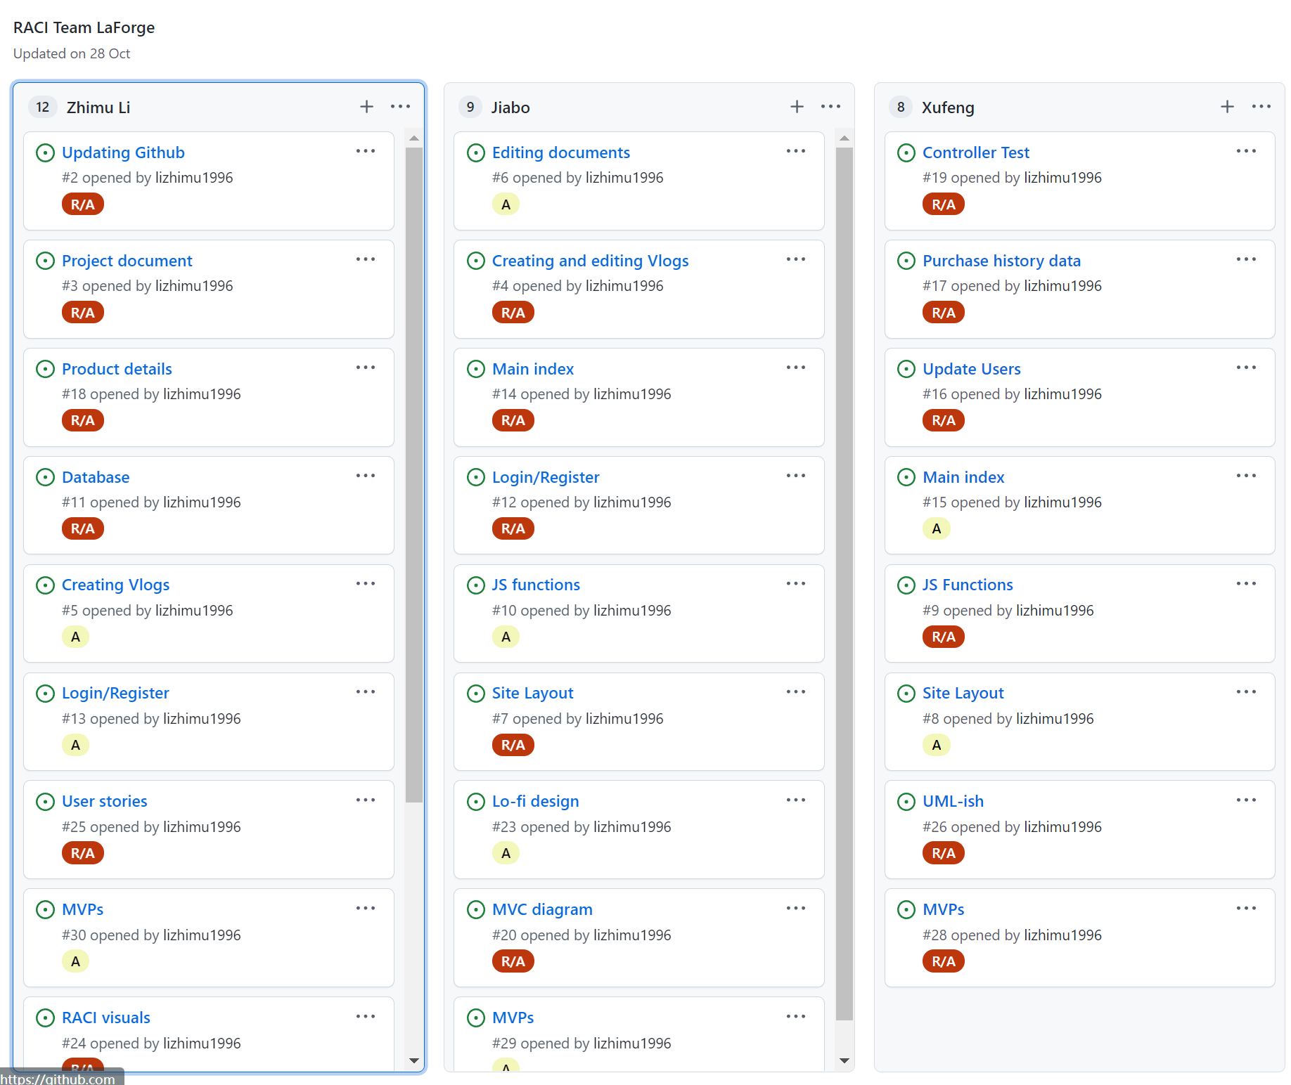
Project RACI

Slide 7
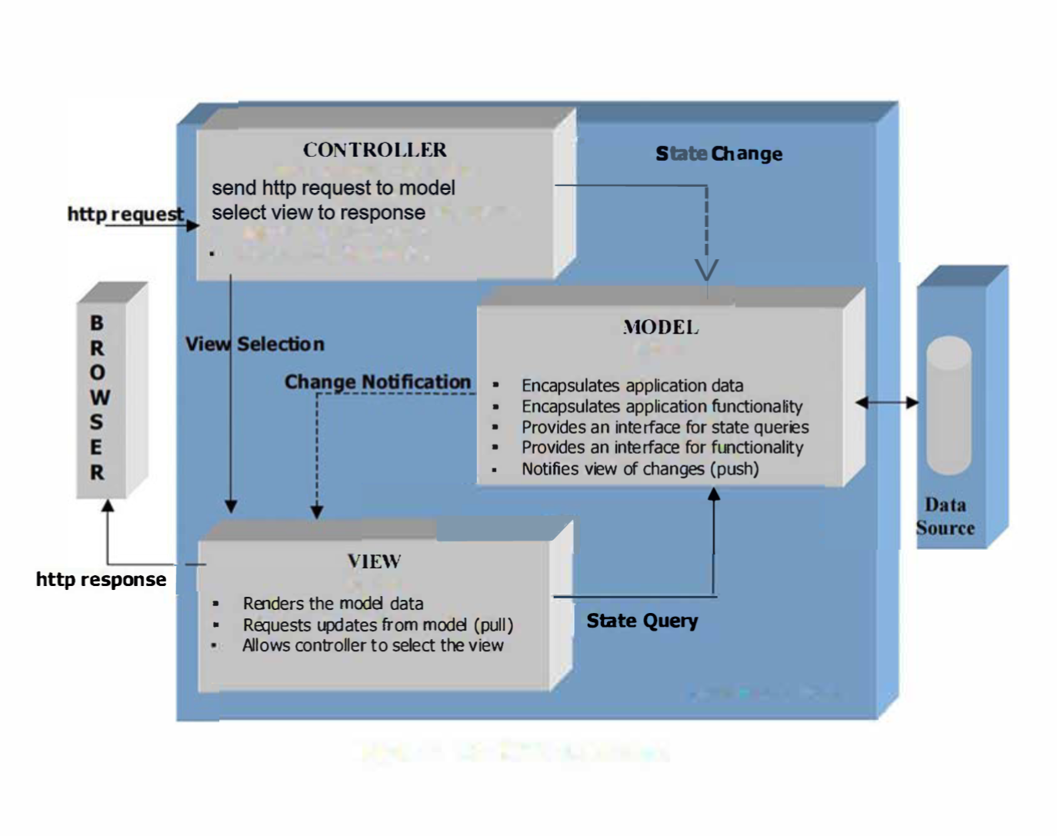
MVC Diagram

Slide 8
Project DEMO

Slide 9
Project MVP Functionalities

Slide 10
Team Reflection

Slide 11
Q & A

Slide 12
Thanks For Watching!

