Slide 1
大模型安全与价值观对齐
大模型可信内容生成
﻿生成式人工智能可信技术
LLMs safety and Alignment
Secure and Trustworthy LLMs

Slide 2
重要论文
ICML 2024， On Prompt-Driven Safeguarding for Large Language Models
ACL2024 Black-Box Prompt Optimization: Aligning Large Language Models without Model Training
Aligner: Achieving Efficient Alignment through Weak-to-Strong Correction, 2024
Safe RLHF: Safe Reinforcement Learning from Human Feedback, ICLR 2024.
基于强化学习的大模型安全对齐方法研究
Privacy-Preserving Instructions for Aligning Large Language Models， ICML 2024
Transforming and Combining Rewards for Aligning Large Language Models， ICML2024
Human Alignment of Large Language Models through Online Preference Optimisation， ICML 2024
TrustLLM: Trustworthiness in Large Language Models，2024 综述
AI Alignment: A Comprehensive Survey, 2024 综述

Slide 3
最近相关论文
ICML 2024, Transforming and Combining Rewards for Aligning Large Language Models
ICML 2024, Human Alignment of Large Language Models through Online Preference Optimisation
ICML 2024, Provably Robust DPO: Aligning Language Models with Noisy Feedback
ICML 2024, Trustworthy Alignment of Retrieval-Augmented Large Language Models via Reinforcement Learning
ICML 2024, Towards Efficient Exact Optimization of Language Model Alignment
ICML 2024, Privacy-Preserving Instructions for Aligning Large Language Models
ICML 2024, Fundamental Limitations of Alignment in Large Language Models
ICML 2024, ReMax: A Simple, Effective, and Efficient Reinforcement Learning Method for Aligning Large Language Models
ICML 2024, MaxMin-RLHF: Alignment with Diverse Human Preferences
ICML 2024, Understanding the Learning Dynamics of Alignment with Human Feedback
ICML 2024, Self-Alignment of Large Language Models via Monopolylogue-based Social Scene Simulation
ICML 2024, Assessing the Brittleness of Safety Alignment via Pruning and Low-Rank Modifications
ICML 2024, Linear Alignment: A Closed-form Solution for Aligning Human Preferences without Tuning and Feedback
ICML 2024, Learning Reward for Robot Skills Using Large Language Models via Self-Alignment
ICML 2024, Is DPO Superior to PPO for LLM Alignment? A Comprehensive Study
ICML 2024, Rewards-in-Context: Multi-objective Alignment of Foundation Models with Dynamic Preference Adjustment
ICML 2024, Decoding-time Realignment of Language Models
ICML 2024, A Mechanistic Understanding of Alignment Algorithms: A Case Study on DPO and Toxicity
ICML 2024, Long Is More for Alignment: A Simple but Tough-to-Beat Baseline for Instruction Fine-Tuning
ICML 2024, Implicit Regularization in Feedback Alignment Learning Mechanisms for Neural Networks
ICML 2024, Position: Social Choice Should Guide AI Alignment in Dealing with Diverse Human Feedback
ICML 2024, Position Paper: Towards Unified Alignment Between Agents, Humans, and Environment
ICML 2024, AI Alignment with Changing and Influenceable Reward Functions
ICML 2024, MusicRL: Aligning Music Generation to Human Preferences
ICML 2024, Model Alignment as Prospect Theoretic Optimization
ICML 2024, Adversarial Robustness Limits via Scaling-Law and Human-Alignment Studies

Slide 4
最近相关论文
NeurIPS 2024 Perplexity-aware Correction for Robust Alignment with Noisy Preferences
NeurIPS 2024 Lazy Safety Alignment for Large Language Models against Harmful Fine-tuning
NIPS 2024 Large Language Models-guided Dynamic Adaptation for Temporal Knowledge Graph Reasoning
NIPS 2024 FLAME : Factuality-Aware Alignment for Large Language Models https://arxiv.org/pdf/2405.01525
NeurIPS 2024 Soft Prompt Threats: Attacking Safety Alignment and Unlearning in Open-Source LLMs through the Embedding Space
NeurIPS 2024, One-Shot Safety Alignment for Large Language Models via Optimal Dualization
NeurIPS 2024 Vaccine: Perturbation-aware Alignment for Large Language Models against Harmful Fine-tuning
NeurIPS 2024 Uncovering Safety Risks of Large Language Models through Concept Activation Vector
Watch Out for Your Agents! Investigating Backdoor Threats to LLM-Based Agents
Spectral Editing of Activations for Large Language Model Alignment
Navigating the Safety Landscape: Measuring Risks in Finetuning Large Language Models
Deep Bayesian Active Learning for Preference Modeling in Large Language Models
The Best of Both Worlds: Toward an Honest and Helpful Large Language Model
Safe LoRA: The Silver Lining of Reducing Safety Risks when Finetuning Large Language Models
Discovering Preference Optimization Algorithms with and for Large Language Models
Weak-to-Strong Search: Align Large Language Models via Searching over Small Language Models
NeurIPS 2024, Transfer Q-star : Principled Decoding for LLM Alignment
NeurIPS 2024, Reward Learning from Human Demonstration Improves Supervised Fine-tuning for LLM Alignment
NeurIPS 2024, Panacea: Pareto Alignment via Preference Adaptation for LLMs
NeuIPS 2024, AgentPoison: Red-teaming LLM Agents via Memory or Knowledge Base Backdoor Poisoning
ReMoDetect: Reward Models Recognize Aligned LLM's Generations
Regularizing Hidden States Enables Learning Generalizable Reward Model for LLMs
Rule Based Rewards for Fine-Grained Safety Behavior in LLMs
MoGU: A Framework for Enhancing Safety of Open-Sourced LLMs While Preserving Their Usability

Slide 5
最近相关论文
Aligner: Achieving Efficient Alignment through Weak-to-Strong Correction, 2024
Safe RLHF: Safe Reinforcement Learning from Human Feedback, ICLR 2024.
BeaverTails: Towards Improved Safety Alignment of {LLM} via a Human-Preference Dataset, NIPS 2023.
Assessing the Brittleness of Safety Alignment via Pruning and Low-Rank Modifications， 2024
Catastrophic Jailbreak of Open-source LLMs via Exploiting Generation, ICLR 2024
Jailbreak in pieces: Compositional Adversarial Attacks on Multi-Modal Language Models， ICLR 2024
GPT-4 is too smart to be safe: Stealthy chat with LLMs via cipher, ICLR 2024
Fine- tuning aligned language models compromises safety, even when users do not intend to! , ICLR 2024
Training socially aligned language models on simulated social interactions, ICLR 2024
Improving Generalization of Alignment with Human Preferences through Group Invariant Learning，ICLR 2024
Confronting Reward Model Overoptimization with Constrained RLHF， ICLR 2024
Can Sensitive Information Be Deleted From LLMs? Objectives for Defending Against Extraction Attacks, ICLR 2024
Generative Judge for Evaluating Alignment, ICLR 2024
Detoxifying Large Language Models via Knowledge Editing，2024
Jailbroken: How does LLM safety training fail? , NIPS 2023
Multilingual Jailbreak Challenges in Large Language Models, ICLR 2024
AutoDAN: Generating Stealthy Jailbreak Prompts on Aligned Large Language Models, ICLR 2024
Beyond Imitation: Leveraging Fine-grained Quality Signals for Alignment， ICLR 2024
Curiosity-driven Red-teaming for Large Language Models，ICLR 2024
How to Catch an AI Liar: Lie Detection in Black-Box LLMs by Asking Unrelated Questions, ICLR 2024
RLCD: Reinforcement Learning from Contrastive Distillation for LM Alignment， ICLR 2024
Safety-Tuned LLaMAs: Lessons From Improving the Safety of Large Language Models that Follow Instructions, ICLR 2024
ARGS: Alignment as Reward-Guided Search, ICLR 2024
Compositional Preference Models for Aligning LMs, ICLR 2024
Gaining Wisdom from Setbacks: Aligning Large Language Models via Mistake Analysis, ICLR 2024
TrustLLM: Trustworthiness in Large Language Models，2024 综述
AI Alignment: A Comprehensive Survey, 2024 综述

Slide 6
经典论文
Christiano, Paul F., et al. Deep Reinforcement Learning from Human Preferences. NeurIPS 2017.
Ouyang L, Wu J, Jiang X, et al. Training language models to follow instructions with human feedback. Advances in Neural Information Processing Systems, 2022, 35: 27730-27744.
Constitutional ai: Harmlessness from ai feedback， 2022
Rafailov R, Sharma A, Mitchell E, et al. Direct preference optimization: Your language model is secretly a reward model， NIPS 2023.
Lee, Kimin, Laura Smith, and Pieter Abbeel. PEBBLE: Feedback-Efficient Interactive Reinforcement Learning via Relabeling Experience and Unsupervised Pre-training. ICML 2021.
Liu, Runze, et al. Meta-Reward-Net: Implicitly Differentiable Reward Learning for Preference-based Reinforcement Learning. NeurIPS 2022.
Kim, Changyeon, et al. Preference Transformer: Modeling Human Preferences using Transformers for RL. ICLR 2023.

Slide 7
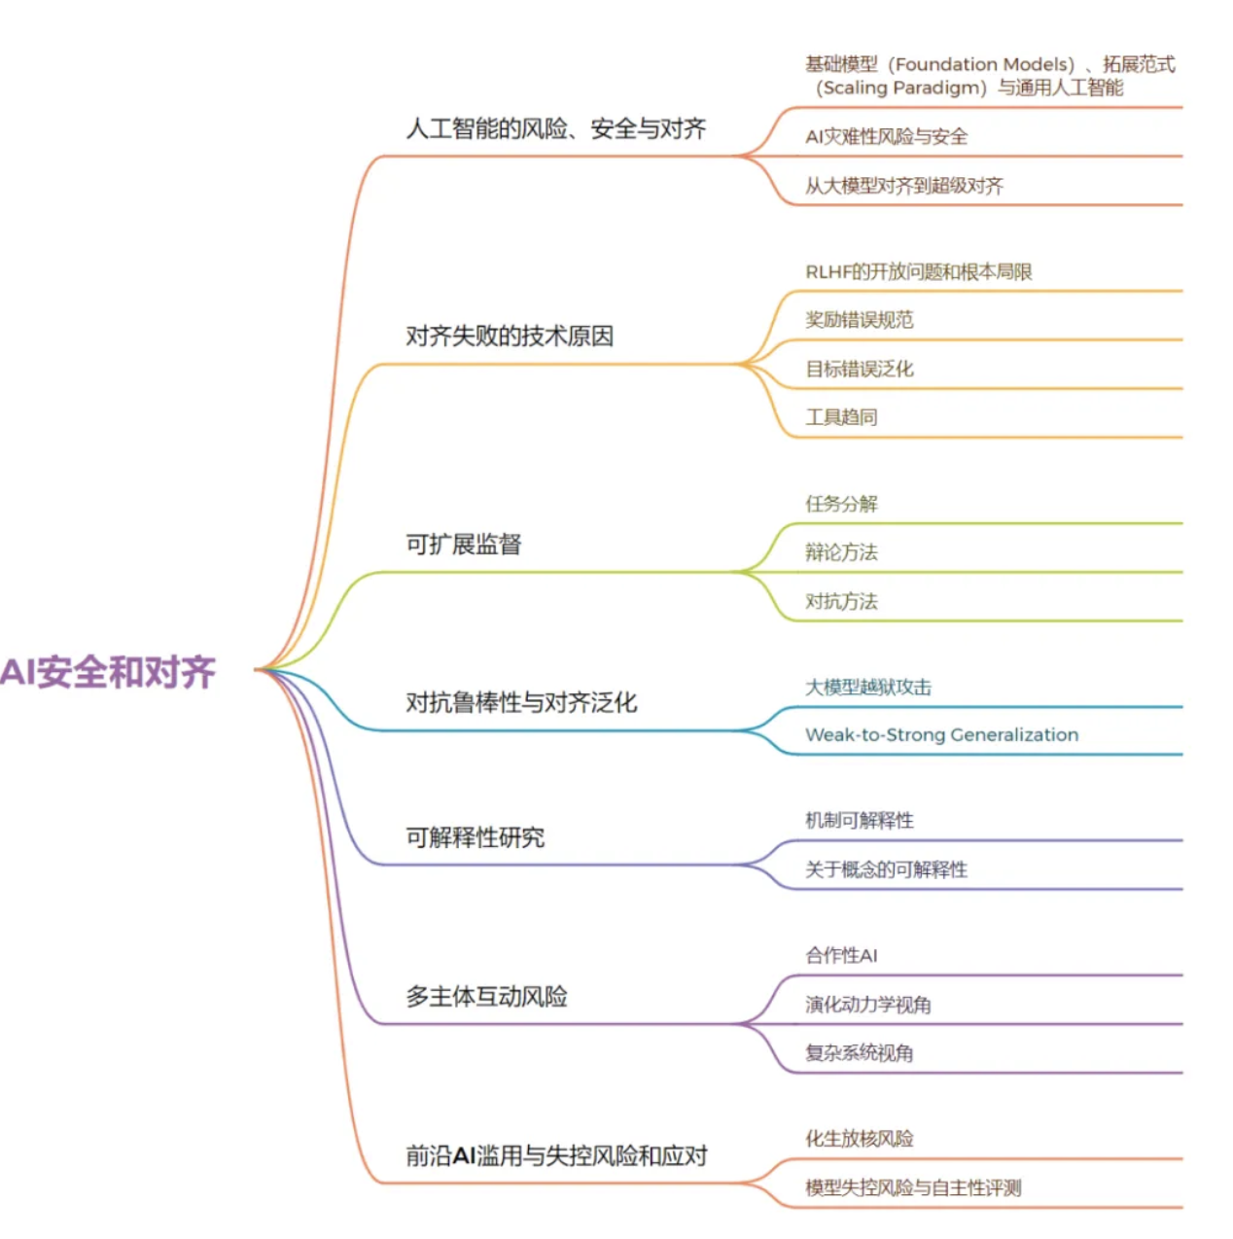
其它参考
2024开年读书会：AI安全与对齐——应对前沿AI失控与滥用的技术路线
https://mp.weixin.qq.com/s?__biz=MzIzMjQyNzQ5MA==&mid=2247679496&idx=1&sn=2f889356c9fcf6fb460dcd87f05036af&chksm=e8996485dfeeed937ca8c59e909b6c991d2ff1cbd132117a91bf54acf9e6205bd0ab2a9e4fb2&scene=21#wechat_redirect

Slide 8
找更多相关论文
NeurIPS 2024
https://neurips.cc/virtual/2024/papers.html?filter=titles&search=
ICML 2024
https://icml.cc/virtual/2024/papers.html?filter=titles
ACL 2024
https://aclanthology.org/events/acl-2024/#2024acl-long
ICLR 2024
https://openreview.net/group?id=ICLR.cc/2024/Conference#tab-accept-oral
ICML
https://openreview.net/group?id=ICML.cc/2023/Conference#tab-accept-poster
NIPS
https://openreview.net/group?id=NeurIPS.cc/2023/Conference#tab-your-consoles
arXiv https://arxiv.org/list/cs.CL/recent

