Slide 1




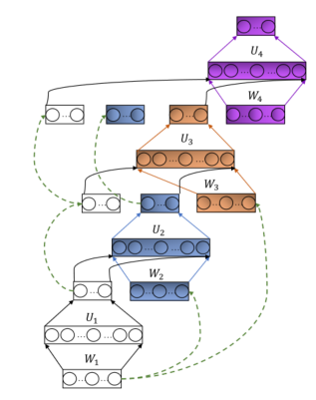
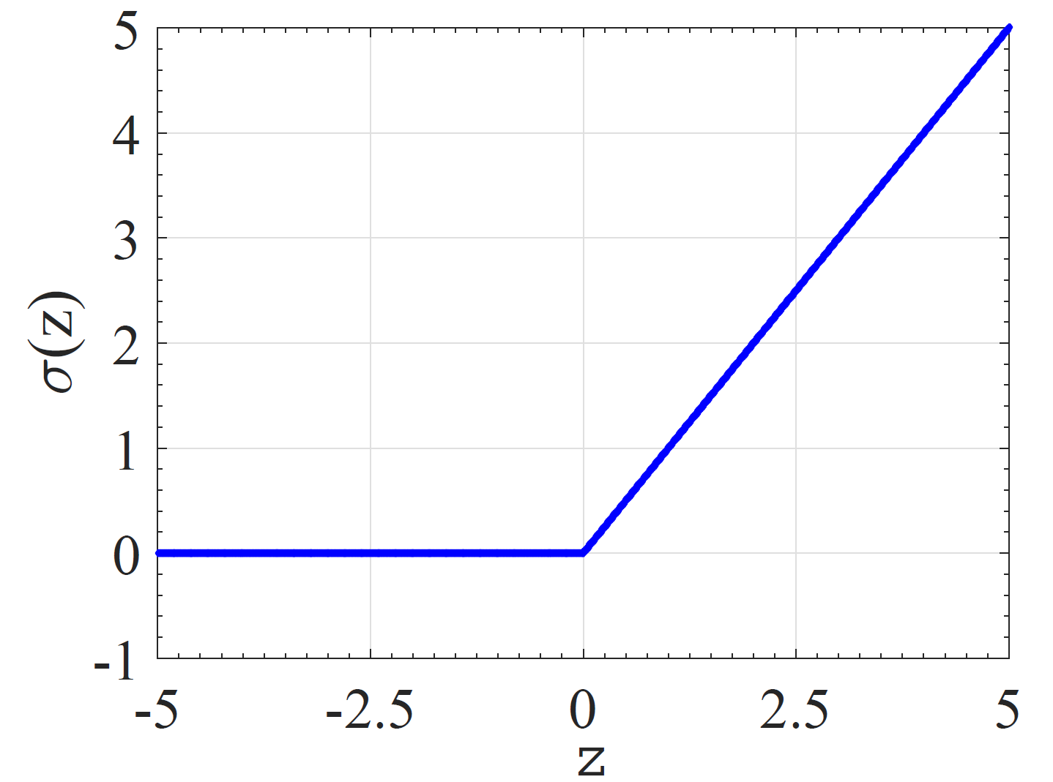

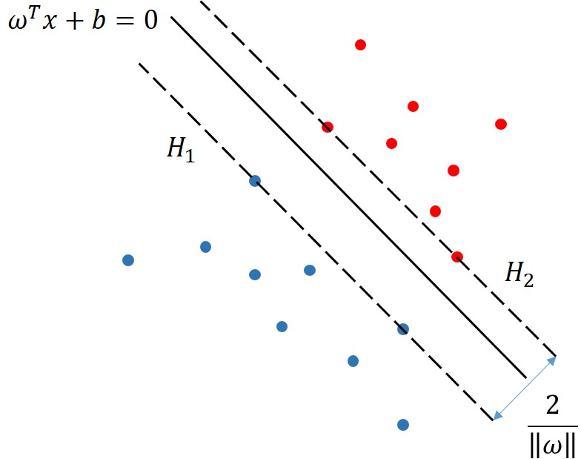
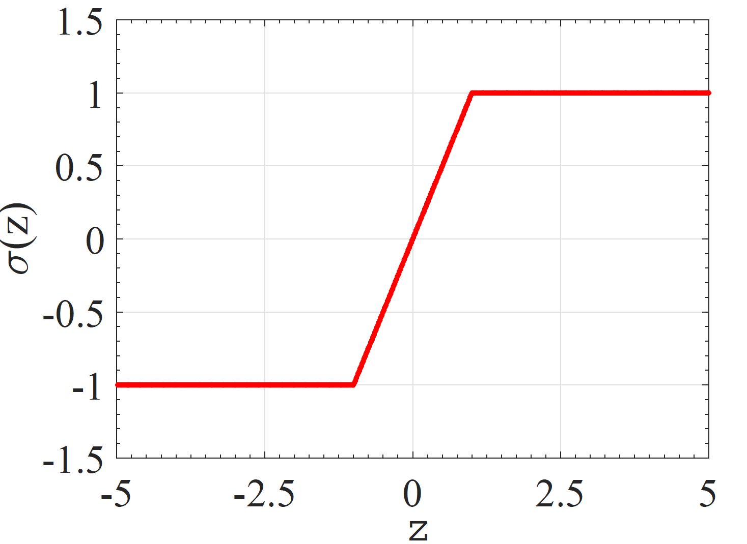


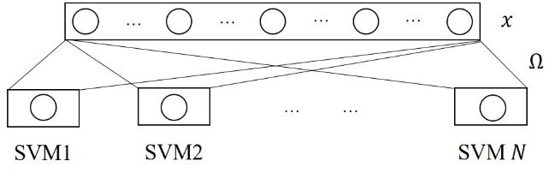
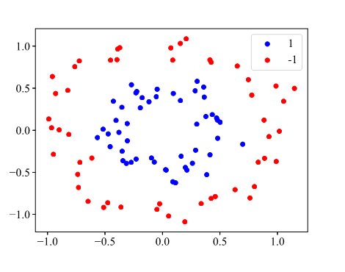
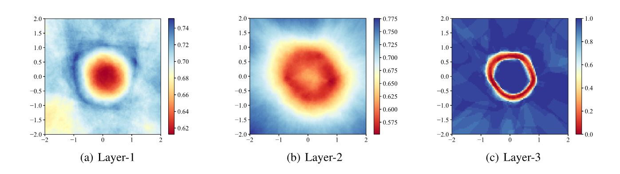
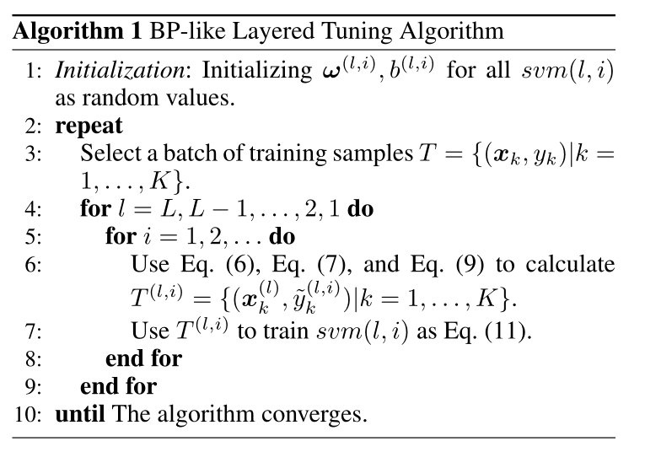

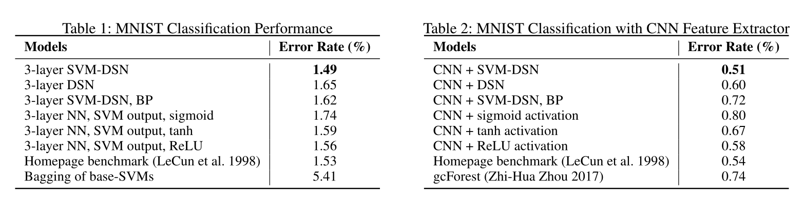


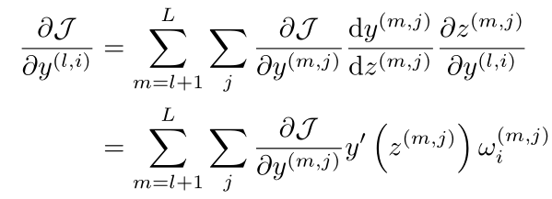
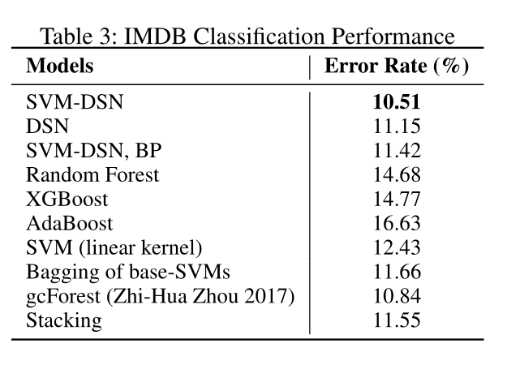



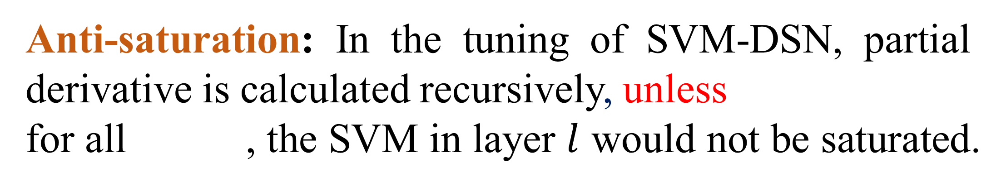
SVM-based Deep Stacking Networks
Jingyuan Wang, Kai Feng, Junjie Wu Beihang University, Beijing, China http://www.bigscity.com/
Motivation
Model Properties
Neural networks are powerful but there are still deficiencies.
Stacking ensemble may be a good alternative.
Deep Stacking Network provides a flexible structure.
SVM has better properties than ANN, such as convex optimization and interpretability.
Universal approximation: activation function in SVM-DSN is bounded and non-constant.
Parallelization: SVM-DSN supports both block level and SVM level parallelization.
Anti-saturation: In the tuning of SVM-DSN, partial derivative is calculated recursively, unless
for all , the SVM in layer $l$ would not be saturated.
Our idea:
+
Integrating SVM and Deep Stacking Network in a whole framework.
Common ANN, saturated
BLT, can update using virtual sample
Interpretation: The average confidence of the sample in a block indicates whether the feature extracted by the block and previous layers offer enough representations to identify label of the sample.
SVM-based Deep Stacking Network
…
SVM group 1
SVM group 2
SVM group $M$
SVM-DSN block
concatenate output of $N×M$ SVMs
…
$$y$$
Fine Tuning & Virtual label
Performance
Hand-written digits recognition over the MNIST data set
Iteratively SVM optimization
BP-like virtual label generation
Sentiment classification
over IMDB data set
…
Backward Propagation
Recursively calculate partial derivative
The SVM-DSN achieved best performance compared with benchmark neural networks and ensemble methods.
…
…
… … …
…
… …

