Slide 1

Coupling Implicit and Explicit Knowledge for Customer Volume Prediction
The Thirty-First AAAI Conference on Artificial Intelligence San Francisco, California, USA. February 4–9, 2017
Jingyuan Wang, Yating Lin, Junjie Wu, Zhong Wang and Zhang Xiong
Beihang University, Beijing, China

Slide 2

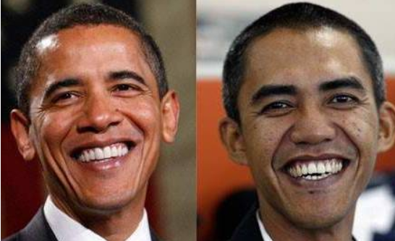
Motivation: Implicit v.s. Explicit Knowledge
Explicit Knowledge
Correlation with a known reason
For example: twins are looked like each other.
Implicit Knowledge
Correlation with unknown reasons
For example: doppelganger

Slide 3


Application Scenarios
The problem definition
Implicit and explicit knowledges in footfall prediction
Explicit knowledges: geographical correlations
Implicit knowledges: latent correlations
Ideas: Mining implicit and explicit knowledges with an fusion model framework.
Explicit knowledges: linear regression models
Implicit knowledges: matrix factorization models
Prediction target：
Customer Volume (footfall)
Customer Point
Service Point

Slide 4
Related Works
Footfall prediction
Geo-spotting (Karamshuk et al. 2013)
Optimized location selection (Li et al. 2015)
Real estate appraisal (Fu et al. 2014a; 2014b)
Service requirements mining (Xu et al. 2016)
Limitation:
Most of these approaches are based on explicit geographic contexts.
Few methods have the ability to exploit implicit correlations in data.
Implicit correlations mining
PHF-MF Model (Cui et al. 2011b; 2011a)
Geo-MF Model (Lian et al. 2014)
CLAR model (Zheng et al. 2010a)
UCLAF model (Zheng et al. 2010b; 2012)
Limitation:
Most of these works treat implicit correlations as the most important knowledge.
Uses explicit information as their regulations.

Slide 5
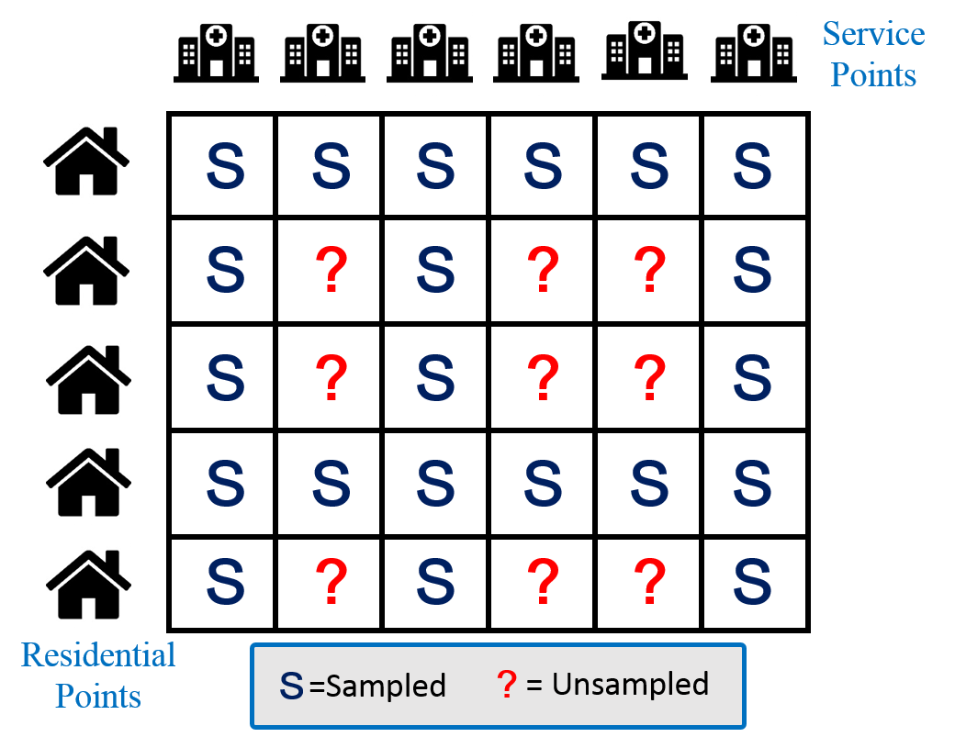
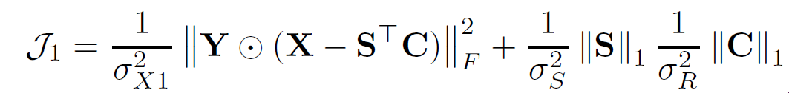
Implicit Correlations
Probabilistic Matrix Factorization
Objective function:
Service Points
-Hidden Space
×
=
Residential Points
-Hidden Space

Slide 6
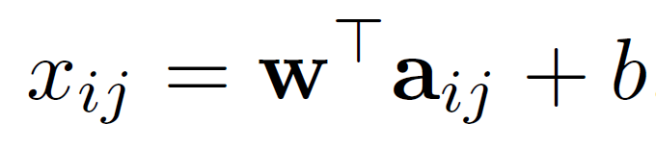

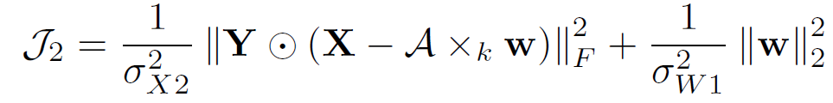
Explicit Correlations
Geographical Regression
The linear regression model
A tensor/matrix expression of LR model
The objective function for footfall prediction

Slide 7
Explicit knowledge: Geographical Context
Geographical Relation
The geographic relationship between service and customer points
Geographical distance
Number of service/ customer points around customer/ service points
Geographical Similarity
The footfall similarity among customer-service point pairs that are geographically close.
The average footfall to a service/customer point from the customer/service points nearest to a customer/service point
Social Geography Features
Social connections between customer and service points
The traffic flow intensity from a customer point and a service point
Whether a customer point and a service point are in the same administrative region

Slide 8
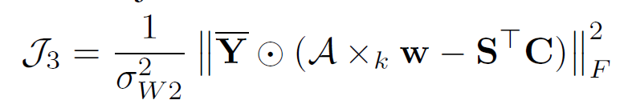
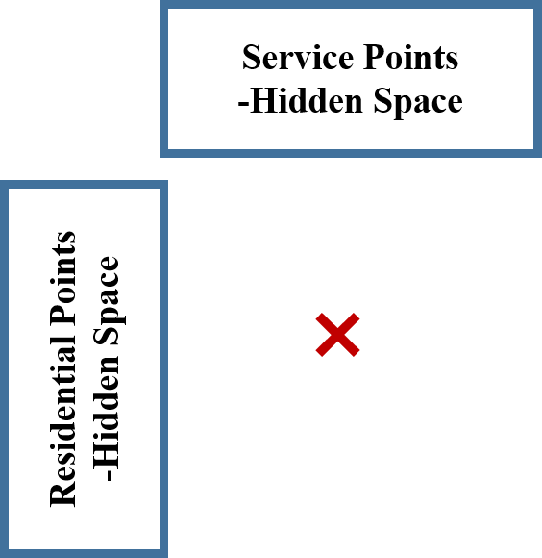




Modeling Unobserved Volumes
The objective function
Calibrating implicit knowledge modeling with explicit knowledge modeling
Unobserved Volumes
×
Implicit knowledge modeling
Explicit knowledge modeling

Slide 9
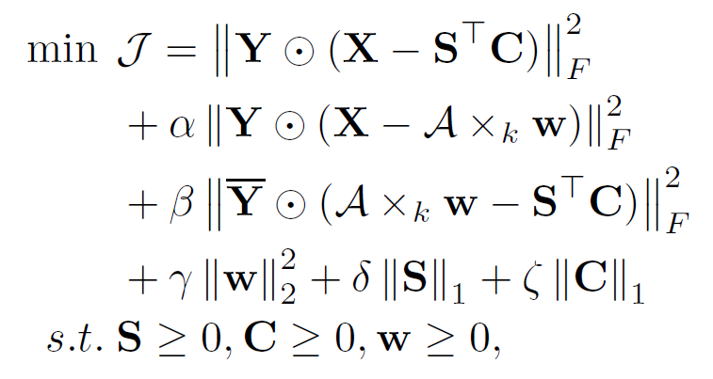
Model and Inference
GR-NMF: Integrated Model for Footfall Prediction
Inference
Alternating Proximal Gradient Descent (APGD)
Implicit Correlations
Explicit Correlations
Unobserved Volumes
Sparsity Factors
Non-negativity Constraints

Slide 10
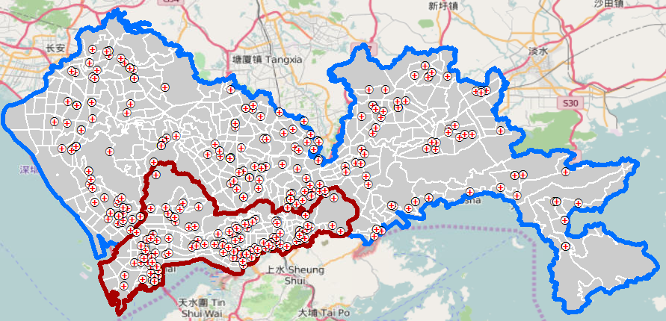
Experiments
Experiments setup
Data set: collected from the public hospital system of Shenzhen, a major city in southern China
Service points: 321 public hospitals of Shenzhen
Customer points: 1343 residential zones of Shenzhen
Time range: January to December, 2014
A 321×1343 patients volume matrix X, with a high sparsity (the ratio of zero elements) equal to 94.87%.

Slide 11


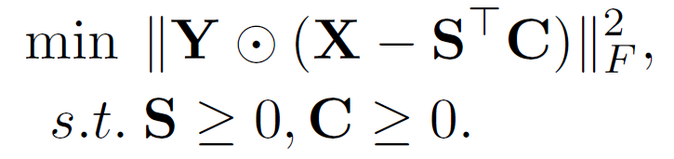

Experiments
Baselines
Linear Regression (LR):
Singular Value Decomposition (SVD):
Basic Non-Negative Matrix Factorization (bNMF):
Sparse Non-Negative Matrix Factorization (sNMF):

Slide 12
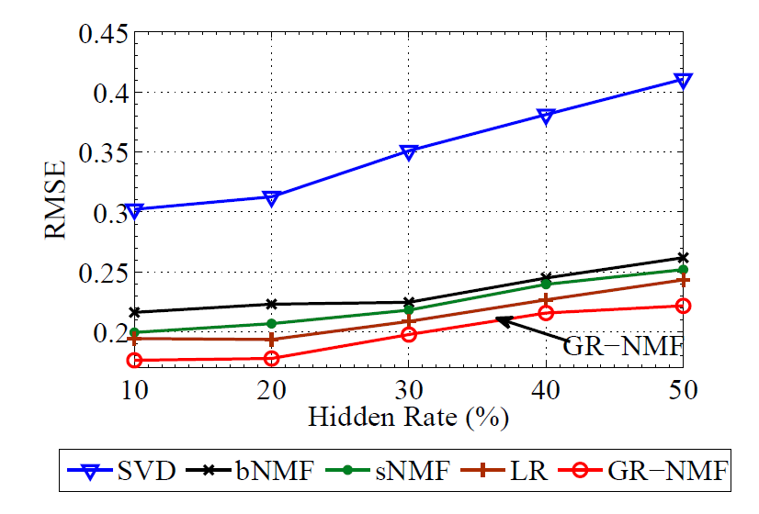
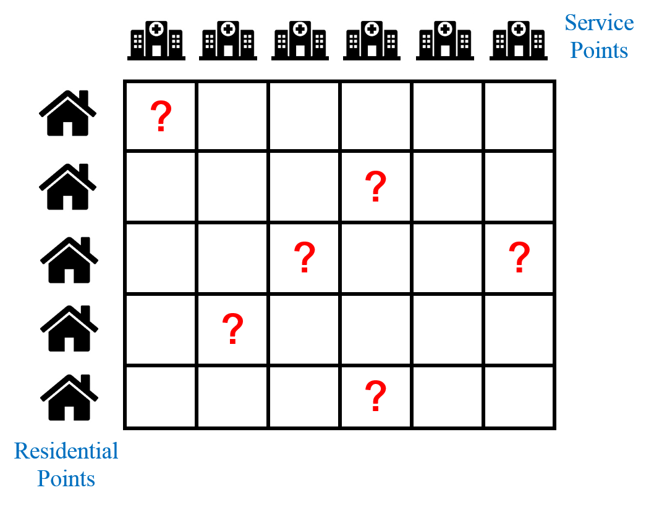
Experiments
The general scenario
Randomly hide 10% to 50% samples of the footfall matrix.

Slide 13
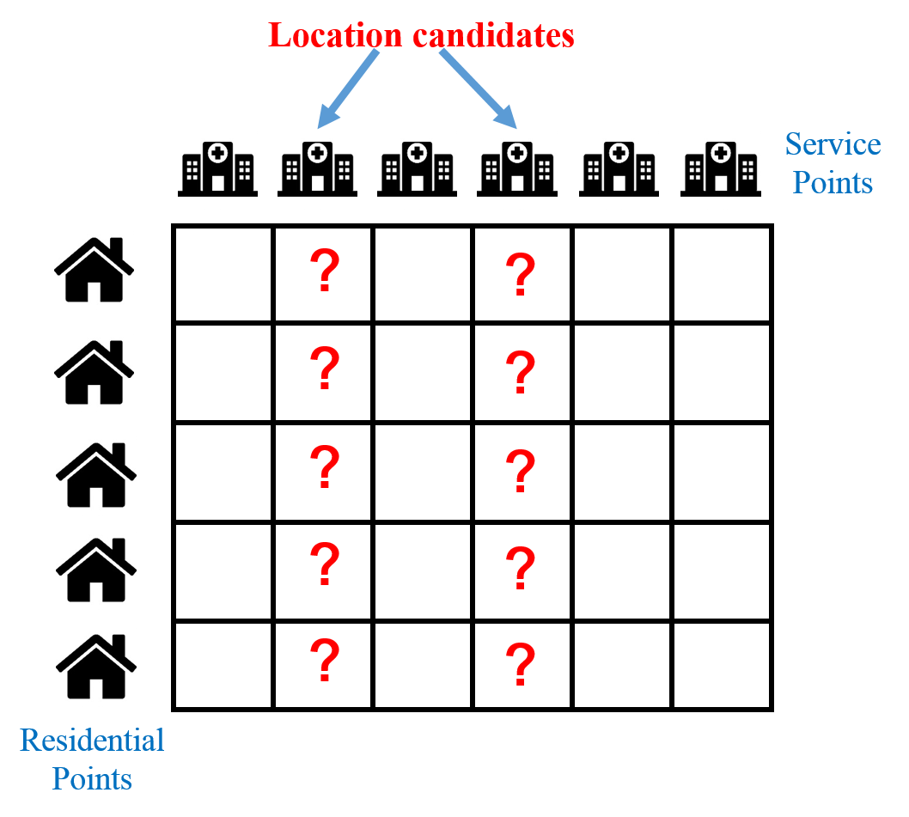
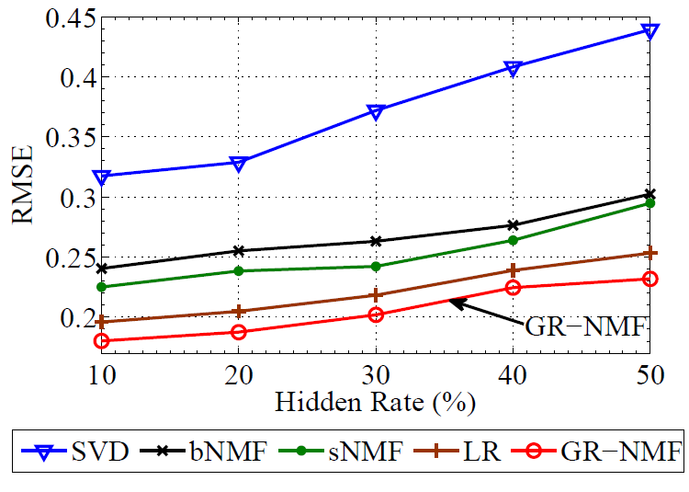
Experiments
The location selection scenario
Randomly hide 10% to 50% columns of the footfall matrix.
The hidden columns correspond to location candidates.

Slide 14
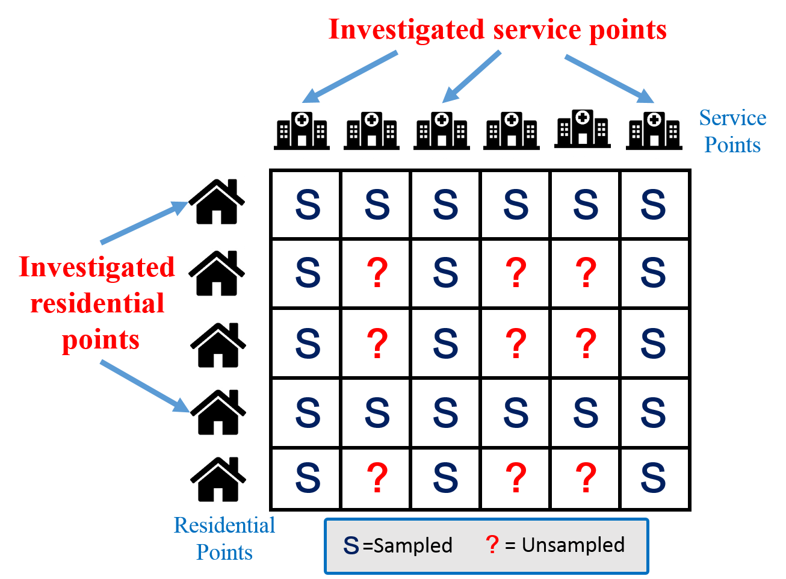
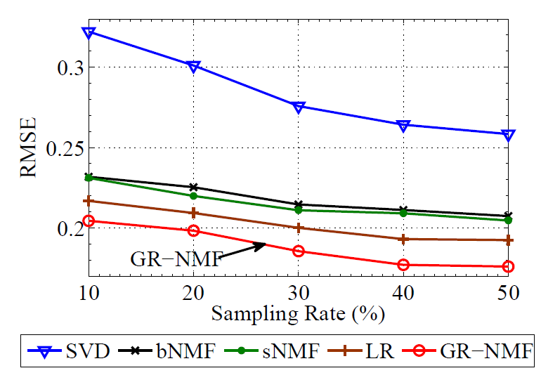
Experiments
The market investigation scenarios
Randomly sample 10%-50% rows and columns.
The sampled rows and columns are investigated service and residential points.

Slide 15
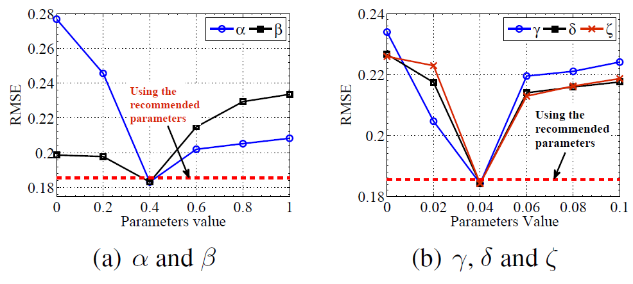
Experiments
The setting of parameters
The performance of our approximate method is just slightly worse than the optimal performance of the traversal method.

Slide 16
Conclusions
The model proposed by this study have following contributions:
GR-NMF is able to jointly model implicit knowledge hidden inside customer volumes and explicit knowledge expressed as geographical relations.
GR-NMF has a unified probabilistic interpretation, which makes the model theoretically solid.
Extensive experiments are conducted on a real-life outpatient dataset obtained from the Shenzhen city of China.
The results show that GR-NMF outperforms competitive baselines consistently in various application scenarios with different sampling rates.

Slide 17
Thank You!
Email: jywang@buaa.edu.cn
Webpage: http://www.bigscity.com/

Slide 18
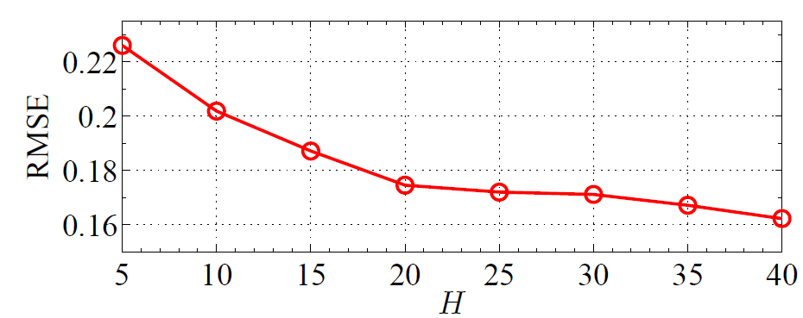
Dimensionality of Latent Space
We set H = 20 as the default setting in the experiments
The default setting

