Slide 1

No Longer Sleeping with a Bomb: A Duet System for Protecting Urban Safety from Dangerous Goods
The 23rd ACM SIGKDD Conference of
Knowledge Discovery and Data Mining
Halifax, Nova Scotia, August 13 - 17, 2017
Jingyuan Wang, Chao Chen, Junjie Wu, Zhang Xiong
Beihang University, Beijing, China
Notes:
dʊ'ɛt

Slide 2
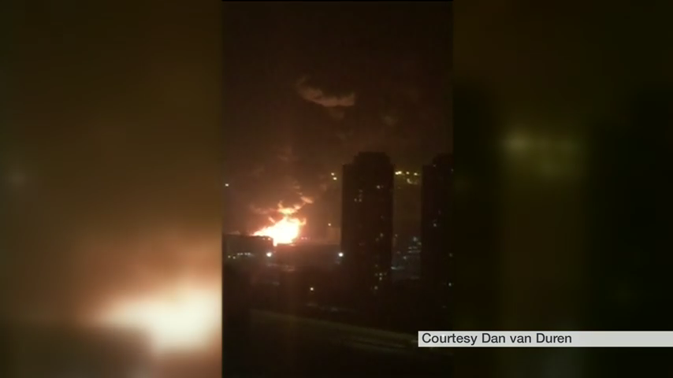
Motivation
Notes:
Before I introduce our work, let’s watch a video first. This video was not shot at a battlefield. It was shot in the downtown of a city in China. Tianjin.

Slide 3
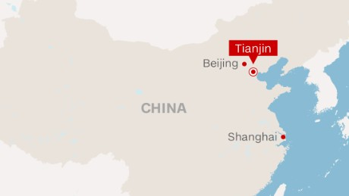
Motivation
Tianjin explosion on Aug. 12, 2015.
A metropolis with 15 million population, the world's 6th-most populous city.
The third biggest city in China mainland.
Notes:
Tianjin is a very important city in China, which is the biggest port city in the north china. In Aug. 12, 2015, a dangerous goods explosion happened in Tianjin port area. The video we just watched was actually shot in the explosion.

Slide 4
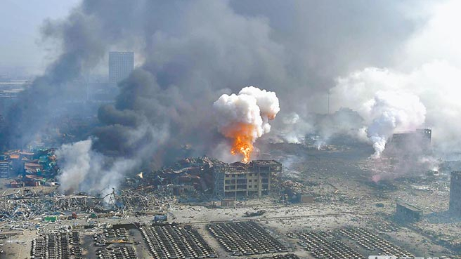
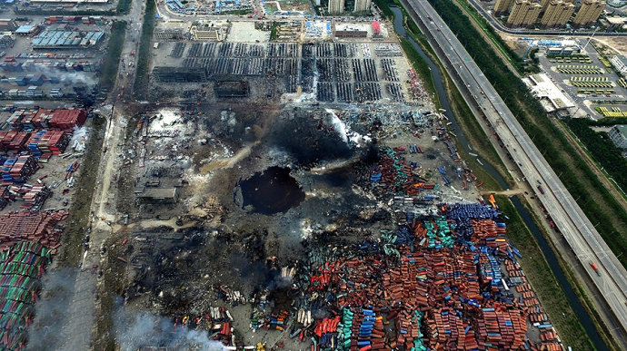
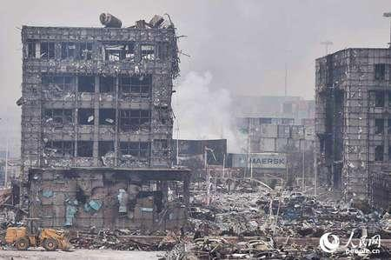
Motivation
Damages in the Tianjin port explosion on Aug. 12, 2015.
TNT equivalent: 21 Tons, was the equivalent of a magnitude 2.9 earthquake.
173 people were killed and hundreds of people were injured.
304 buildings, 12,428 cars and 7,533 intermodal containers were seriously damaged.
Surrounding buildings were declared as “structurally unsafe”.
Local environments and air were also seriously polluted by exploded dangerous goods, which incurs immeasurable loss.
Notes:
All of these photos was taken in the explosion site. More than one hundred and seventy three people were killed in the explosion. Hundreds of buildings and ten thousands of cars were damaged. The equivalent of the explosion is 21 tons of TNT. The power is same as a 2.9 earthquake.

Slide 5
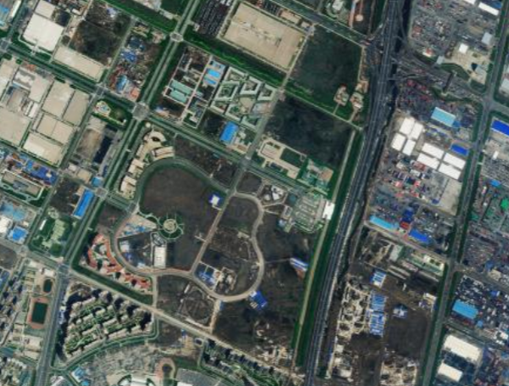
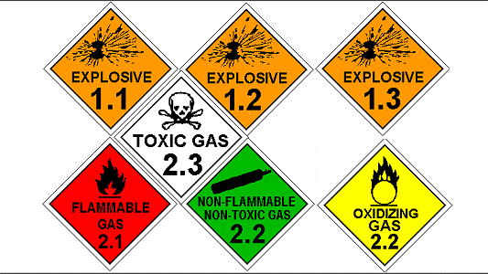
Motivation
What kind of explosives caused the Tianjin explosion?
“Over 40 kinds of hazardous chemicals (dangerous goods) were stored on site. … all together there should have been around 3,000 tons.” reported by CCTV.
Why this explosion killed so many people?
Explosion site
(Dangerours goods storage)
Residential
areas
People lived in Tianjin port were sleeping with bombs beside their beds, but they didn’t even know!
Notes:
[,rɛzɪ'dɛnʃl]
After this seriously event, we have two questions must be answered: what caused the Tianjin explosion? And why this explosion killed so many people?
As reported by the government media, the explosives were 3,000 tons hazardous chemicals. As shown in the map, all of these dangerous goods were stored in the area circled by the red line. Just beside the storage site, the area circled by the yellow line is the downtown of the port district of Tianjin. Obviously, the dangerous goods storage is too close to a residential area.
However, before this explosion, even the government didn’t realize the hidden dangers! People lived in Tianjin port were sleeping with bombs beside their beds, but they didn’t even know!

Slide 6
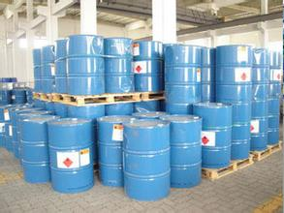
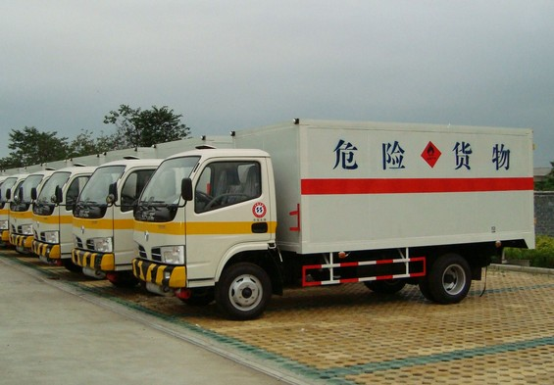
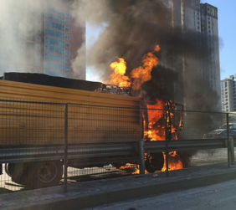
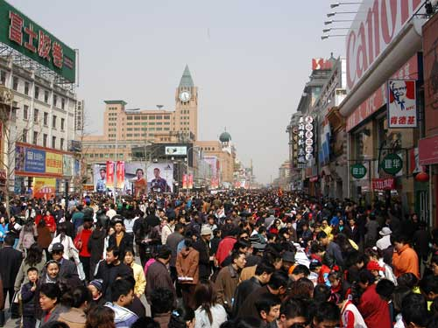
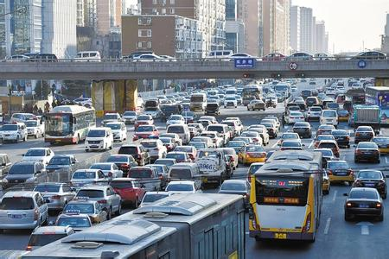
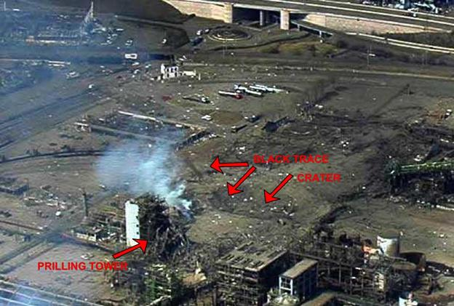
Motivation
Are similar things still happening in other cities?
2016 Dangerous goods
transportation
accidents in Beijing, China
Chemicals storage
Gas transportations
2001 Chemical explosion in Toulouse, France
Population Density
Traffic
A system protecting our cities from dangerous goods
risks are desired!
Notes:
This conditions are not just existed in Tianjin. In everyday, many dangerous goods are stored or transported crossed our city. Such as gas, chemicals. We need these gas, we need these chemicals, but we must protect our live from the risks caused by these dangerous goods!
Similar explosion was happened in Toulouse, an industry city of France. Beijing also happened dangerous goods transportation accidents in the last year.

Slide 7
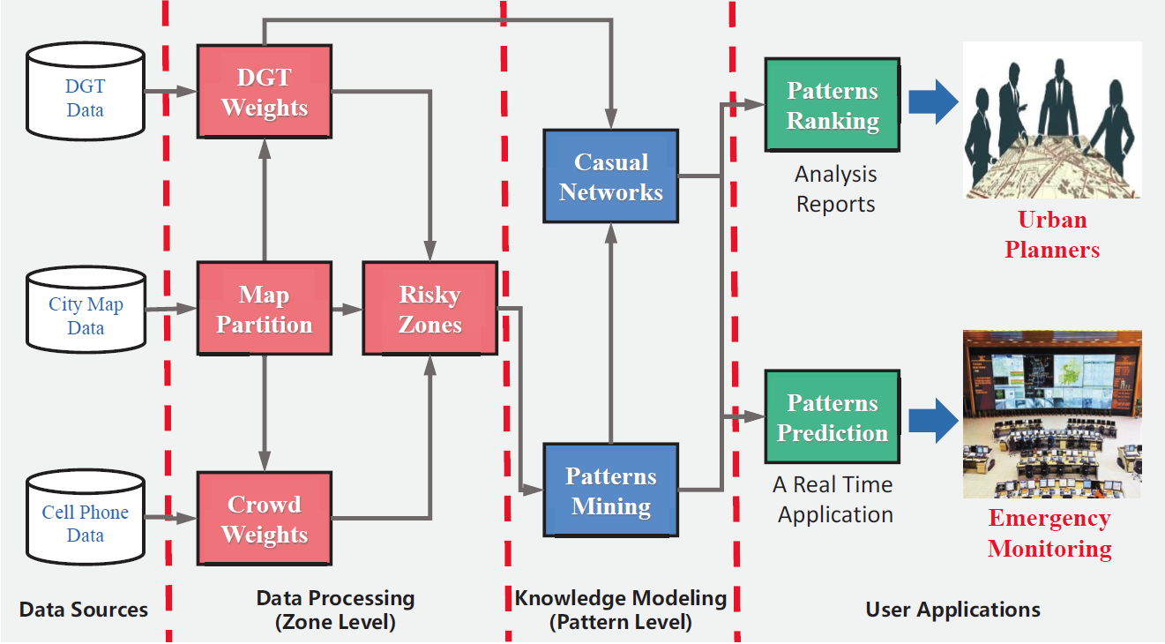
DGeye : City Eyes on Dangerous Goods
Knowledge
Modeling
Data Fusion
Applications
Notes:
Based on this motivation, we proposed a system that could protect our city from dangerous goods risk. We call our system as Dgeye: city eyes on dangerous goods. This system uses three steps to extract knowledge from multi-source data.

Slide 8
DGeye : City Eyes on Dangerous Goods
Multi-source data fusion
Frequent risk pattern mining
Causal network building
Applications
Notes:
The first step is data fusion

Slide 9
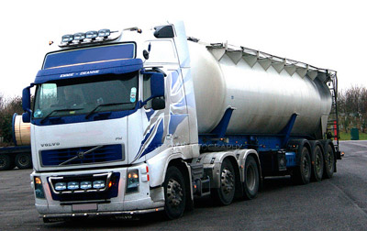

Data Sources
Dangerous goods transporters in China are mandatorily equipped with a GPS terminal and reports real-time locations to the local government, which are then aggregated into DGT trajectory data.
Dangerous Goods
We use the amount of mobile phone users to approximate the population in an urban zone.
The mobile phone user data are collected by mobile operators.
Population
Multi-source Data
Notes:
We call our system as a duet system, that is due to we used two types of data in our system. The fist type is the trajectory data of dangerous goods transporters. In china, all vehicles [ˈviəkəl] that carried dangerous goods must equip with GPS terminals. These terminals report their real-time locations to the local government. We use these trajectory data to indicate where have dangerous goods. In the same time, we build a cooperation with mobile phone operators. They given us mobile phone location data of a city. We use mobile phone user number to approximate the population in different urban zones.

Slide 10
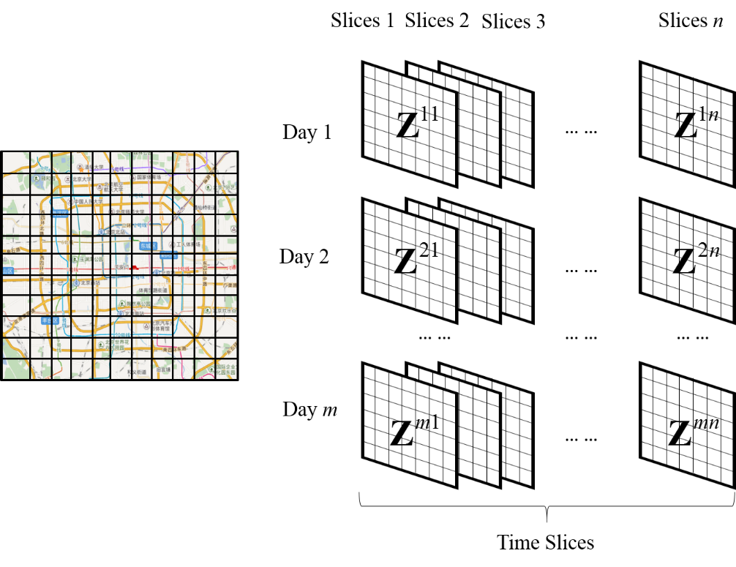
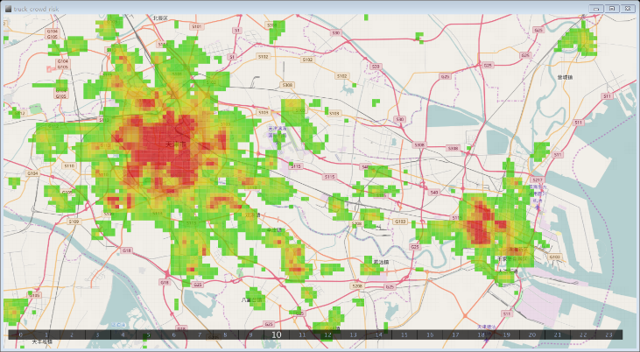
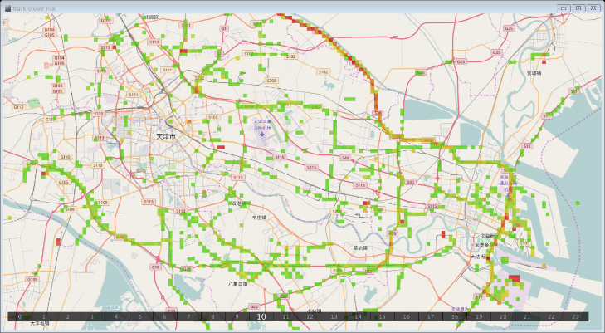
Data Fusion
DGT
Weight
1
1
2
1
1
1
1
1/4
1/4
1/4
1/4
Crowd
Weight
Crowd Weight
DGT Weight
Notes:
We divided map of a city as many grids, and divide time axis as many time slice. For everyday, we have a group of matrices. For each cell in a matrix, we calculate two weights. A DGT weight using DGT trajectory data and a crowd weight using mobile phone data.

Slide 11
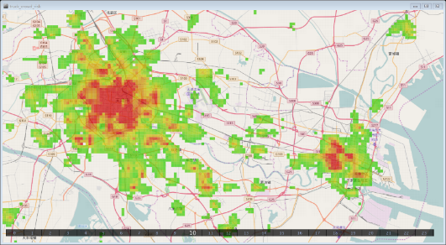
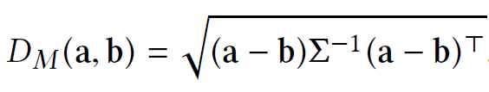

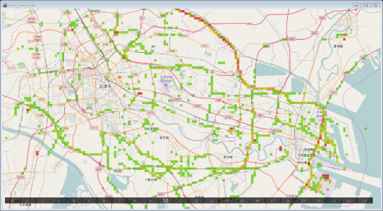
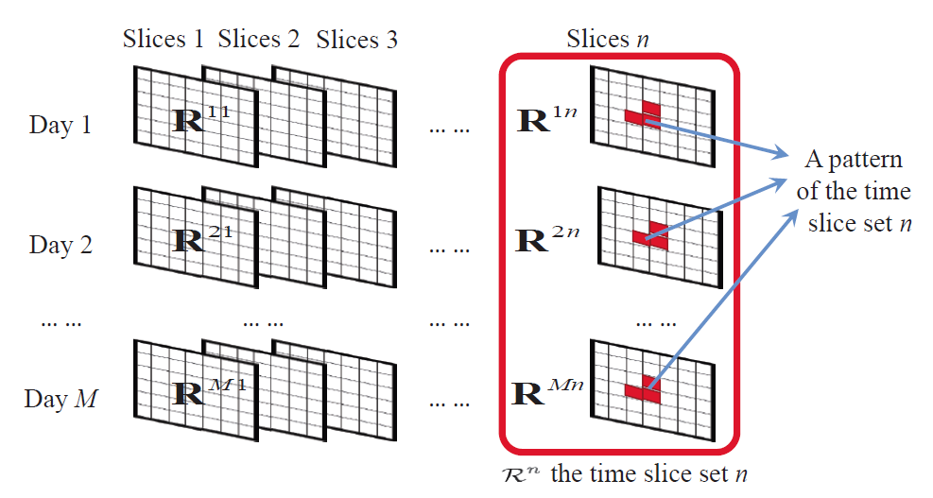
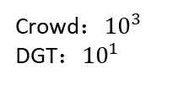

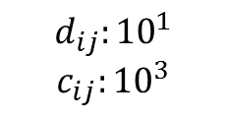

Data Fusion
Mahalanobis distance using
$${zone}_{ij}$$
Mahalanobis distance:
Crowd：${10}^{3}$
DGT：${10}^{1}$
Risk score:
Different scales
$$d_{ij}:{10}^{1}$$
$$c_{ij}:{10}^{3}$$
$${zone}_{ij}:({10}^{1},{10}^{3})$$
The population in Beijing is more than 20 millions, but the DGTs in our Beijing data set is only 3,790.
Risky Zone:
(90% upper quantile of all the risk scores)
Notes:
In order to fusion the two weight together, we calculate a product of the two weights in the mahalanobis distance. We name the product as a risk score. If the risk score of a cell in a matrix is higher than a threshold, we mark the cell as a risky zone.
multiply

Slide 12
DGeye : City Eyes on Dangerous Goods
Multi-source data fusion
Frequent risk patterns mining
Causal network building
Applications
Notes:
In the second step, we mine frequent risk patterns from the risk zone set.

Slide 13
Risky Patterns Mining
A risky pattern refers to a set of adjacent urban zones that are at the risky state together frequently in a same time slice of a day.
Association rules :
The risk zones in the same pattern should be spatially adjacent.
The daily support of a pattern should be larger than a given threshold (frequent enough).
A pattern should be not a proper subset of any other risky patterns.
An illustration of risky patterns mining
Notes:
In this step, we adopt association rule mining to detect risk patterns. We define a risk pattern as a set of adjacent urban zones that are at the risky state together frequently. We adopted three rules in our algorithm. The first is the risk zones in the same pattern should be spatially adjacent. The second is the daily support of a pattern should be larger than a threshold. The daily support is the support of a pattern for slices of different days.

Slide 14
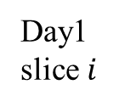

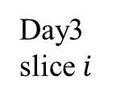
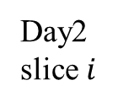
Risky Patterns Mining
Apriori-like algorithm
0 1 2 3 4
0 1 2 3 4
Size = 1
Size = 2
Size = 3
zone
daily support
zone
daily support
zone
daily support
Day1 slice $i$
11: 1
21: 1
31: 2/3
13: 2/3
23: 2/3
33: 1/3
44: 1
(11,21): 1
(21,31): 2/3
(13,23): 1/3
(11,21,31): 2/3
0 1 2 3 4
0 1 2 3 4
Day2 slice $i$
Daily support threshold = 2/3
0 1 2 3 4
0 1 2 3 4
Pruning: ${"F}_{k−1}×F_{k−1}"$method
*spatially adjacent
Day3 slice $i$
Final patterns: (11,21,31),13,23,44
*not a subset
Notes:
[praɪ'ɔraɪ]

Slide 15
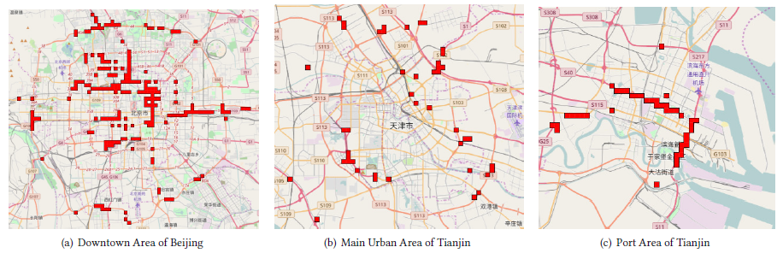
Risky Patterns in Tianjin

Slide 16
DGeye : City Eyes on Dangerous Goods
Multi-source data fusion
Frequent risk pattern mining
Causal network building
Applications
Notes:
The third step is to analyze causality among patterns.

Slide 17
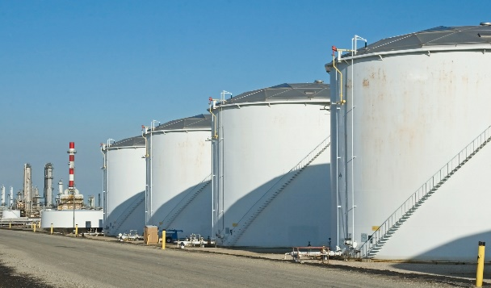
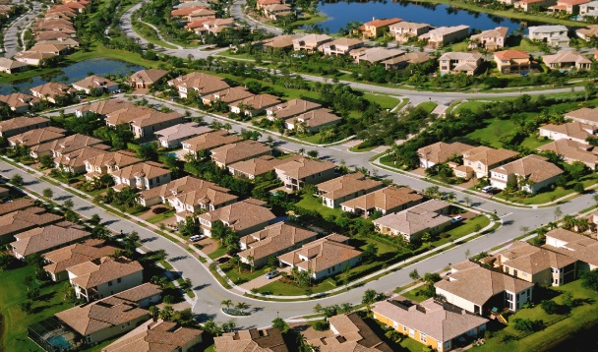
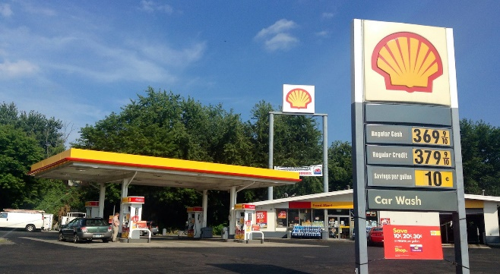


Causal Relations among Patterns
Reason: dangerous goods requirements in the destination
Notes:
We adopt a special insight to model causality among patterns. We consider the reason of a risk pattern as the dangerous goods requirements of the destination of the transporters that went through the pattern. Using this case as an example, a truck carried gas tank went from a gas storage to a gas station and went through a residential [,rɛzɪ'dɛnʃl] area. Why this truck must went through the residential [,rɛzɪ'dɛnʃl] area. Because there are dangerous goods requirements in the gas station.
Follow this logic, we know the reason of a risk pattern could be considered as the dangerous goods requirements in the destination of the transporters that went through the pattern.

Slide 18
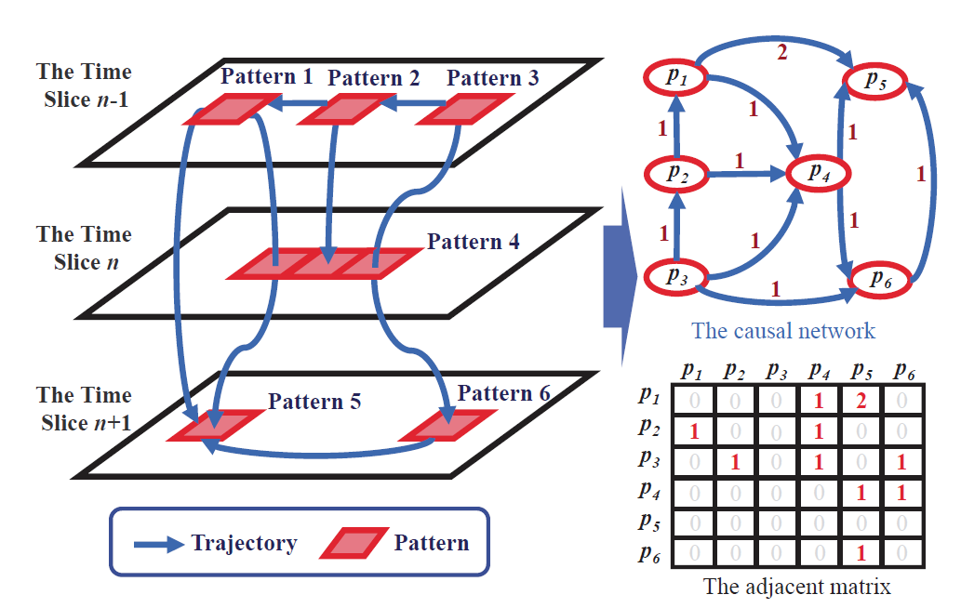
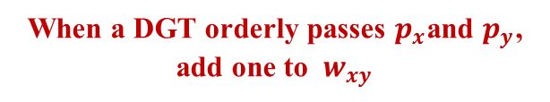
Causal Network Building
Risk patterns
When a DGT orderly passes $p_{x}$and $p_{y}$, add one to ${ w}_{xy}$
DGT traces
Causal: $p_{x}→ p_{y}$, risk in $p_{y}$ as a cause of the risk in $p_{x}$.
DGT traces: Extract traces whose destination is close to downtown.
Notes:
Follow this logic, we build a causal network to model relations among the risk patterns. In the network, we consider risk patterns as nodes. If there exist a DGT traffic from pattern A to the pattern B, we build a edge from the node A to the node B. The weight of an edge is the traffic volume between the two patterns.

Slide 19
DGeye : City Eyes on Dangerous Goods
Multi-source data fusion
Frequent risk pattern miming
Causal network building
Applications
Notes:
Finally, we developed two applications based on the causal network.

Slide 20








Ranking Importance of Risk Patterns
Random Walk with Restart (RWR) on the causal network
1) Causal transition probability from $p_{x}$to $p_{y}$
Causal
Network
2) Ranking score vector
Transition matrix G composed of $g_{xy}$.
is a pattern-size ratio vector.
3) Iterate until error is less than threshold.
A pattern with a greater score is more important.
Notes:
The first application is ranking importance of the risk patterns. We use a random walk with restart algorithm on the causal network. This process is very like a pagerank. Using the algorthim, we got a ranking score for each pattern. A pattern with a greater score is more important.

Slide 21
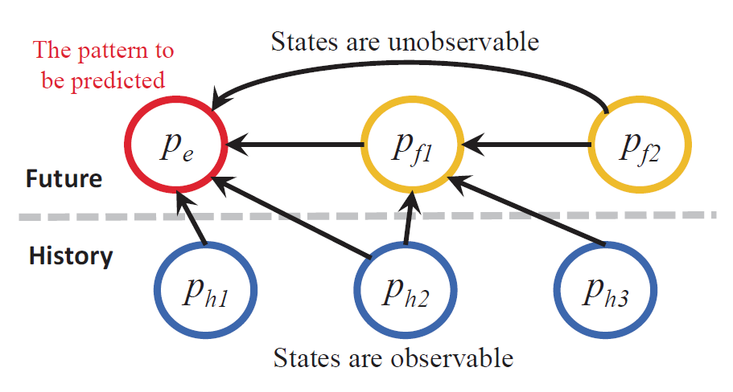
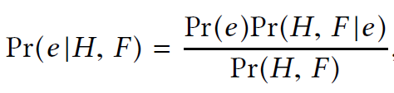
Pattern State Prediction
How to predict whether a pattern will be in the risky state in the next time slice?
Solution: Causal network based Bayesian inference
Observable states (t, t-1…)
Challenges:
Some pattern happened in the same time slice with the pattern to be predicted. The states of these patterns are unobservable.
Unobservable states (t+1)
To be predicted (t+1)
Notes:
The second application is pattern state prediction. In this application, we predict whether a pattern will be in the risky state in the next time slice. Because our network is a causal network, we directly use the network as a Bayesian network, and use Bayesian inference to predict pattern states.

Slide 22
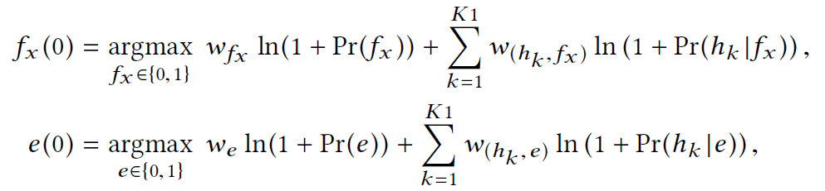
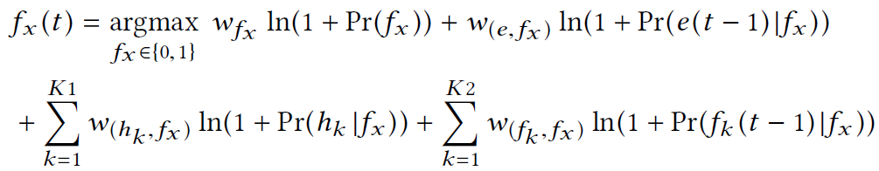
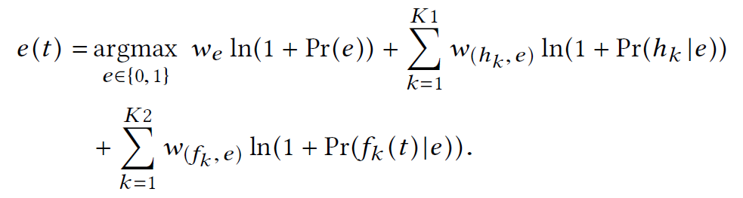
Causal network based Bayesian inference
Expectation-Maximization (EM) algorithm to
infer the state of unobservable patterns
Edge-weighted naive Bayesian model
t-th round of the E-step
Two advantages
Exploit the causal dependency among patterns.
Make use of causal information in unobservable patterns.
t-th round of the M-step
Notes:
Because in the network, some reason patterns for the pattern to be predicted is not observable, we proposed a EM algorithm to infer the states of unobservable patterns.

Slide 23
Experiments

Slide 24
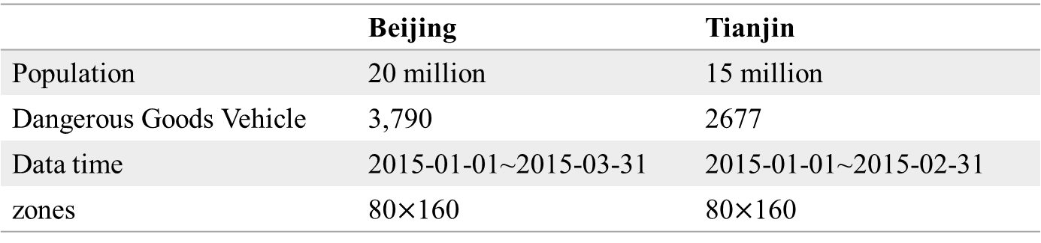
Experiments
Experimental Setup
Test the DGeye system using the data of two big cities in China: Beijing and Tianjin
Divide one day into 24 time slices, one hour per slice.
Divide the maps of the two cities into 500m$×$500m urban zones.
 | Beijing | Tianjin
Population | 20 million | 15 million
Dangerous Goods Vehicle | 3,790 | 2677
Data time | 2015-01-01~2015-03-31 | 2015-01-01~2015-02-31
zones | 80$×$160 | 80$×$160
Notes:
Apply the DGeye system to two big cities of China: Beijing and Tianjin. This is the experimental setup. Because we want to whether the system could help us to prevent [pri'vɛnt] the Tianjin explosion, we selected data before the explosion in our experiment.

Slide 25
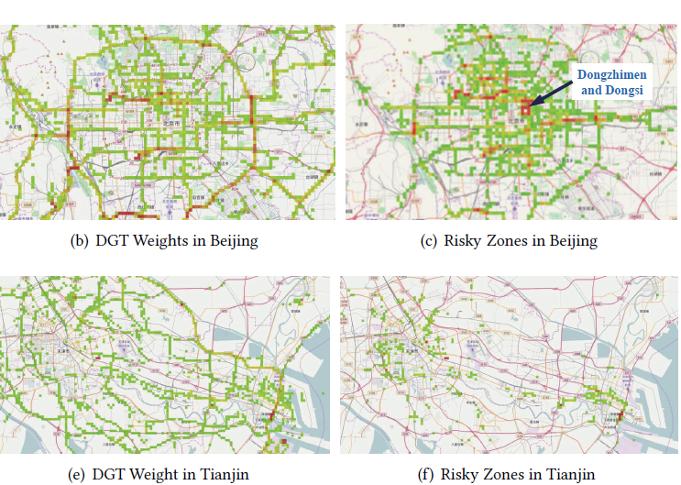
Experiments
Risky Zones Detection
Dangerous Goods
Risk Scores
Notes:
We first see these four maps. The maps in the left column show distribution of dangerous goods, and the right column shown the high risk score zones. As shown in these map, if we only see dangerous goods, we may think the most risks are distributed out of cities. But if we merge population data with dangerous goods, we can find there are many high risk zones located in the center of the city. In Tianjin, we found there many high risk zones in the port area. The explosion just happened in this area.

Slide 26
Experiments
Risky Pattern Mining
Spatial distributions of patterns in Beijing and Tianjin
are also different
10:00 time slice
Beijing
Tianjin downtown
Tianjin port
Different Spatial Distributions
Beijing:
Gas stations and restaurants.
Big-size risky patterns are located in downtown area.
Tianjin:
Most of big-size patterns are in the port area.
Main urban area is relatively safe.
Notes:
These three maps show spatial distributions of risk patterns in Beijng and Tianjin. The customers of dangerous goods in Beijing are gas stations and restaurants, so most of big size patterns in Beijing are located in the downtown. In Tianjin, dangerous goods are for import and export, so big size patterns are located in the port areas.
The dangerous good requirements in Beijing are daily life’s requirements. Such as gas in gas station, and liquid gas in restaurants, but in Tianjin are chemical materials for import and export. Therefore, temporal distribution in Beijing is very is similar as rhythm with people’s daily life, but in Tianjin the rhythm is very weak. This results show why we need risk patterns, which indicate stable rules of dangerous goods risks.

Slide 27
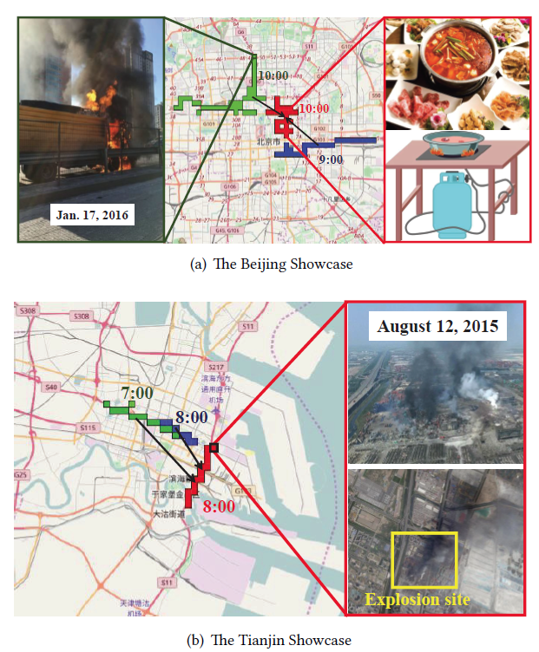
Experiments
Importance Ranking
Different Colors
Red: the first ranking pattern.
Green: the first ranking pattern caused by the red pattern.
Blue: the second ranking patterns caused by the red pattern.
Notes:
In the next step, we use a show case to demo the experiment result of our pattern ranking method. In the map, the red blocks are the first important pattern we detected in Tianjin. The pattern happened in the 8:00, and cover a street long the port railway. The green and the blue patterns are the first and second important patterns that caused by the red pattern, which covered the main street to the port. The Tianjin explosion just happened in the intersection of the streets covered by the three patterns. This case verified effectiveness of our system. If we have the Dgeys system before the explosion, we may have a chance to avoid the terrible blast.

Slide 28
Experiments
Importance Ranking
The Guijie food street
Different Colors
Red: the first ranking pattern.
Green: the first ranking pattern caused by the red pattern.
Blue: the second ranking patterns caused by the red pattern.
Notes:
In Beijing, the first important ranking pattern covers a very famous food street, the guijie street. The most popular food in the guijie street is hotpot. As show in the figure, hotpot need a gas tank to cook food on tables, which cause everyday, many trucks transport liquid gas tank to Guijie. The green and blue patterns are the first and second patterns caused by the red pattern, which covers the main street from out of the city to the Guijie.
On Jan. of the last year, a gas tank transporter fired on the road covered by the green pattern. This destination of the truck is just a restaurant in Guijie, which verified our experiment result.

Slide 29
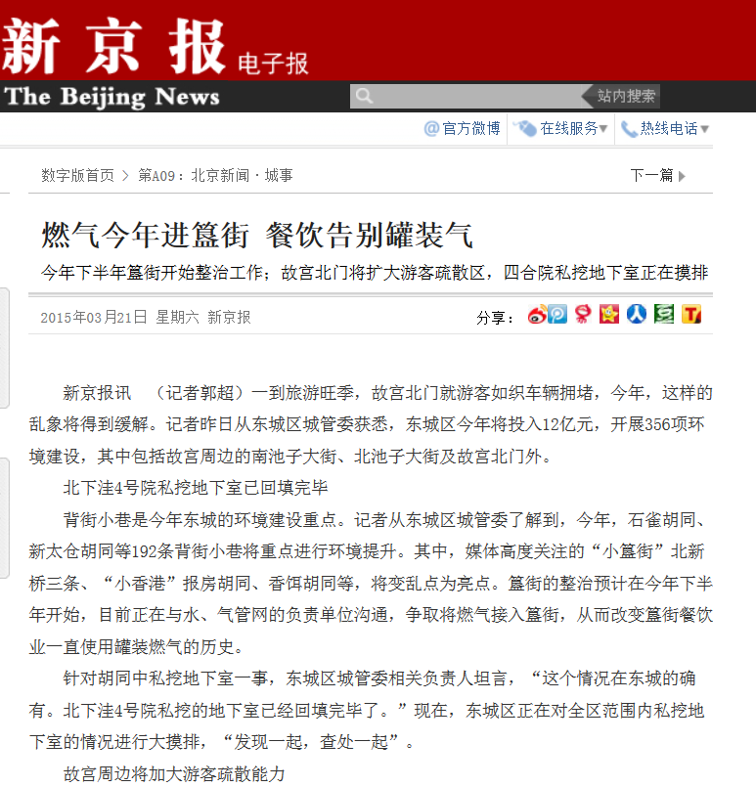
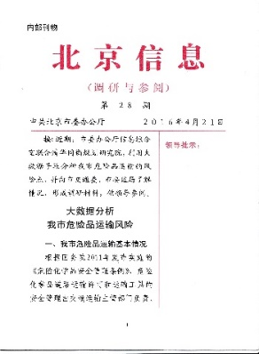
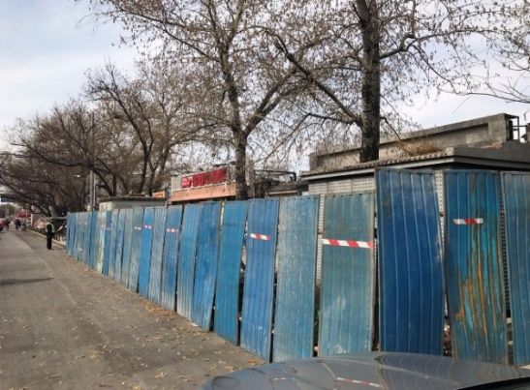
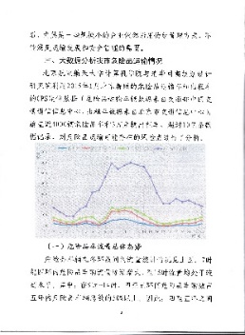
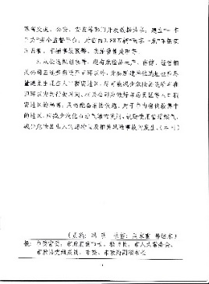
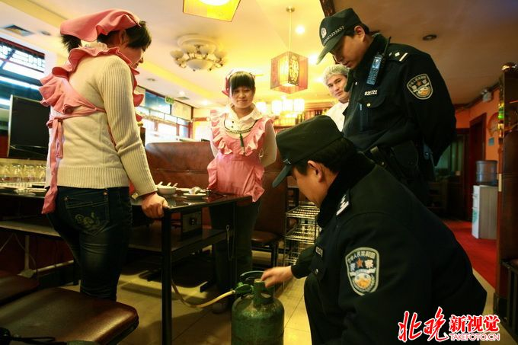
Experiments
Policy Applications
Beijing government implemented policies in Guijie
The Beijing government started a gas pipeline laying project in the Guijie food street of the Dongzhimen and Dongsi district in September 2016, reported by news.
Notes:
We reported this discovery to the Beijing government. Driven by our work, the Beijing government started as gas pipeline layering project in the Guijie food street. This is a successful application case of our system.

Slide 30
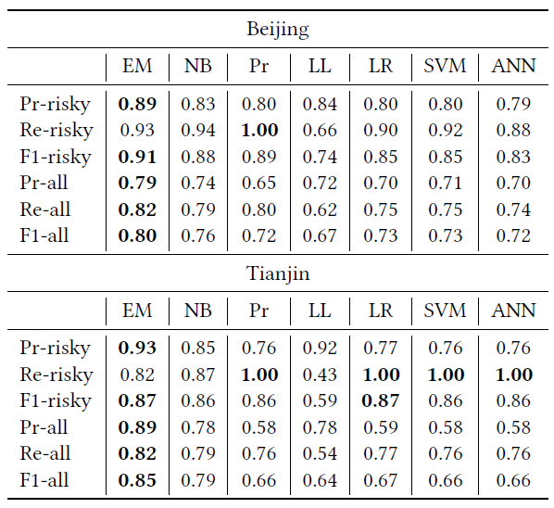
Experiments
Patten State Prediction
High performance prediction using EM
Baselins
The Prior model(Pr)
The Likelihood model(LL)
The Naive Bayes model (NB)
The Logistic Regression (LR)
Support Vector Machine (SVM)
Neural Networks (ANN)
2/3 days as training sets and the remaining as test sets.
Advantages
The causality relations in the causal network is very effective.
The information of unobservable states could improve the prediction performance.
The Bayesian method adopted by our model is very suitable to the prediction scenario with small training sets.
Notes:
Finally, we test the performance of pattern risky state prediction of our system. The experiment results show that our model achieved the best performance than other baseline models.

Slide 31
Conclusion
In this paper, we present a novel system call DGeye for urban dangerous goods management.
The keystone of DGeye lies in risky spatial patterns that reveal the rhythms of the risks in a city and are mined by a carefully designed Apriori-like algorithm.
A causal network make DGeye an ideal decision support system for urban planning and emergency management.
DGeye has proven itself in successfully recognizing the hidden explosion risks in Guijie food street of Beijing and in port area of Tianjin.

Slide 32
THANK YOU!

Slide 33
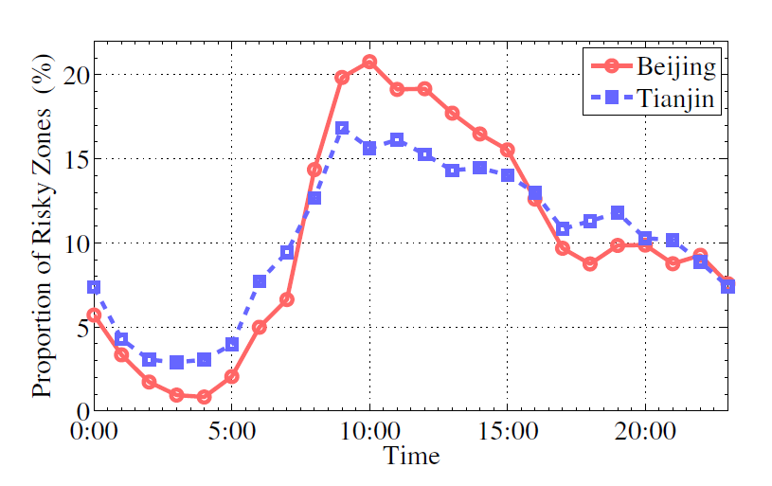
Experiments
Risky Zones Detection
Similar risky zone proportions between Beijing and Tianjin
Averaged on all days in the data set.
Emergence of risky zones in the morning peak seems more severe for Beijing.
Temporal distributions of risky-zone numbers (in percent).
Notes:
This figure shows the temporal distribution of risky zone number in Beijing and Tianjin. As shown in this figure, although the morning peak in Tianjin is more smooth, both Beijing and Tianjin has similar distribution shape.

Slide 34
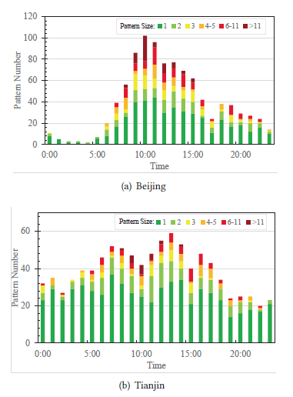
Experiments
Risky Pattern Mining
Temporal distributions of patterns in Beijing and Tianjin
are very different
Different Temporal Distributions
Beijing: obvious tide, more big-size patterns.
Tianjin: more smoothly.
Beijing
Diverse Requirements of Dangerous Goods
Beijing:
citizens in daily life.
distribution has a similar rhythm with people’s daily life.
Tianjin:
chemical materials import and export in the Tianjin port.
Rhythm is very weak.
Tianjin
The reason why we need risky patterns, which indicate relatively stable rules and zones depict instant phenomenon.
Notes:
If we see the temporal distribution in the patterns level, we can get different conlusion. The risk patterns in Beijing have an obvious tide trend, but in Tianjin are very smooth. This is due to dangerous good requirement in Beijng and Tianjin are very different. The dangerous good requirements in Beijing are daily life’s requirements. Such as gas in gas station, and liquid gas in restaurants, but in Tianjin are chemical materials for import and export. Therefore, temporal distribution in Beijing is very is similar as rhythm with people’s daily life, but in Tianjin the rhythm is very weak. This results show why we need risk patterns, which indicate stable rules of dangerous goods risks.

