Slide 1
TranCIM: Full-Digital Bitline-Transpose CIM-based Sparse Transformer Accelerator
With Pipeline/Parallel Reconfigurable Modes

Slide 2
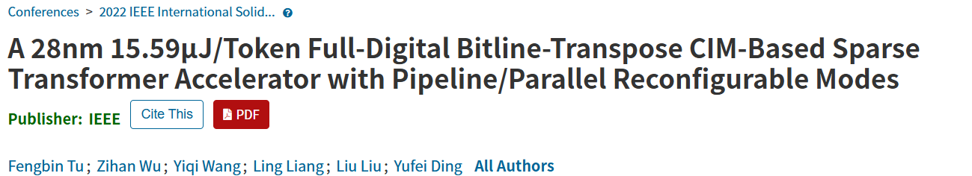
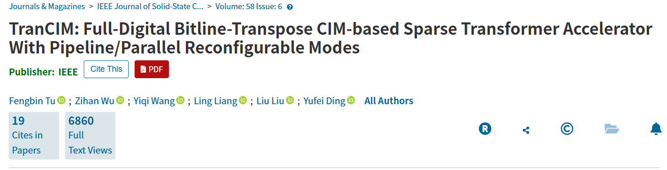

Slide 3
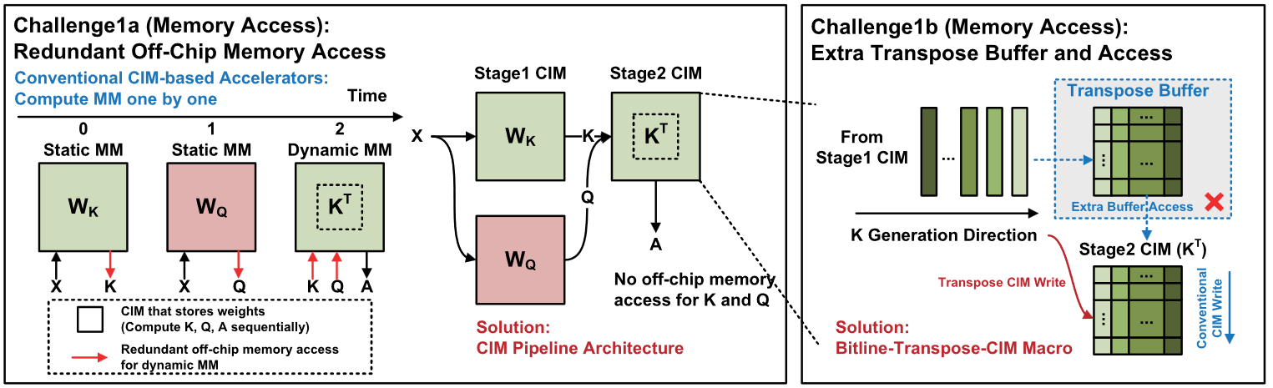
Challenge 1

Slide 4
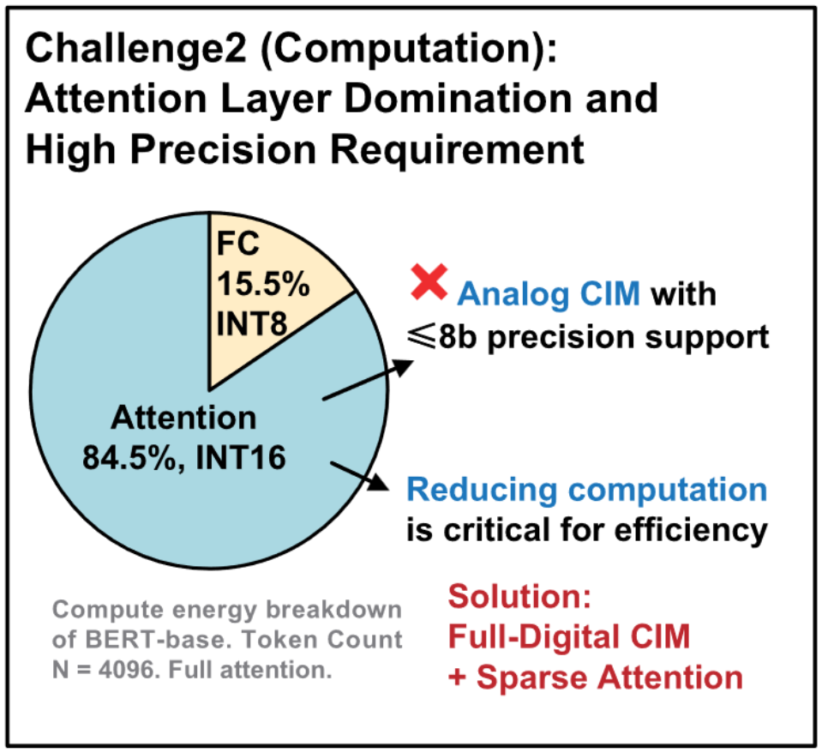
Challenge 2
the transformer’s computation and require >8b precision
previous analog CIM can only support ≤8b precision
reduce the computation amount of attention layers becomes more critical for efficiency improvement

Slide 5
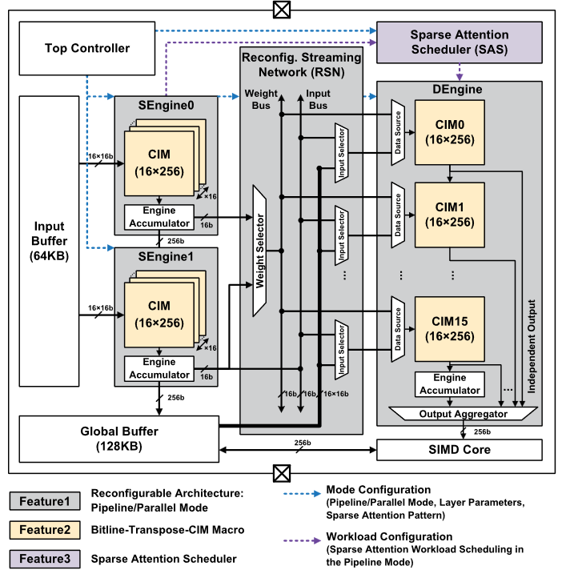
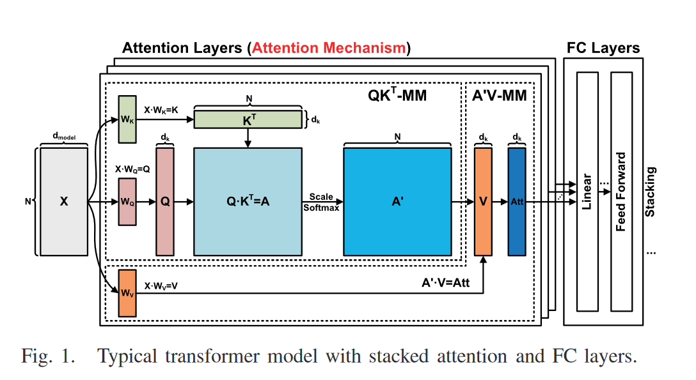
Overall Architecture

Slide 6
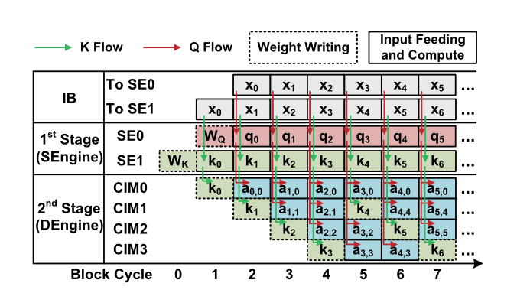
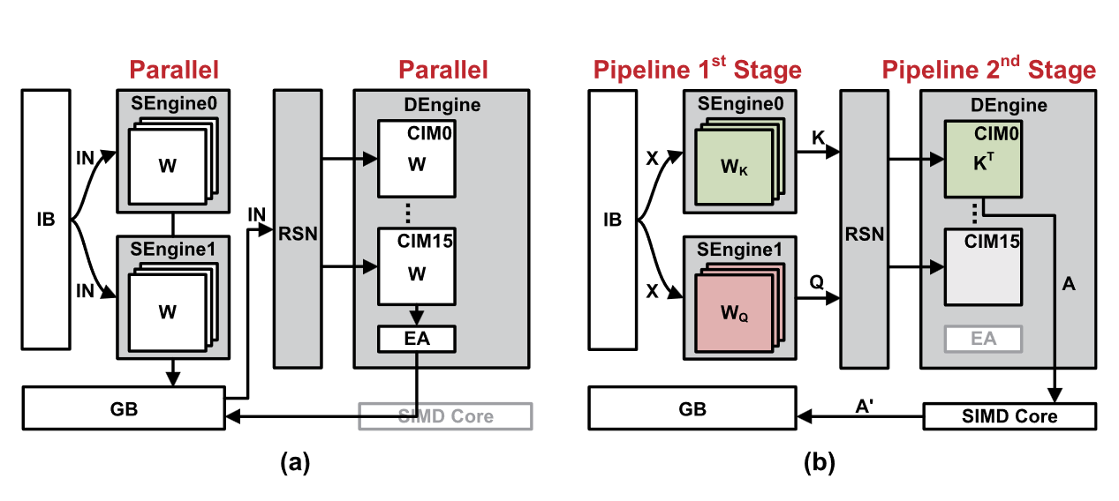
Solution 1a
pipeline/parallel reconfigurable modes
(a) Parallel mode (FC layer) (b) Pipeline mode (attention layer)
QKT -pipeline time chart,
with global + local sparse attention.

Slide 7
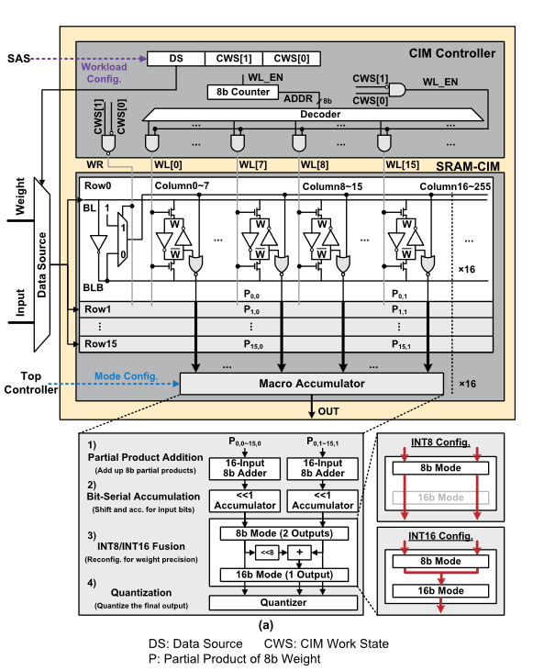
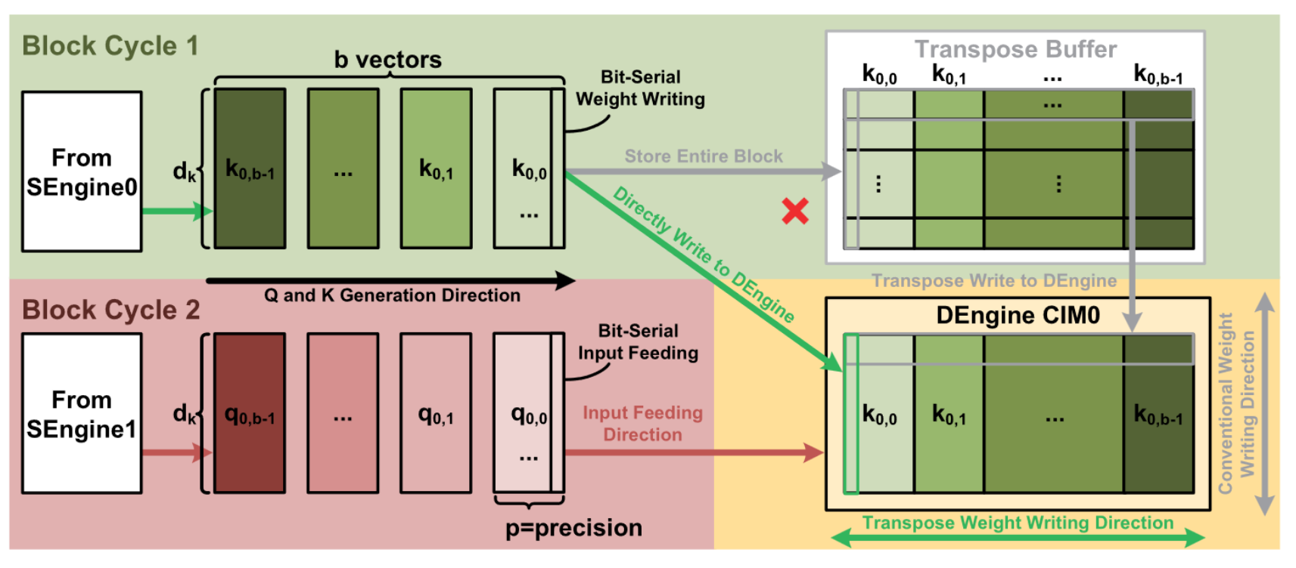
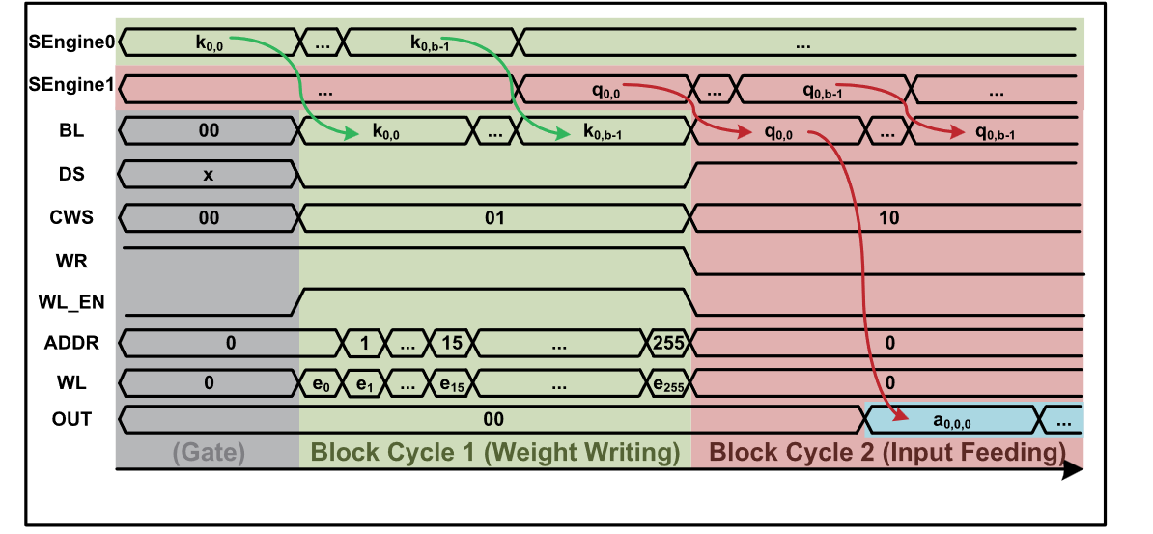
Solution 1b
Wordline-feeding CIM + bitline-transpose CIM

Slide 8
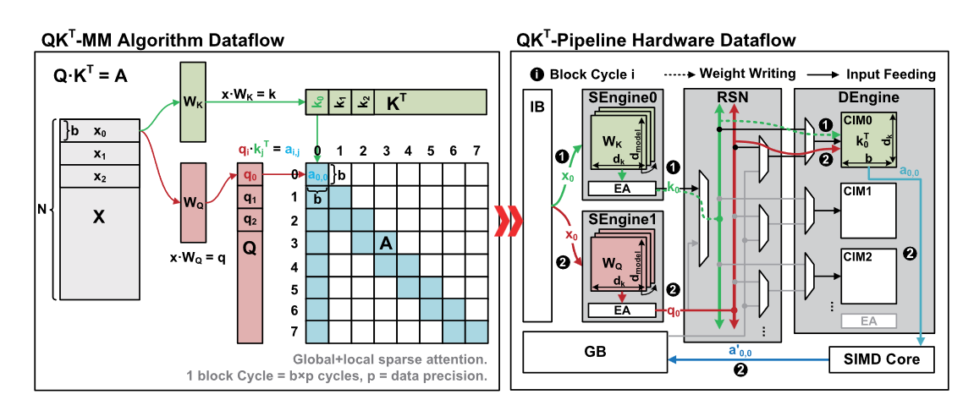
Solution 2
INT16 precision for attention layers and INT8 precision for FC layers
Block sparse patterns to reduce computation while maintaining high accuracy.

Slide 9
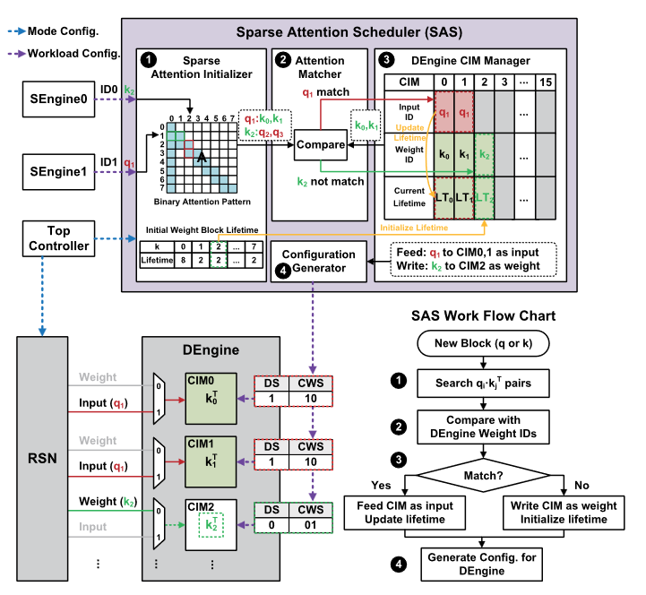
Overall Architecture

Slide 10
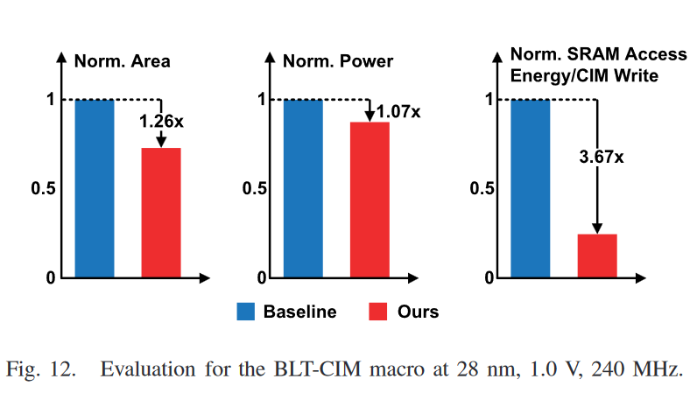
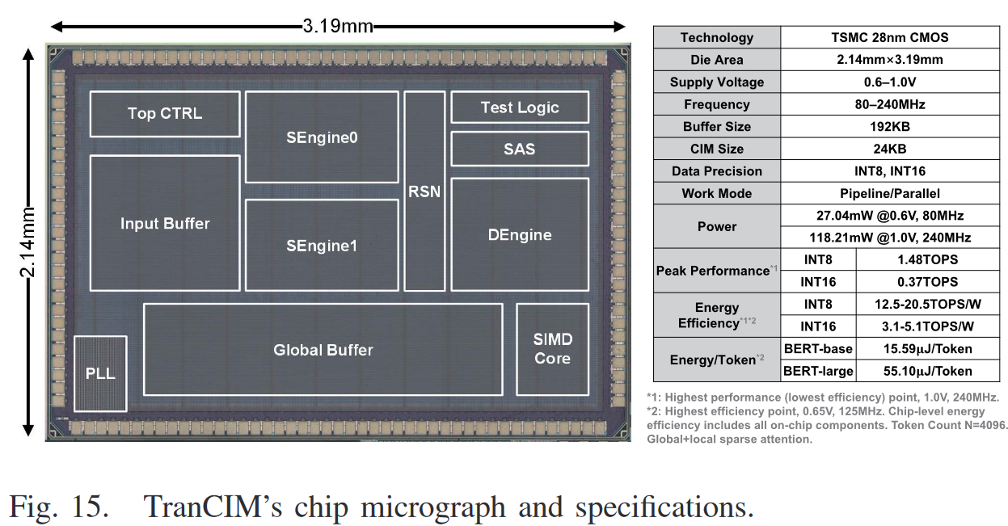
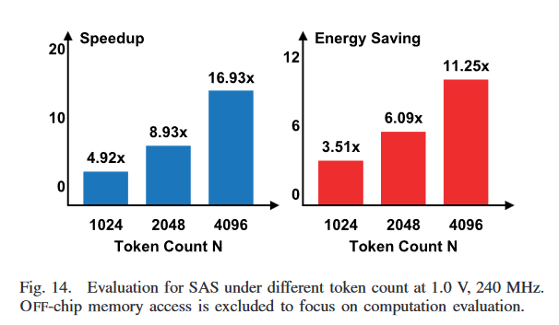
Technique Evaluation
Future work can lower power consumption by:
1) exploring circuit design at lower operating points;
2) designing more compact CIM layout with shorter data transmission paths;
And 3) exploiting more sparsity schemes for a lower toggle rate.

