Slide 1
Time_Freq_Analysis: Verification and Validation
Liz Hofer
October 22nd, 2020
CAS 741

Slide 2
Functional Test Cases
Area of testing: Fun. Req. 3 –
The output shall be a time frequency representation of the signal in the specified time period and over the specified frequency range.
The output shall be a time frequency representation of the signal in the specified time period and over the specified frequency range.
Part 1
Part 2

Slide 3
The output shall be a time frequency representation of the signal
All models are wrong; some models are useful.”
All time-frequency representations are wrong, some time-frequency representations are useful
Matrix vs Heatmap
This problem:

Slide 4
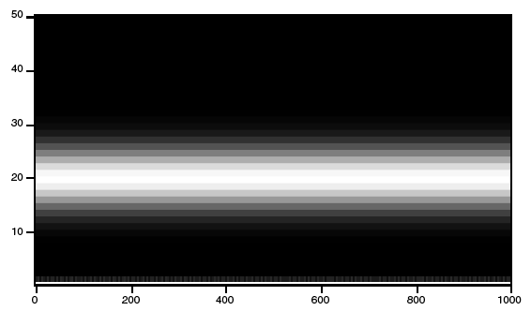
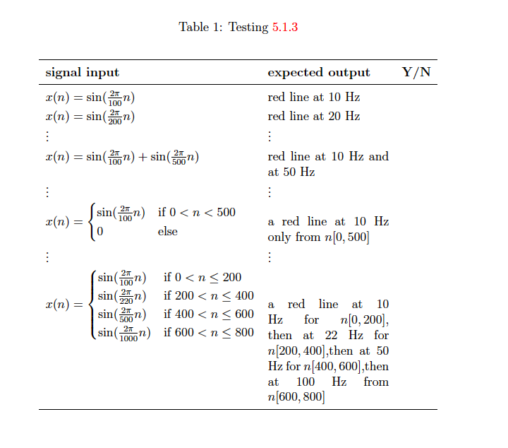
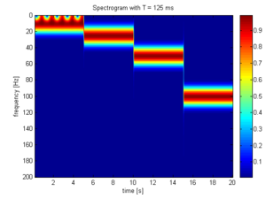
Testing Plan: Option 1
signal=sin(2*pi*x*50/1000)
https://www.wavemetrics.com/products/igorpro/dataanalysis/signalprocessing/timefrequency
https://en.wikipedia.org/wiki/Shorttime_Fourier_transform#/media/File:STFT_colored_spectrogram_125ms.png

Slide 5
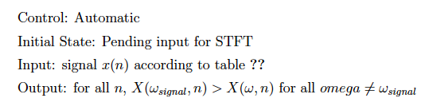
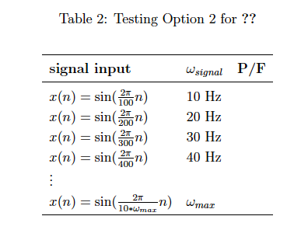
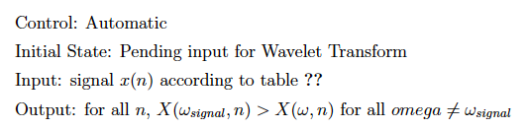
Testing Plan: Option 2

Slide 6
Functional Test Cases
Area of testing: Fun. Req. 4 –
The program should minimize spectral leakage.

Slide 7
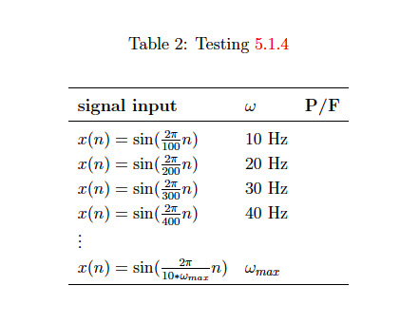
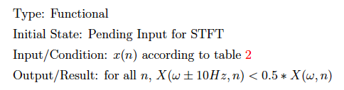
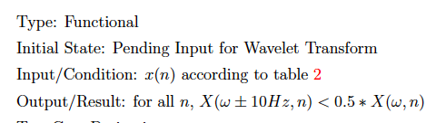
The program should minimize spectral leakage.
Dependent on what the signal actually is
What minimizes spectral leakage for one signal might amplify it in another

