Slide 1
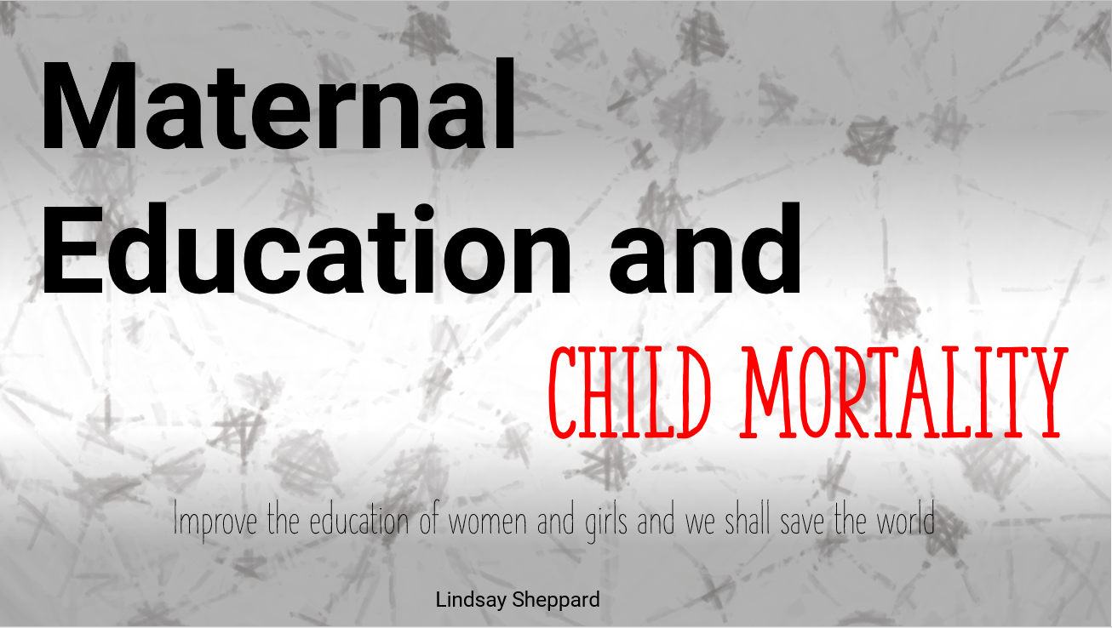

Slide 2
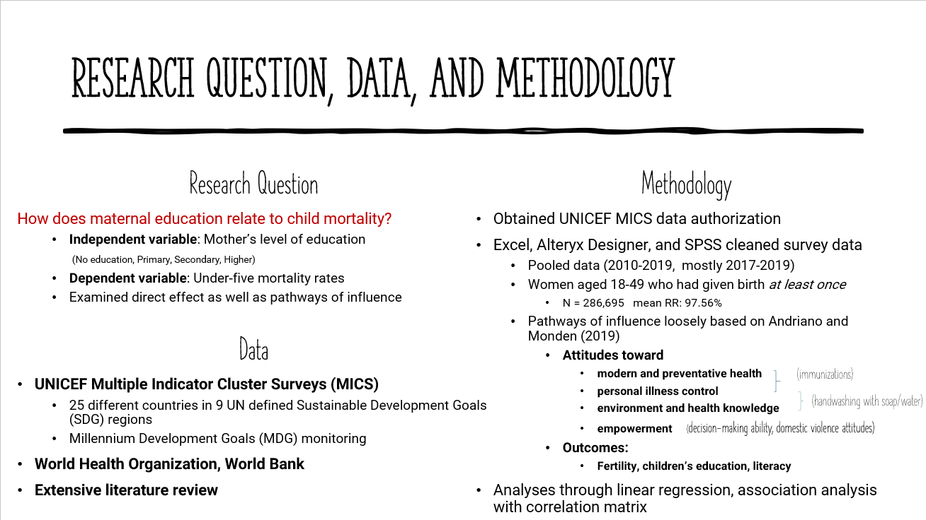

Slide 3
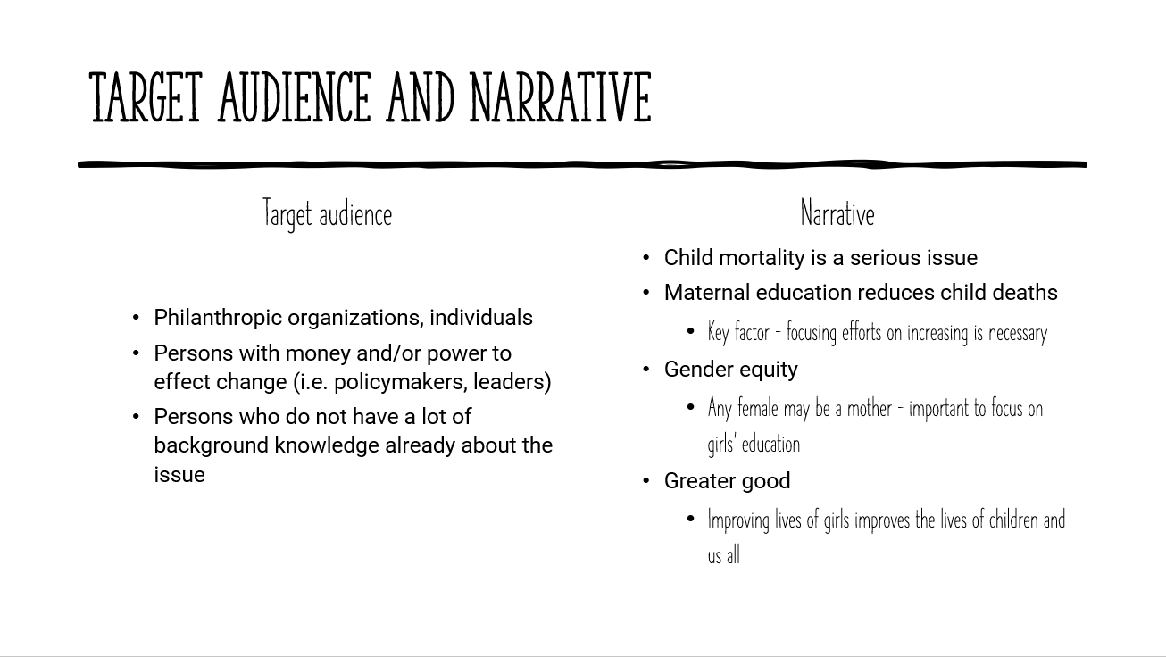

Slide 4
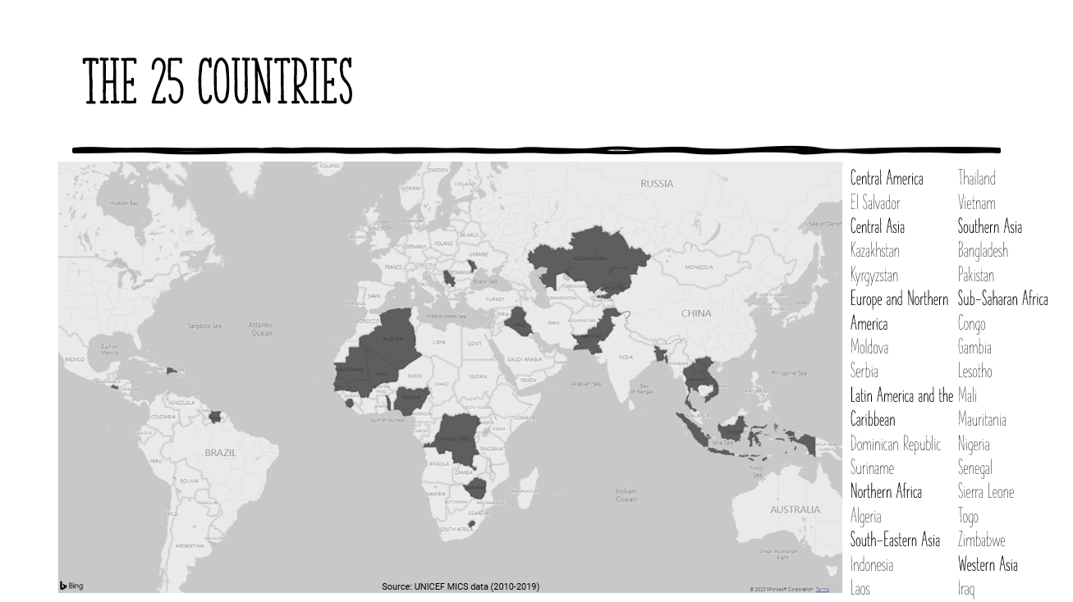

Slide 5
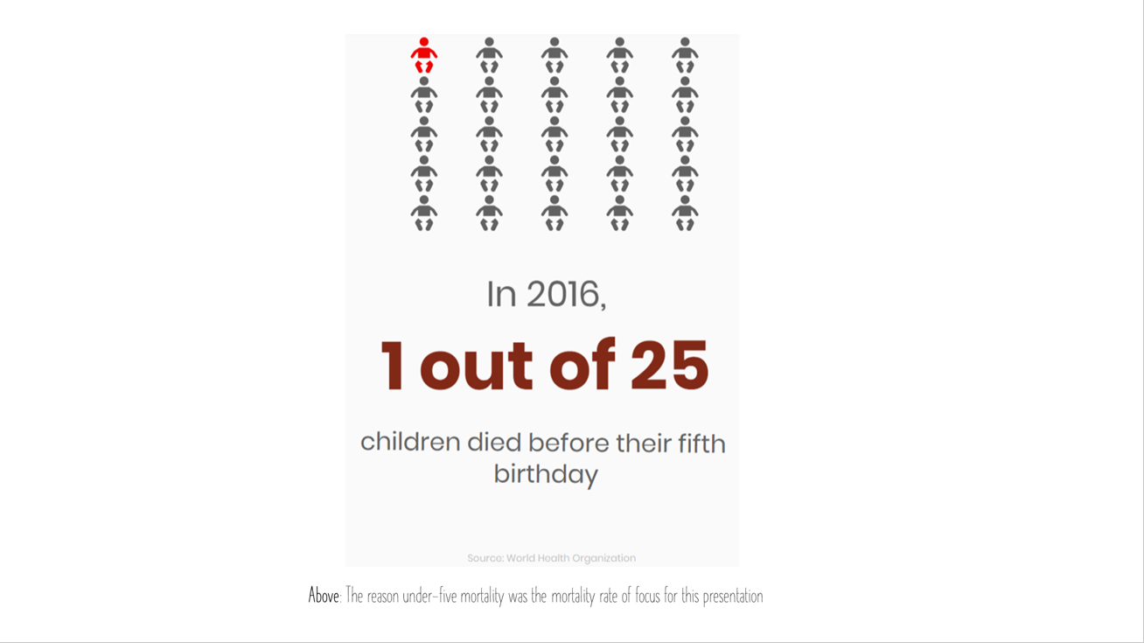

Slide 6
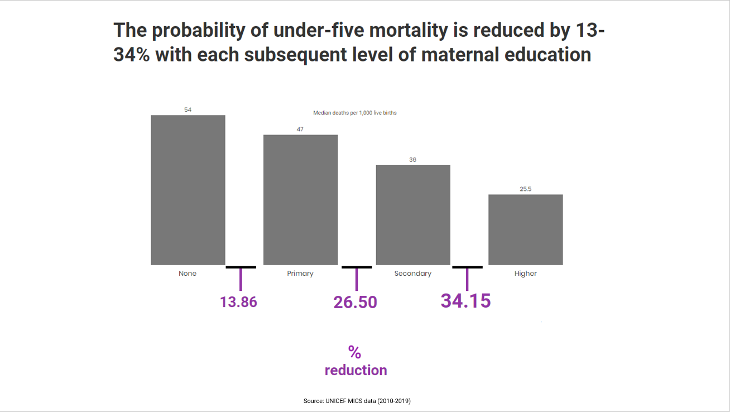

Slide 7
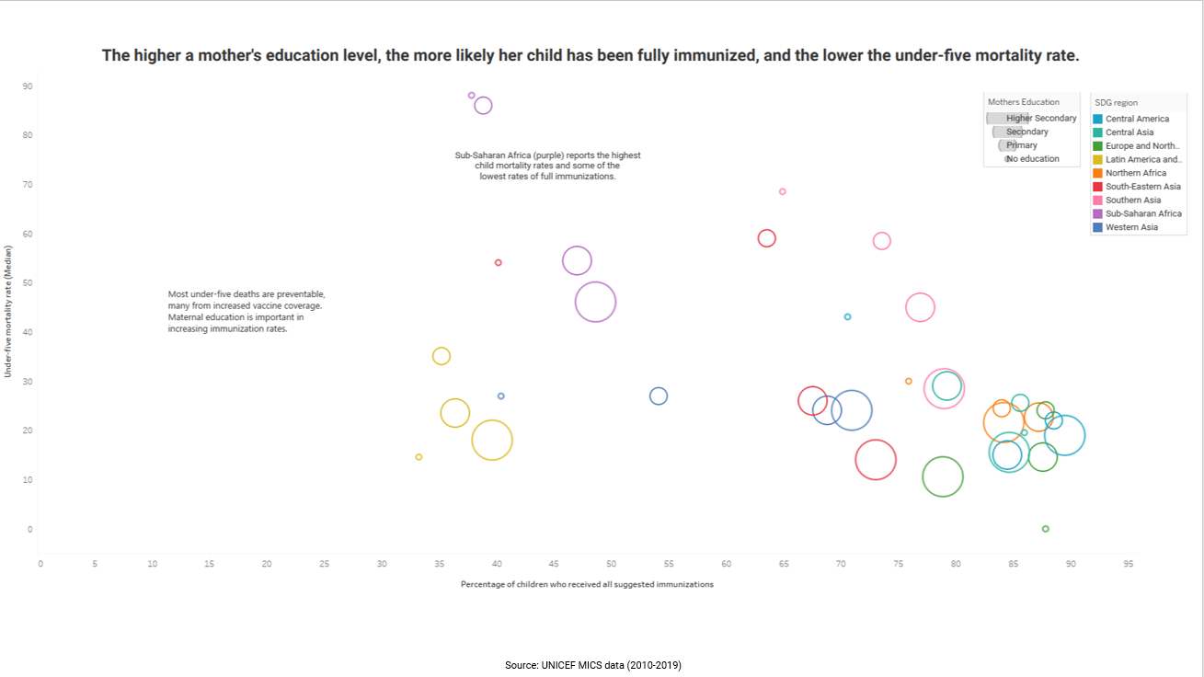

Slide 8
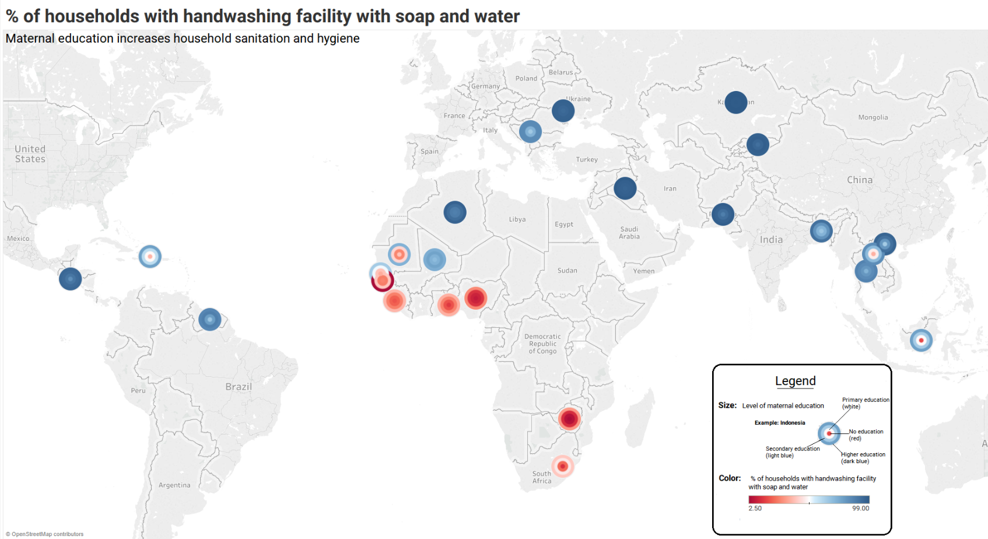
Source: UNICEF MICS data (2010-2019)
Notes:
Figure 5: The percent of households that have a place to wash their hands with soap and water is an important indicator of sanitation and hygiene practices. The graph suggests that all regions experience increased sanitation with increasing levels of maternal education. A legend has been provided as this is a more complicated graph. Color choice has been kept at greyscale plus two colors per Berengueres et al (2020).
Blue circles were chosen to resemble drops of water; red is used to indicate danger. Overall, we can see parts of Europe and Asia have high sanitation regardless of educational level, but Sub-Saharan Africa lags behind.

Slide 9
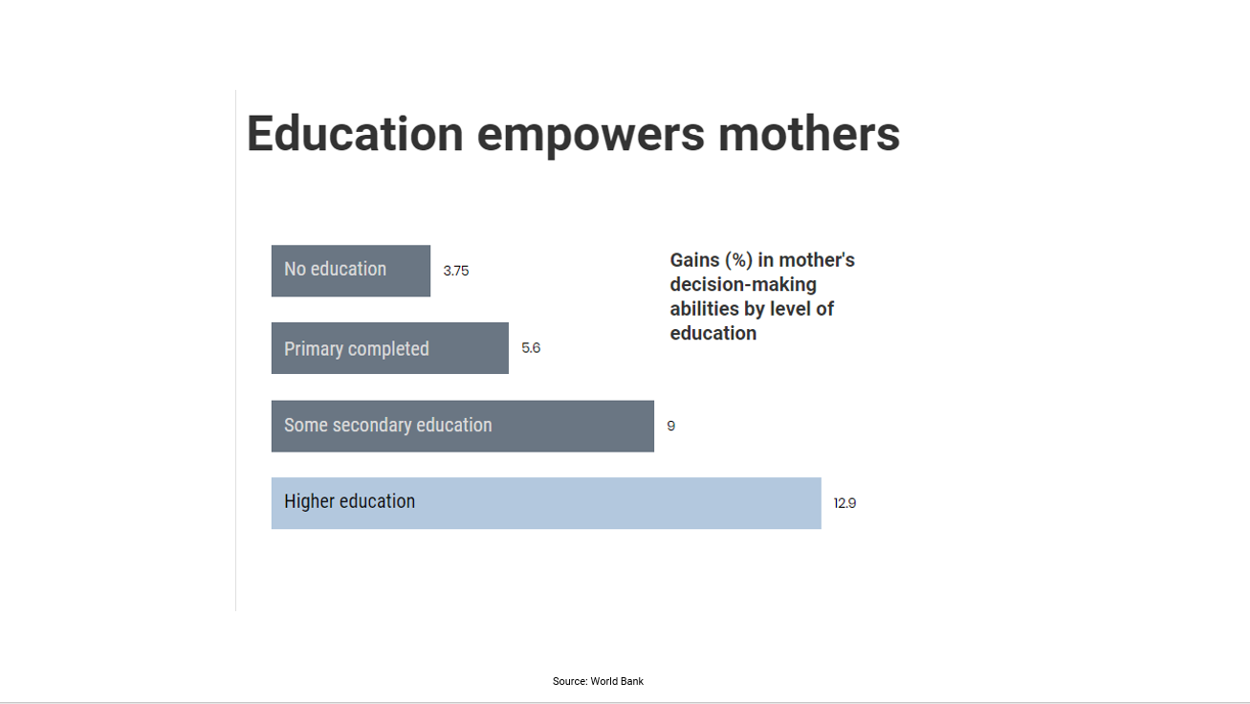

Slide 10
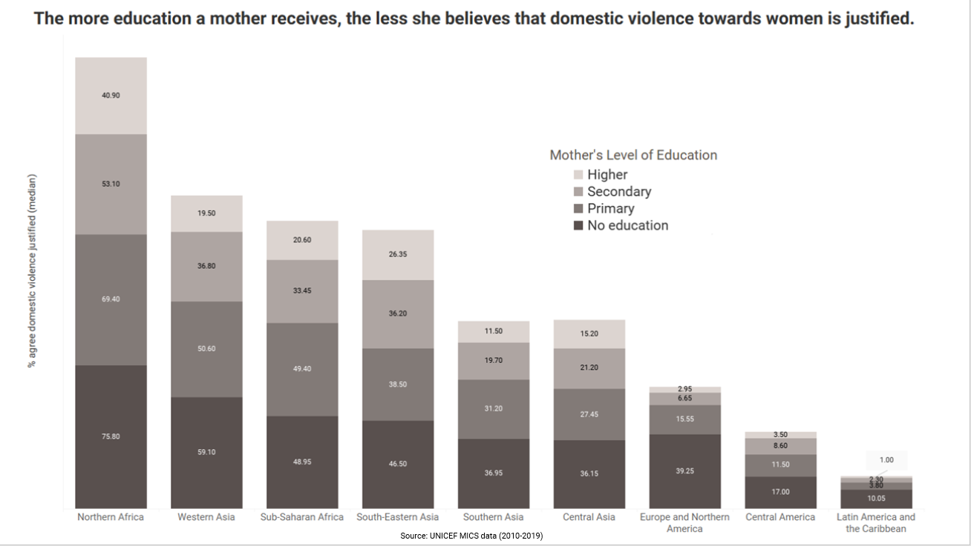

Slide 11
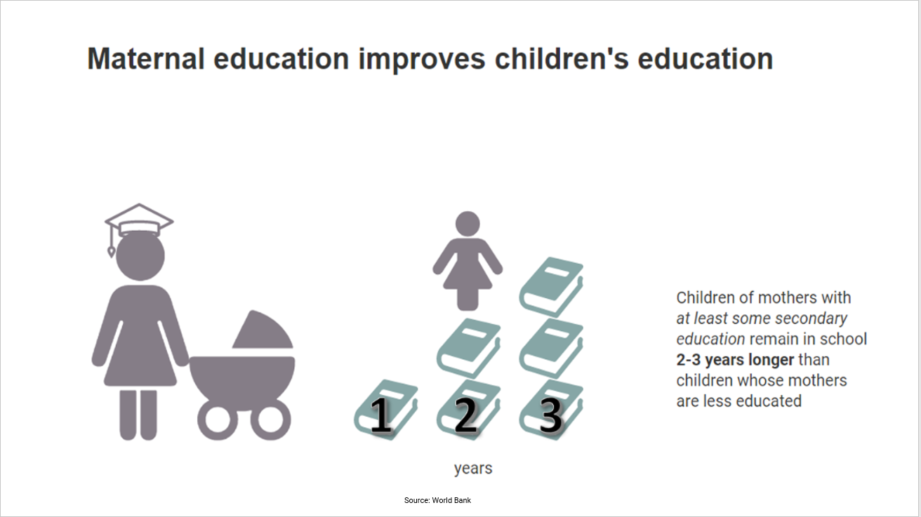

Slide 12
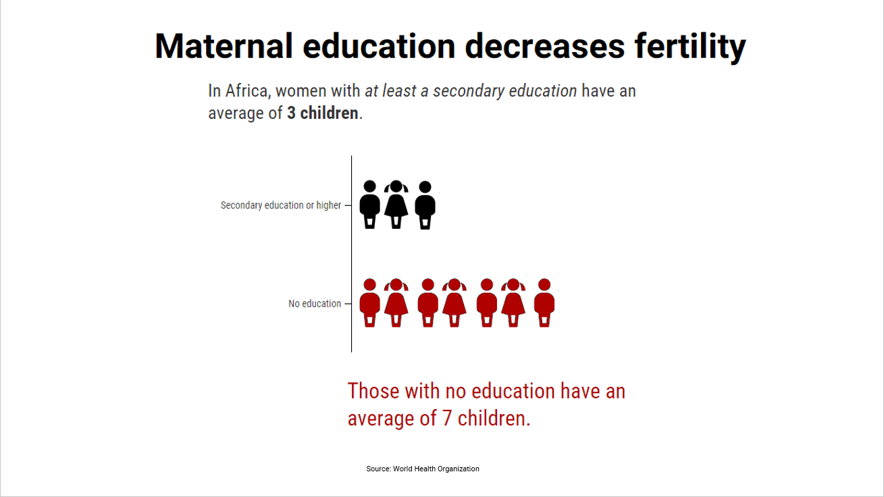

Slide 13
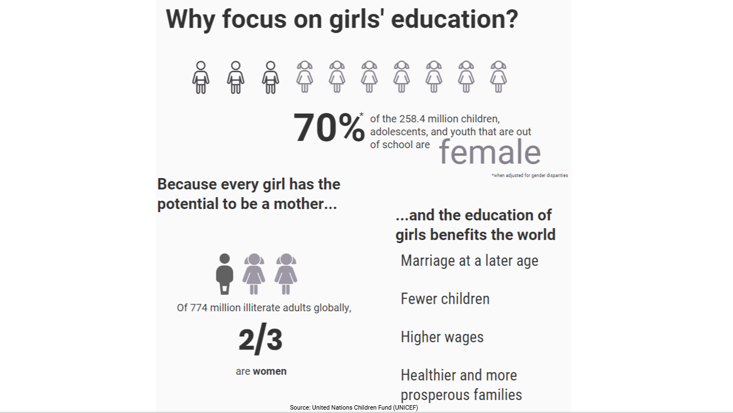

Slide 14
