Slide 1
Image Matting with multi-features generated by filter bank and wavelet transform
Team Ziwen Li and Guanqing Li

Slide 2
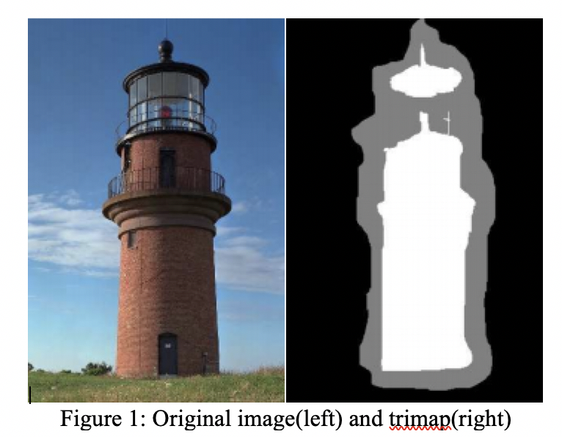
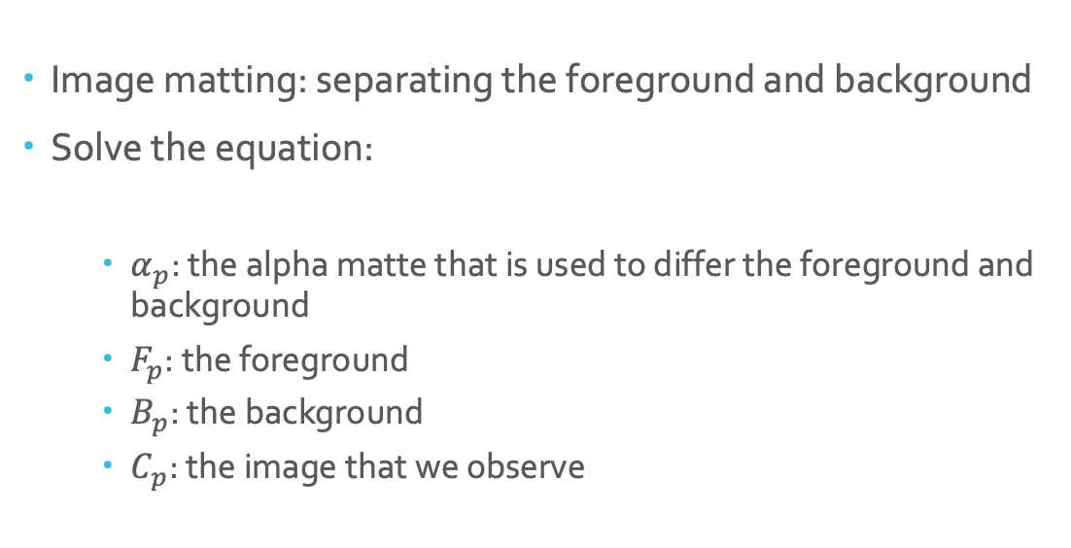
Problem description
Image matting: separating the foreground and background
Solve the equation:
$α_{p}$: the alpha matte that is used to differ the foreground and background
$F_{p}$: the foreground
$B_{p}$: the background
$C_{p}$: the image that we observe

Slide 3
Other approaches
Bayesian matting: uses MAP to predict the foreground and background from trimap.
Pro: shows great success
Con: cannot be used when the foreground and background have similar colors
Context aware matting: utilize trimap as input to an encoder network to supervise the output of another encoder-decoder which has original image as input.
Pro: high accuracy
Con: needs trimap which is time consuming
Index matting: transform trimap to the weighted mask to guide the network of original image.
Pro and con are similar to CAM
Background matting: use the original image and the background image (without the object to be matted) as input
Pro: state of the art technique
Con: uses the original image without feature extraction

Slide 4
Proposed approach
Use filter banks and wavelet transform to extract the features
Gabor filters
Wavelet transform
Combine them with the deep learning algorithms
Improve the performance of the algorithm

Slide 5
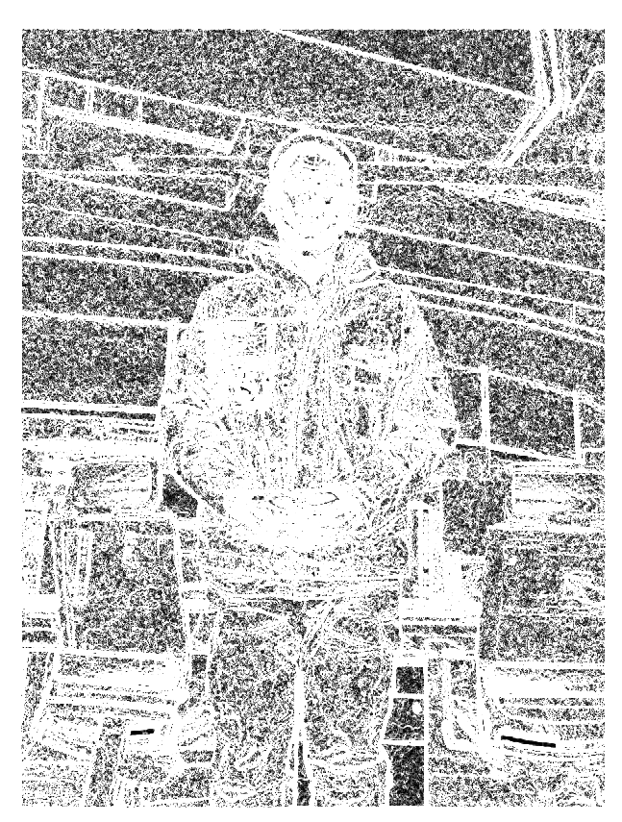
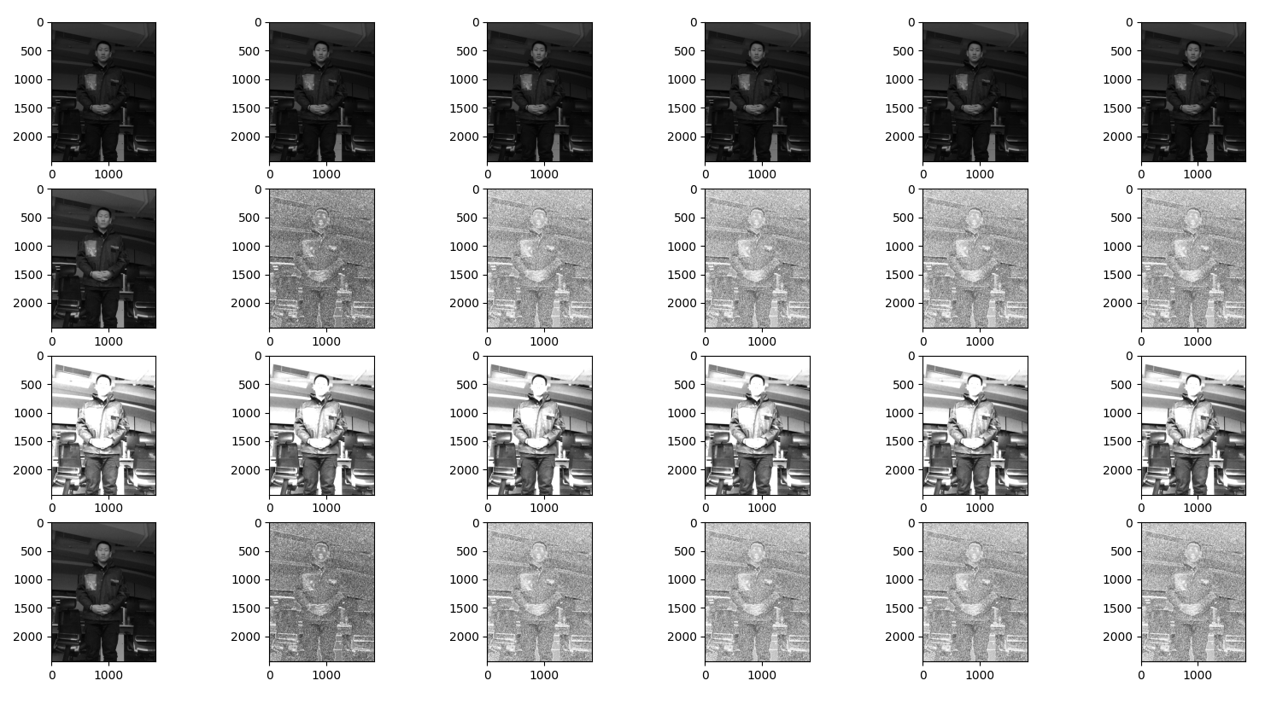
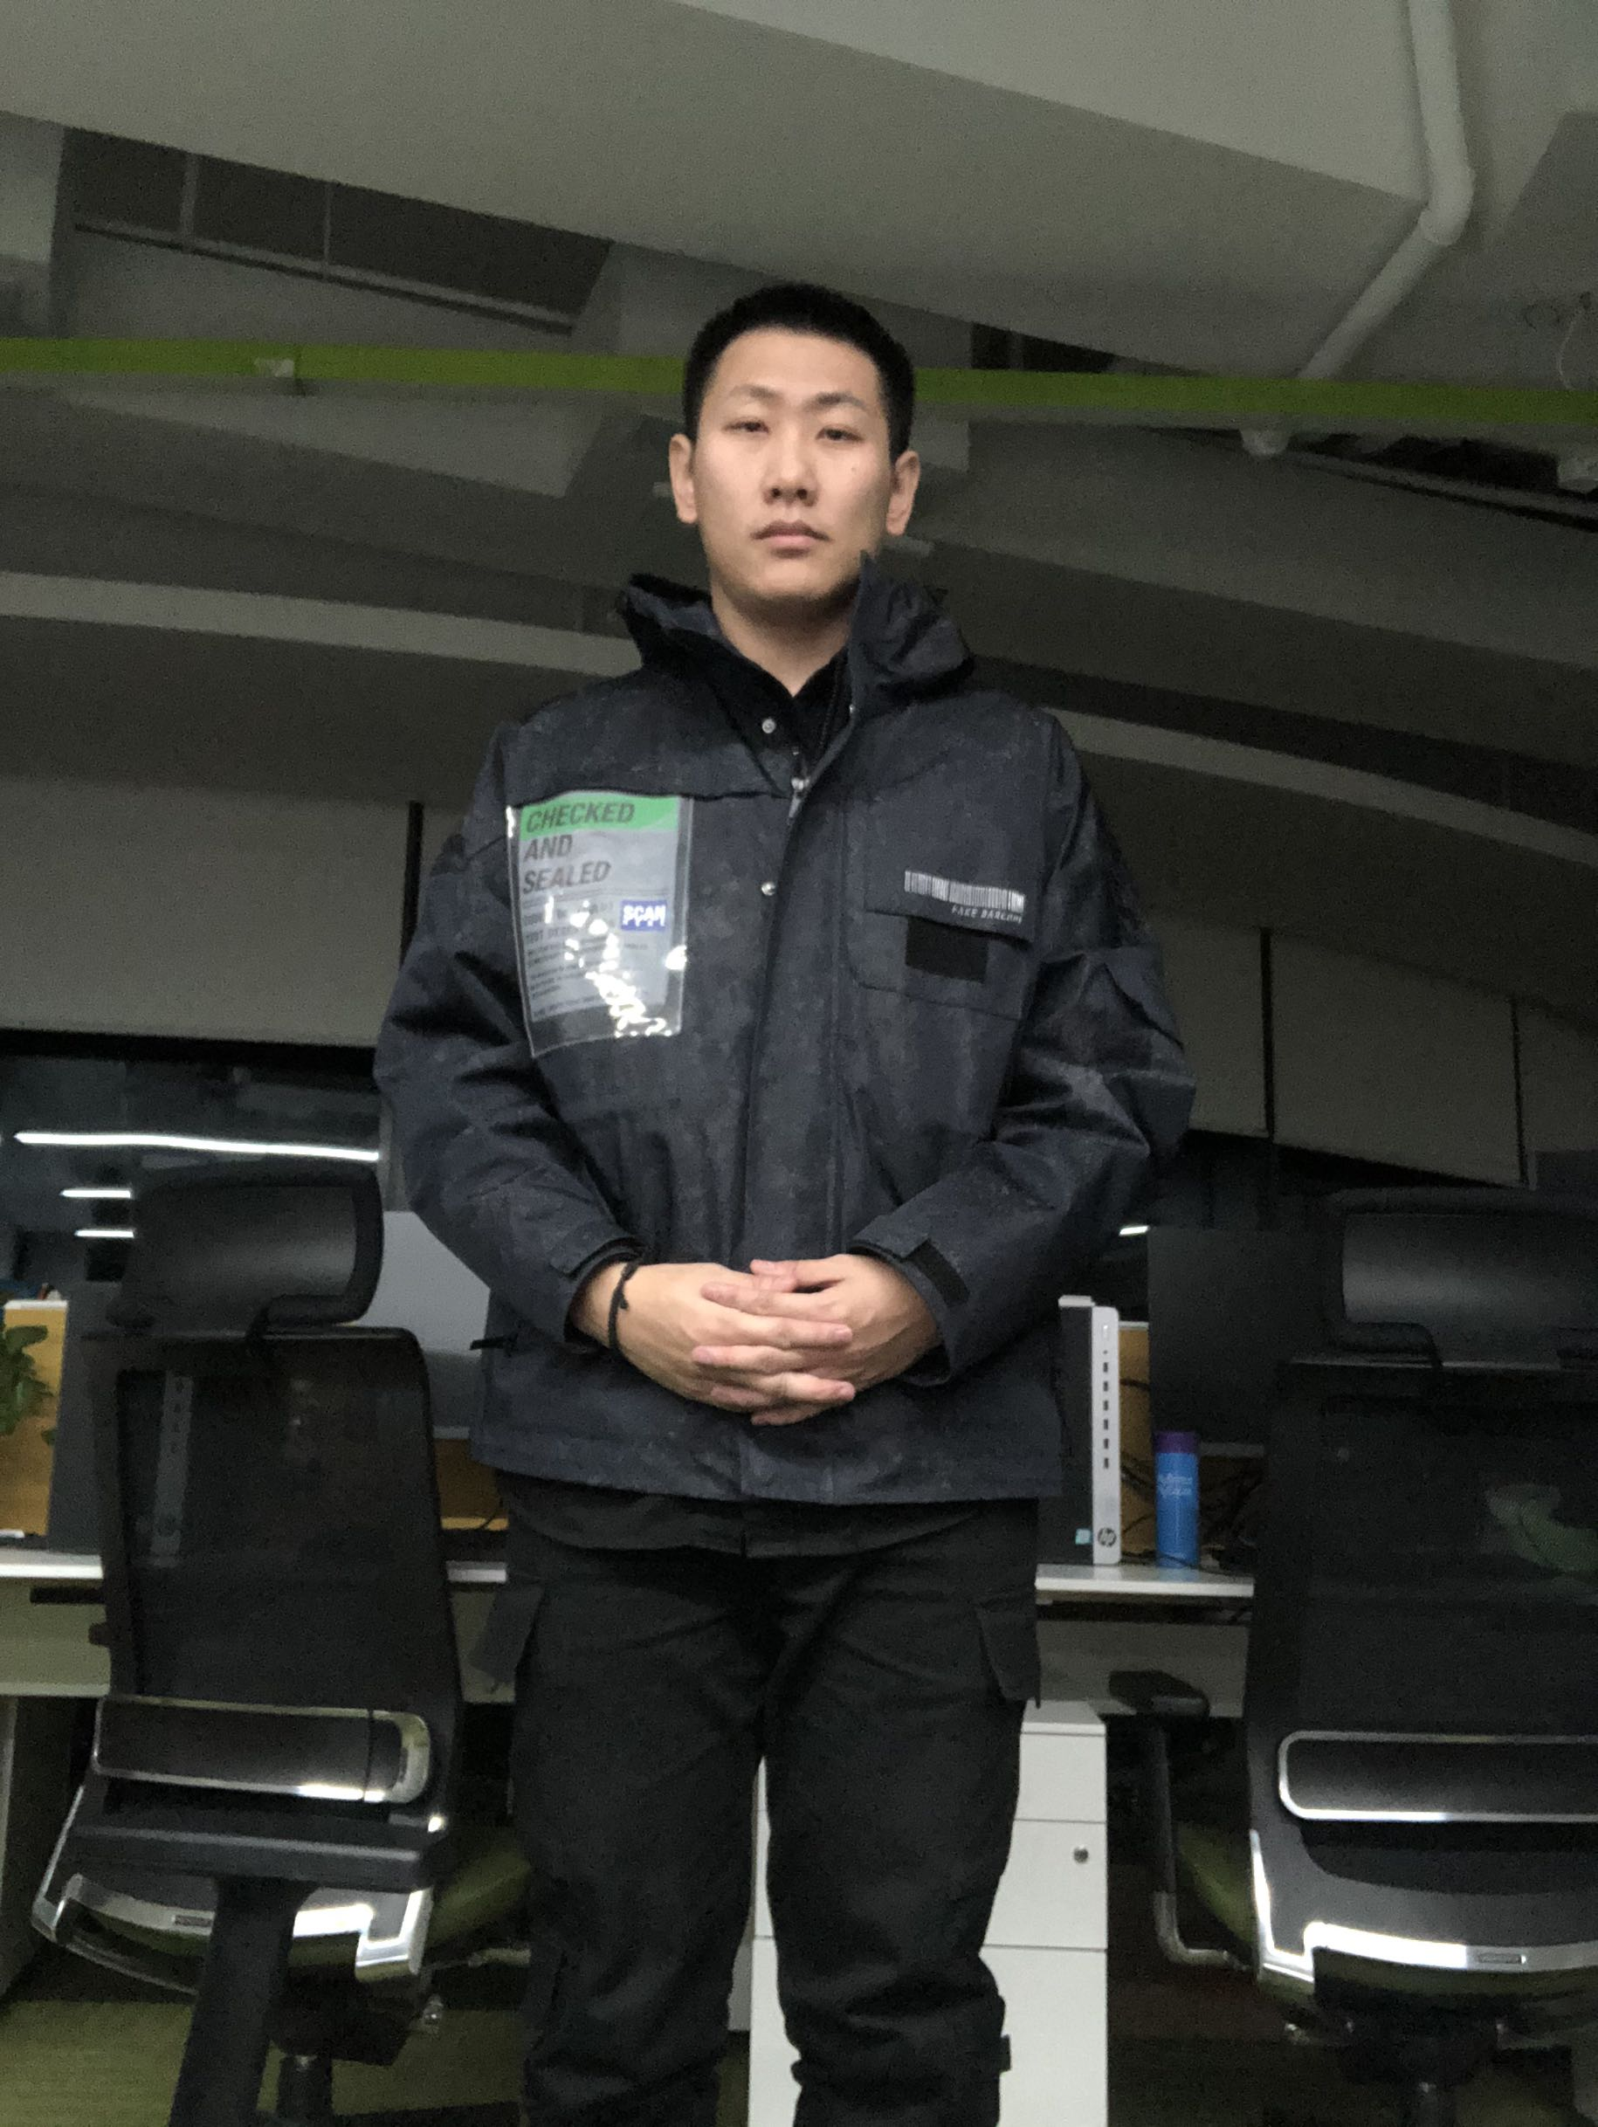
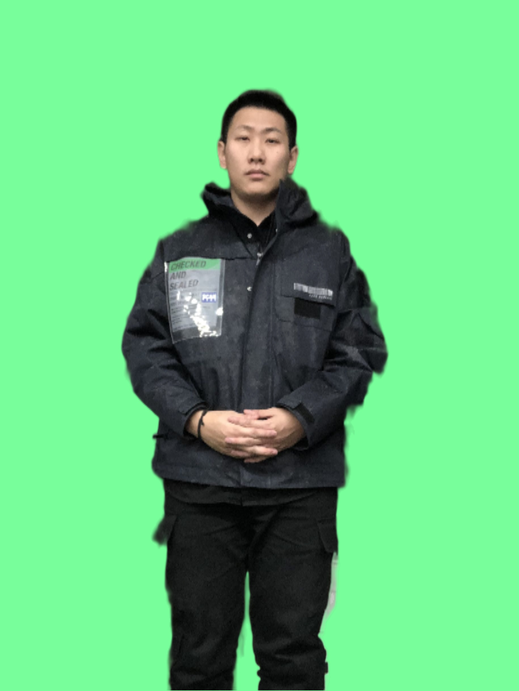

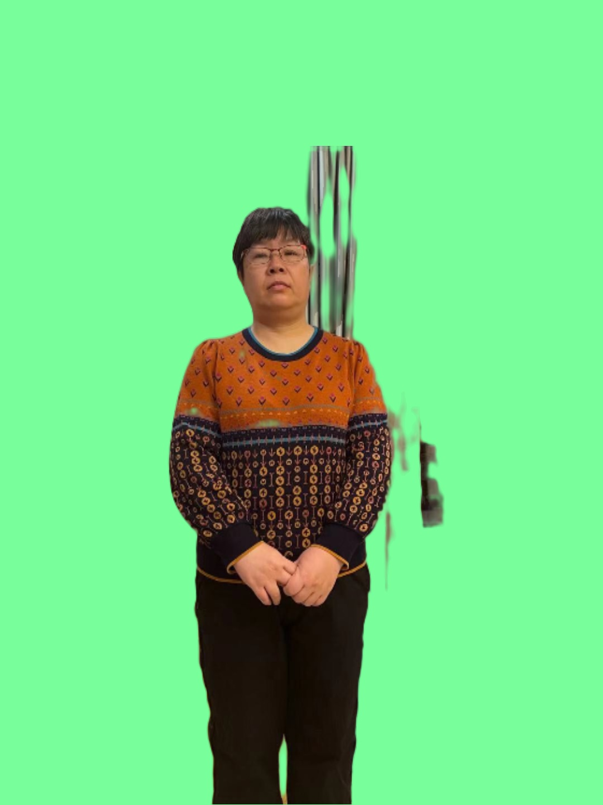
Preliminary result
Wavelet transform
Gabor filters
Good case
Bad case

Slide 6
Project plan
Next steps:
Add the filtered images into training
Compare and see if the results are improved
Try to find other filter banks or wavelet transforms which can be useful as feature extractor for matting

