Slide 1


Function as a Service
Tencent
Advisor: Stone
11510506 Yilin ZHENG
11510352 Ziqiang LI
11510086 Yulian MAO
11510374 Chenyu ZHOU
11510602 Xizi NI

Slide 2
FaaS
Content
PART ONE
PART TWO
PART THREE
PART FOUR
PART FIVE
Background
Motivation
Feature
&
Requirements
Design
&
Implementation
Demo

Slide 3
FaaS
PART ONE
Background

Slide 4
Background
Physical Server
Cloud VM (laaS)
Low Cost
Docker (CaaS)
Strong Expandability
Cloud Function (FaaS)
Simpler Management
High Resource Utilization

Slide 5
FaaS
PART TWO
Motivation

Slide 6
Motivation
Lack of Expandability
Cannot afford unexpected demand
Decrease Complexity
Cut down the trivial functions

Slide 7
FaaS
PART THREE
Feature & Requirements

Slide 8
Requirement
B2B
Cloud Function
Highly Customize
Fit Business Demanding (Slice Figure)
Embedded with Tencent Cloud
Strong Expandability
Speed Up
API Documents
Easy to read

Slide 9
FaaS
PART FOUR
Design & Implementation

Slide 10
Design
Auth
Server
Get signature
1
return signature
2
COS
6
Upload raw image
Download raw image
SCF
3
10
Download Processed image
Upload Processed image
7
Post parameter
4
9
Processed image path
8
Processed image path
API Gateway
5
Invoke SCF with parameter

Slide 11






Implementation
Cloud Function
Thumbnail
Watermark (Word / Figure)
Round Corner
Overlap QR Codes
Convert Format
Slice Image

Slide 12
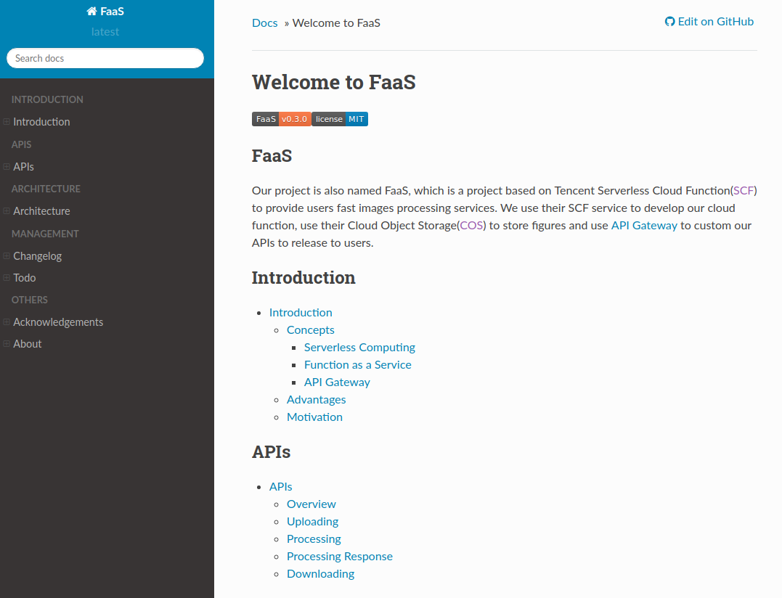
Document

Slide 13
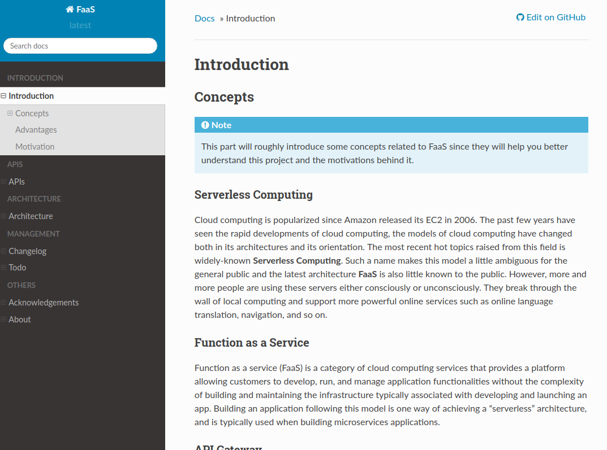
Document

Slide 14
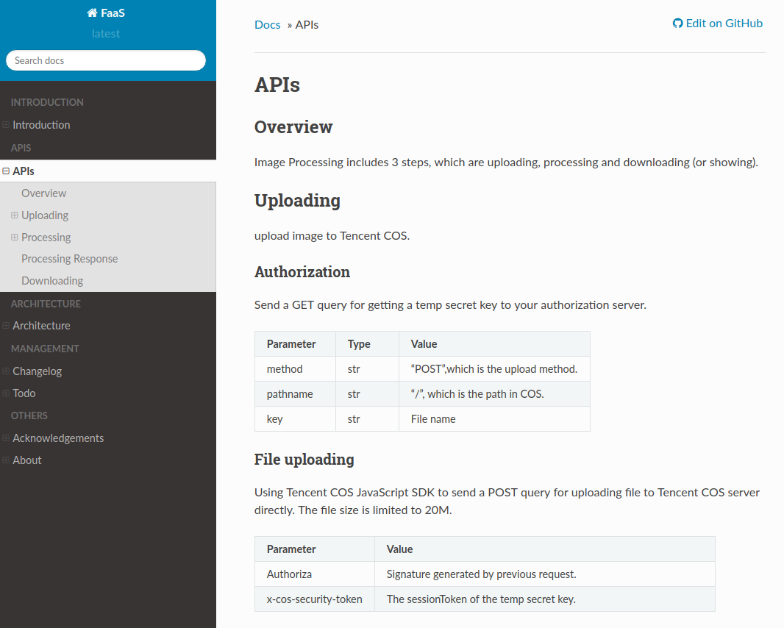
Document

Slide 15
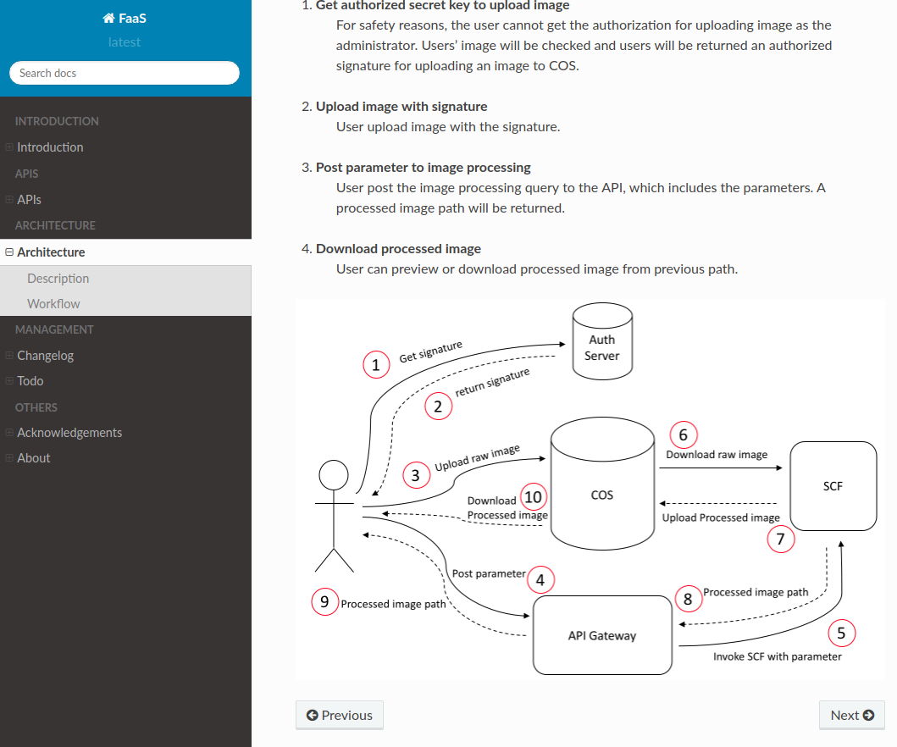
Document

Slide 16
FaaS
PART THREE
Demo

Slide 17
FaaS
THANK YOU
Q&A
非常感谢Stone老师，Alfred老师
以及其他SCF开发团队成员对本项目的大力支持

