Slide 1


Function as a Service
Tencent
11510506 Yilin ZHENG
11510352 Ziqiang LI
11510086 Yulian MAO
11510374 Chenyu ZHOU
11510602 Xizi NI

Slide 2
FaaS
Content
PART ONE
PART TWO
PART THREE
Introduction
Achieved
Progress
Future
Plan

Slide 3
FaaS
PART ONE
Introduction

Slide 4
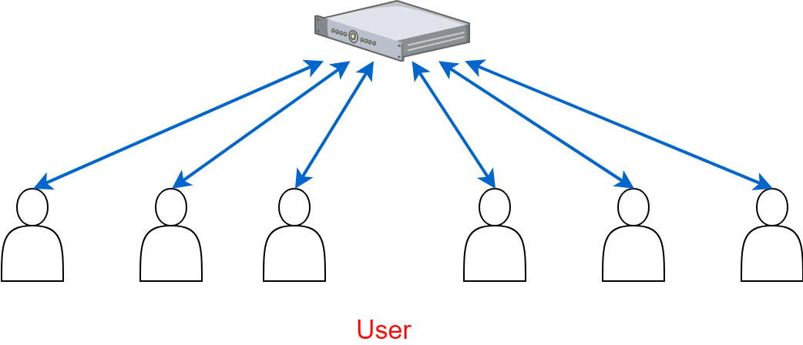
Introduction

Slide 5
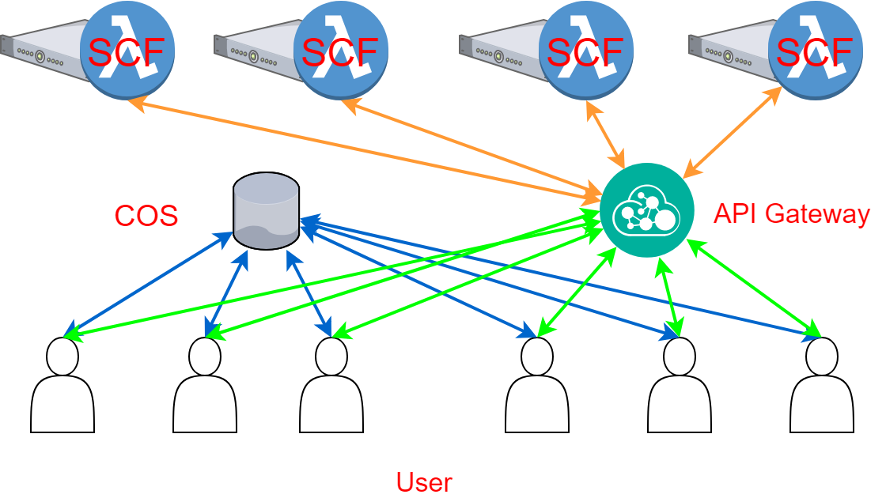
Introduction

Slide 6
FaaS
PART TWO
Achieved Progress

Slide 7




Achieved Progress
Cloud Function
Thumbnail
Watermark (Word / Figure)
Round Corner
Overlap QR Codes
COS Trigger API Gateway
COS storage

Slide 8
FaaS
PART THREE
Following Work

Slide 9
Following Work
To be continued...
User-defined parameters
More image processing functions
...

Slide 10
FaaS
THANK YOU
Q&A

