Slide 1

CS304 Software Engineering
Lab 6 Fault-localization

Slide 2
Outline
Motivating example
SBFL
Tarantula
Assignment

Slide 3
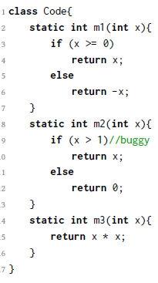
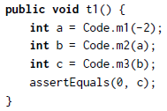
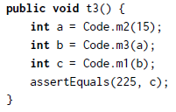


Motivating Example
×
√
×
√

Slide 4
Any thoughts?
Could we find the faulty method?
How to quantify these info?
A method in a failed unit test must be faulty
A method in a passed unit test is not necessarily correct
A method covered by many failed tests tends to be faulty
A method covered by many passed tests tends to be correct

Slide 5
What we have?
ef : the number of failed tests executing the program entity e (method, function, etc)
ep: the number of passed tests executing the program entity e
nf: the number of failed tests that do not execute the program entity e
np: the number of passed tests that do not execute the program entity e

Slide 6
Rankings
ef/(ef+ep) “Kulczynski”
ef/(ef+ep+nf) “Jaccard”
1-ep/(ef+ep) “SBI”
ef^2/(ef+ep) “DStar2”

Slide 7
Spectrum-based Fault Localization (SBFL)
The ranking formulas reflect the information between test cases and methods, which is defined as “spectrum”.
In spectrum-based fault localization, the methods that rank top are recommended to testers for efficient debugging process.

Slide 8
How about SBFL performance (on Defects4J)
ID | Program | #Faults | LoC | #Tests
Chart | JFreeChart | 26 | 96K | 2205
Closure | Closure Compiler | 133 | 90K | 7927
Lang | Commons Lang | 65 | 22K | 2245
Math | Commons Math | 106 | 85K | 3602
Time | Joda-Time | 27 | 28K | 4130
Real-Bug Total | 5 projects | 357 | 321K | 20109
SBFL | Top-1 | Top-3 | Top-5
Tarantula | 66 | 172 | 215
SBI | 66 | 172 | 215
Jaccard | 70 | 169 | 213
Kulczynski | 70 | 169 | 213
Dstar2 | 73 | 171 | 209
Op2 | 77 | 166 | 206

Slide 9
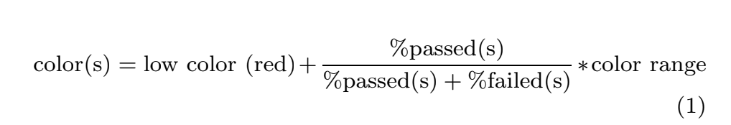
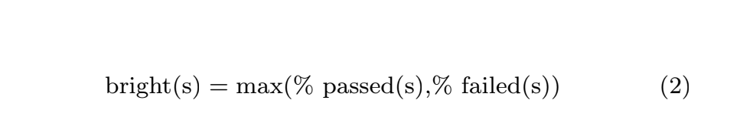
Tarantula
Visualize the result of fault-localization with colors.
James A. Jones, Mary Jean Harrold, and John Stasko. 2002. Visualization of test information to assist fault localization. In Proceedings of the 24th International Conference on Software Engineering (ICSE '02). ACM, New York, NY, USA, 467-477. DOI=http://dx.doi.org/10.1145/581339.581397

Slide 10
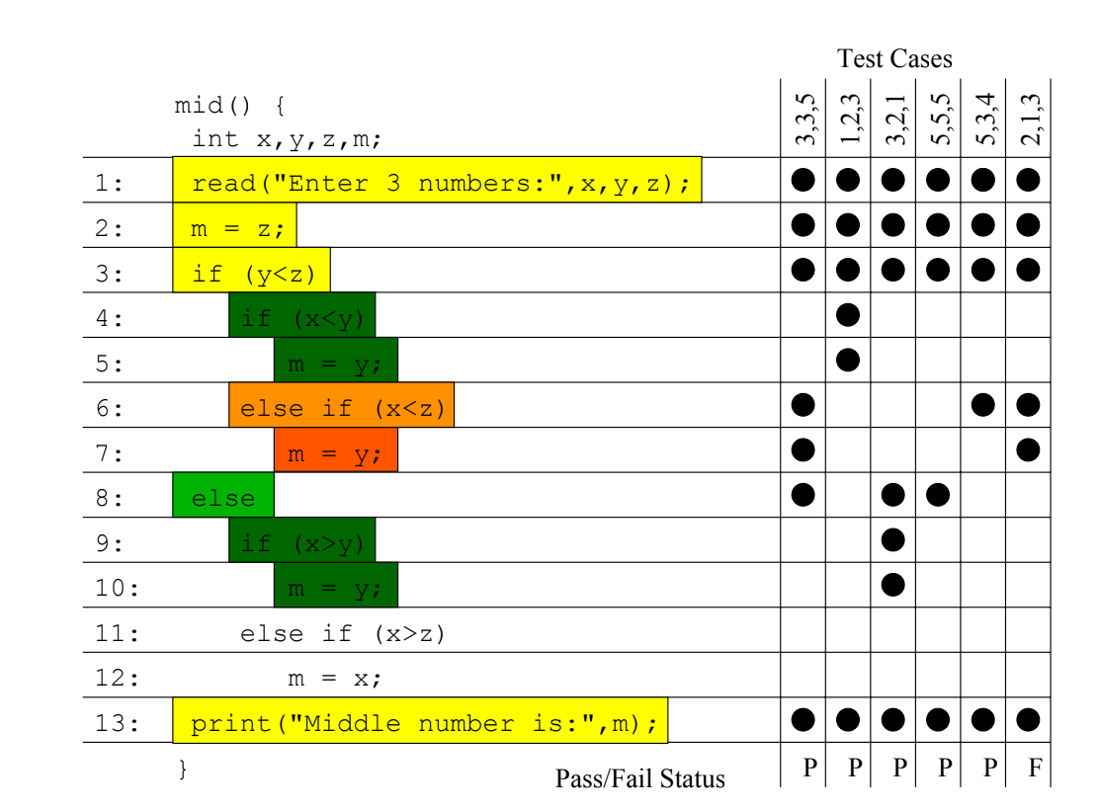
Example

Slide 11
Assignment 1 (mandatory): due 23:59 pm, May 2
PDF: Lab 6 Instruction
Install Maven and Ant
https://maven.apache.org/install.html
https://ant.apache.org/manual/index.html
Follow the instruction to install a Tarantula tool

Slide 12
Assignment 2 (mandatory): due 23:59 pm, May 2
PDF: Lab 6 Instruction
Run a demo (Triangle test suite)
Write Python code to visualize the result (PLEASE mark the lines that are not covered by the test suite, specified with -1 -1 output)

Slide 13
Assignment 3 (bonus): due 23:59 pm, May 7
Change the code to compare at least 4 (including the algorithm for Tarantula) different ranking algorithms in total.
You will need to read the source code of the tool in Java not only Python code to visualize. You may need to change code in src/tarantula/TarantulaSuspiciousnessCalculation.java
If you want to run the program on other test suite, please contact me.
To submit: code, report (algorithms, results including statistics, tables and plots) and analysis if possible.
You will receive at most double points (2*2) of this lab

Slide 14
Tips
Manage research papers: Mendeley (portable, sync, notes…)
What is a research postgraduate life?
Reading: The PhD Grind (by Philip Guo)
Should I apply for a Ph.D program? How to apply?
Reading: Applying to Ph.D. Programs in Computer Science (by CMU)

