Slide 1

CS304 Software Engineering
Lab 7 Build Automation and Continuous Integration

Slide 2
Outline
Motivating example
Build automation
Continuous integration
Assignment

Slide 3
Your project…
Copy paste source code files around…
A file loss
Conflict implementation
Crash on another machine
…
Solution
Git - version control
Gradle - build automation
Travis CI – continuous integration

Slide 4
Build automation
Build automation is the process of automating the creation of a software build and the associated processes including: compiling computer source code into binary code, packaging binary code, and running automated tests.

Slide 5
Tools
C/C++: CMake, Makefile, Autotools…
Java: Maven, Gradle, Ant…
Multi-support: Scons

Slide 6
Continuous Integration
Continuous Integration (CI) is a development practice that requires developers to integrate code into a shared repository several times a day. Each check-in is then verified by an automated build, allowing teams to detect problems early. By integrating regularly, you can detect errors quickly, and locate them more easily.
https://www.thoughtworks.com/continuous-integration

Slide 7
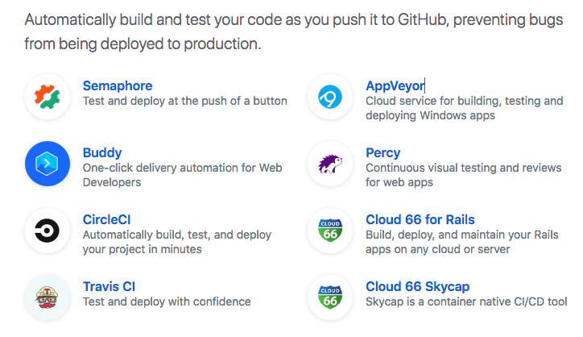
Tools
https://github.com/marketplace/category/continuous-integration

Slide 8
Assignment 1: due 23:59, May 7
Write a report on comparing build management tools for Java, including Gradle, Maven and Ant.
At least 800 words (exclude punctuations).

Slide 9
Assignment 2: due 23:59, May 7
Complete this tutorial: https://spring.io/guides/gs/gradle/
Submit:
code
screenshots of files structure and running results

Slide 10
Assignment 3 (bonus 1.5*2): due 23:59, May 7
Convert the Ant build.xml of the tool used in Lab 6 to Gradle, and try to make it works for the same usability.
You cannot use any existed automatic tools to convert.
Submit:
build.gradle file
running screenshots

Slide 11
Assignment 4 (bonus 1.5*2): due 23:59, May 7
Deploy your project in Assignment 1 on Travis-Ci
Submit:
Screenshots of project status
Link to the project status page on Travis-Ci

