Slide 1

CS304 Software Engineering
Lab 9 Instrument Java Code

Slide 2
Outline
ASM
Visitor Design Pattern
Adapter Design Pattern
Assignment

Slide 3
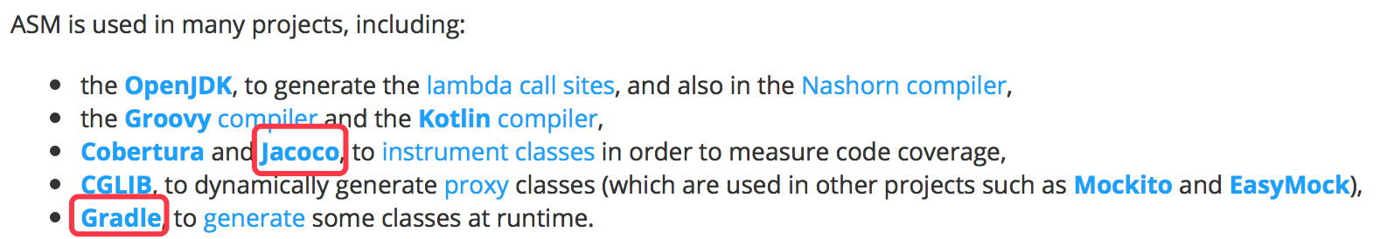
ASM
ASM is an all purpose Java bytecode manipulation and analysis framework. It can be used to modify existing classes or to dynamically generate classes, directly in binary form.
http://asm.ow2.io

Slide 4
Visitor Design Pattern
访问教务系统
你：选课、课表、自己成绩
老师：导入、导出、所有同学成绩
（原）小马哥：置入、修改信息、修改成绩（大雾）
大家都是访问者（visitor）

Slide 5
Double Dispatch
static dispatch - compile time selection of which version of the polymorphic function to execute
dynamic dispatch – run-time selection
single dispatch – selection based on a single object, supported in C++ using virtual functions
double dispatch – selection based on multiple objects, not directly supported by C++/Java but implemented using Visitor Design Pattern

Slide 6
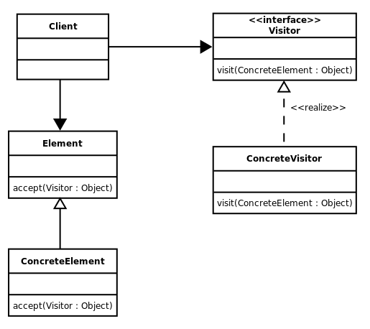
Visitor UML Diagram
学生
教授
小马哥
报名系统
教务系统
OA 系统

Slide 7
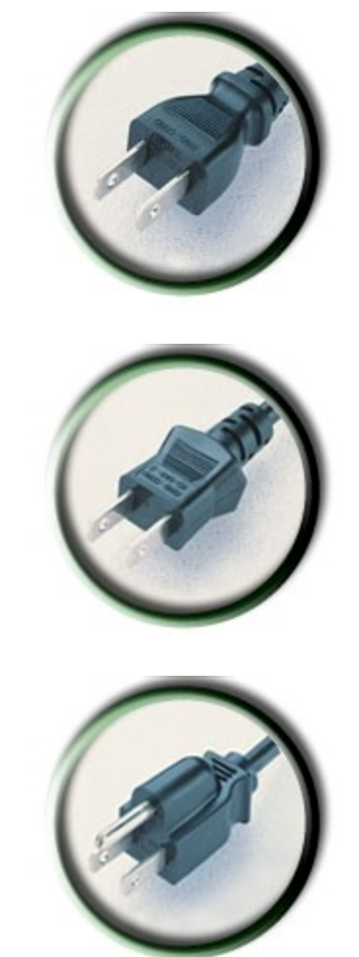
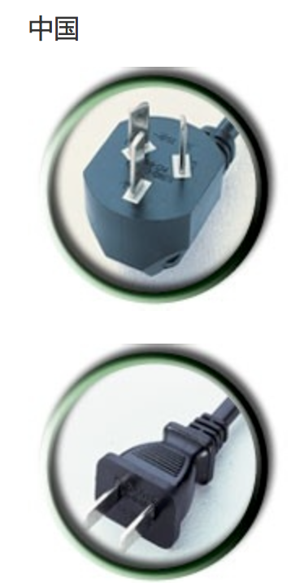
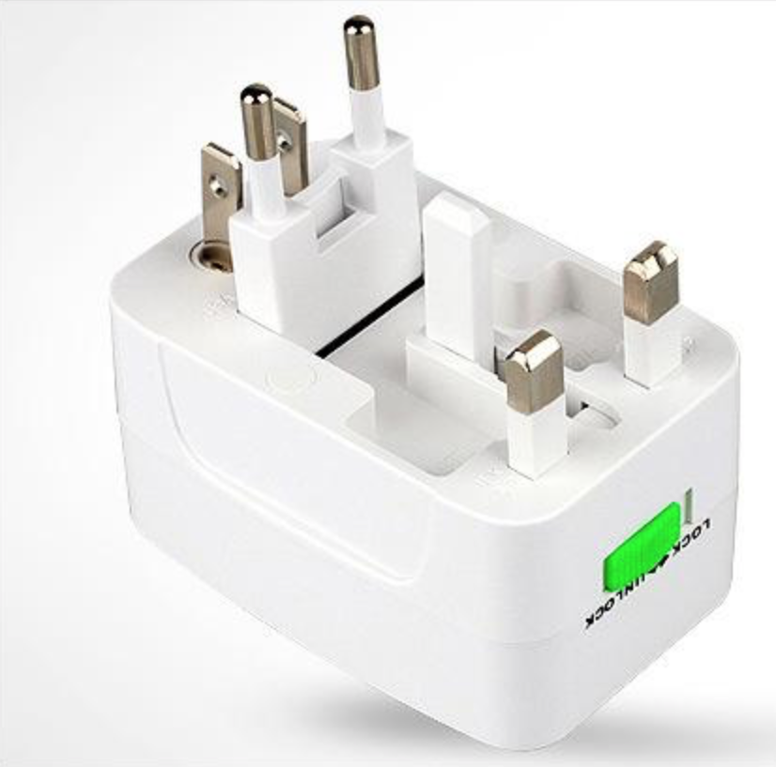
Adapter Design Pattern （适配器）

Slide 8
Adapter Design Pattern (continued.)
adapter (wrapper) - concrete class that inherits from interface
adaptee – implementation class whose interface is modified (adapted)
two approaches
class adapter – uses multiple inheritance
object adapter – uses delegation from adapter to adaptee

Slide 9
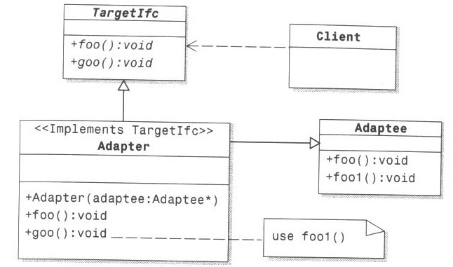
Class Adapter
Adapter (publicly) inherits interface from Target and (privately) implementation from Adaptee

Slide 10
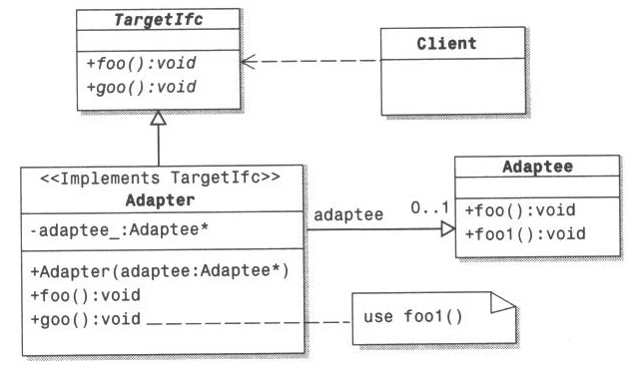
Object Adapter
Adapter uses aggregation to delegate requests to Adaptee

Slide 11
Assignment 1: due 11:59 pm, May 21
Follow the ASM tutorial to learn the basics of Java bytecode, Visitor Design Pattern and Adapter Design Pattern.
Reading materials:
https://www.cnblogs.com/honger/p/5970283.html
https://blog.csdn.net/u012124438/article/details/70537203
Submit:
Code for the tutorial
(optional) report on what you read and learn

Slide 12
Assignment 2 (bonus 2): due 11:59pm May 28
Complete this Lab in C++ http://vega.cs.kent.edu/~mikhail/classes/cs3/Labs/lab22.html
You could find all related slides here: http://vega.cs.kent.edu/~mikhail/classes/cs3/
Submit:
Strategy you use
Code

