Slide 1

VPC 技术详解

Slide 2
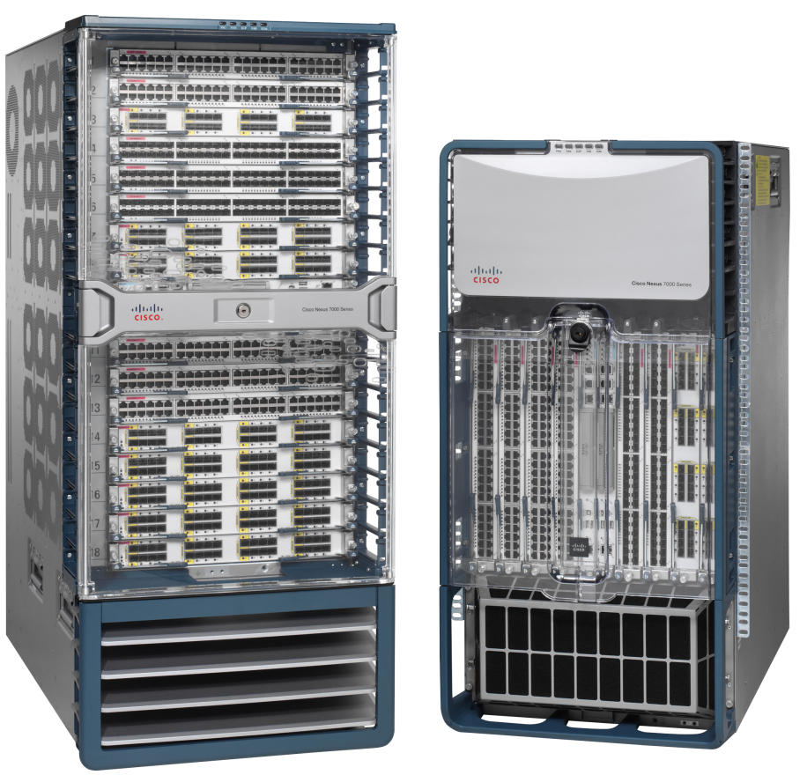
议程
VPC基本原理
- VPC 概述
VPC 组件和原理
VPC 基本业务流
VPC 的互操作
VPC 和VDC 的互操作
VPC和ISSU的互操作
VPC和 STP 的互操作
VPC和HSRP 的互操作
VPC故障恢复
最佳实践
Q&A

Slide 3



VPC 概述
VPC： Virtual Port-Channel
允许跨设备的链路捆绑
消除STP环路
快速收敛
提高链路利用率
HSRP/VRRP 双活
NX-OS 平台支持 VPC 功能（Nexus 7000， Nexus 5000）
接入交换机没有特殊要求，只需要标准支持802.3ad /LACP
传统STP 二层网络逻辑拓扑
VPC 网络逻辑拓扑
Notes:
支持VPC 的产品， highlight 接入交换机
相对于其他的multi-chansis 链路捆绑的优势： 收敛快，HSRP双活。。。

Slide 4
议程
VPC基本原理
- VPC 概述
VPC 组件和原理
VPC 基本业务流
VPC 的互操作
VPC 和VDC 的互操作
VPC和ISSU的互操作
VPC和 STP 的互操作
VPC和HSRP 的互操作
VPC故障恢复
最佳实践
Q&A

Slide 5

vPC 术语和组件
vPC Domain —包含vpc peer，peer-link，keepalive-link， 下联port-channel等
vPC peer – vpc交换机，成对出现
vPC member port – 组成vpc的一组端口（port-channel）
vPC – 连接下联交换机与两个vpc peer之间的port-channel链路
vPC peer-link –vpc peer之间的链路，状态和信息同步，必须为10GE
vPC peer-keepalive link vpc peer之间的心跳线，作为peer-link的备份
vPC VLAN –通过 vpc链路和peer-link承载的vlan.
non-vPC VLAN –不通过vpc承载的vlan
CFS – Cisco Fabric Services 协议，用于vpc peer之间状态同步，配置验证
vPC Domain
vPC peer-keepalive link
vPC peer-link
CFS protocol
vPC peer
vPC member port
vPC member port
vPC
non-vPC device
Notes:
Compare to VSS terminology
vPC VSS
peer-link MCT
vPC MEC

Slide 6
vPC Domain
vPC Domain
vpc peer双方 均需要定义VPC Domain，且建议两边的Domain ID一致
在Domain mode下定义vpc 的全局参数 ——角色优先级（低值优先），keepalive等等
VPC Peer设备使用Domain ID自动产生一个唯一的VPC system-MAC （用于LACP链路操作）

Slide 7
Peer Link
用途
标准 802.1Q Trunk
承载vpc vlan 和非vpc vlan
CFS协议
FHRP 第一跳泛洪报文
STP BPDUs, HSRP Hellos, IGMP updates等
特殊情况下需要承载流量
使用建议
至少两个10GE的端口，并且分布在不同的板卡上
10GE端口均设置成独占模式
vPC peer-link
Notes:
All VLANs carried over the peer-link will suspend on this interface after a peer-link failover occurs and until the two adjacency forms and vPC is fully syncronized". A separate ISL trunk can be used for the STP VLANs to physically decouple vPC/STP VLANs and avoid this behavior

Slide 8
Cisco Fabric Services (CFS) 协议
STP does send BPDUs
IGMP updates
MAC updates
用途
配置验证/比较
STP管理，STP BPDU 抑制
MAC 同步
vPC 成员端口状态
IGMP snooping 同步
HSRP 双活
CFS Messaging
STP doesn’t send BPDUs
HSRP Standby->ActiveL3
IGMP updates
MAC updates

Slide 9
vPC 配置元素
配置元素类型
类型 1
如果类型1中的元素不一致，则VPC无法建立起来
vPC, STP, Vlan status, Port channel, MTU…
类型 2
VPC可以建立起来，但是可能会导致流量异常
VLAN interfaces, HSRP, PIM, GLBP ,ACLs ,etc…
系统会对这些不一致的配置产生Syslog
Notes:
While vPC is a N7K feature, it is very similar to MEC in VSS on the 6K. Differences are highlighted on a separate slide.
The devices automatically check for compatibility for some of these parameters on the vPC interfaces.
The per-interface parameters must be consistent per interface, and the global parameters must be
consistent globally:
• Port-channel mode: on, off, or active
• Link speed per channel
• Duplex mode per channel
• Trunk mode per channel:
– Native VLAN
– VLANs allowed on trunk
– Tagging of native VLAN traffic
• Spanning Tree Protocol (STP) mode
• STP region configuration for Multiple Spanning Tree
• Enable/disable state per VLAN
• STP global settings:
– Bridge Assurance setting
– Port type setting
– Loop Guard settings
• STP interface settings:
– Port type setting
– Loop Guard
– Root Guard
• Maximum Transmission Unit (MTU)

Slide 10
Peer-Keepalive
用途
VPC Peer之间的心跳
Active/Active ( Peer-Link失效) 检测
心跳消息间隔为2s，hold timer为3s （默认）
使用建议
必须为一个单独的三层链路 (1Gb 带宽足够)，三层可达即可，独立VRF
不能通过peer-link在路由
可以使用引擎上的管理口
vPC peer-keepalive link

Slide 11
vPC成员端口
用途
VPC peer之间对port-channel进行终结
配置建议
VPC peer之间的属于同一个vpc组的成员端口的配置必须一致
下联交换机和两个VPC Peer之间最多可捆绑16条链路
vPC member port
vPC member port

Slide 12
Virtual Port Channel
用途
接入设备与两个VPC Peer建立的port-channel
流量可以在接入设备的所有上联链路上进行负载分担
标准 802.3ad port-channel
接入设备功能需求
支持标准802.3ad
LACP 可选
vPC
vPC member port
Normal Port-channel port
Notes:
802.3ad -> LACP
When you configure the port channels in a vPC—including the vPC peer link channel—without using LACP, each device can have up to eight active links in a single port channel. When you configure the port channels in a vPC—including the vPC peer link channels—using LACP, each device can have eight active links and eight standby links in a single port channel.

Slide 13
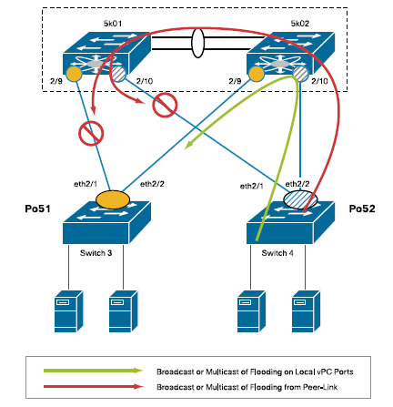
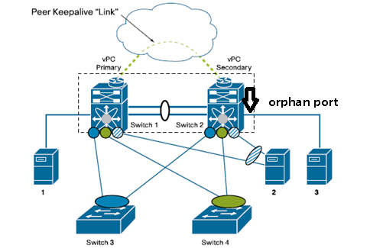
重复帧防护机制
VPC的一个重要转发原则：从vpc peer通过peer link发送过来的帧不会从vpc成员端口转发出去，而发给非vpc vlan，orphan port或者上联链路的流量会正常转发
Orphan port：不是通过vpc连接，但承载vpc vlan的端口
Notes:
是不是vpc vlan
是不是发给vpc member port
如果VPC中有一条链路故障了，那么另一条链路也成为orphan port

Slide 14
VPC 配置
启用VPC, LACP 功能
定义VPC 域
建立keepalive连接
创建peer-link
把VPC成员端口加入到vpc组当中
确认vpc peer的配置一致性
(config)# feature vpc
(config)# vpc domain 1
(config-vpc-domain)# peer-keepalive destination x.x.x.x source y.y.y.y
(conifg)# int port-channel 10
(config-int)# vpc peer-link
(config)# int port-channel 20
(config-int)# vpc 20
(config-int)#show vpc consistency-parameters
N7k01
N7k02
Notes:
Enable the vPC Feature (Modular NX-OS):
(config)# feature vpc
Example: Configuring vPC domain, starting the peer-keepalive link and the peer-link on both peers:
(config)# vpc domain 1
(config-vpc-domain)# peer-keepalive destination x.x.x.x source y.y.y.y vrf management
(conifg)# int port-channel 10
(config-int)# vpc peer-link
Example: Reuse () and Move any port-channels into appropriate vPC groups:
(config)# int port-channel 20
(config-int)# vpc 20
Notes:
Make sure to leverage LACP
domain-id needs to differ between the N7k vPC and the N5k vPC
Spanning-Tree root is defined on one of the 2 N7ks
N5k priorities are unmodified

Slide 15
议程
VPC基本原理
- VPC 概述
VPC 组件和原理
VPC 基本业务流
VPC 的互操作
VPC 和VDC 的互操作
VPC和ISSU的互操作
VPC和 STP 的互操作
VPC和HSRP 的互操作
VPC故障恢复
最佳实践
Q&A

Slide 16

单播——从Mac_A 到 Mac_B
Packet Send
ECMP
ECMP
L3
SW1
vPC PK-Link
SW2
Packet(s) blocked on vPC member ports, vPC peer-link traversed
vPC_PL
L2
Packet Flooding
Packet Flooding
CFS MAC table update message
Port channel path selection
vPC1
vPC2
SW3
SW4
MAC_A
MAC_B
Notes:
A packet destined to MAC_B from Mac_A is initially flooded through the fabric. It takes one path across vPC1 (which is a port channel, so uses the Sw3 port channel load balancing algorithm to select a path), and then is flooded down other vPCs in the VLAN, and across the vPC peer-link as well.
SW2 doesn’t forward the packet down it’s local vPC links because it received the packet across the vPC peer-link. Only in the case that SW1 doesn’t have a port in the vPC (perhaps due to a link failure) will it forward down it’s local vPC member port(s).\

Slide 17
单播——从Mac_B 到 Mac_A的响应
Packet Send
ECMP
ECMP
L3
SW1
vPC PK-Link
SW2
vPC_PL
Local forwarding, previously learned destination
L2
Port channel path selection
vPC1
vPC2
SW3
SW4
MAC_A
MAC_B
Notes:
Sw4 uses it’s own load balancing to determine which path to forward the response on, as this is an etherchannel. As such it can choose a different path than where the in bound message came from.
The receiving swithc (Sw2) doesn’t forward the packet across the vPC peer-link though, as it has learned that the destination is connected via vPC1, which it has a member port of, so it forward it via the local path.

Slide 18
议程
VPC基本原理
- VPC 概述
VPC 组件和原理
VPC 基本业务流
VPC 的互操作
VPC 和VDC 的互操作
VPC和ISSU的互操作
VPC和 STP 的互操作
VPC和HSRP 的互操作
VPC故障恢复
最佳实践
Q&A

Slide 19
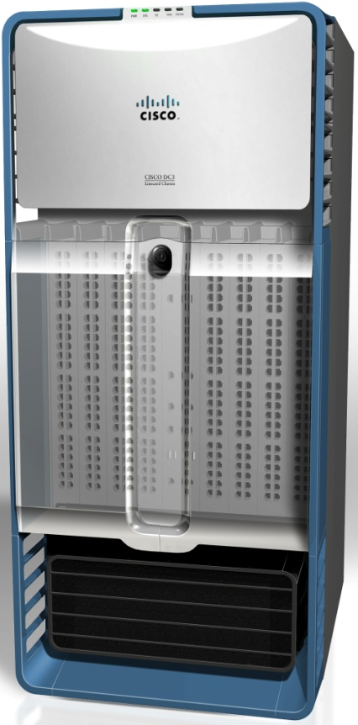
Nexus 7000 VDC 简介
虚拟化
VDC 1
Layer 2 Protocols
Layer 3 Protocols
Virtual Device Context
一个物理设备上虚拟多个逻辑设备
灵活的硬件资源分配
软件功能以及故障隔离
有效提高资源利用率
安全独立的管理模式
VDC 2
VDC 1
VLAN
UDLD
OSPF
GLBP
Layer 2 Protocols
Layer 3 Protocols
PVLAN
CDP
BGP
HSRP
VDC 2
STP
VLAN
802.1X
UDLD
EIGRP
OSPF
IGMP
GLBP
LACP
PVLAN
CTS
CDP
PIM
BGP
SNMP
HSRP
VDC 3
…
…
STP
802.1X
EIGRP
IGMP
VDC 4
LACP
CTS
PIM
SNMP
…
…
Infrastructure
Kernel

Slide 20
VPC和VDC的互操作
VPC可以在VDC环境下正常的工作，不会有任何影响
Core
Nexus7010
Nexus7010
VDC1
VDC1
Distribution
VDC2
VDC2
VDC3
VDC3
VDC4
VDC4
Access

Slide 21
议程
VPC基本原理
- VPC 概述
VPC 组件和原理
VPC 基本业务流
VPC 的互操作
VPC 和VDC 的互操作
VPC和ISSU的互操作
VPC和 STP 的互操作
VPC和HSRP 的互操作
VPC故障恢复
最佳实践
Q&A

Slide 22

vPC和 ISSU互操作
4.1(3)
4.2(1)
4.1(3)
4.2(1)
在VPC环境下仍建议使用ISSU进行系统升级
VPC Peer会分别进行单独的升级，不会影响流量转发
升级采用线性的顺序，一次一台设备
在其中一台设备升级时，peer设备的config会被锁住
4.1(3)
4.2(1)
Notes:
Upgrade on one system locks the other system
Intirim state, runs older CFS protocol, acts as older system
Upgrade other (lock first), when upgrade completes move to new CFS version

Slide 23
议程
VPC基本原理
- VPC 概述
VPC 组件和原理
VPC 基本业务流
VPC 的互操作
VPC 和VDC 的互操作
VPC和ISSU的互操作
VPC和 STP 的互操作
VPC和HSRP 的互操作
VPC故障恢复
最佳实践
Q&A

Slide 24
vPC 和STP互操作
STP仍需启用:
VPC失效/增加/删除时的备份机制
非VPC设备的防环机制
STP不会控制VPC 成员端口的状态
配置建议
在二层网络中使用Rapid-PVST或者MST，提高收敛速度
接入交换机下联主机的端口配置portfast
STP is running to manage loops outside of vPC’s direct domain, or before initial vPC configuration
vPC
vPC

Slide 25
BPDU发送机制
Packet Send
ECMP
ECMP
STP process updated, BDPUs not forwarded on vPC member ports
L3
SW1
vPC PK-Link
SW2
L2
vPC_PL
Packet Flooding
Packet Flooding
BPDUs forwarded
STP Root
STP Root Backup
vPC1
vPC2
SW3
SW4
MAC_A
MAC_B

Slide 26

STP端口配置建议
N
Network port
E
Edge or portfast port type
Normal port type
-
B
BPDUguard
R
Data Center Core
Rootguard
L
Loopguard
Primary
vPC
Secondary
vPC
vPC
Domain
HSRP
ACTIVE
HSRP
STANDBY
Layer 3
Aggregation
Secondary Root
Primary
Root
N
N
-
-
-
-
-
-
-
-
Layer 2 (STP + Rootguard)
R
R
R
R
R
R
R
R
Access
-
-
-
L
E
E
E
E
E
B
B
B
B
B
Layer 2 (STP + BPDUguard)
Notes:
26

Slide 27
议程
VPC基本原理
- VPC 概述
VPC 组件和原理
VPC 基本业务流
VPC 的互操作
VPC 和VDC 的互操作
VPC和ISSU的互操作
VPC和 STP 的互操作
VPC和HSRP 的互操作
VPC故障恢复
最佳实践
Q&A

Slide 28
VPC和FHRP（HSRP/VRRP）互操作
VPC环境中FHRP处于双活状态
正常的FHRP配置
Standby设备与vpc manager交互，来判断是否vpc peer是否active
HSRP/VRRP “Active”: Active for shared L3 MAC
HSRP/VRRP “Standby”: Active for shared L3 MAC
L3
L2

Slide 29
VPC 环境中HSRP工作机制
不改变HSRP控制协议
HSRP 共享虚拟的MAC地址（从初始active HSRP设备导出）
HSRP active设备响应ARP请求
负载分担到standby设备上的流量直接从 本地转发
减少peer-link的使用，提高L3上联链路的带宽

Slide 30
VPC 和HSRP互操作流程
Packet Send
HSRP active process communicates the active MAC to its neighbor. Only the HSRP active process responds to ARP requests
HSRP active MAC is populated into the L3 hardware forwarding tables, creating a local forwarding capability on the HSRP standby device
ECMP
ECMP
L3
SW1
vPC PK-Link
SW2
vPC_PL
L2
HSRP Active
HSRP Standby
vPC1
vPC2
SW3
SW4
MAC_A
MAC_B
Notes:
Packets destined for L3 can select either route upstream (based on port channel load balancing)
When a packet arrives at either switch, it is forwarded to the local HSRP process for routing rather than being sent across the vPC peer-link
This is not a change to HSRP, simply the forwarding engine for the HSRP shared MAC is programmed into the standby HSRP switch’s fowrarding table to be local
HSRP process handles the packet normally

Slide 31


VPC环境下 HSRP改进： peer-gateway
场景：
有一些NAS设备（ NETAPP Fast-Path 或 EMC IP-Reflect ） 回应的时候使用的是发送设备的实MAC地址，而不是HSRP网关的虚拟MAC地址
报文被负载分担到非实MAC所在VPC设备时，会通过peer-link发送到实MAC所在的VPC设备上，而由于重复帧防护机制，该设备会把报文丢弃.
Vpc peer-gateway 解决方案:
当目标MAC地址为peer vpc设备的三层报文发送到本地时，该功能允许本地vpc设备网关正常转发该报文
Local Routing for peer router –mac Traffic
vPC PL
L3
L2
vPC PKL
N7k(config-vpc-domain)# peer-gateway
Notes:
过三层
必须是peer的mac地址

Slide 32
议程
VPC基本原理
- VPC 概述
VPC 组件和原理
VPC 基本业务流
VPC 的互操作
VPC 和VDC 的互操作
VPC和ISSU的互操作
VPC和 STP 的互操作
VPC和HSRP 的互操作
VPC故障恢复
最佳实践
Q&A

Slide 33
VPC故障恢复
典型故障场景
下联接入交换机链路故障
上联三层链路故障
Peer-link 故障
Keep-alive link 故障
Peer-link 和keepalive-lnk同时故障
整机故障
2
ECMP
VPC Primary
HSRP Active
STP Root
L3
6
5
VPC Secondary
HSRP Standby
STP Root Secondary
4
L2
3
1
接入交换机

Slide 34
场景一：下联接入交换机链路故障
所有流量会发往VPC Secondary设备，并从secondary设备发往上联链路
故障收敛：～21ms 恢复收敛：～0.09ms
ECMP
VPC Primary
HSRP Active
STP Root
L3
VPC Secondary
HSRP Standby
STP Root Secondary
L2
接入交换机
Notes:
增加一页 列出6个场景

Slide 35
场景二：上联三层链路故障
负载分担到VPC Primary的流量会通过peer-link发往VPC Secondary设备，再发往上联链路
故障收敛：～60ms 恢复收敛：0ms
ECMP
VPC Primary
HSRP Active
STP Root
L3
VPC Secondary
HSRP Standby
STP Root Secondary
L2
接入交换机

Slide 36
场景三：peer-link故障
通过keepalive-link检查对端active
VPC Secondary关闭所有的VPC member port和VPC Vlan SVI。
流量通过VPC Primary发送
Peer-link恢复后，被shutdown的端口和SVI会自动恢复
故障收敛：～75ms 恢复收敛：～41ms
ECMP
VPC Primary
HSRP Active
STP Root
L3
VPC Secondary
HSRP Standby
STP Root Secondary
L2
接入交换机
Notes:
The secondary vPC peer, by design, shuts down (hard down) all its vPC port-channels
Next when the keep-alive link fails a syslog message on both N7K specifying the keep-alive link is down.
Hence all traffic both directions is now flowing through N7K-01 and once the peer links are restored N7K-02 brings back up all vPC port-channels, VLAN and HSRP interfaces.
Minimal Packets drop observed.

Slide 37
场景四：Keepalive-link故障
Peer-link仍正常工作，流量正常转发，不会受到任何影响
故障收敛：0ms 恢复收敛：0ms
ECMP
VPC Primary
HSRP Active
STP Root
L3
VPC Secondary
HSRP Standby
STP Root Secondary
L2
接入交换机
Notes:
The secondary vPC peer, by design, shuts down (hard down) all its vPC port-channels
Next when the keep-alive link fails a syslog message on both N7K specifying the keep-alive link is down.
Hence all traffic both directions is now flowing through N7K-01 and once the peer links are restored N7K-02 brings back up all vPC port-channels, VLAN and HSRP interfaces.
Minimal Packets drop observed.

Slide 38
场景五：peer-link和keepalive均断掉 （1）
Peer-link先断，keepalive后断 （此场景非常罕见！）
- VPC Secondary 关闭所有VPC member port 和VPC vlan SVI
- peer-link和keepalive均恢复之后，被关闭的端口自动恢复
故障收敛：75ms 恢复收敛：149ms
ECMP
VPC Primary
HSRP Active
STP Root
L3
2
VPC Secondary
HSRP Standby
STP Root Secondary
1
L2
接入交换机
Notes:
The secondary vPC peer, by design, shuts down (hard down) all its vPC port-channels
Next when the keep-alive link fails a syslog message on both N7K specifying the keep-alive link is down.
Hence all traffic both directions is now flowing through N7K-01 and once the peer links are restored N7K-02 brings back up all vPC port-channels, VLAN and HSRP interfaces.
Minimal Packets drop observed.

Slide 39
场景五：peer-link和keepalive均断掉 （2）
Keepalive先断，peer-link后断 （此场景非常罕见！）
- active/active
- 两个VPC peer 均会发送BPDU，各自为根
- 原来的流量可正常转发
故障收敛：0ms 恢复收敛：～131ms
ECMP
VPC Primary
HSRP Active
STP Root
L3
1
VPC Secondary
HSRP Standby
STP Root Secondary
2
L2
接入交换机
Notes:
The secondary vPC peer, by design, shuts down (hard down) all its vPC port-channels
Next when the keep-alive link fails a syslog message on both N7K specifying the keep-alive link is down.
Hence all traffic both directions is now flowing through N7K-01 and once the peer links are restored N7K-02 brings back up all vPC port-channels, VLAN and HSRP interfaces.
Minimal Packets drop observed.

Slide 40
场景六： 一台N7K 出现整机故障
Secondary VPC角色变成Primary，流量均通过该设备转发
故障收敛：～474ms 恢复收敛：～882ms
ECMP
VPC Primary
HSRP Active
STP Root
L3
VPC Secondary
HSRP Standby
STP Root Secondary
L2
接入交换机
Notes:
The secondary vPC peer, by design, shuts down (hard down) all its vPC port-channels
Next when the keep-alive link fails a syslog message on both N7K specifying the keep-alive link is down.
Hence all traffic both directions is now flowing through N7K-01 and once the peer links are restored N7K-02 brings back up all vPC port-channels, VLAN and HSRP interfaces.
Minimal Packets drop observed.

Slide 41
议程
VPC基本原理
- VPC 概述
VPC 组件和原理
VPC 基本业务流
VPC 的互操作
VPC 和VDC 的互操作
VPC和ISSU的互操作
VPC和 STP 的互操作
VPC和HSRP 的互操作
VPC故障恢复
最佳实践
Q&A

Slide 42
部署最佳实践
Port-channel 建议使用LACP ，有利于failover和配置不匹配保护
使用SVI和HSRP作为下联网段的网关
Peer-link 至少两条独占模式的万兆端口，最好分布在不同的板卡上
Peer-link上启用UDLD
Keepalive link， 三层端口，独立VRF，路由可达
1G 带宽足够， 使用板卡上的千兆三层端口，独立VRF
可使用SUP上的管理口，但是不要背靠背连接(N7K)
ECMP
VPC Primary
HSRP Active
STP Root
L3
VPC Secondary
HSRP Standby
STP Root Secondary
L2
接入交换机

Slide 43
VPC vlan 和非VPC vlan
非vpc vlan不通过peer-link承载，以免vpc fail时 影响非vpc vlan
可把vpc vlan和非vpc vlan可使用独立的VDC
Orphan Ports
Orphan Ports

Slide 44


L3和VPC
使用独立的三层链路连接路由器
Switch
Switch
Po2
Po2
7k1
7k2
L3 ECMP
Po1
Router
Router

Slide 45
HSRP link Tracking
不建议在VPC环境中使用HSRP Link Tracking 功能。
VPC peer 不会向vpc成员端口转发从peer-link转发过来的流量
L3
L2
VLAN A
VLAN B

Slide 46
VSS vs. vPC
 |  | VSS | vPC
支持情况 | 设备型号 | Catalyst 6500 | Nexus 7000, Nexus 5000
链路捆绑 | L2跨机箱链路捆绑 (Active-active) | 是 | 是
 | 是否支持L3 链路捆绑 | 是 | 否
控制层面/ HA | 控制层面 | 统一 | 独立，双活
 | 配置文件 | 统一 | 独立
 | 引擎冗余 | 跨机箱冗余 | 每个机箱都有冗余
L2 | 链路捆绑协议 | LACP, PaGP(+) | LACP
 | 是否需要STP | 否 | 否
L3 | 单个逻辑网关 | 是 (不需要FHRP) | 是, active-active HSRP
 | 路由进程 | 单个 | 相互独立
 | 路由邻居 | 减少 | 相互独立
组播 | PIM DR | 单个 | 相互独立 (DR&N-DR)

Slide 47
Q&A

Slide 49



STP 收敛增强功能： peer-switch
STP Root
VLAN 1
VLAN 2
4.2(6) and 5.0 Releases
STP Root VLAN 1
STP Root VLAN 2
Bridge Priority
VLAN 1 → 4K
VLAN 2 → 8K
Bridge Priority
VLAN 1 → 8K
VLAN 2 → 4K
vPC Primary
vPC Secondary
Bridge Priority
VLAN 1 → 4K
VLAN 2 → 4K
Bridge Priority
VLAN 1 → 4K
VLAN 2 → 4K
vPC Peer-link
S1
S2
Animated Slide
Nexus 7000(config-vpc-domain)# peer-switch
vPC1
vPC2
S3
S4
No STP Topology Changes
vPC switches to appear as a single STP Root in the L2 topology (same bridge-id).
vPC peer-link excluded from STP computation (vPC peer-link treated as “backplane extension”).
Improves convergence on vPC primary switch failure/recovery avoiding Rapid-STP Sync

Slide 50


上联链路和peer-link均在一块万兆版卡上时 VPC Object Tracking
Scenario:
vPC deployments with a single N7K-M132XP-12 card, where core and peer-link interfaces are localized on the same card.
This scenario is vulnerable to access-layer isolation if the 10GE card fails on the primary vPC.
vPC Object Tracking Solution:
Leverages object tracking capability in vPC (new CLI commands are added).
Peer-link and Core interfaces are tracked as a list of boolean objects.
vPC object tracking suspends vPCs on the impaired device, so traffic can get diverted over the remaining vPC peer.
e1/…
e1/…
e1/…
e1/…
L3
e1/…
vPC PL
e1/…
L2
e1/…
e1/…
vPC PKL
vPC
Primary
e2/…
e2/…
vPC
Secondary
rhs-7k-1(config-vpc-domain)# track <object>

