Slide 1
Web Crawler
Working of Web Crawler
&
How to crawl websites without being blocked
Presented by Zhaokang Li

Slide 2
Basic crawl architecture
WWW
robots
filters
URL
set
Parse
Content
seen?
Fetch
URL
filter
Dup
URL
elim
URL Frontier

Slide 3
How to detect web crawlers?
&
How to crawl websites without being blocked?

Slide 4
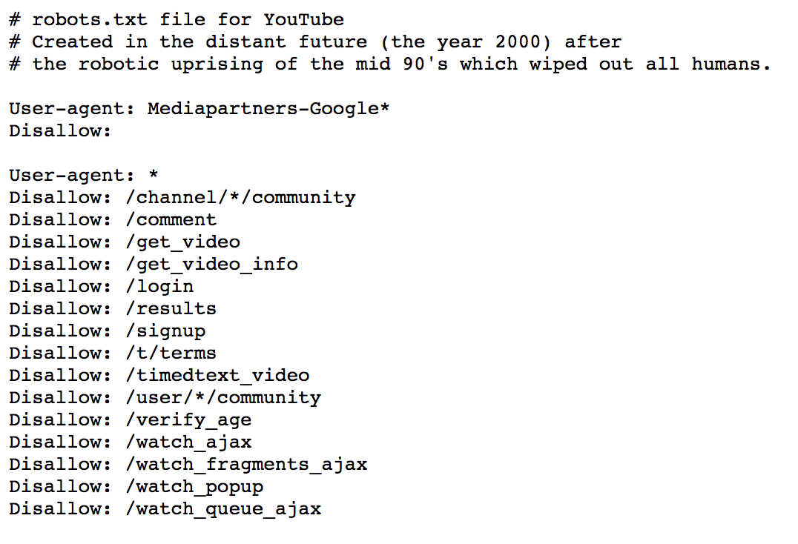
Robot Exclusion
robots.txt file specifies rules for good behavior
Robots META Tag is individual document tag to exclude indexing or following links.
Allow all search engine from Mediapartners – Google to crawl any directories.
Follow rules in the
robots.txt file!
Disallow all other search engines from particular folders.

Slide 5

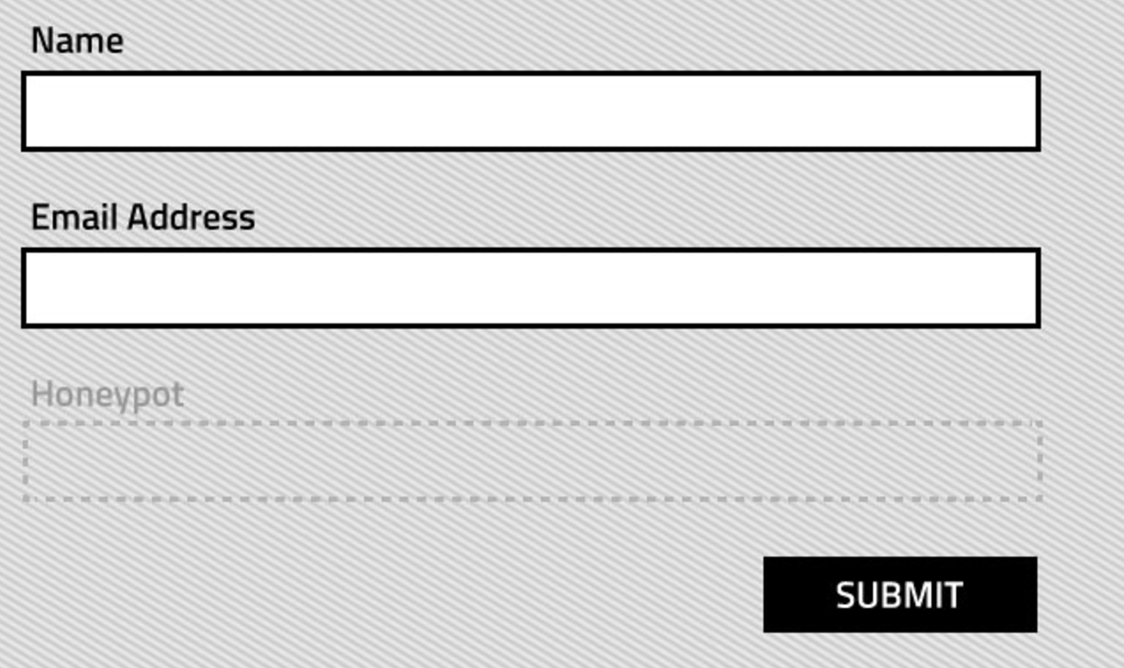
HONEYPOTS
A honeypot is a trap set to detect attempts at unauthorized use of a website.
Honeypots usually are contents that normal user can’t see but a spider can access.
What if legitimate bots?
Access to the honeypot will be prevented
in robots.txt file
e.g. CSS style display:none
Follow rules in the
robots.txt file!

Slide 6
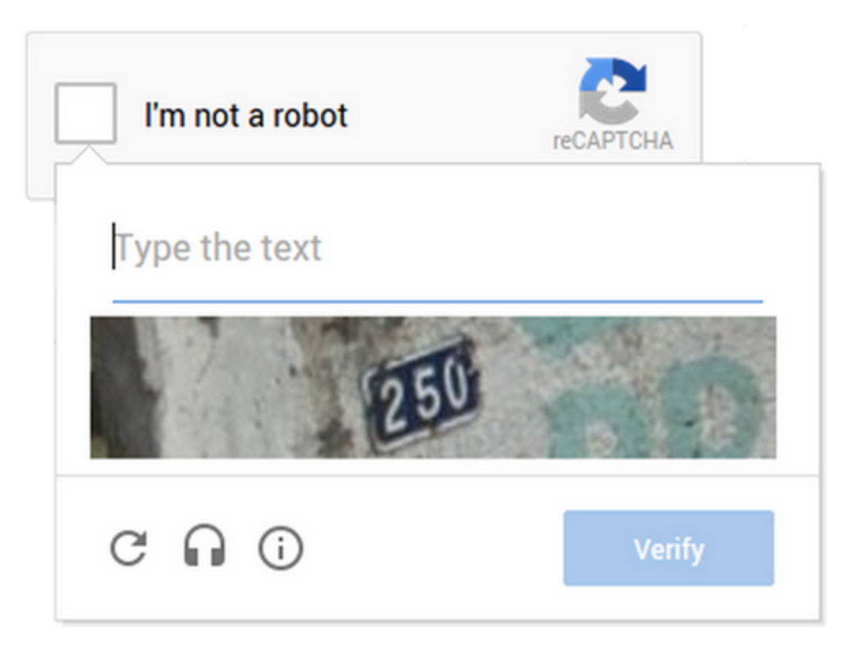



CAPTCHA
(Completely Automated Public Turing test to tell Computers and Humans Apart)
A CAPTCHA is a type of challenge-response test used in computing to determine whether or not the user is human. ^{[1]}
Hinder the user experience
No ethical way to evade a CAPTCHA
Optical Character Recognition (OCR)

Slide 7
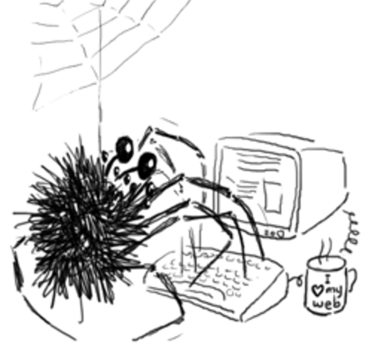
Conclusion
No single technique offers full protection.
Be polite. Avoid DoS attacks.
Respect rules.

Slide 8
Q & A
THANK YOU !

