Slide 1


Standardizing development environments Vagrant + Puppet Open Repositories, June 2016 Liz Krznarich, Software Engineer/UI Design, ORCID e.krznarich@orcid.org http://orcid.org/0000-0001-6622-4910

Slide 2

VAGRANT + PUPPET
Vagrant: What is it?
Software tool for building portable/reproducible local dev environments using virtual machines
Awesome

Slide 3

VAGRANT + PUPPET
Vagrant: Why use it?
Ensure devs have the same local environment
Package/distribute a project and the environment needed to run it, all in one repo

Slide 4
VAGRANT + PUPPET
Vagrant: Why use it?
Loads of handy features:
Disposable environments
Nice CLI
Synced folders
Multi-machine
Plugins

Slide 5
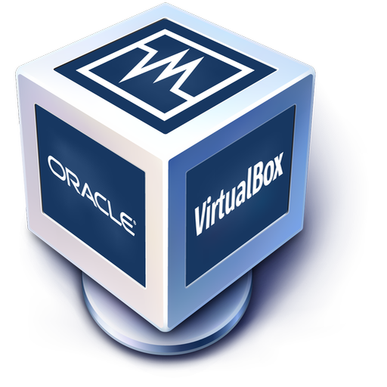
VAGRANT + PUPPET
Vagrant: Start using it!
Install Vagrant https://www.vagrantup.com/downloads.html
Install VirtualBox https://www.virtualbox.org/wiki/Downloads

Slide 6
VAGRANT + PUPPET
Create a Vagrant file
Vagrant.configure("2") do |config|
# Base system to build from – see list at https://atlas.hashicorp.com/boxes/search
config.vm.box = "ubuntu/trusty64"
# Forward a port from host to guest so that you can run a server
config.vm.network "forwarded_port", guest: 80, host: 8080
# Sync a host directory to a location on the guest
config.vm.synced_folder "./my-project", "/var/www/html"
end

Slide 7
VAGRANT + PUPPET
Vagrant: Terminology
Provider Software providing your VM (Virtualbox, VMWare, etc)
Box System specs for your VM
Provisioner Tool that will perform setup tasks once the VM is running (Puppet, shell script, etc)
Vagrantfile Vagrant configuration file (goes in your project root)

Slide 8
VAGRANT + PUPPET
Fire it up!
Access your machine
vagrant up
vagrant ssh

Slide 9

VAGRANT + PUPPET
Great! But that’s just a Linux box. My project needs much more stuff.
You’re in luck! Vagrant supports provisioners (like Puppet) that help to customize your setup.

Slide 10


VAGRANT + PUPPET
Puppet: What is it?
Configuration management tool
Standardize & declare system configuration - make it deployable across multiple machines
Software, user/access mgmt, network config, databases…
“Infrastructure as code”

Slide 11
VAGRANT + PUPPET
Puppet: Why use it?
Easily manage multiple machines/spin up new machines
Config as code = works w/version control (easy to identify/fix problems)
Keep users from mucking up configuration!
And so much more…

Slide 12
VAGRANT + PUPPET
Why Vagrant + Puppet?
Specify config details that can’t be included in a Vagrantfile
Install applications
Set up databases
Add directories, users, etc
Already using Puppet in production? Allow devs to ‘Puppetize’ in situ while writing new code

Slide 13
VAGRANT + PUPPET
Puppet: Nuts & Bolts
Open source (also Enterprise version)
Written in Ruby (but config is written in Puppet ‘language’)
Client-server architecture (puppet master/puppet agent)

Slide 14
VAGRANT + PUPPET
Puppet: Nuts & Bolts
Puppet Master (server)
Puppet Agent (client)
Puppet Agent (client)
Puppet Agent (client)
Puppet Master stores node configuration info
Puppet agents poll Master and pull configuration updates (default: every 30min)

Slide 15
VAGRANT + PUPPET
Puppet: Terminology
Manifests Puppet config code goes here
Templates Complex code that’s tricky to write in manifests (Embedded Puppet or Embedded Ruby)
Modules Extend the Puppet core / segment your Puppet code

Slide 16
VAGRANT + PUPPET
Create a Puppet manifest
# specify default paths
Exec {
path => ["/usr/bin", "/bin", "/usr/sbin", "/sbin", "/usr/local/bin", "/usr/local/sbin"]
}
# install packages
class install-packages {
exec { 'apt-get update':
command => 'apt-get update',
}
$packages = [ "apache2", "php5", "php5-mysql", ”wget”]
package { $packages:
ensure => "installed”,
require => Exec['apt-get update'],
}
}

Slide 17
VAGRANT + PUPPET
Enable the Puppet provisioner in your Vagrantfile
Vagrant.configure("2") do |config|
config.vm.box = "ubuntu/trusty64”
config.vm.network "forwarded_port", guest: 80, host: 8080
config.vm.synced_folder "./my-project", "/var/www/html"
# Enable the Puppet provisioner and specify the manifest location
config.vm.provision :puppet do |puppet|
puppet.manifests_path = "puppet/manifests"
puppet.options = ['--verbose']
end
end

Slide 18

VAGRANT + PUPPET
Load the changes and run provisioner
Revel in the joy of reproducible configuration
vagrant reload --provision

Slide 19

VAGRANT + PUPPET
Hot tips & minor pitfalls
Want to pull config from a remote Puppet master? Sure, Vagrant can do that!
Dependency headaches Puppet doesn’t execute in order; dependencies must always be declared
Installing a Ruby version higher than Puppet Ruby? Things get weird fast O_o
*nix VM on Windows using Synced Folders = #$&*! (not specific to Puppet)

Slide 20
Get the code
https://github.com/lizkrznarich/OR2016

Slide 21
THANK YOU!
Questions? e.krznarich@orcid.org https://github.com/lizkrznarich http://orcid.org/0000-0001-6622-4910

