Slide 1
Online learning

Slide 2
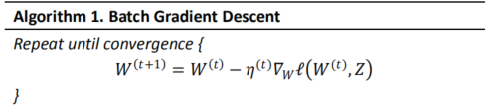
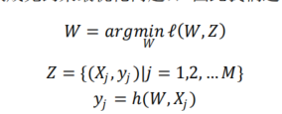
definition
In computer science, online machine learning is a method of machine learning in which data becomes available in a sequential order and is used to update our best predictor for future data at each step, as opposed to batch learning techniques which generate the best predictor by learning on the entire training data set at once.
Minimize the cumulative loss doesn’t work
01

Slide 3
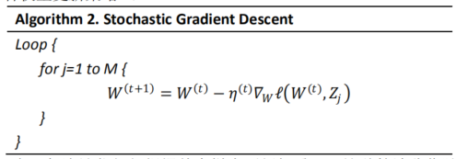
process
01

Slide 4
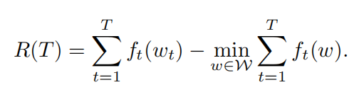

evaluation
regret
The difference between the real cumulative loss and this minimum cumulative loss for fixed hypothesis in hindsight is defined as regret
If regret grows linearly, R(T) = Ω(T), the player is not learning.
If regret grows sub-linearly, R(T) = o(T), the player is learning and its prediction accuracy is improving. The regret per round goes to zeros as T goes to infinity
Regret bound
02

Slide 5
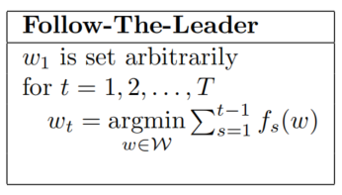
Follow the Leader
algorithm
We are playing on round t the weight vector that minimizes the regret if the game stopped on round t-1.
We use all the seen examples as a batch machine learning problem, and solve for the best weight vector.
02

Slide 6

Regret analysis
Regret bound
02

Slide 7
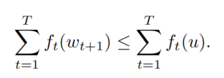
Regret analysis
Proof
Be The Leader
02

Slide 8
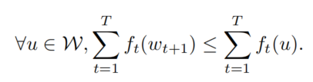

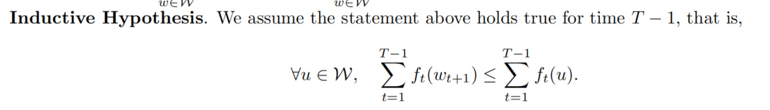
Regret analysis
Proof: induction
Target:
02

Slide 9
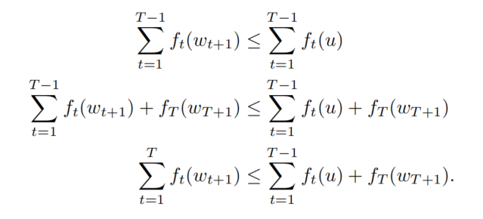
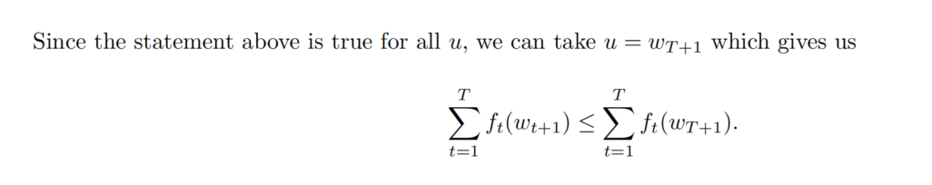
Regret analysis
Proof: induction
Target:
02

Slide 10
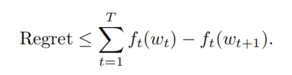
Regret analysis
Key problem
in general, the regret bound is O(T). This is especially true for linear functions.
The poor regret bound comes from the fact that ft(wt) - ft(wt+1) will be large if wt+1 is far from wt.
adding regularization to improve the stability of the solution.
02

Slide 11
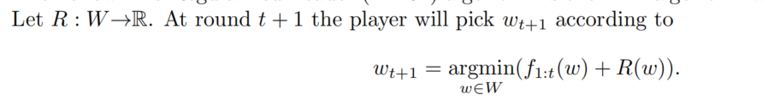

Follow the Regularized Leader
algorithm
We are playing on round t the weight vector that minimizes the regret if the game stopped on round t-1.
We use all the seen examples as a batch machine learning problem, and solve for the best weight vector.
02

Slide 12
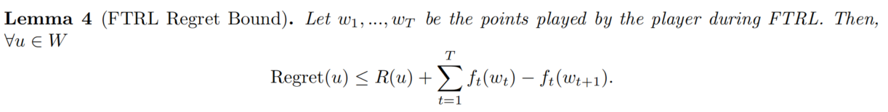

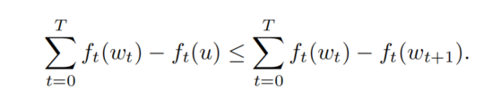

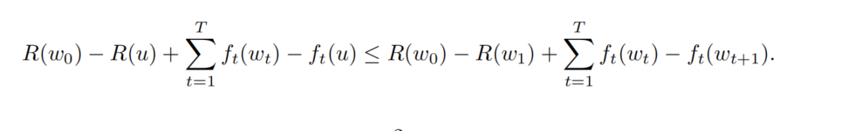

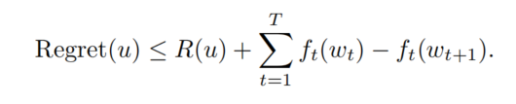
Regret analysis
Regret bound
02

Slide 13







Linear loss FTRL regret bound
Linear loss function
regularization term
Substituting to
Get
take the gradient and set it to 0:
Online Gradient Descent (OGD)
02

Slide 14


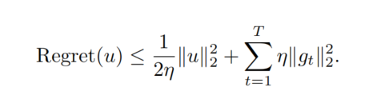
Linear loss FTRL regret bound
whether this regret is sublinear.
this depends on the learning rate
too high , adversary can pick points such that we constantly oscillate around the optimal solution.
too small ,the adversary can pick an optimal
value far away from the initial value and we will never get there.
Pick an optimal step size.

Slide 15
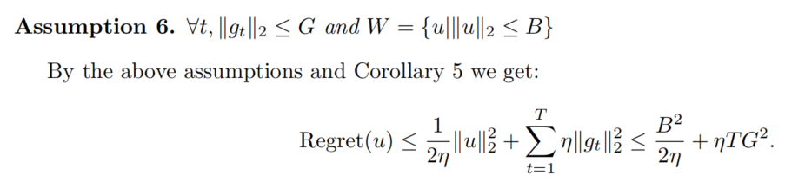
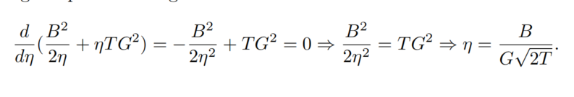
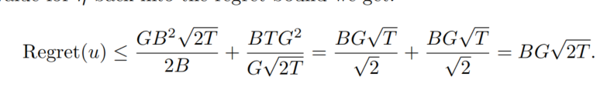
Linear loss FTRL regret bound

Slide 16
由OGD导出的代表算法FOBOS、RDA、FTRL
一是稀疏性不够，即使加上了正则项也会因为浮点数相加而很难得到精确零值。这时可以采用截断法，比较流行的有 Truncated Gradient 以及 FOBOS。二是不能处理非光滑函数，这时就需要用次梯度代替梯度，即 SubGD。
SubGD 虽然能处理非光滑，但收敛速度慢，FOBOS 通过向前看一步，有效提升了收敛速度。而且在加上正则项后通过软阙值截断，能达到较好的稀疏性。RDA 也是 SubGD 的加强版，相比 FOBOS 能达到更好的稀疏性，不过由于其中心化点是原点，可能会在预测我们已经见过的样本时有一定偏差。
02

Slide 17




FOBOS（Forward-Backward Splitting ）
Online Gradient Descent
Stochastic Gradient Descent
要求光滑
Subgradient Descent (SubGD)
收敛速度较慢
究其原因，由于损失函数非光滑，导致次梯度值会出现急剧变化，比如从-1跳到了1，尽管 wt 和 wt+1 是很接近的，这就导致了收敛速度减慢。
02

Slide 18




FOBOS（Forward-Backward Splitting ）
后向次梯度下降：用 t+1 时刻的次梯度去更新得到 wt+1
Fermat 引理
更新式
对于光滑项梯度下降
对于非光滑项后向次梯度下降
FOBO（Forward-Backward Splitting ）
02

Slide 19
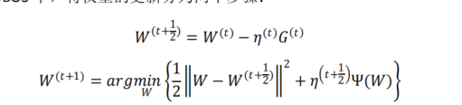


FOBOS（Forward-Backward Splitting ）
FOBO（Forward-Backward Splitting ）
02

Slide 20
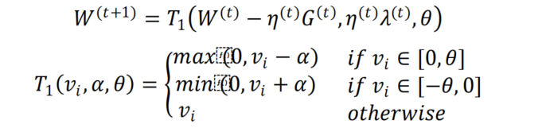
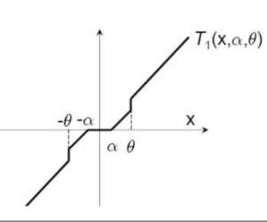
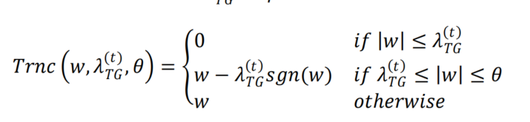
TG(Truncated Gradient)
02

Slide 21
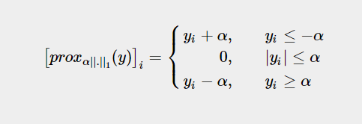
FOBOS（Forward-Backward Splitting ）
当正则项为 L1 的时候，我们把它的邻近算子称为软阙值算子 Tα（soft-thresholding operator）
02

Slide 22
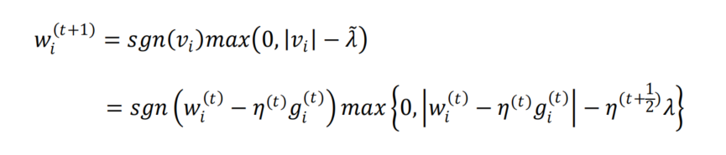

L1-FOBOS（Forward-Backward Splitting ）
FOBO（Forward-Backward Splitting ）
02

Slide 23
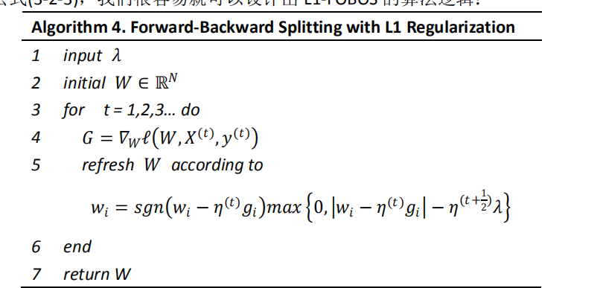
L1-FOBOS（Forward-Backward Splitting ）
FOBO（Forward-Backward Splitting ）
02

Slide 24
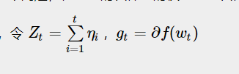
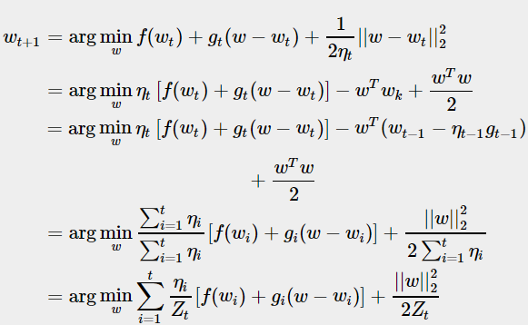
Regularized Dual Averaging
02
老的次梯度相比新的次梯度有更高的权重，这显然不合理

Slide 25

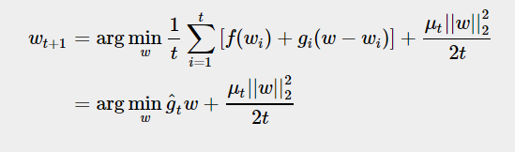

Regularized Dual Averaging
对偶平均（Dual Averaging）通过赋予所有次梯度同等权重
02
为了得到稀疏解，
正则对偶平均（Regularized Dual Averaging (RDA)
RDA 增加了一个正则项 Ψ ，用一个强凸函数 h 替代了原先的二阶范数

Slide 26
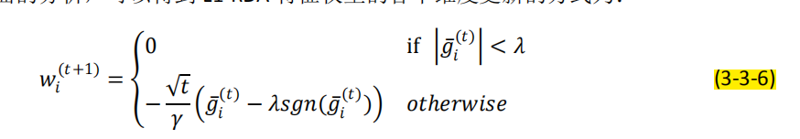
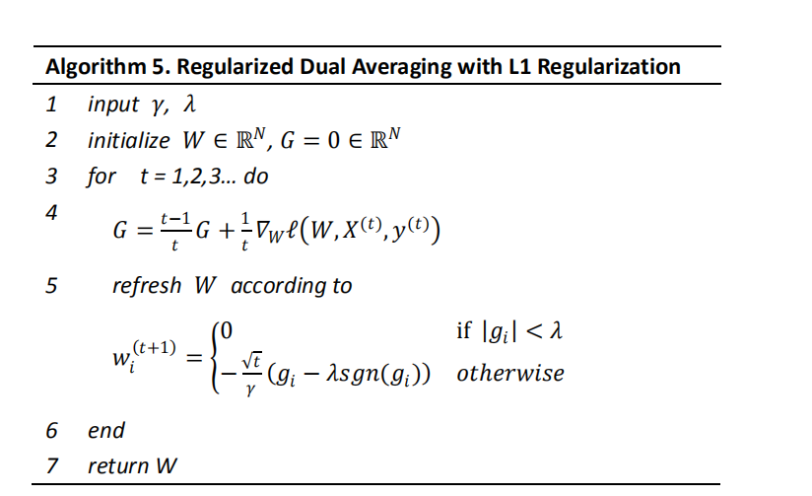
L1_Regularized Dual Averaging
02

Slide 27
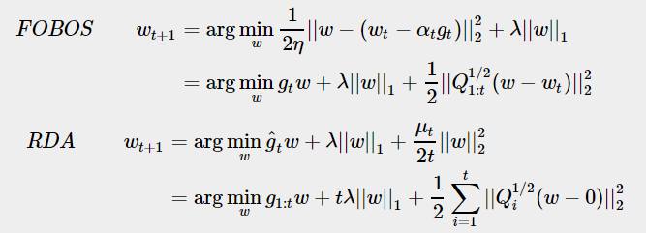

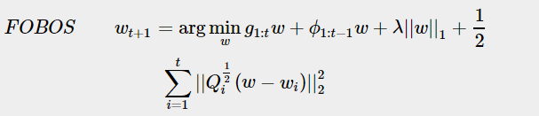
比较引出FTRL
L1_FOBOS
L1_RDA
02
第一项：损失函数的一阶近似，FOBOS只对最近的梯度，但RDA针对了过去所有的梯度
第二项:非光滑的正则项，FOBOS只针对当前的，但RDA做了累计
第三项：强凸正则项，FOBOS 强凸项中心化点为 wt，而 RDA 的中心化点为 0，即FPBOS的W只能在前一个W附近，而RDA限制在0附近
次梯度估计的存在才导致了 FOBOS 的稀疏性不如 RDA 来得好

Slide 28
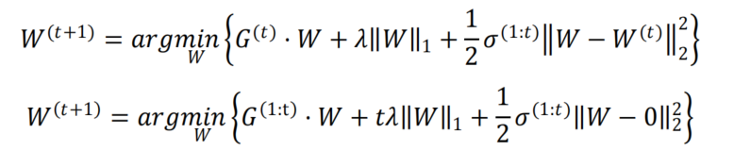
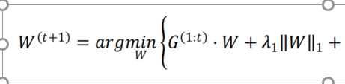

比较引出FTRL
L1_FOBOS
02
L1_RDA
L1_FTRL
精度和稀疏性都有提升

Slide 29
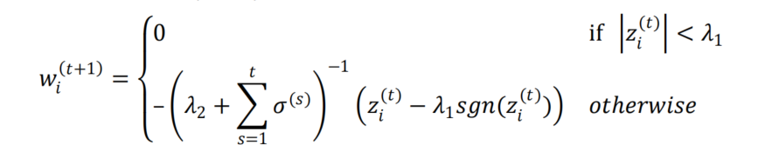
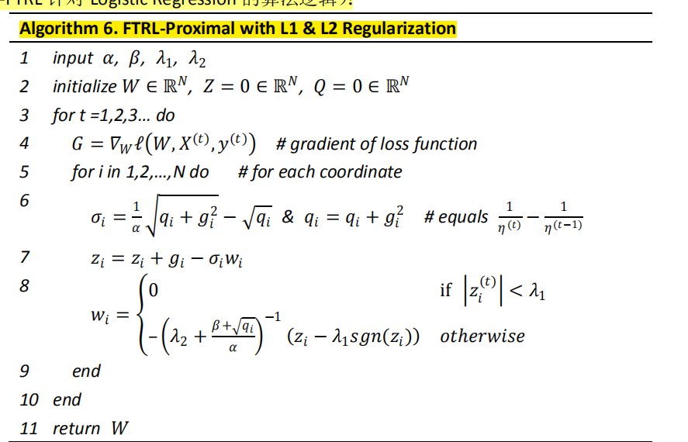
L1_FTRL
02

Slide 30
Thank you!
Company Logo
Go to our website!
(click here)

