Slide 1
近期汇报
”
神经数据仿真调研

Slide 2
A simulation study on the effects of neuronal ensemble
Details of paper
Kim M K , Sohn J W , Lee B , et al. A simulation study on the effects of neuronal ensemble properties on decoding algorithms for intracortical brain–machine interfaces[J]. Biomedical Engineering Online, 2018, 17(1):28.
Target
explore how decoders’ performance varies with the neuronal properties on movement direction.
Neuronal properties
signal-to-noise ratio of neurons
the proportion of well-tuned neurons
the uniformity of their preferred directions (PDs),
and the non-stationarity of PDs.
Decoders
Kalman filter, optimal linear estimator, and population vector algorithm
01

Slide 3
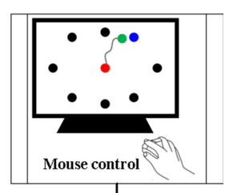
A simulation study on the effects of neuronal ensemble
Neuronal spike generation
Cosine tuning function
AWGN （SNR）
Behavior tasks
02

Slide 4
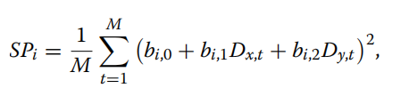
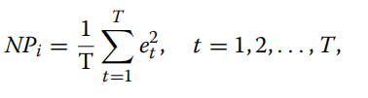

A simulation study on the effects of neuronal ensemble
SNR
Data-driven estimate of SNR: error variance of turning model from the observed firing rate.
AWGN （SNR）
03

Slide 5
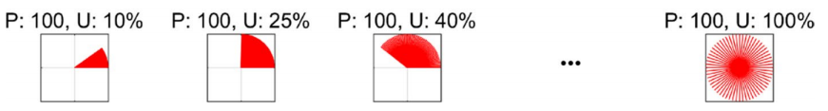
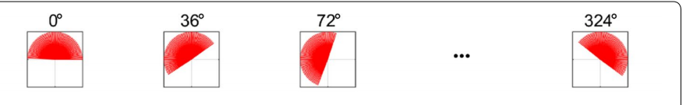
A simulation study on the effects of neuronal ensemble
PD of each neuron and its uniformity
Uniformity : a percentage of whole angular space all PDs of a neuronal ensemble occupied
Bias: the central angle of uniformly distributed PDs.
04

Slide 6
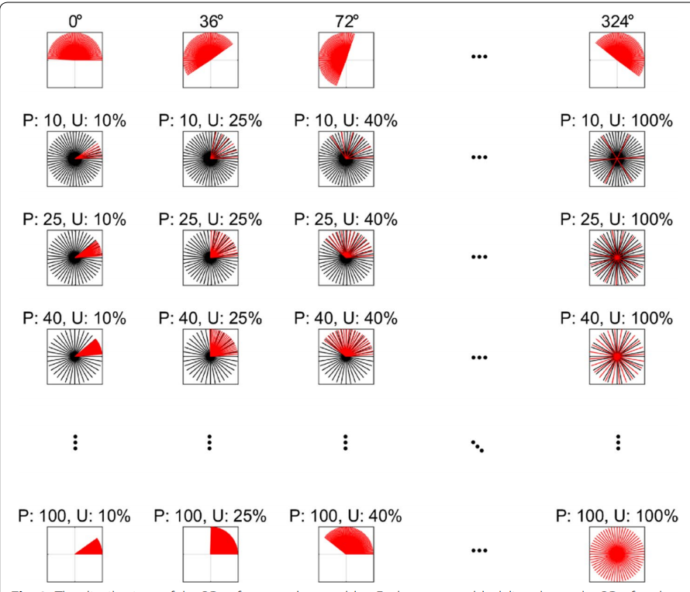
A simulation study on the effects of neuronal ensemble
Proportion of well-tuned neurons and their PD distribution
Equals to w how widely the PDs of well-tuned neurons are distributed.
PWTN: proportion of well-tuned neurons
UWTN: the uniformity of well-tuned neurons
well-tuned and poorly tuned neurons were determined by controlling SNR.
poorly tuned neurons to be uniformly distributed.
01

Slide 7

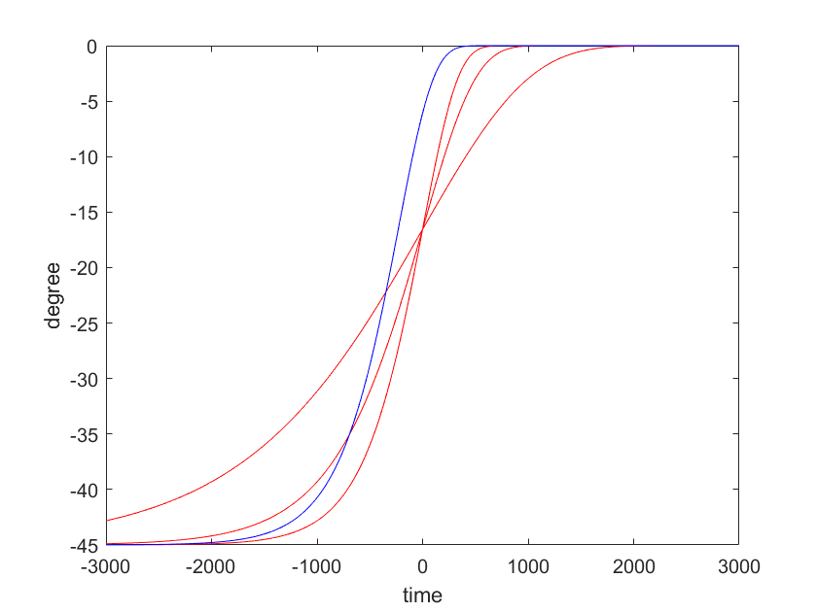
A simulation study on the effects of neuronal ensemble
Non-stationary neuronal properties
α: degree of the angular shift of a PD
λ: the displacement along the time axis
c: the displacement along the changing rate
red line: change c
blue line : change λ
01

Slide 8
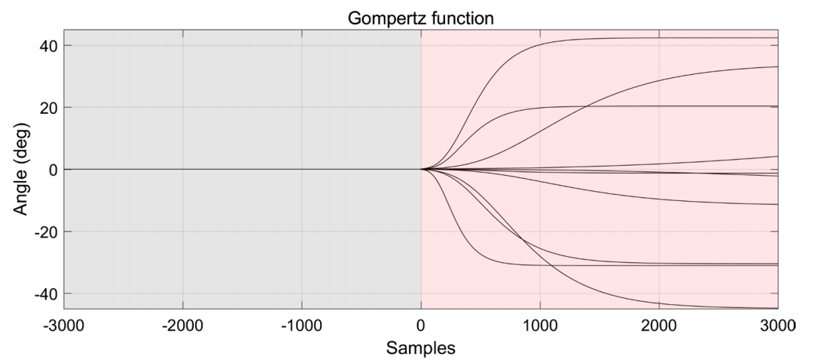
A simulation study on the effects of neuronal ensemble
Non-stationary neuronal properties
gradually changing PDs over time.
fix λ randomly choosing α and c 1000 times.
Both PWTN and UWTN were fixed to be 100%
01

Slide 9

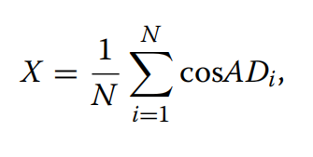
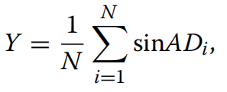
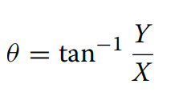
A simulation study on the effects of neuronal ensemble
Evaluation
We tested whether θ was significantly different from zero using Rayleigh’s z-test.
We then compared mean ADs between decoders using Watson’s U2 test that is known as one of the methods for evaluating directional statistics
08

Slide 10
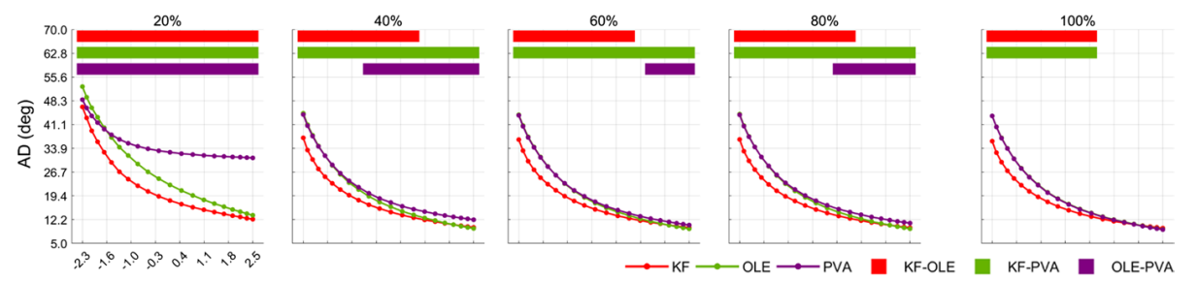
A simulation study on the effects of neuronal ensemble
Result
the effect of SNR along with PD uniformity on decoding performance
showed that AD of each decoding algorithm decreased exponentially as the SNR increased regardless of the PD
01

Slide 11
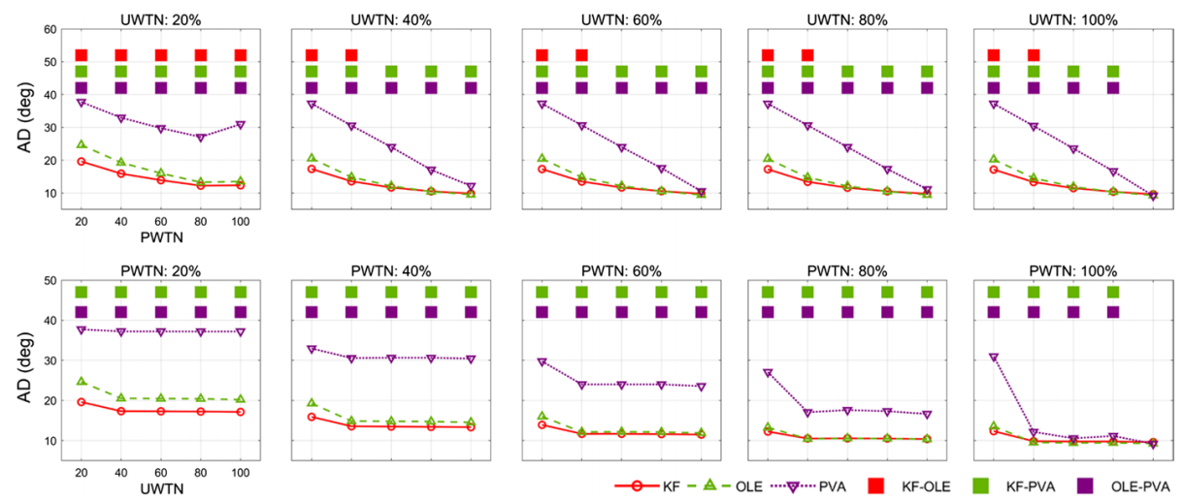
A simulation study on the effects of neuronal ensemble
Result
effects of PWTN and UWTN on decoding performance
KF and the OLE performed significantly better than the PVA for most cases of PWTN and UWTN
01

Slide 12
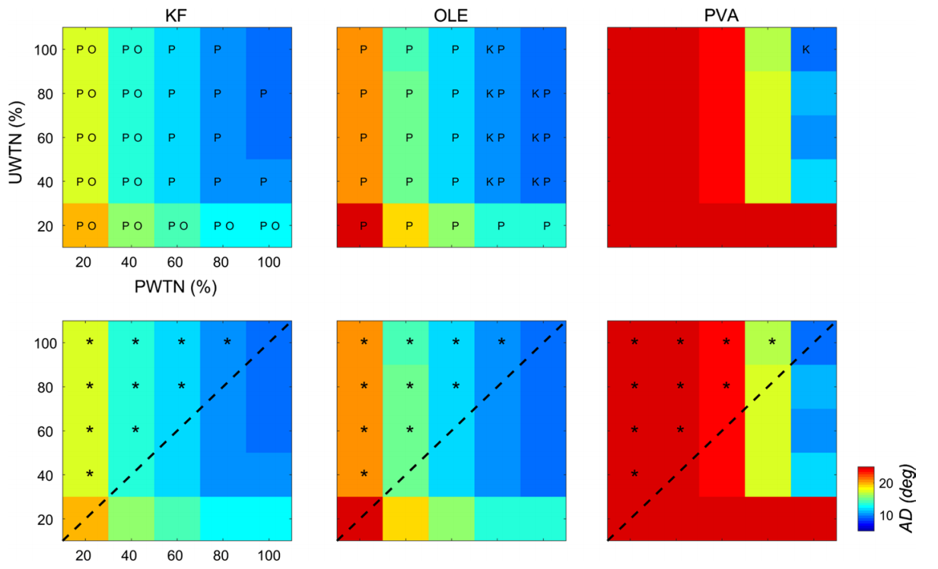
A simulation study on the effects of neuronal ensemble
Result
which of PWTN and UWTN influenced decoding performance more.
an increase in PWTN seemingly improved performance more than an increase in UWTN.
01

Slide 13
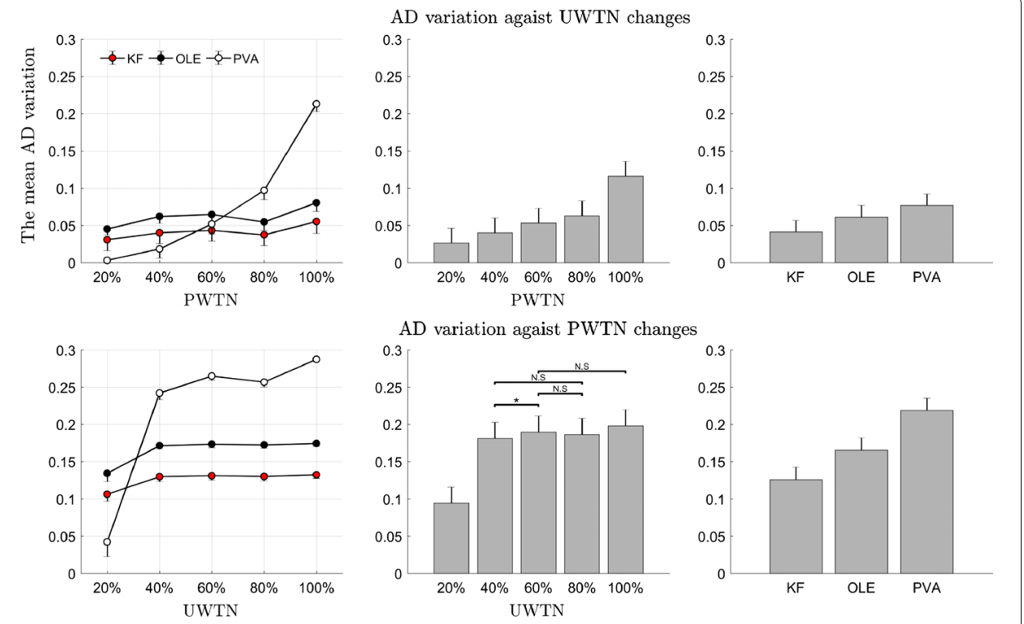
A simulation study on the effects of neuronal ensemble
Result
stability of each decoder against changes in UWTN or PWTN.
01

Slide 14
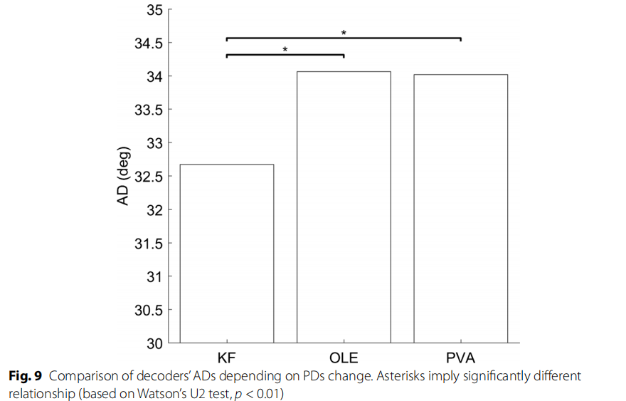
A simulation study on the effects of neuronal ensemble
Result
non-stationarity of PD
KF was more robust to non-stationarity of PD than the other decoders.
01

Slide 15
A simulation study on the effects of neuronal ensemble
Conclusion
decoding performance of all the models exponentially increased as SNR increased
employ the KF with low SNRs or the OLE with high SNRs when the ensemble PDs cover more than 20%
On the other hand, when the coverage of the ensemble PDs is less than 20%, the KF appears to be the best option among the three models.
PVA relies more on the number of well-tuned neurons in an ensemble than other models.
harvesting one more well-tuned neuron may be more crucial to direction decoding than having more widespread PDs(could be used in training paradigm)
KF yielded the best performance among others, revealing its robustness to the non-stationarity of PD.
14

Slide 16
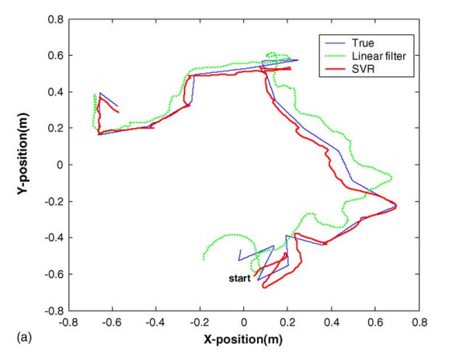

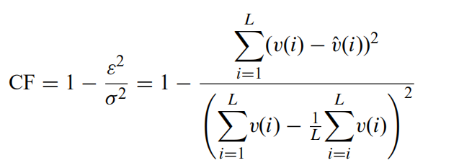
Superiority of nonlinear mapping in decoding
Details of paper
Kim K H , Kim S S , Kim S J . Superiority of nonlinear mapping in decoding multiple single-unit neuronal spike trains: A simulation study[J]. Journal of Neuroscience Methods, 2006, 150(2):202-211.
Tuning function
Detail of simulation
The number of delay elements was 10
The PD’s of each unit were randomly selected by generating 30 random numbers
Evaluation
CF(coding fraction)
01

Slide 17
Decoding arm speed during reaching
Details of paper
Yoh, Inoue, Hongwei, et al. Decoding arm speed during reaching.[J]. Nature Communications, 2018.
Tuning function
direction-only model
offset model
gain-only model
Detail of simulation
θ_Pdi , were chosen from either a uniform or a non-uniform distribution.
No delay
Normalize time
on the behavior of Monkey N
Poisson noise
16

