Slide 1
Recording from the same neurons chronically in motor cortex
”
A classification using four similarity features

Slide 2
major contribution
develop a method to determine whether single units in two separate recording sessions represent the same neuron.
analysis the firing properties of chronically recorded neurons were stable over time.
01

Slide 3
method
Features
Main idea
mean waveform shape
the autocorrelation function
the mean firing rate
the cross-correlograms
When two units recorded on separate days were compared using these features, their similarity scores tended to be either high, indicating two recordings from the same neuron, or low, indicating different neurons.
Although these metrics are individually weak, together they produce a strong classifier.
02

Slide 4
Tracking the same neurons
Problem
determining whether a particular sorted unit in session 1 represents the same neuron as another sorted unit in session 2, one or more days later.
Condition
This is because the interelectrode spacing on the Utah array is large (400 m), so it is unlikely that one neuron will be recognized on two different channels..
02

Slide 5
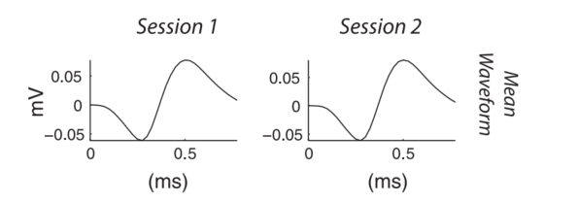
The mean waveform shape
Similarity computer
the peak value of the cross-correlogram between the average waveform shape in session 1 vs. session 2.
Fisher transformed
02

Slide 6
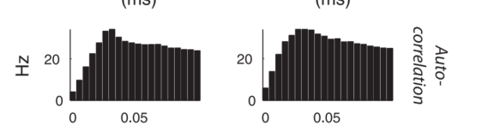
the autocorrelation function
Similarity computer
estimate the autocorrelation function from 0 to 100 ms by
binning at 5-ms resolution
To quantify the similarity of
these vectors, we take the Pearson correlation coefficient between
them.
Fisher transform to make the distribution more
normal.
02

Slide 7

The mean firing rates
Similarity computer
the difference between the log of the mean rates.
mean firing rates follow an approximately log-normal distribution.
02

Slide 8
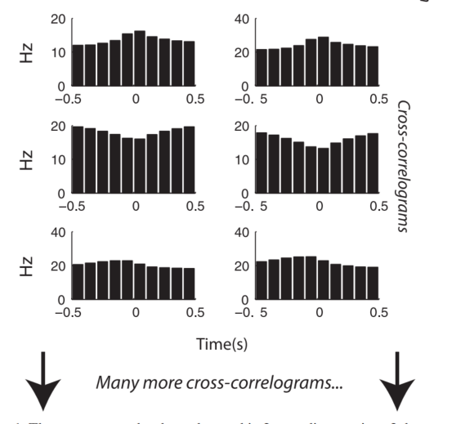
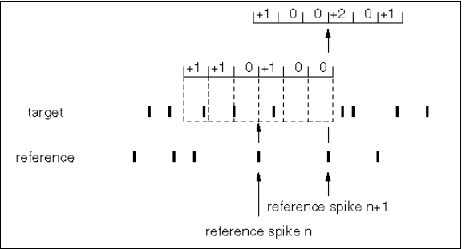
the pairwise cross-correlograms
Similarity computer
02

Slide 9
the pairwise cross-correlograms
Similarity computer
computed for a range of 0.5 s at 100-ms
resolution.
There are consistent features of the cross-correlograms, which tended to be
positive and negative triangular bumps with lags near zero.
Pearson correlations
Fisher transform those numbers
and take the mean,
Problem: the reference neuron should be the same
02

Slide 10
the pairwise cross-correlograms
problem
Solve
For instance, two neurons sorted on channel 1 might be labeled “unit 1a” and “unit 1b.” On the next day, their labels may be exchanged by the investigator doing spike sorting, or unit 1a may have disappeared and unit 1b is now labeled 1a.
Iterative procedure, making an initial assumption that, wherever the unit labels are the same between session 1 and session 2, they represent the same neuron. We then used our four-score classifier to identify which units putatively corresponded to the same neurons from session to session. This set of identities was then used to relabel all the units, and classification was performed again, under the assumption that the number of labeling errors will be reduced with each iteration.
02

Slide 11
Classifier
Our data set includes many points with known labels (cross-channel comparisons), whereas the remainder has mixed labels (within-channel, subsequent day comparisons that might be the same neuron).
Because the different-neuron data set is so large, it essentially dictates the shape of one of the Gaussians, and the other Gaussian converges very quickly onto a second cluster of points that lie away from the different-neuron distribution, putatively corresponding to the same-neuron comparisons.
All four scores were combined with a quadratic classifier that computes an optimal decision boundary under the assumption that the
underlying data can be modeled as a mixture of multivariate Gaussians.
a great deal of known different-neuron data (comparisons across different channels, which cannot be the same neuron).we do not have any known same-neuron data. Therefore we used partially supervised expectation-maximization
03

Slide 12
Result
We tracked the same neurons across many sessions by repeatedly applying this classifier to adjacent pairs of recordings. When following neurons across many sessions, it is theoretically possible that better choices could be made by considering the entire data set at once and employing a graph-cut algorithm.
We chose not to pursue this approach because the “soft” assignment
(probability same/probability different) of the Gaussian model was so
bimodally distributed that almost any decision procedure would produce the same answers.
03

Slide 13
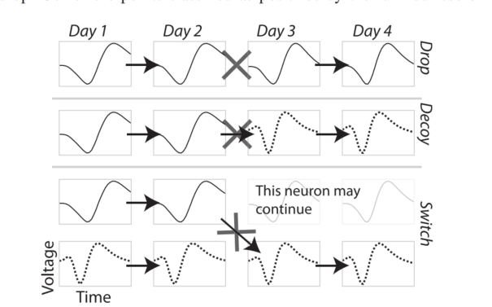
Errors
Drop errors occur when the same neuron on two days is classified as two different neurons.
Switch errors occur when the classifier switches the labels between two neurons, but at least one of them continues between days.
Decoy errors occur when one neuron disappears at the same time another appears, and they are classified as the same neuron.
03

Slide 14
Analysis
Problem:
some neurons may be recorded for a few sessions and then become undetectable for some period of time, only to return later. Such a neuron would be given two labels, one for each period it was continuously recorded.
Method:
not to attempt to correct such situations
because the most important metric of similarity (cross-correlations) works best when there are many identical neurons present in both sessions
Also, attempting to link such segments dramatically increases the potential for errors because a long series of recordings will contain many segments of recording that could be linked together erroneously.
03

Slide 15
Preferred direction
model
PD
03

Slide 16
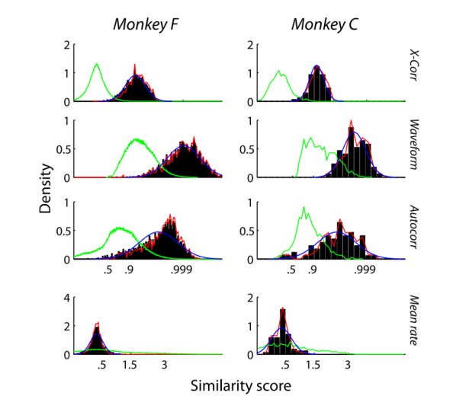
Result
different neurons distribution (recordings from separate channels, green line)
The data points classified as same neuron are shown as a black histogram.
The Gaussian computed by the expectation-maximization procedure (de
scribed below) is shown in blue and tends to match the black histograms,
synthetic data distribution in red, where we repeatedly classified the data using only three scores
03

Slide 17
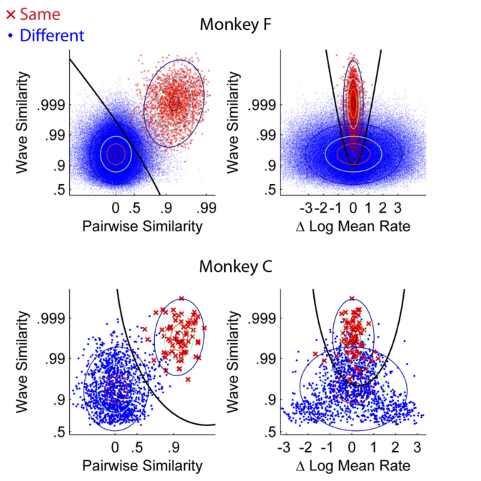
Result
The decision boundary of the
classifier is calibrated to produces a 5% error rate in the known
different-neuron distribution.
mean firing rates can indicate that two units are definitely not the same neuron,
but they can never give high confidence that they are the same.
The mean firing rate of a single neuron tends to be consistent from day to day, but the expected difference in mean rate
between two different neurons is also zero Thus, if two units on two days have a very different mean rate, then they are almost certainly different neurons; but, if they have a similar mean rate, we cannot be certain that they are the same neuron.
03

Slide 18
Result
Classification accuracy: knowing the ground truth
generate a data set where the ground truth is known by splitting each recording session in half and comparing the two halves as though they were separate sessions.
we changed the initial conditions of the iterative identification procedure by randomizing the unit labels so that the classifier was not initialized with the correct answer.
Testing our classification algorithm using split session data gave zero errors in monkey C and a 0.005% overall error rate in monkey F.
03

Slide 19
Result
Classification accuracy: without knowing the ground truth
Estimate the decoy error rate using comparisons across separate electrodes, which can’t be the same neuron.
Estimate the drop rate by modeling the data as a mixture of Gaussians
Estimate the drop rate with synthetic data.
03

Slide 20
Result
Classification accuracy: decoy error rate
We use method 1 to set the classification boundary with a
target decoy error rate of 5%. Where we set the classification
boundary amounts to a tradeoff between drop errors and switch
or decoy errors. A 5% target for the decoy rate heavily favors
the drop rate, which ends up 1%. The decoy error rate in a
real data set will be the product of 5% and the rate at which the
decoy error scenario occurs (see Fig. 4), which is rare.
03

Slide 21
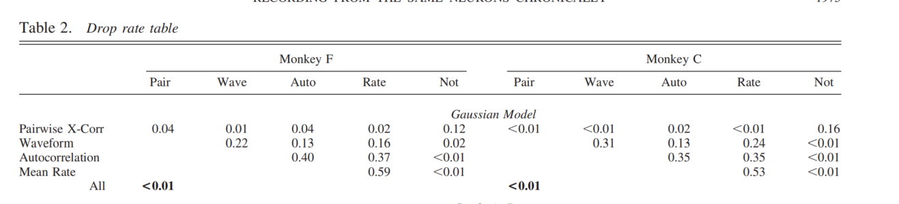
Result
Classification accuracy: Gaussian models
For method 2, we used the Gaussian models shown in Fig. 3. For every same-channel comparison classified as a negative, we estimated the probability that it was actually an unusually inconsistent single neuron using the density of the same-neuron and different-neuron Gaussians. By taking the mean of these probabilities we estimated the overall drop rate (Table 2).
03

Slide 22
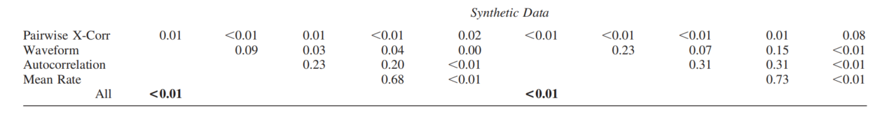
Result
Classification accuracy: synthetic data set
a synthetic data set as described in MATERIALS AND METHODS, applied our classifier, and calculated the drop rate
Pairwise cross-correlograms are the most important metric, followed by waveform, autocorrelation, then mean rate.
03

Slide 23
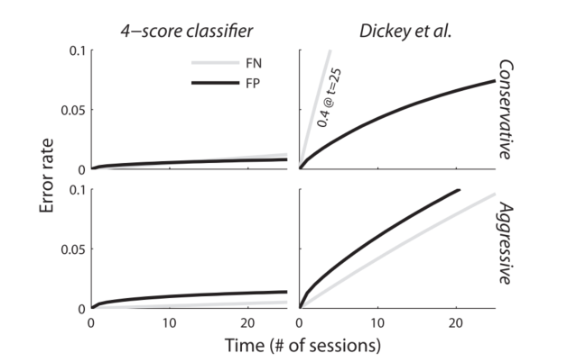
Result
Classification accuracy: synthetic data set
whether after x days a label is still correct.
False negatives (FN) :label is gone but the target neuron is still around.
False positives (FP) the label is on the wrong neuron, whether or not the original target is still present.
error rates tend to increase over longer
periods of recording.
03

Slide 24
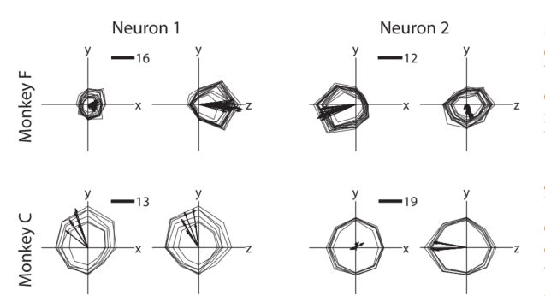
Result
Tuning parameters
The neurons shown are the first 2 neurons from each monkey that were recorded for at least 14 days with a mean preferred direction measurement error of 5°.
03

Slide 25
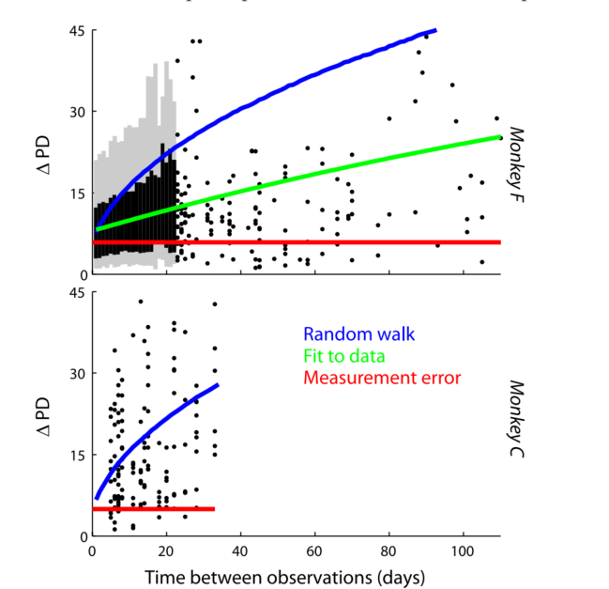
Result
Tuning parameters
Hypothesis 1: the PD is static.
Hypotheses 2: the PD experiences real variation that accumulates over time.
Red line :the expected average difference in PD if all change is caused by measurement error.
Blue line indicates a hypothetical trend assuming that the changes in PD accumulate over time (see Preferred directions for details).
Green line shows a simple nonlinear function fit to the data
03

Slide 26
Thank you!
Company Logo
Go to our website!
(click here)

