Slide 1

GitHub: A thing you (yes, YOU) can do!
9/11/2019

Slide 2
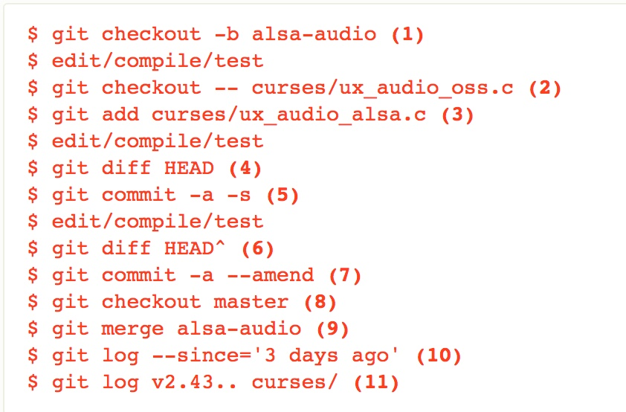
1. What Git
GIT is software for version control
GITHUB is a website that uses git to make software open source
Free to sign up
Projects are public by default
For a fee, can make projects private
Can make changes from the browser or copy to local and edit there

Slide 3
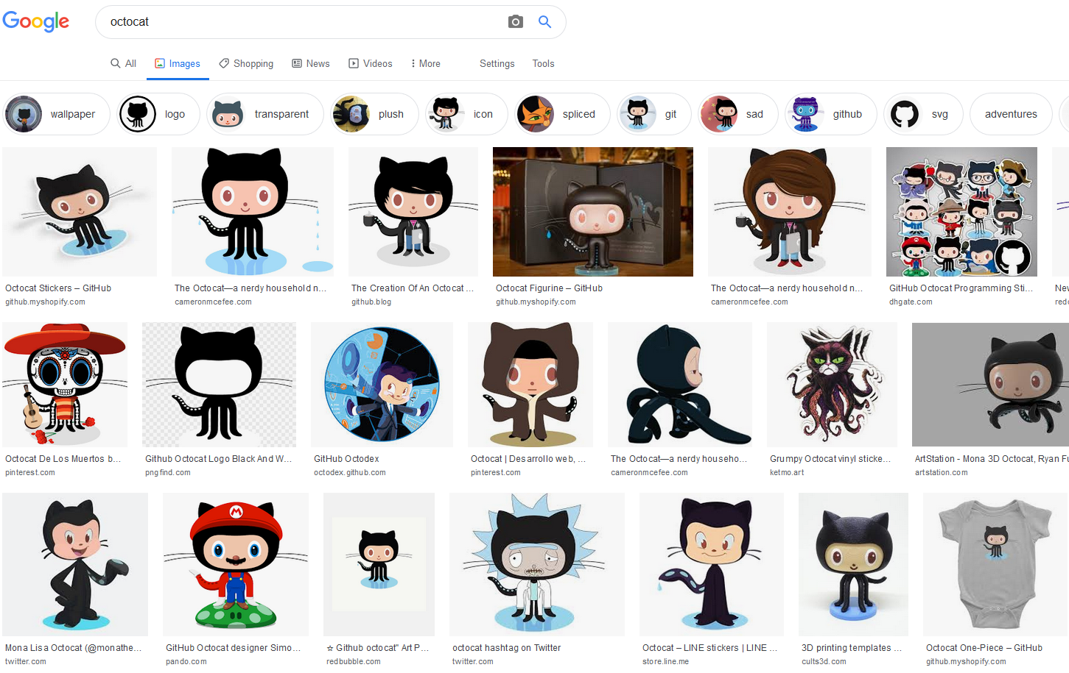
1a. Cat thing?
OctoCat.
No one else understands either.

Slide 4

2. Why Git
Build software collaboratively in an accountable way (everyone can see who did what when)
Easily undo any that happens in production software
Via GitHub, easy to share code with team members, friends, strangers on the internet
Think Google Docs vs Microsoft Word (ignoring Office 365)

Slide 5
3. How Git
Oversimplified Version
Vocabulary
Write Code
Create a COMMIT
PUSH that commit to github REPO so others can access
[time passes]
PULL fresh data from GitHub to your local computer
Repeat
REPO: short for “repository”, the place where all your things live
COMMIT: a batch of code you wrote/changed/deleted that is ready to be shared from your local machine
PUSH: taking a commit and adding it to the virtual repo that everyone pulls from
PULL: updating your local machine with the info from the virtual repo

Slide 6
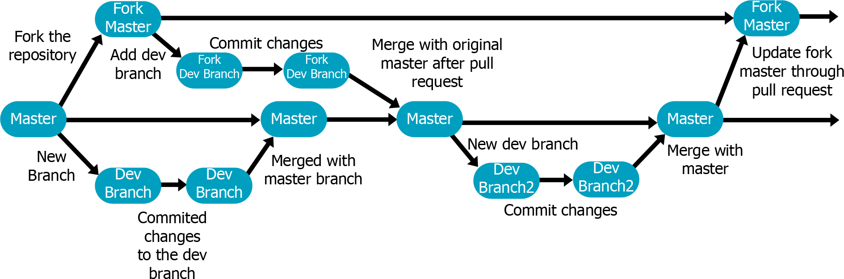
4. Git, but Team
BRANCHING: Create your own version of the repository WITHIN the repo. Make changes without breaking other people’s work, then merge it back to the main project (aka master branch) when you’re done.
FORKING: create your own separate version of the repository on your account. Good for working on projects where you may not have full access to the codebase.

Slide 7
5. Try Git!
We’re going to be following the instructions from Leah Bannon’s Git 101 demo
Create a GitHub Account
Navigate to https://github.com/codefordc/github-101
FORK the repository
Find the file with the number assigned to you
Add a header titled “Hello World!”. In that section share your name (or nickname,GitHub username, twitter handle, etc, etc).
Submit a Pull Request
profit!

Slide 8
6. More Git
Things to Try Next:
Install the Desktop client on your machine
Get set up on the command line
Try cloning a project to your local machine (following the README if available)
Resources:
Jessica Garson’s Intro to Command Line Git
Neal Humphrey’s Git Playground exercise
Rails Girls Guide to Pushing to GitHub
Udacity’s 4-week Intro to Git & GitHub course
For advanced users in a pickle: Oh Sh*t Git

Slide 9
7. Help Git?
Lizzie Ellis
Github.com/lizmeister321
@lizmeister321
lizzie@codefordc.org

