Slide 1

USING THE ACTIVE MODEL FOR TRACKING
Student Elizaveta Kulakova,
Student Yuliya Chindina
Samara, April 2024

Slide 2

TABLE OF CONTENTS
Introduction
Method
Method
Results
Results
Discussion
Conclusion
References
2

Slide 3
INTRODUCTION
The purpose of the work: extract parameters describing the adaptation of a face model to the frames of a video sequence.
Since the target applications are video-phones and man-machine interaction, we assume a “video phone-like”. That is, we assume that there is a face in the image, looking approximately into the camera.
3

Slide 4
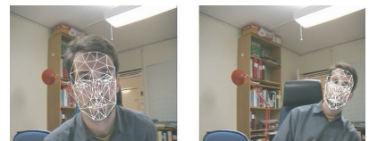
METHOD
Our active facial parameter extraction model is a simplification of the global active model, and here we describe its design and parameterization. AAM search effectively adapts the model to the image. [1]
In a video sequence, the changes between each frame are quite small (assuming the frame rate is high enough), so adaptation of the previous frame can be used as an initial estimate.
Picture — Examples of the colour-based algorithm giving a rough initial estimate of the location, size, and inplane rotation of the face.
4

Slide 5
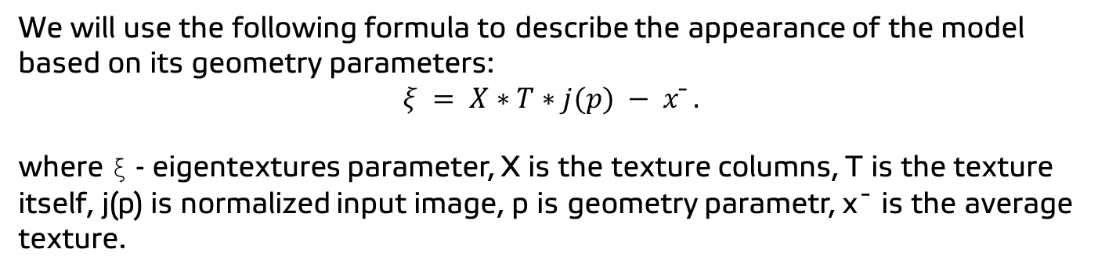
METHOD
We will use the following formula to describe the appearance of the model based on its geometry parameters:
$$ξ = X∗T∗j(p) − x¯ .$$
where ξ - eigentextures parameter, X is the texture columns, T is the texture itself, j(p) is normalized input image, p is geometry parametr, x¯ is the average texture.
5

Slide 6
RESULTS
Measurement | RGB | Grayscale
Iterations per frame | 6.9 | 6.8
Total time per frame (ms) | 94.1 | 69.1
Time per iteration (ms) | 13.6 | 10.2
Time for computing ∆p (ms) | 7.2 | 5.05
Table — Timing results (average over 341 frames).
6

Slide 7
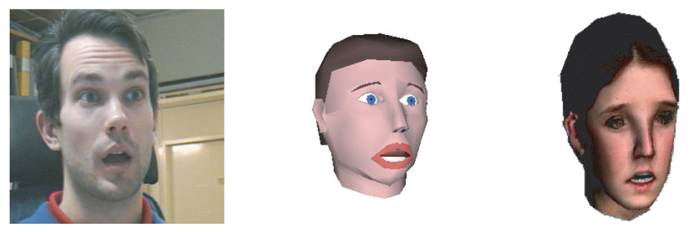
RESULTS
As a result, if the footage is recorded at a high frame rate (with little movement between frames), tracking will also perform at a higher speed and accurately extract parameters. The visual results are shown in the Picture.
Picture — The original frame (left), the frame synthesized with FAE from DIST, University of Genova (middle), and the facial animation system by Miralab, University of Geneva (right).
7

Slide 8
DISCUSSION
We believe that using such a model is very effective in speeding up the facial feature tracking process. Therefore, it is worth using this system when speed matters.
However, since the static shape does not change in this algorithm, the model must be adjusted in advance to take into account the characteristics of the object and external factors. If you forget about this adjustment, the result may not be ideal.
8

Slide 9
CONCLUSION
We looked at a system that tracks faces and extracts facial features from video footage.
The system operates in almost real time, and the experimental results are encouraging.
With some further refinement and optimization, 3D facial imaging and real-time face tracking could be implemented on consumer hardware.
9

Slide 10
REFERENCES
[1] J. Ahlberg, “An Active Model for Facial Feature Tracking,” EURASIP J. Adv. Sig. Proc., vol. 2002, pp. 566–571, Jun. 2002, doi: 10.1155/S1110865702203078.
[2] A. Lanitis, C. J. Taylor, and T. F. Cootes, “Modeling the process of ageing in face images,” in Proc. Int. Conf. on Computer Vision, vol. 1, pp. 131–136, Kerkyra, Greece, 1999.
[3] J. Strom, “Reinitialization of a model-based face tracker,” in Proc. Int. Conf. on Augmented, Virtual Environments and 3-D Imaging, pp. 128–131, Mykonos, Greece, 2001.
[4] G. J. Edwards, T. F. Cootes, and C. J. Taylor, “Interpreting face images using active appearance models,” in Proc. 3rd Int. Conf. on Automatic Face and Gesture Recognition, pp. 300–305, Nara, Japan, 1998.
10

Slide 11
THANK YOU FOR YOUR ATTENTION!

