Slide 1

WELCOME TO OUR PRESENTATION

Slide 2
Presented by
Md.Lizur Rahman
2014-3-60-014
Ifrat Jahan
2014-2-60-051
Aiswarja Saha Joye
2014-2-60-114

Slide 3


Wanna play an interesting game??????

Slide 4

A MINUTE TO LEARN… A LIFETIME TO MASTER…

Slide 5

INTRODUCTION
BOARD GAME
TWO PLAYER GAME
SUITABLE FOR ALL AGES
REVERSI GAME

Slide 6
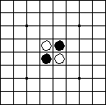
A Game of Othello
8x8 board, black and white tokens
Fully Observable
Episodic
Today, we will use it as a design example

Slide 7


ROBOT VS HUMAN
First player
Second player
Vs

Slide 8

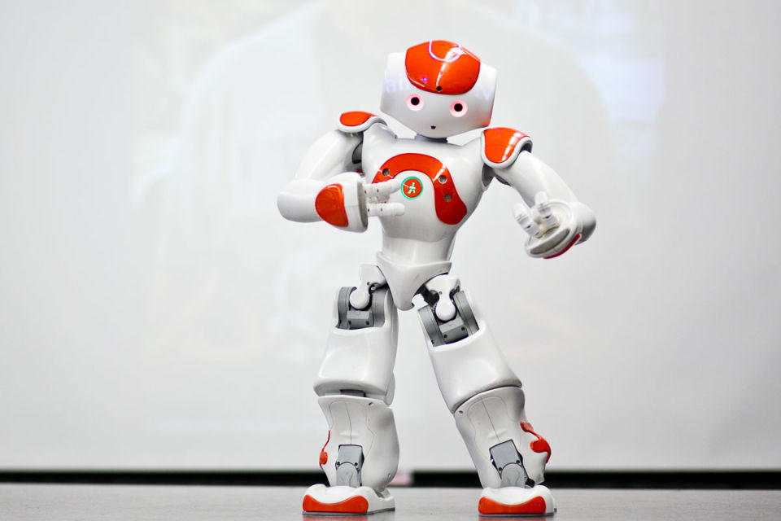
HUMAN VS ROBOT
First player
Second player
Vs

Slide 9

HUMAN VS HUMAN
First player
Second player
Vs

Slide 10
Strategy of Othello Game:
Playing one more move than your opponent
Forcing your opponent to initiate play elsewhere

Slide 11
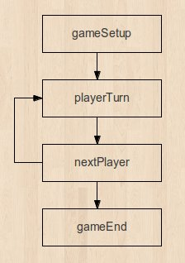
Process:

Slide 12
Othello: Rules and Game Play
The object of the game is to have the majority of your color discs on the board at the end of the game
Rules
Black places two black discs and White places two white discs as shown in here. The game always begins with this setup.
A move consists of "outflanking" your opponent's disc(s), then flipping the outflanked disc(s) to your color.
To outflank means to place a disc on the board so that your opponent's row (or rows) of disc(s) is bordered at each end by a disc of your color. (A "row" may be made up of one or more discs).
Here's one example: White disc A was already in place on the board. The placement of white disc B outflanks the row of three black discs.

Slide 13

Outflanking Example:
White disc A was already in place on the board. The placement of white disc B outflanks the row of three black discs.
White flips the outflanked discs and now the row looks like this:

Slide 14
Global Picture of Our System
Circuit in Each Square to:
Keep State of the Square
Compute whether move in square is legal
Game Controller
Global Game State
Orchestrates individual move logic

Slide 15
Game Controller State Machine
Flip
Current
Color
Game
Over
Flip
Current
Color
N
Legal
Move?
N
Current
Color =
White
Y
Legal
Move?
Y
Update
Board
Enable
Move
Move selected
Move selected’

Slide 16

THANK YOU……

