Slide 1
Good Questions !
Security
Generation
Simon S. Woo Zuyao Li
CSCI 662 Final Presentation
Dec 4th 2014
University of Southern California
Automatic

Slide 2
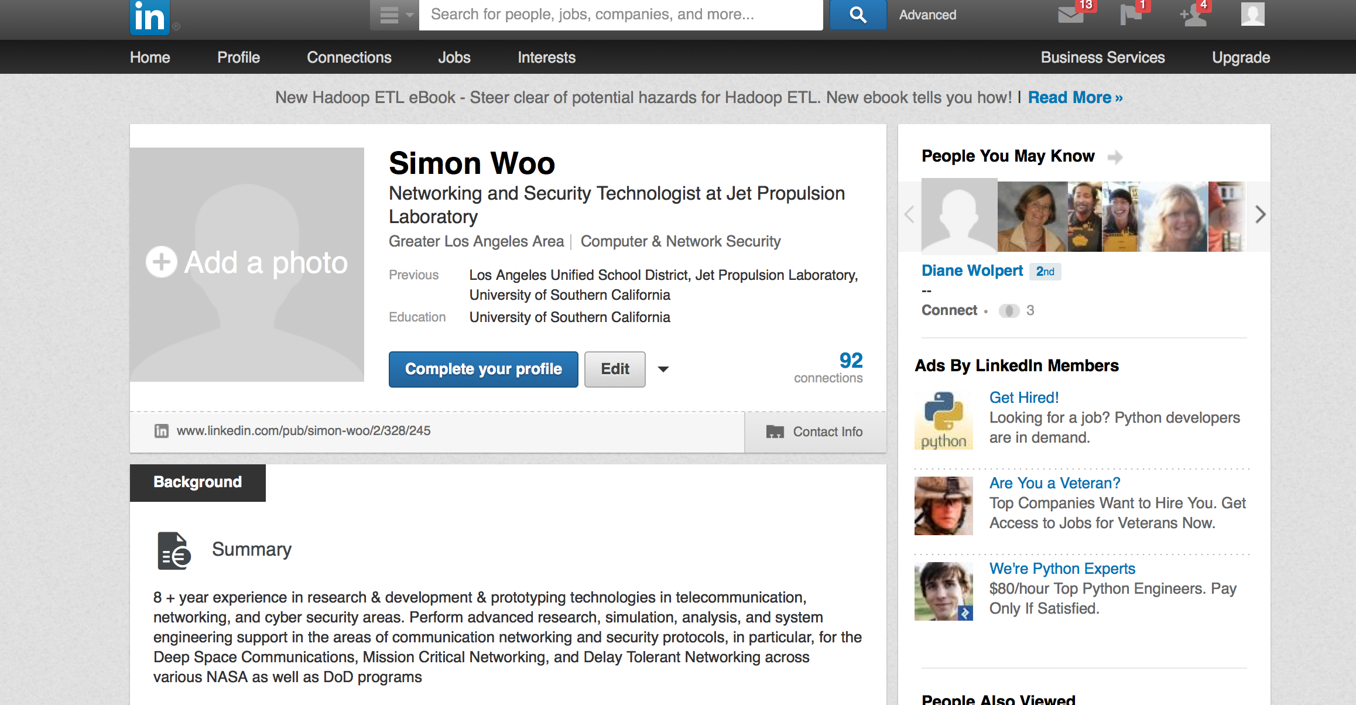
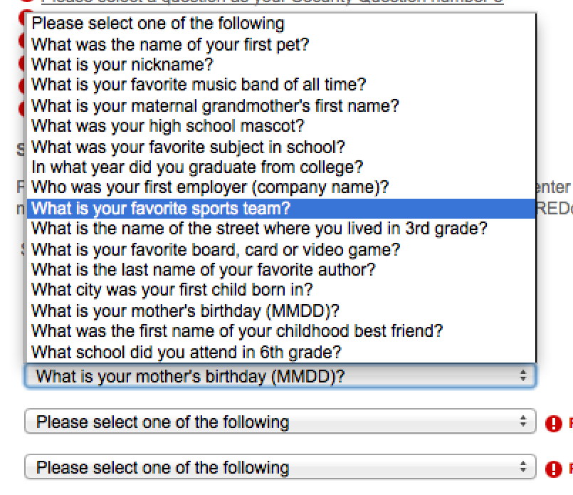

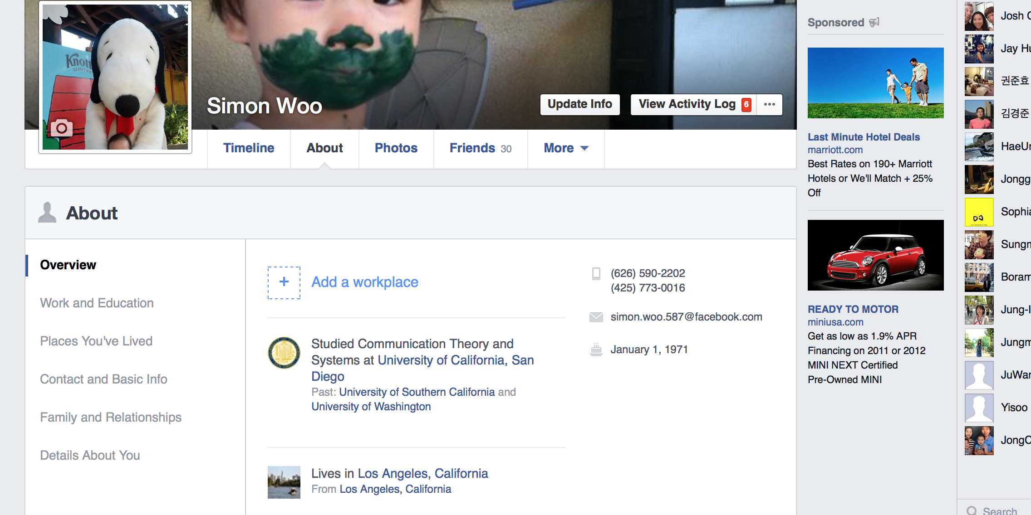
Security Questions for Authentication
Knowledge based Authentication/Cognitive Passwords based on something you know

Slide 3
Problem Description: Better Security Question Generation
From freeform short narratives/texts from users:
In November 2010, I took part in a mathematical contest for Chinese college student, host by Shing-Tung Yau. It was a great experience for me. I did a great job in the writing part, and earned a chance for interview section in August 2011. The interview is in Beijing, and I met a lot of famous mathematicians there, like Chi-Wang Shu, Shing-Tung Yau, jun Liu. I earned a medal finally with great happiness.
Q: what month and year did you take part in ? A: November 2010
Q: who hosted the competition ? A: Shing-Tung Yau
Q: What month and year was the interview ? A: August 2011
Q: What city was the interview in ? A: Beijing
Q: Who are the three people you meet ? A: Chi-Wang Shu, Shing-Tung Yau, jun Liu.

Slide 4
Related Work (Security Perspective)
[1] Grammar Undercuts Security Of Long Computer Passwordshttp://www.cmu.edu/news/stories/archives/2013/january/jan24passwords.html.
[2] M. N. Al-Ameen, S. Haque, and M. Wright. QA: Towards the solution of usability-security tension in user authentication.
[3] M. Just and D. Aspinall. Personal choice and challenge questions: a security and usability assessment. In Proceedings of the 5th Symposium on Usable Privacy and Security, page 8. ACM, 2009.
[4] S. Schechter, A. B. Brush, and S. Egelman. It’s no secret. Measuring the security and reliability of authentication via ’secret’ questions. In Security and Privacy, 2009 30th IEEE Symposium on, pages 375–390. IEEE, 2009.
[5] R. Veras, C. Collins, and J. Thorpe. On the semantic patterns of passwords and their security impact. In Network and Distributed System Security Symposium (NDSS14), 2014.
[6] V. Griffith and M. Jakobsson. Messing with texas deriving mother’s maiden names using public records. In Applied Cryptography and Network Security, pages 91–103. Springer, 2005.
Security Question GAP : No good alternatives…No rigorous NLP approach

Slide 5
Related Work (NLP Perspective)
[7] Mazidi, Karen, and Rodney D. Nielsen. "Linguistic Considerations in Automatic Question Generation.”, ACL 2014
[8] M. Heilman and N. A. Smith. Good Question! Statistical Ranking for Question Generation. In Proc. of NAACL/HLT, 2010.
[9] M. Heilman and N. A. Smith. Question generation via overgenerating transformations and ranking. Technical Report CMU-LTI-09-013, Carnegie Mellon University Language Technologies Institute, 2009.
[10] X. Yao, E. Tosch, G. Chen, E. Nouri, R. Artstein, A. Leuski, K. Sagae, and D. Traum. Creating conversational characters using question generation tools. Dialogue & Discourse, 3(2):125–146, 2012.
[11] M. Heilman and N. A. Smith. 2010. Extracting Simplified Statements for Factual Question Generation. In Proc. of the 3rd Workshop on Question Generation.
[12] Proceedings of QG2010: The Third Workshop on Question Generation
Question Generation GAP: Mostly educational applications, focus more on linguistic fluency, long Qs and rules (cannot go very far)

Slide 6
Proposed System (leveraging exiting QG tools [9,10])
Step 0. Tried the word alignment approach
Input Sentence: Last year, we had a holloween party at my apartment near USC with our friends, most are from the badminton club.
Step 1. Break a sentence into shorter sentences as much as possible (still resort on the rules):
POS, Semantic Parser (input can be noisy)
Short Sentence 1: Last year, we had a holloween party at my apartment near USC with our friends
Short Sentence 2: most are from the badminton club.
Short Sentence 1: Last year, we had a holloween party at my apartment near USC with our friends
Step 2. Directly generate question
from shorter sentences using Semantic Parser and NER (Subj, Obj, Time, Location, Org)

Slide 7
Proposed System
Short Sentence 1: Last year, we had a holloween party at my apartment near USC with our friends
Short Sentence 2: most are from the badminton club.
Q: Where are your friends most from ?
A: the badminton club
Q: Where was the party at ?
A: my apartment near USC
Q: What year was the party ?
A: Last year (Good NLP Q/but Bad SQ)
Step 3. Generate short short short specific indepedent questions, even though not perfect (better for generation and security)
Step 4. Filter out bad (easy to guess) SQs based on Q/A pair using entropy and bad NLP Qs
Step 5. Apply Language Model to improve generated Q
(use Qs from QA system)

Slide 8
Current Data Set
Conducted User Study and obtained freeform personal narratives from USC students, friends, and Mturkers (40 people~100 personal narratives)
Some of participants are non-native English speakers
(Noisy inputs)
Manually generated ~ 500 Good Security Question & Answer Pairs (Gold)
Also, obtained previous QG data from [9]
In addition, many Q/A data from Question Answering system (but no input texts)

Slide 9
Unsupervised learning (word alignment)
Align question and input sentence pairs using Giza++
Training on ~500 sentence pairs dataset
Sample: It was the new year’s eve in 2012.
NULL({3 7}) What year was it({1 2 4 5 6 8})
The data set is not big enough to do unsupervised learning.

Slide 10
Sentence Break and Rule based approach
We try to parse the sentence with dependency parser and semantic role labeling.
Find the subject, object, time and location of the sentence to form who, what, where, when questions.
We also try to detect the name entity to find the type of the name entity to form which question.

Slide 11
Sample of Results
Input sentence: James lived in Dalian in summer.
who Q: who lived in Dalian in summer? (too much info)
who A: James
what Q: what did James live?
what A: in Dalian in summer
which Q: which Person?
which A: James
which Q: which City did James live in?
which A: Dalian
when Q: when was this event?
when A: in summer
where Q: where was this event?
where A: in Dalian

Slide 12
Evaluations
We use unigram accuracy and BLEU score to evaluate our system for 200 input sentences
BLEU | What | Who | Where | When
OpenAryhpe (OA)[10] | 0.587 | 0.581 | 0.579
Ours | 0.693 | 0.485 | 0.707 | 0.655
Unigram ACC | What | Who | Where | When
OpenAryhpe (OA)[10] | 0.336 | 0.235 | 0.129
Ours | 0.446 | 0.220 | 0.25 | 0.315

Slide 13
Conclusion and Future Work
Plan to use Language Model training on large amount of question dataset.
Then use LM to help remove or reorder the words of our system output to make it grammar correct.
Noisy User Input ?
Try to stay away from rules (accurate but narrow coverage). More general approach to cope with unseen and noisy user inputs ?
Leverage Q&A dataset ?
Decipher the following ?
String tregexMatchFiniteS = "S=finite !> ROOT ! >> NP|PP < NP < (VP < VBP|VB|VBZ|VBD|MD) ?< /\\./=punct";

Slide 14
Or Comments?
Good Questions ?
Any

Slide 15
Back up

Slide 16
Survey on
Current Security Questions (SQs)
6-7-2014

Slide 17
SQs Data Set
Good Security Question: 90 Questions
http://goodsecurityquestions.com/examples.htm
U.S. Bank: 29 Questions
TIAA-CREF: 31 Questions
Note: Several questions overlap among those sites

Slide 18
Ground/Background work
Analysis on current SQs
NLP/Linguistic Perspective
Semantic Perspective
SQ Type | Count | percent
What+name+people | 24.00 | 20.87
What+name+stuff | 42.00 | 36.52
What + numeric | 16.00 | 13.91
What+location | 21.00 | 18.26
Where+Event | 7.00 | 6.09
Who+name | 2.00 | 1.74
How many | 1.00 | 0.87
Which | 2.00 | 1.74
Total | 115.00 | 100.00
SQ Type | Count | percent
What+name+people | 25.00 | 21.74
What+name+stuff | 44.00 | 38.26
What + numeric | 18.00 | 15.65
What+location | 28.00 | 24.35
Total | 115.00 | 100.00

Slide 19
NLP/Linguistic Perspective

Slide 21
Detailed Taxonomy of SQ
From NLP/Topic Analysis perspective

Slide 22
Some Taxonomy
SQ types:
What + is/was + person_name ? 10
What + is/was + stuff/thing/Org ? 7
What + is/was + numeric ? 9
What + verb + location ? 9
Where + was/verb + Event ? 3
Who + was + name ? 1
What time (When) + verb ? 1

Slide 23
Some Taxonomy
Some of them are semantically similar, starting with different Wh*
What + is/was + person_name ? 10
What + is/was + stuff/thing/Org ? 7
What + is/was + numeric ? 9
What + verb + location ? 9
Where + was/verb + Event ? 3
Who + was + name ? 1
What time (When) + verb ? 1

Slide 24
Taxonomy of SQs
What + be + specifier/adj + name_people/pet ? (24)
What + be + specifier/adj + name_things/stuff ? (42)
What + be + specifier/adj + numeric ? (16)
What + verb + Location ? (21)
Where + be+ Event ? (7)
Who+ was+ name with Event ? (2)
How + many + ?(1)
Which + verb ? (2)

Slide 25



Slightly Topic Oriented View
What
Adj/Specifier{favorite, oldest, childhood…}
{First, Middle, Last name}
Family
members
Nick
Name
Friends
Neighbors
Teachers/
Professors
Neighbors
Others: hair
stylist
Managers/
Supervisors
Animals

Slide 26
How much info that FB, GOOG, LNKD will have on these ?
What
Adj/Specifier{favorite, oldest, childhood…}
{First, Middle, Last name}
Family
members
Nick
Name
Friends
Neighbors
Teachers/
Professors
Neighbors
Others: hair
stylist
Managers/
Supervisors
Animals

Slide 27
Now, inference and text mining problems
What
Adj/Specifier{favorite, oldest, childhood…}
{First, Middle, Last name}
Family
members
Nick
Name
Friends
Neighbors
Teachers/
Professors
Neighbors
Others: hair
stylist
Managers/
Supervisors
Animals

Slide 28
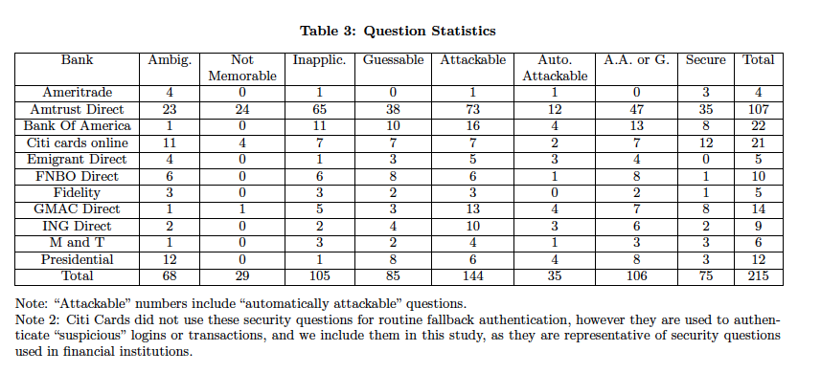

Slide 29
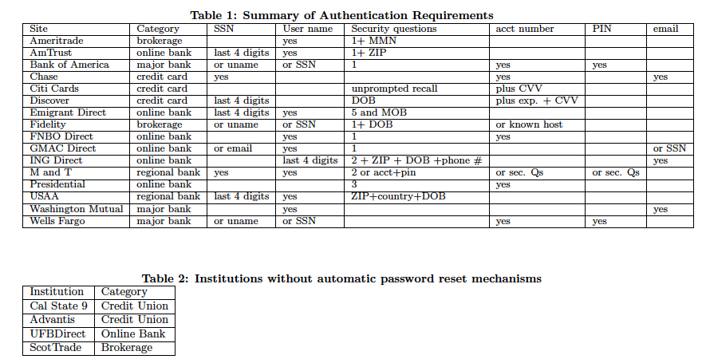

Slide 30
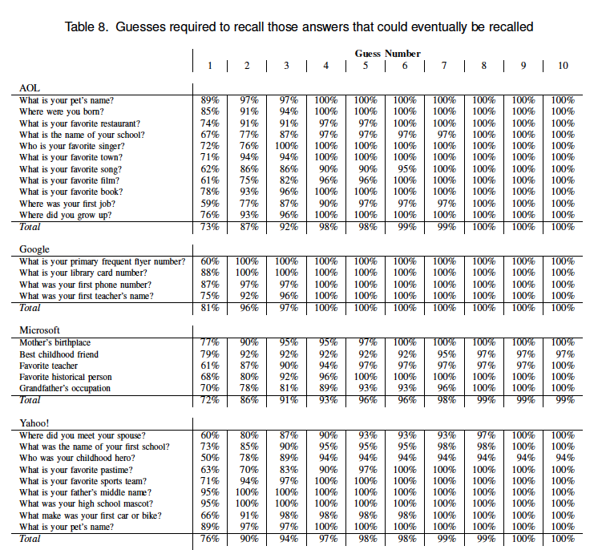

Slide 31
