Slide 1
Camera trap simulation
Lizzie Bru MRes project

Slide 2
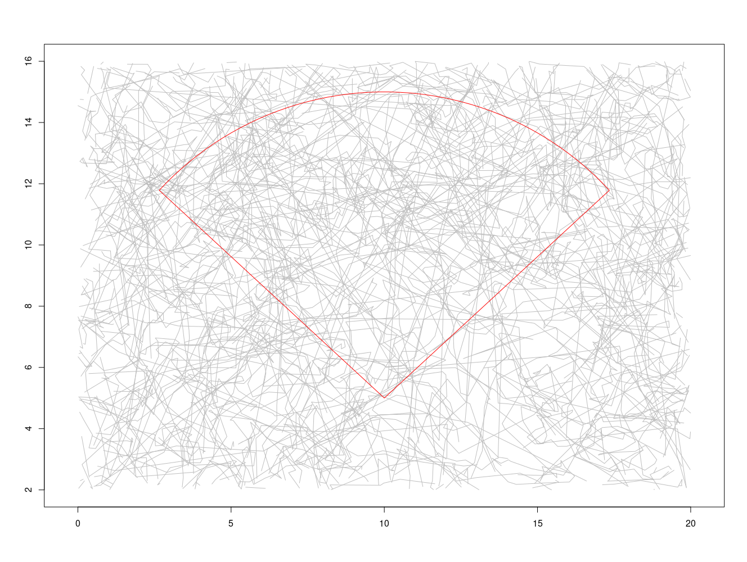

Slide 3
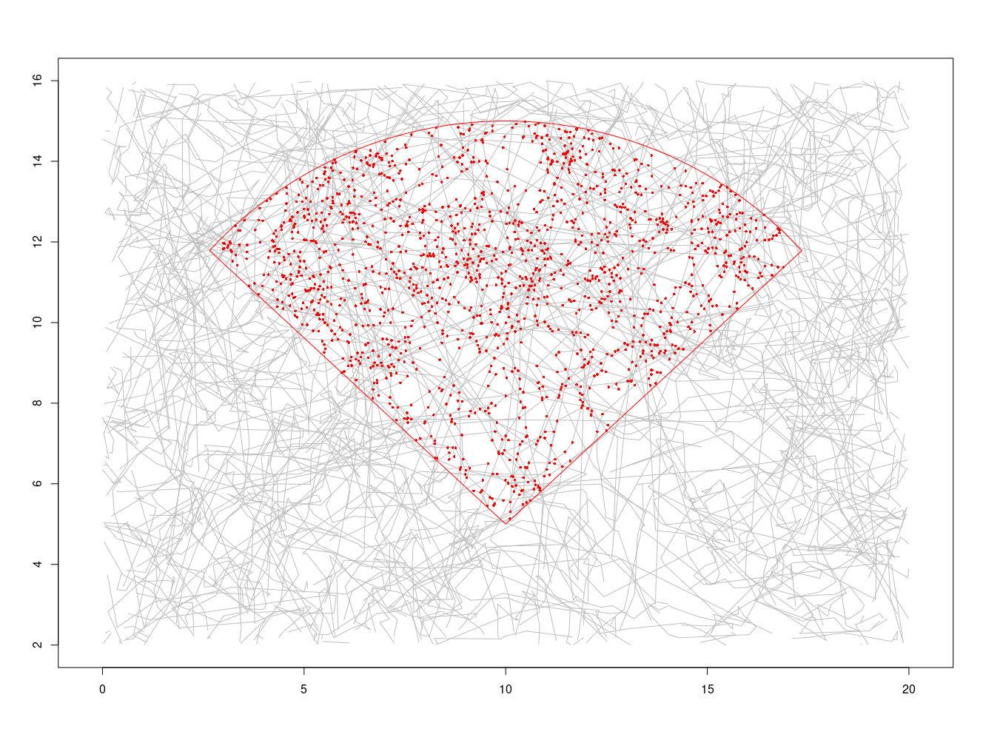

Slide 4
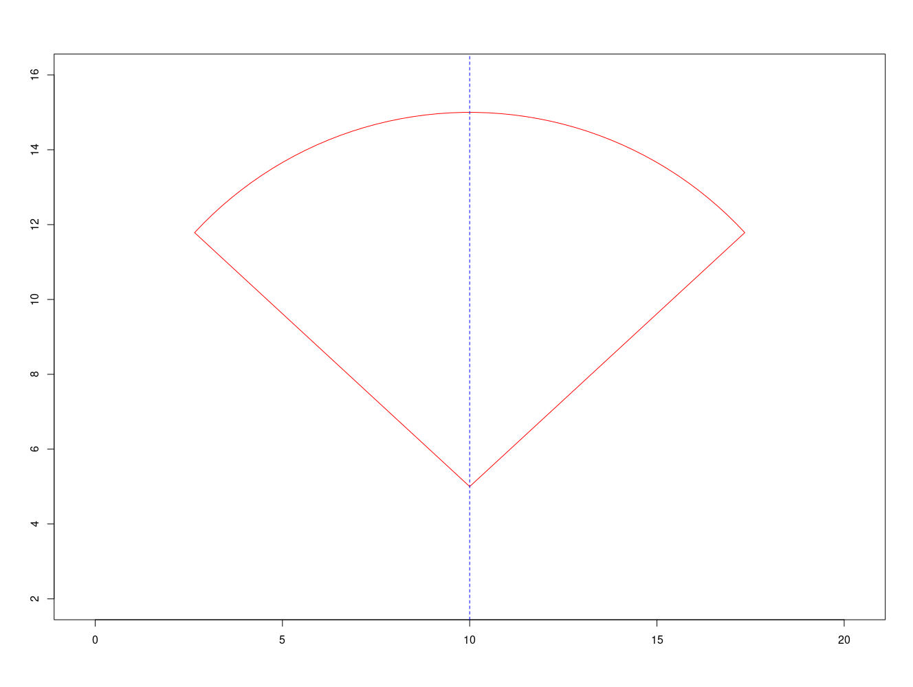
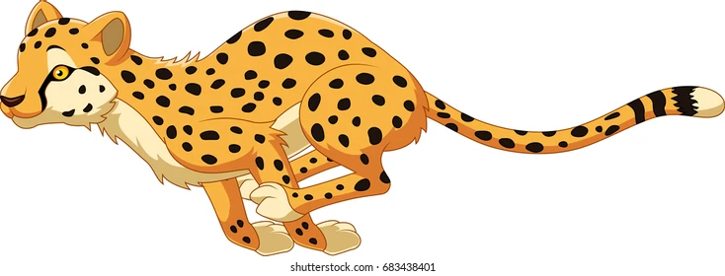
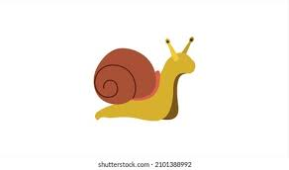
Parameters: camera trap
radius
rate of image capture
width angle
+ distance detection probability according to animal size

Slide 5
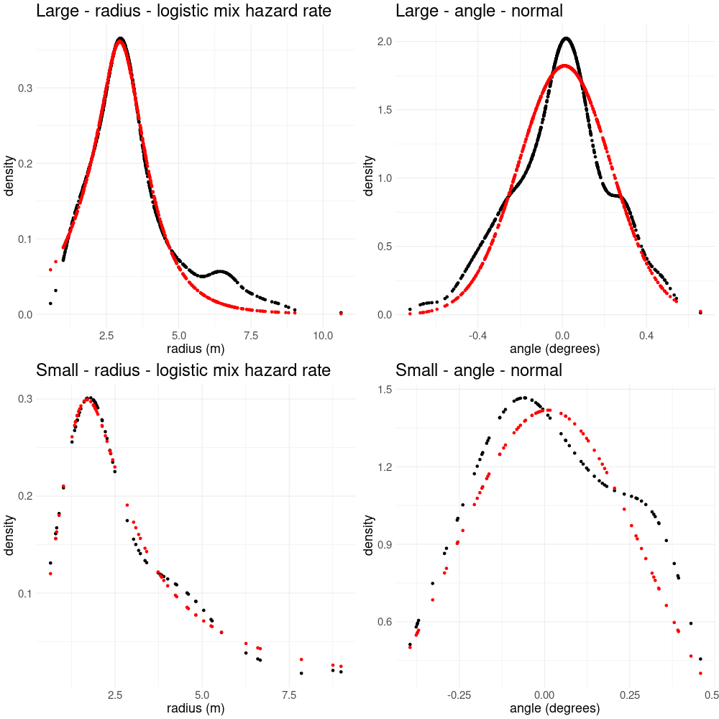
Detection probability for a given distance and angle

Slide 7
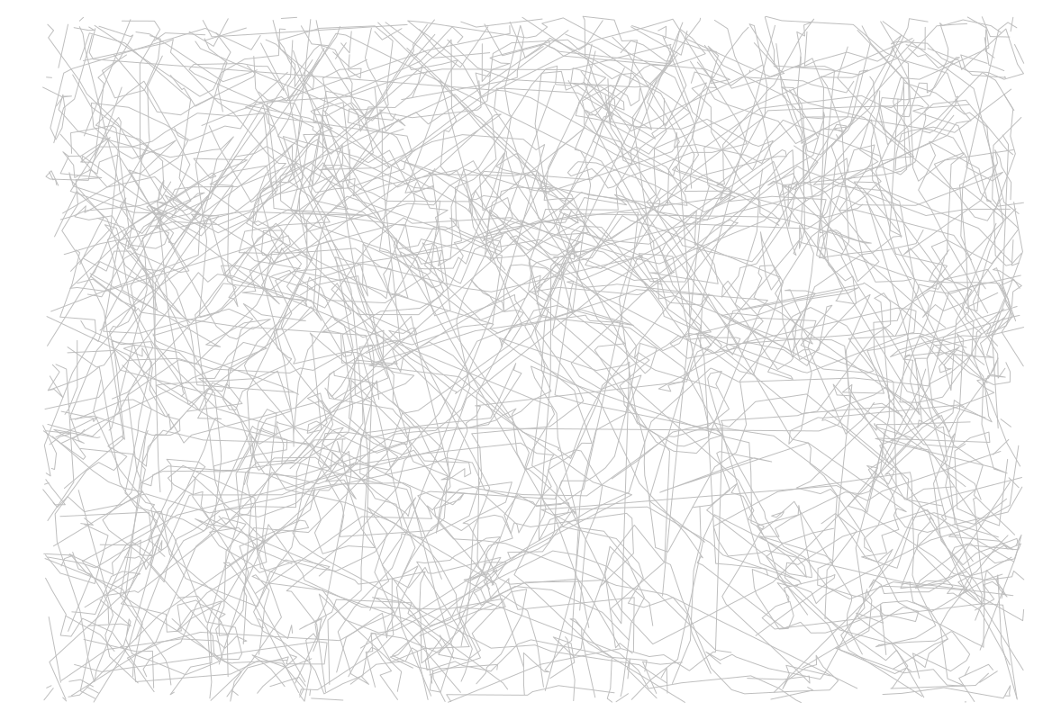
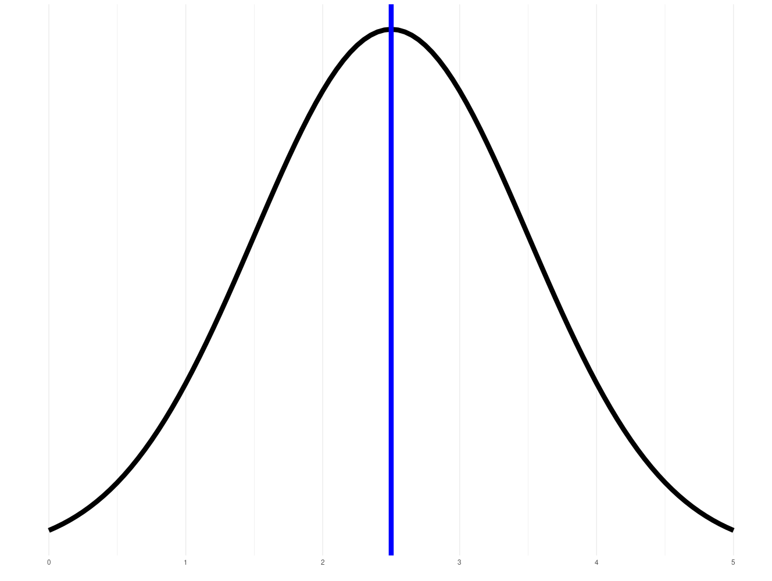
Parameters: path
mean speed
number of steps
probability of turning at each step
variation in turn angle across different steps
variation in speed about the mean
whether to correlate variation in turn angle with speed
spatial limits of the path
autocorrelation in speed
+ many of these scaled by animal size

Slide 8
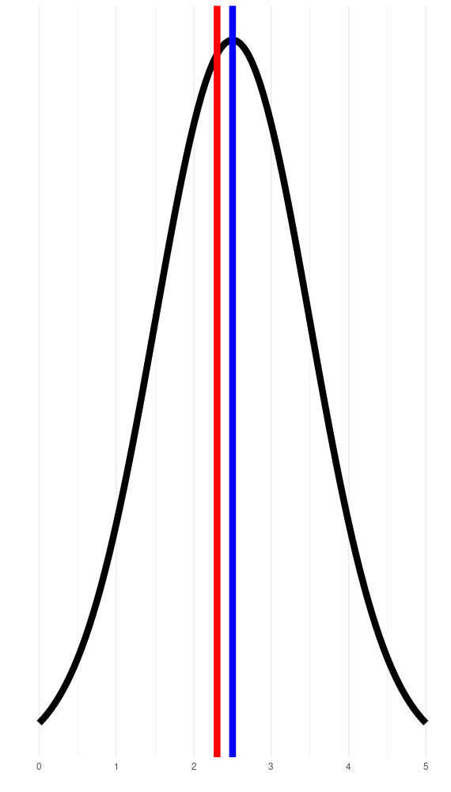
Flowchart
Input mean speed parameter
Simulated path with varying speeds
observed speeds
Speeds centred around a mean realised speed
1 per crossing of the detection zone
Observed speed (m/s)
2.00014
2.19878
1.99801
2.07452
1.99905
Fit size-biased distributions or use harmonic averaging to calculate estimated speed

Slide 9
Setting parameters
Animal size
Detection probability based on distance
Small: < 4kg
Large: > 4kg
Radius: hazard rate + logistic mix
Angle: normal..?

Slide 10
Animal | Body mass (kg) | Dataset
Mouse | 0.1 | Panama
Central American spiny rat | 0.4 | Panama
Red-tailed squirrel | 0.4 | Panama
Hedgehog | 0.8 | Regent’s Park
Central American agouti | 3.5 | Panama
White-nosed coati | 4.0 | Panama
Armadillo | 2.5 – 6.5 | Panama
Tamandua | 1.5 – 8.4 | Panama
Opossum | 4 – 6 | Panama
Fox | 6.5 | Regent’s Park
Paca | 8.0 | Panama
Ocelot | 11.9 | Panama
Red brocket deer | 25.2 | Panama
Collared peccary | 25.2 | Panama
Takin young | ~60? | India
Takin | 180 | India
Himalayan black bear | 200 | India

Slide 11
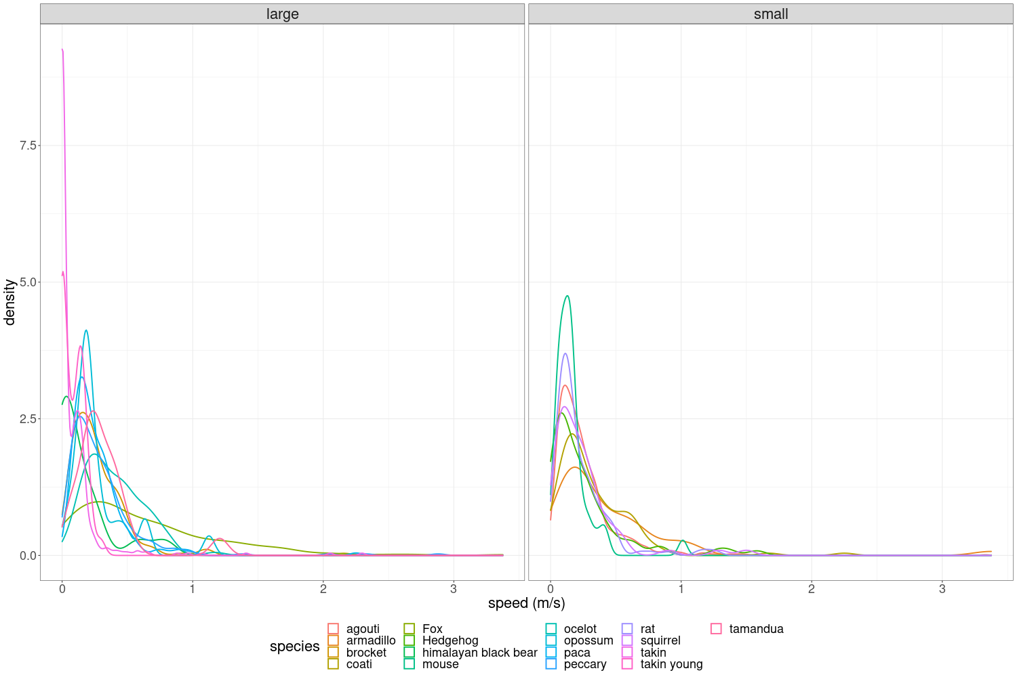

Slide 12
Questions
Are there biases in this process of speed estimation?
What drives these biases?
How can we fix these biases?
Speed proportional to trap rate?
Very high speeds missed by camera traps?
size?
speed?
do these biases occur in realistic parameter space?
distribution of speeds?
e.g. bimodality

Slide 13
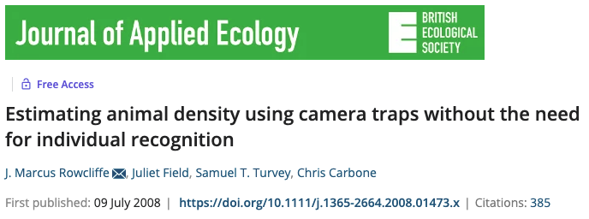

Is speed proportional to trap rate?
predicted by the Random Encounter Model (REM)
Population density
number of independent photographic events
detection zone angle
camera trap rate
detection zone radius
= method based on camera trap data for estimating population densities without the need for individual recognition
average animal movement speed

Slide 14
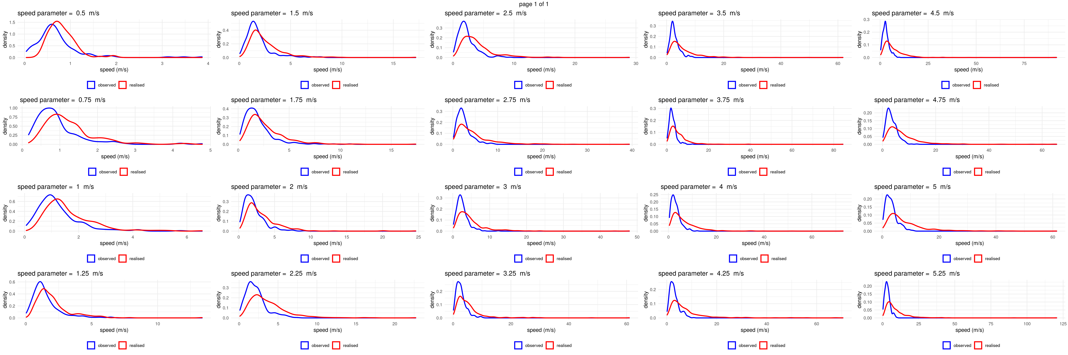
Is speed proportional to trap rate? - comparison of realised and observed speeds

Slide 15
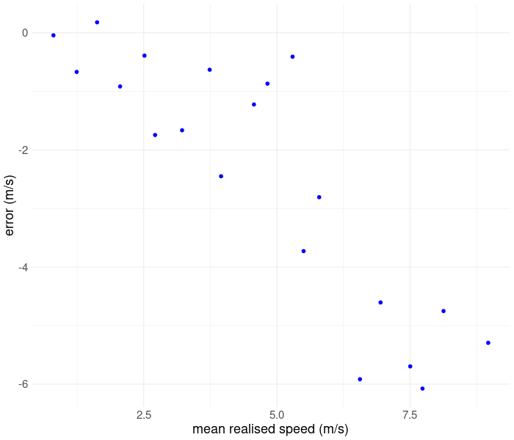
Error between observed speeds and mean realised speed for different mean realised speeds

Slide 16
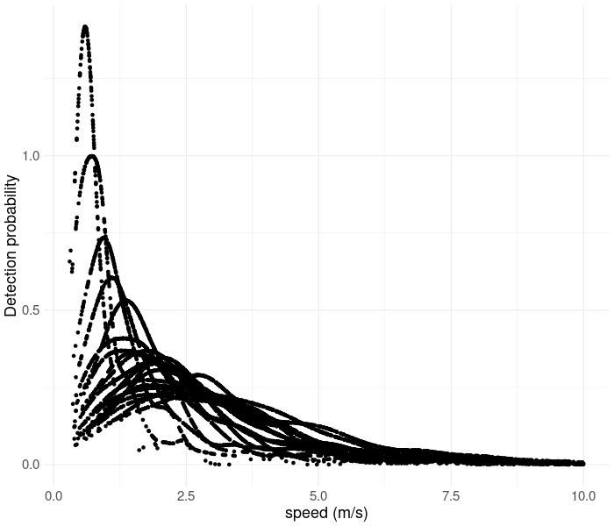
Detection probabilities of different realised speeds

Slide 17
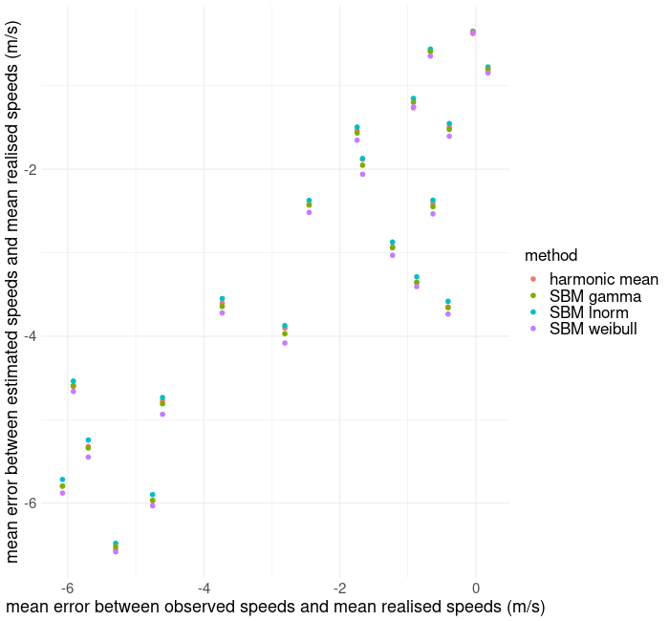
Speed proportional to trap rate: effects on estimated speed calculation

Slide 18
Are high speeds missed by camera traps?
Plot of number of single- and zero- frame sequences against mean realised speed

Slide 19
Are high speeds missed by camera traps? - effects on estimated speed calculation
Plot of no. of single and zero frame sequences against error between estimated speeds and mean realised speeds

Slide 20
Questions
Are there biases in this process of speed estimation?
What drives these biases?
How can we fix these biases?
Speed proportional to trap rate?
Very high speeds missed by camera traps?
size?
speed?
do these biases occur in realistic parameter space?
distribution of speeds
e.g. bimodality?

Slide 21
Speed proportional to trap rate: drivers
plot of mean error between observed<-->mean realised speed and a factor which we think might influence this e.g. speed?

Slide 22
High speeds missed: drivers

Slide 23
Speed proportional to trap rate: solutions

Slide 24
High speeds missed: solutions
Increase frequency of CT image capture?

