Slide 1

Stopping the Terror
An Exploration of ways to Predict a Successful Terrorist Attack in the US
Liz Hay

Slide 2
What’s the Problem?
Terrorist Activity continues to plague the US in modern times. Upon starting this course in 2017, we had an attack in NYC.
Between 2010-2016, we have seen 192 attacks take place on US soil.
How can we know if an attack will be a success?
What factors can we examine to make this determination?
Are there places, targets, weapons that we can examine to prevent this?
Goal: Use variables to determine if an attack will be successful

Slide 3
Preliminary Thoughts/Goals
To see a overall decline in terrorist activity in the US
To determine prime locations/states for terrorist activity. I would think CA & NY would be prime locations for terrorist activity
To isolate target locations of attacks, which I hypothesize are Tourist locations
To evaluate the devices/weapons of choice which I believe will be explosives being more likely than any other weapons
To evaluate the success of an attack using specific variables

Slide 4
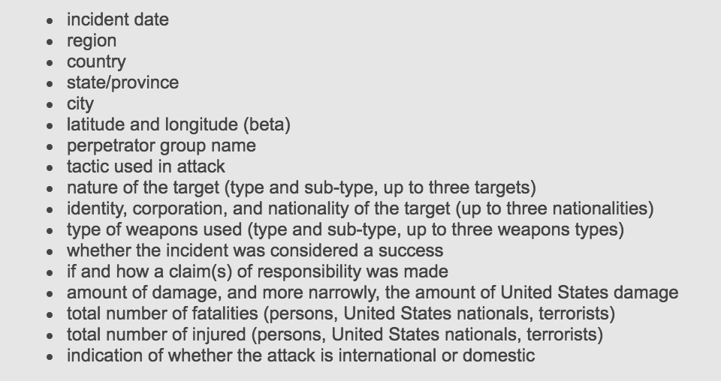
The Data
University of Maryland’s Global Terrorism Database of terror events from 1970-2016 – pulled from Kaggle
Defining Terrorism
Defining success of the attack
For exploration, we will be looking at ~ 2,758 events in the US*.

Slide 5
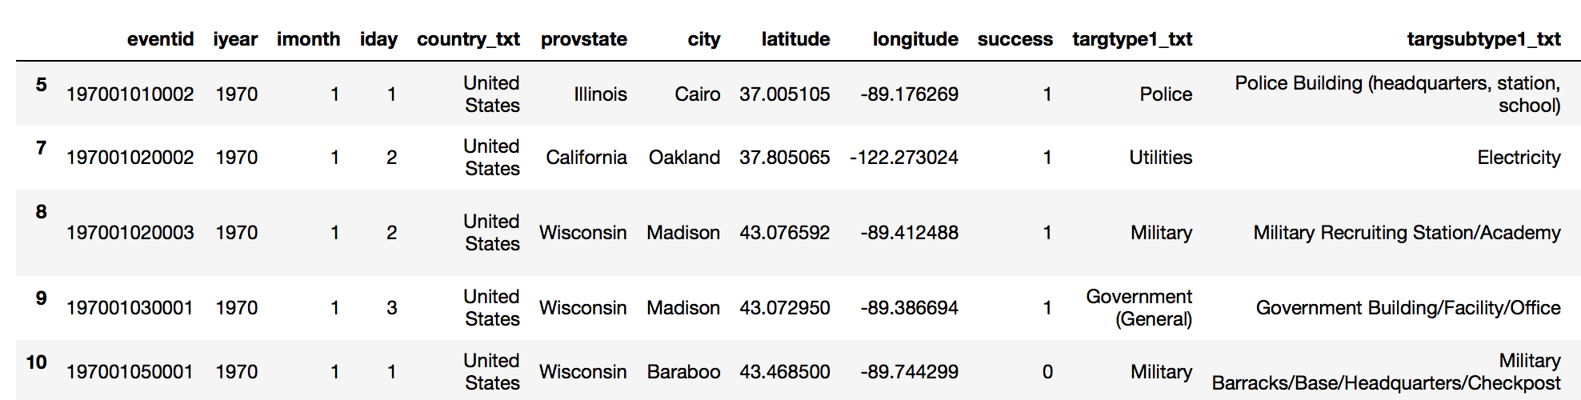
Variables to Isolate
Time of Events
Location of Events – isolating States
Success of the Event
Target Location of Event
Weapons used for Events

Slide 6
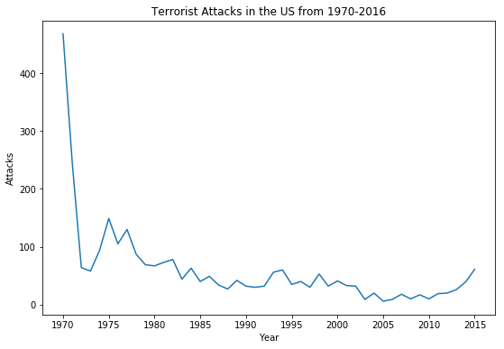
Exploration of Data – Attacks in the US

Slide 7
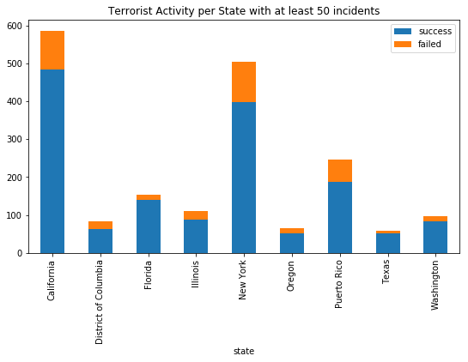
Exploration of Data – Success within States

Slide 8
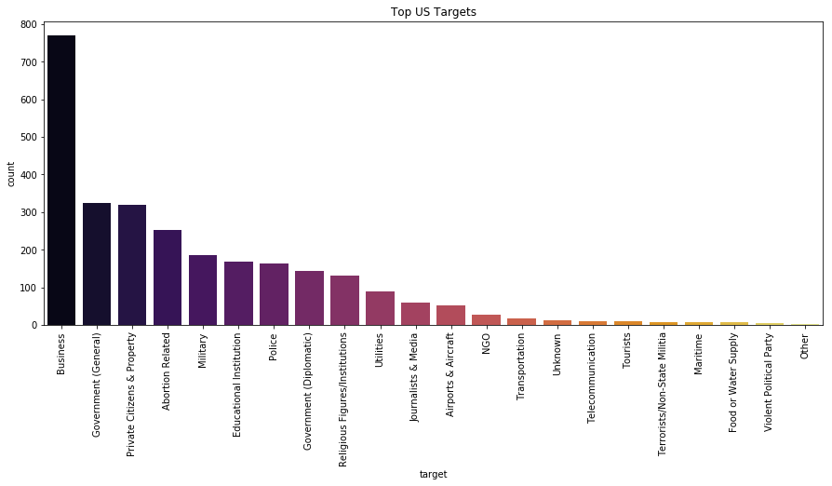
Exploration of Data – Target Locations

Slide 9
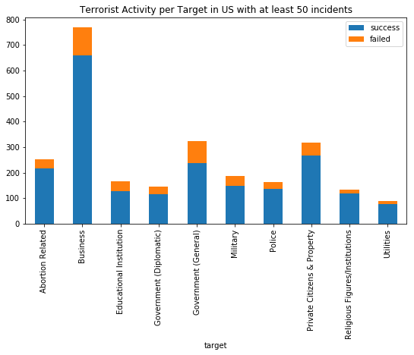
Exploration of Data – Target Locations

Slide 10
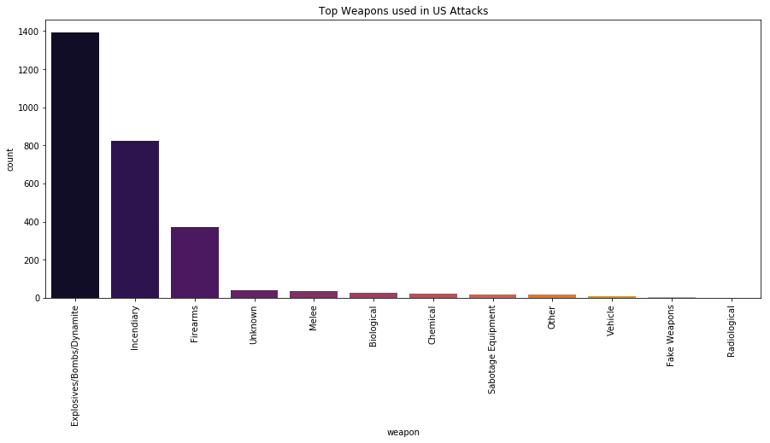
Exploration of Data - Weapons

Slide 11
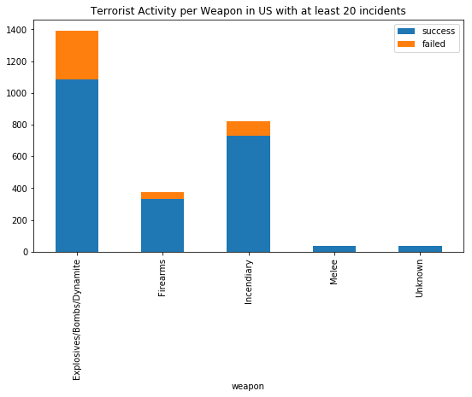
Exploration of Data - Weapons

Slide 12
Modeling the Data
Isolating States, Target Locations and Weapons for the model to compare success of the attack
Focusing the data on 2010-2016 rather than 1970-2016, condensing the variables (192 vs 2758)
Did not want to be selective on which states vs which targets vs which weapons – Feature Selection/Feature Deletion
Divert away from time-series to more cross-sectional

Slide 13
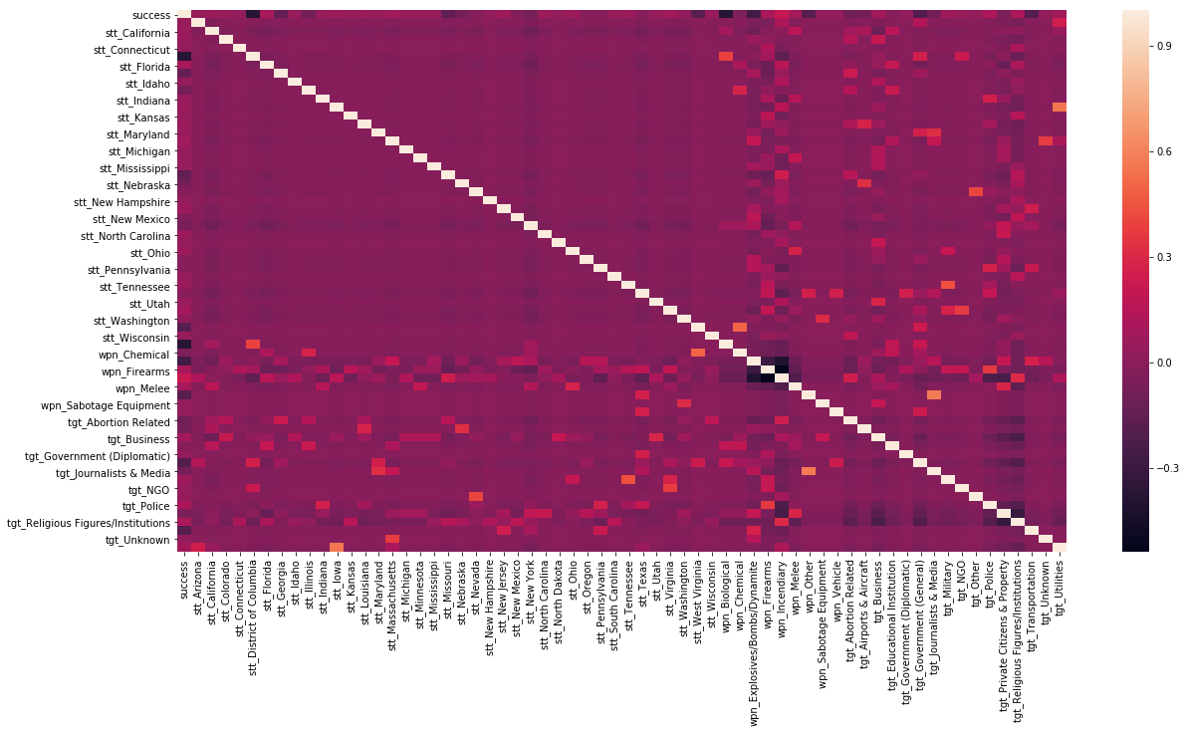
Modeling the Data

Slide 14

Modeling the Data
Chosen Models:
Decision Trees – quick, non-linear relationships, possible overfit
Random Forests – multiple trees, random

Slide 15
Modeling the Data – Training & Testing
There was some separation between our models:
Decision Tree – Average AUC – 0.614 – 61.4%
Random Forest - Average AUC – 0.665 - 0.711 – 66.5% - 71.1%
A significant change with Random Forest
Testing
Random Forest: Precision Score – 82% / Recall Score – 98%
The Random Forest model was able to accurate predict success 82% of the time.

Slide 16

Next Steps
The Random Forest model was able to predict the success outcome using states, target locations and weapons from 2010-2016
Next steps would be to consider looking at other models to improve predictor – possibly using grid search with random forest to optimize n-estimators, max-depth while considering concerns of overfitting
To consider looking at cities and other variables to determine success

Slide 17
Questions?

Slide 18
Contact Information
Liz Hay
Data Science Student
713-304-0252
Lizzie.h14@gmail.com
https://www.linkedin.com/in/allison-liz-hay-038a7a27/

