Slide 1
CMSC204
V(StateGraph) = {Oregon, Alaska, Texas, Hawaii, Vermont, NewYork, California}
E(StateGraph) = {(Alaska, Oregon), (Hawaii, Alaska), (Hawaii, Texas), (Texas, Hawaii), (Hawaii, California), (Hawaii, New York), (Texas, Vermont), (Vermont, California), (Vermont, Alaska)}
1. Draw the StateGraph
Hawaii
Alaska
Texas
California
New York
Oregon
Vermont
{Oregon, Alaska, Hawaii, Vermont, New York, California}
{(Alaska, Oregon), (Hawaii, Alaska), (Hawaii, Texas), (Texas, Hawaii), (Hawaii, California), (Hawaii, New York), (Texas, Vermont), (Vermont, California), (Vermont, Alaska)}
No
Yes
Texas

Slide 2
a. Show the adjacency matrix that would describe the edges in the graph. Store the vertices in alphabetical order
States
1 2 3 4 5 6 7
1. Oregon
2. Alaska
3. Texas
4. Hawaii
5. Vermont
6. New York
7. California
0 | 0 | 0 | 0 | 0 | 0 | 0
1 | 0 | 0 | 0 | 0 | 0 | 0
0 | 0 | 0 | 1 | 1 | 0 | 0
0 | 1 | 1 | 0 | 0 | 1 | 1
0 | 1 | 0 | 0 | 0 | 0 | 1
0 | 0 | 0 | 0 | 0 | 0 | 0
0 | 0 | 0 | 0 | 0 | 0 | 0
3. b. Show the adjacency lists
that would describe the edges in the graph
1. Oregon
2. Alaska
3. Texas
4. Hawaii
5. Vermont
6. New York
7. California
1
4
5
2
3
6
7
2
7

Slide 3
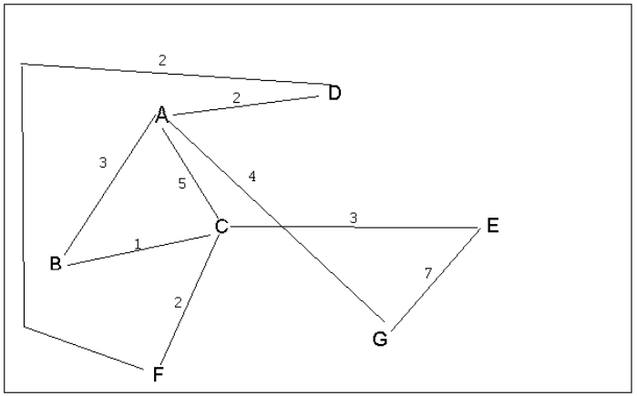
4 a. Which of the following lists the graph nodes in depth first order beginning with E? C
A) E, G, F, C, D, B, A
B) G, A, E, C, B, F, D
C) E, G, A, D, F, C, B
D) E, C, F, B, A, D, G
4 b. Which of the following lists the graph nodes in breadth first order beginning at F? A
A) F, C, D, A, B, E, G
B) F, D, C, A, B, C, G
C) F, C, D, B, G, A, E
D) a, b, and c are all breadth first traversals

Slide 4
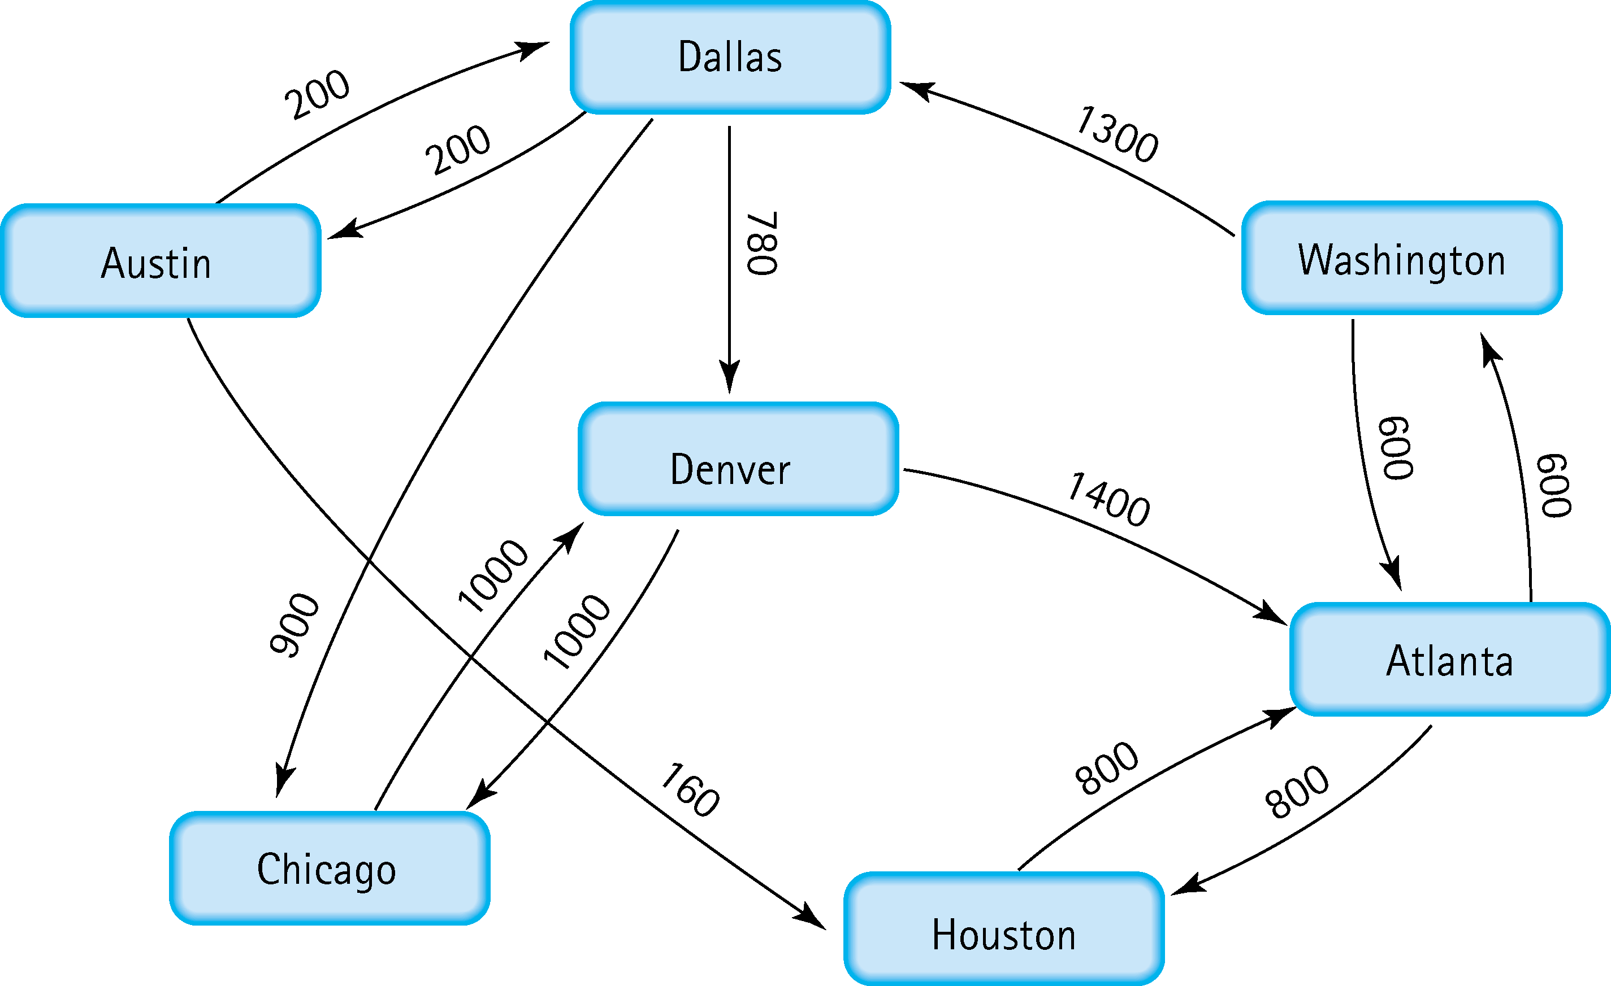
5. Find the shortest distance from Atlanta to every other city
Atlanta – Washington
Atlanta – Houston
Atlanta – Washington – Dallas
Atlanta – Washington – Dallas – Denver
Atlanta – Washington – Dallas – Chicago
Atlanta – Washington – Dallas – Austin

Slide 5
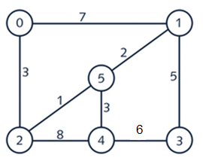
6. Find the minimal spanning tree using Prim’s algorithm. Use
0 as the source vertex . Show the steps.
minimum spanning tree
0
0 | 2
0 | 2 | 5
0 | 2 | 5 | 1
0 | 2 | 5 | 1 | 4
0 | 2 | 5 | 1 | 4 | 3
3 < 7
1 < 7,8
2 < 3,7,8
3 < 5,8
5 < 6
steps

Slide 6
7. Find the minimal spanning tree using Kruskal’s algorithm.
Show the weights in order and the steps.
Edge Added (weight) | All Vertices Connected
2-5 (1) | 2,5
5-1 (2) | 1,2,5
5-4 (3) | 1,2,4,5
2-0 (3) | 0,1,2,4,5
1-3 (5) | 0,1,2,3,4,5
steps

Slide 7
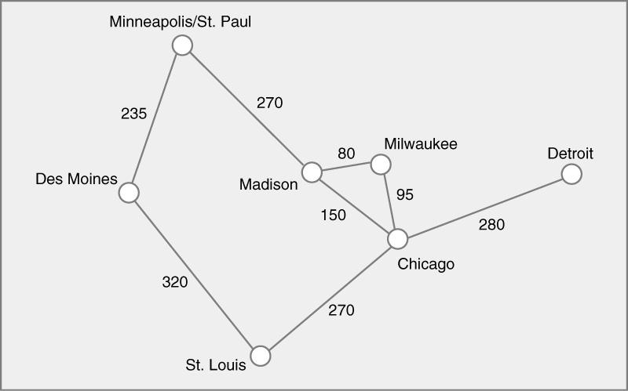
8. Find the minimal spanning tree using the algorithm you prefer. Use
Minneapolis/St. Paul as the source vertex

Slide 8
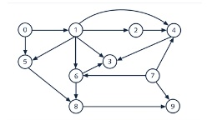
9. List the nodes of the graph in a breadth first topological ordering. Show the
steps using arrays predCount, topologicalOrder and a queue
predCount | topologicalOrder | queue
0|1|1|3|3|2|2|0|2|2 |  | 0,7
0|0|1|3|3|1|2|0|2|2 | 0 | 7,1
0|0|1|3|2|1|1|0|2|1 | 0|7 | 1
0|0|0|2|1|0|0|0|2|1 | 0|7|1 | 2,5,6
0|0|0|2|0|0|0|0|2|1 | 0|7|1|2 | 5,6,4
0|0|0|2|0|0|0|0|1|1 | 0|7|1|2|5 | 6,4
0|0|0|1|0|0|0|0|0|1 | 0|7|1|2|5|6 | 4,8
0|0|0|0|0|0|0|0|0|1 | 0|7|1|2|5|6|4 | 8,3
0|0|0|0|0|0|0|0|0|0 | 0|7|1|2|5|6|4|8 | 3,9
0|0|0|0|0|0|0|0|0|0 | 0|7|1|2|5|6|4|8|3 | 9
0|0|0|0|0|0|0|0|0|0 | 0|7|1|2|5|6|4|8|3|9

Slide 9
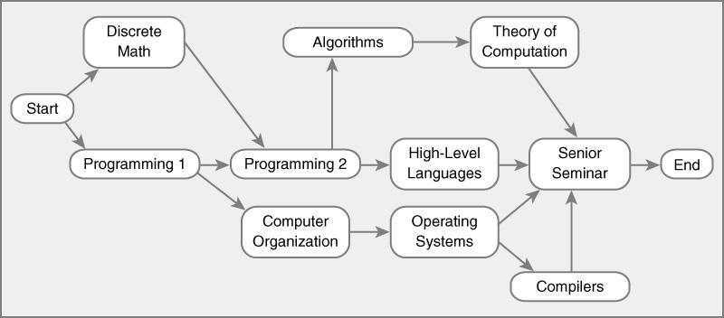
10. List the nodes of the graph in a breadth first topological ordering.
Start
Discrete Math
Programming 1
Programing 2
Computer Organization
Algorithms
High-Level Languages
Operating Systems
Theory of Computation
Compilers
Senior Seminar
End

