Slide 1

Improving Your Life With Git
Lizzie Lundgren
elundgren@seas.harvard.edu
Graduate Student Forum
26 April 2018

Slide 2
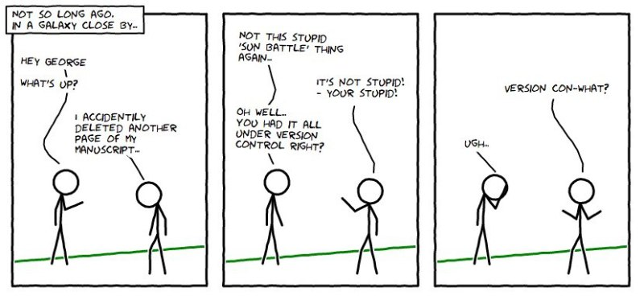
Scenarios to Avoid
My code was deleted from 90-day retention!
Crap, I can’t remember what I changed. I *think* it was…
It worked before, I swear!
Model version? No idea. I got a copy from a classmate, who got a copy from a friend.
https://madusudanan.com/blog/best-practices-for-using-version-control-systems/

Slide 3
How Version Control Can Help
Travel back in time to prior versions of a file
But it’s even more than that!
  Track changes to remind yourself what, when, why
  Short-term undo for recent mess-ups
  Far back undo for catastrophic fails
  Sandboxing areas big (branch) or small (uncommitted)
  Branch merging
It is especially useful for collaboration
  Version synchronization for easy file sharing
  Track ownership to give blame credit
Adapted from: https://betterexplained.com/articles/a-visual-guide-to-version-control/

Slide 4

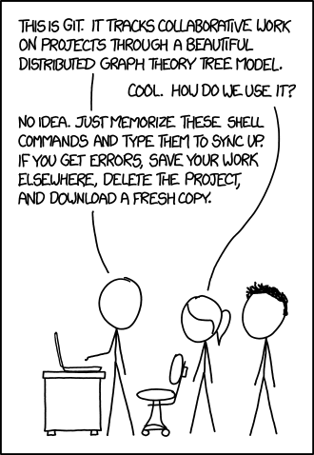
Work Slow to Work Fast
Understanding version control requires a conceptual leap
There is a learning curve. You will mess up. It’s worth it!
But please try not to do this
Sources: https://xkcd.com/1597/, https://medium.com/@rakeshnchinta/the-learning-curve-for-dummies-bb14ab5c6414

Slide 5
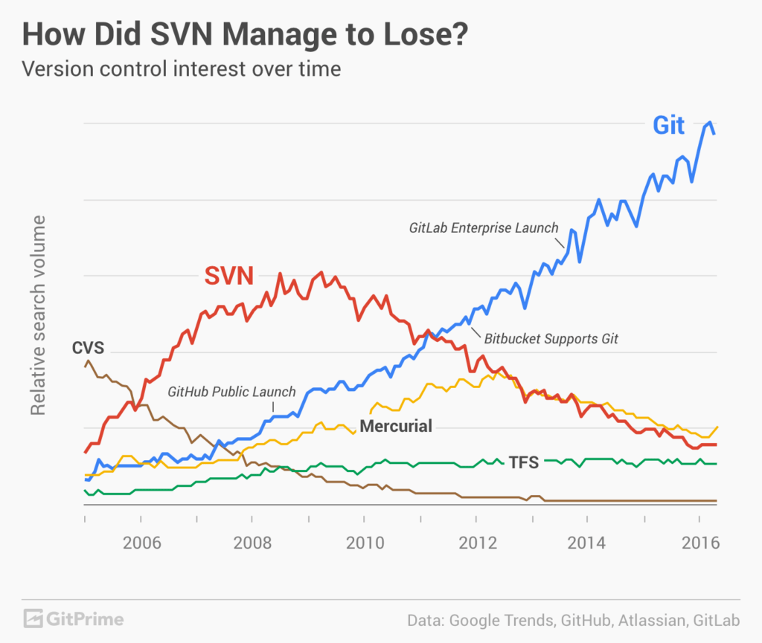
Why Git?
There are other options, but git usage has been steadily growing

Slide 6
Git Version Control Software
Git version control software is a free distributed source code management system (as opposed to centralized)
Offers many benefits over other version control software
  Keep an identical copy of a shared repository on your own system
  Every client contains the entire history of the project (this is huge!)
  Easy-to-use graphical tools ship with it (git gui, gitk)
Install git if you don’t already have it
  Check if your computer has git with ‘git --version’ or ‘which git’
  Use ‘module load git’ on Odyssey (check if it’s already in your .bashrc)
  If you don’t have it, get it here: https://git-scm.com/downloads
What about on Windows?
  Check out tools for making git easier to use at https://gitforwindows.org/

Slide 7
Graphical Tools Distributed with Git
gitk
  Graphical repository browser for viewing and searching git history
  Use this to search history, view differences in past commits, create branches off of old versions, and revert to earlier version
  Use the --all option to view commits for all branches
  See https://git-scm.com/docs/gitk
git gui
  Graphical user interface for commit generation
  Use this to view uncommitted changes, write commit messages, and stage and commit files
  I frequently use the “Amend Last Commit” option to polish my commits
  See https://git-scm.com/docs/git-gui
These tools are optional but will make your life easier

Slide 8
Optional Config Files
.gitconfig
  Text file with your global settings, e.g. your name and email
  Store it in your home directory
  Feel free to copy and edit mine: ~elundgren/.gitconfig
.gitignore
  Text file listing files git should ignore
  Store it in your repository
  See https://git-scm.com/docs/gitignore
.gitk
  Text file with your visual settings for the gitk repo browser
  Store it with your .gitconfig
  Feel free to copy and edit mine: ~elundgren/.gitk

Slide 9
Remote Hosting
To fully use the power of git you will want to make your project accessible to you and/or others from anywhere
Privately-owned web-based hosting services allow you to do this
There are many options, each with pros and cons:
  GitHub
  Bitbucket
  SourceForge
  GitLab
  And more!
I won’t go into these here, other than this:
  GitHub is very popular, and arguably the reason git is taking over the world
  But private repos on GitHub cost $
  Bitbucket is less popular but a good option for free private repos
  Harvard offers free public and private github repos with limitations
    For more info, see https://www.seas.harvard.edu/office-of-computing/announcements/codeharvard-harvard-enterprise-github

Slide 10
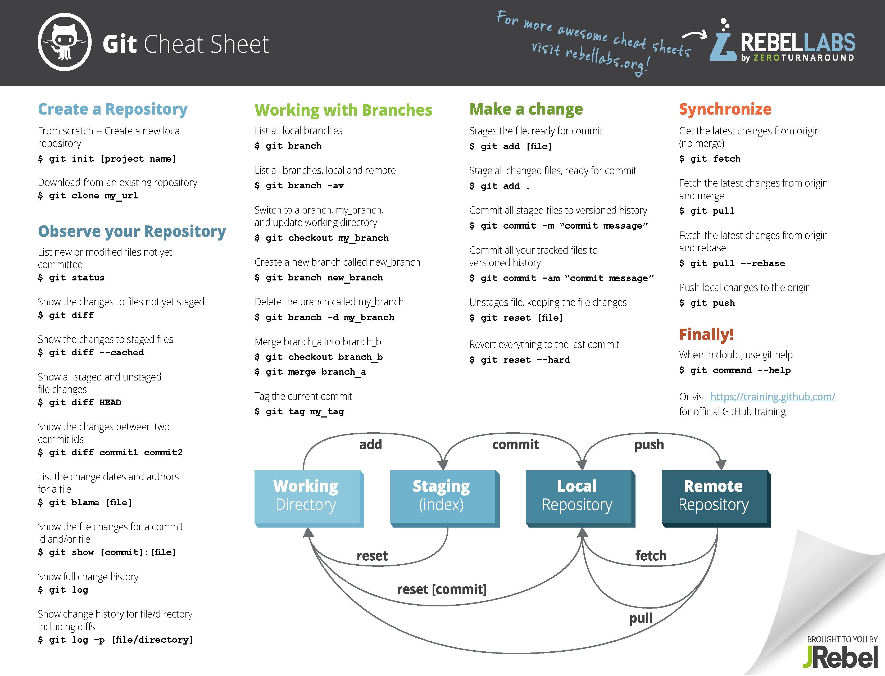
Git Lingo and Workflow
http://files.zeroturnaround.com/pdf/zt_git_cheat_sheet.pdf

Slide 11
Initialize a Local Repository
Do this from the command line
    $ cd my_working_directory
    $ git init
Yes, it is that easy!
However, your repo is empty until you stage and commit files
What files should I add?
  Typically people track text files, but other file types are possible
  If you plan on using GitHub to host your project:
    Hard file size limit: 100 MB
    Soft repo size limit: 1 GB (will prompt a warning email)
    No hard repo size limit but bad things might happen >1 GB
  If you plan on using Bitbucket:
    No file size limit
    Soft repo size limit: 1 GB (will prompt a warning email)
    Hard repo size limit: 2GB

Slide 12
Staged versus Unstaged Changes
The staging area, aka index, is where all changes to commit are stored
Basic steps to add your update to git history
  Make file changes
  Stage file changes
  Commit changes stored in the staging area
Staging as an intermediary step allows the following:
  Committing a subset of files
  Committing a subset of changes in a single file
Both of these features are very useful for keeping your git history clear and well-organized

Slide 13
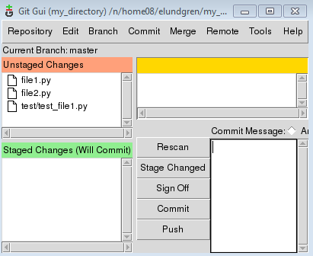
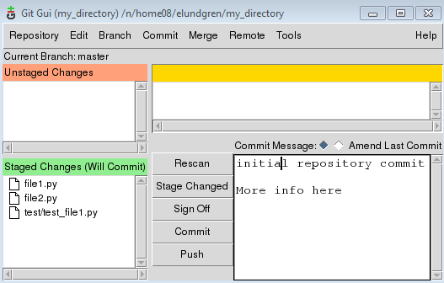
To Stage and Commit All Files…
Command line
    $ git add *
    $ git commit –m “initial repository commit”
You can also do this in one line…
    $ git commit –am “initial repository commit”
…or using git gui
Note: Click on file in upper left box, then right-click line in upper right box to stage a subset of file changes.
Click each unstaged file to stage, add message, then click commit.
You can prevent files from showing up by adding them to .gitignore

Slide 14
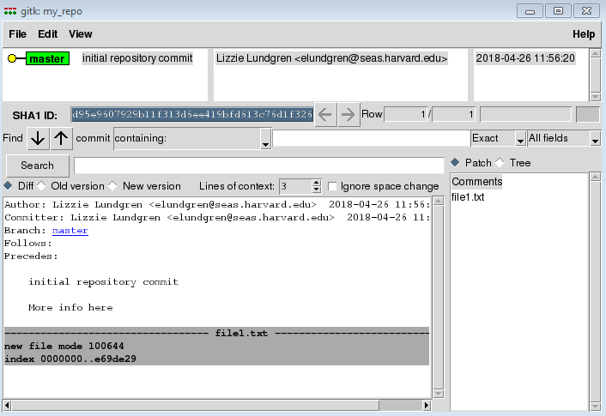
Inspect Your Commit History
Using the command line…
    $ git log
    $ git show
    $ git show {commit hash}
…or using gitk

Slide 15
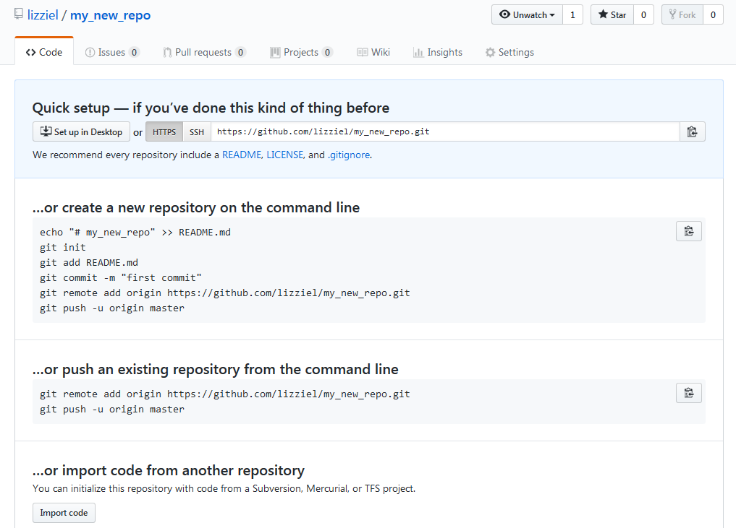
Import to a Remote Repository
For this example I will use GitHub
  Open a free account if you don’t already have one: https://github.com/
  Click ‘Start a project’
  Enter repository name and click ‘Create repository’
  Follow instructions to import code
I usually do this

Slide 16
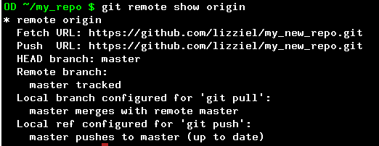
Inspect Your Remote
I just use the command line for this
    $ git remote show origin

Slide 17
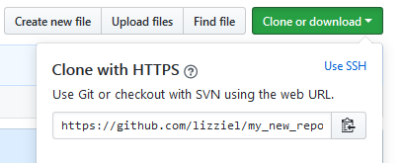
Clone Remote Repository
Say I delete my local repository. How do I get it back?
    $ git clone https://github.com/lizziel/my_new_repo.git my_repo_clone
What if I don’t remember the link? Go to the GitHub repo:
You can also clone anything local on your network
    $ git clone ~elundgren/my_repo my_repo_clone
Clone don’t copy! Cloning configures the remote to be the original.
Advanced Topic Alert: If you plan on contributing to an open-source project, consider forking the project. This clones the repo to your GitHub account which you can then clone. Ultimately this enables pull requests.

Slide 18
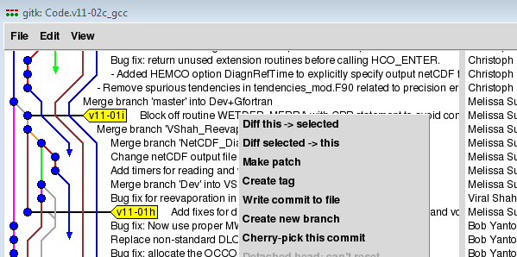
Branching
Check what branch you are on (will be asterisked)
    $ git branch
Create new branch off of current branch (will include unstaged)
    $ git checkout –b branch_name
Change to an existing branch (might require you to commit)
    $ git checkout branch_name
gitk is useful for branching off of old versions
GEOS-Chem example:
This popped up when I right-clicked v11-01i. Choose ‘Create new branch’ and then enter new branch name. It will then automatically be checked out (you will be in it).
Each one of the vertical lines in gitk is a branch. Horrifying, I know.

Slide 19
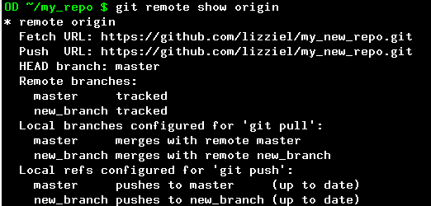
Push New Branch to Remote
Make sure you are on the branch
    $ git branch
If you aren’t, check it out
    $ git checkout new_branch
If you are, make sure everything is committed
    $ git status
The rest is simple, but I still look it up on the internet every time
    $ git push –u origin new_branch
Check that it worked
    $ git remote show origin
Notice there are remote branches and local branches, and they have the same names
Woot!

Slide 20
Get Changes from Remote
This is relevant if you use the remote repo on different computers, or if you collaborate on a project with others
Danger zone! Always check your branch before pulling.
Basics:
  Update your local remote branches to match the actual remote
    $ git fetch
  Same as above, but also merge into your checked out local branch
    $ git pull
  This method is safest
    $ git pull origin branch_name
Pull gets updates from the remote (origin) by default. But you can also pull from local repositories. Always specify branch name.
    $ git pull ~elundgren/my_other_repo branch_name

Slide 21
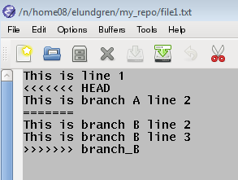
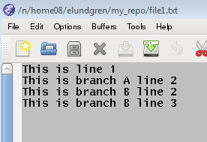
Merge Branches in a Repository
Merge branch B into branch A within your local repo:
    $ git checkout branch_A
    $ git merge branch_B
Obsessively checking log and status first is good practice
You may run into merge conflicts…
Current branch only (A) separated by <<<<<<<HEAD and =======
Merged branch only (B) separated by ======= and >>>>>>> branch_name
Edit the file to make it how you want, delete the separator text, and commit the merge.
“Resolved” file to commit

Slide 22
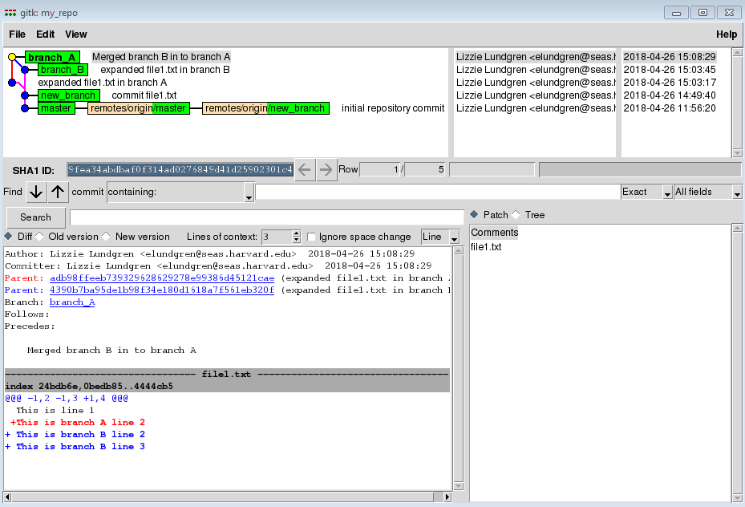
Inspect the Merge
Merging can be messy. It is good to check your work.
Use gitk for this purpose
    $ gitk --all &

Slide 23
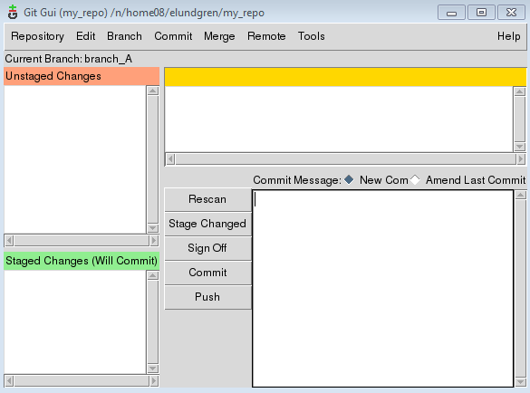
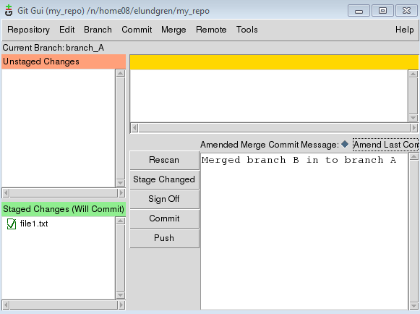
Amend a Commit
My last commit had ‘in to’ but I want it to be ‘into’
You can update the last commit, but be careful
Click here (“Amend Last Commit”)
Now I can edit my previous commit message and to overwrite it
Do NOT do this if you have pushed to the remote!!!

Slide 24
Resources
Tons of info here: https://git-scm.com/
Pro Git by Scott Chacon is a great intro textbook
  Download for free: https://git-scm.com/book/en/v2
  Borrow it from me if you prefer the feel of paper
Google anything related to git and you will get an answer
For command line access to the git user manual:
    $ git command --help
There are lots of advanced topics not covered in this presentation. Use the web, use each other, and come find me if you need help.

Slide 25
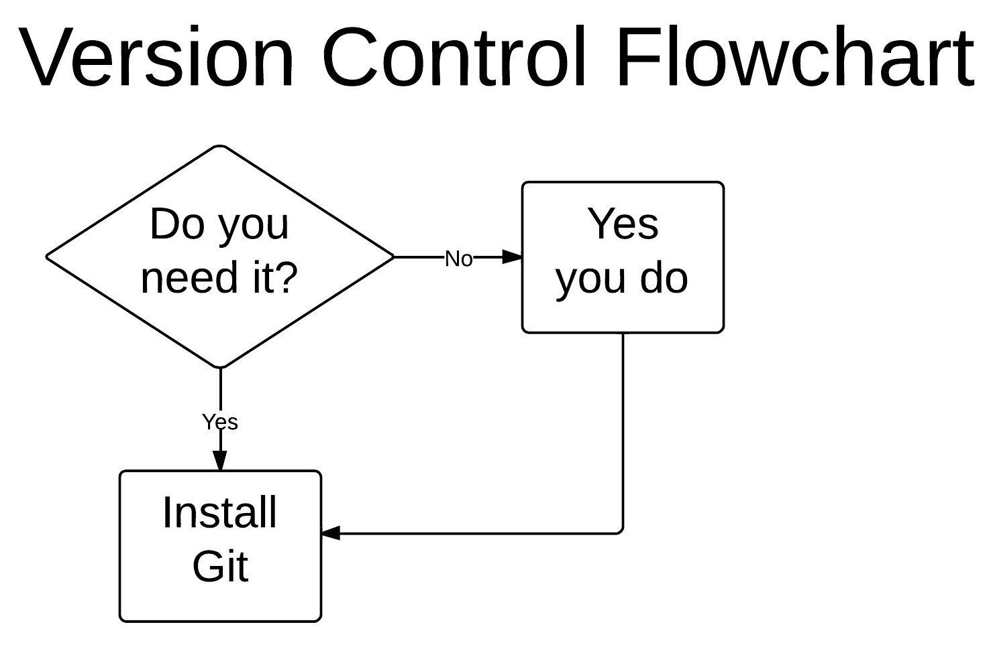
Questions?
Source: http://i.imgur.com/yuSjmlk.png (courtesy of reddit)

Slide 26
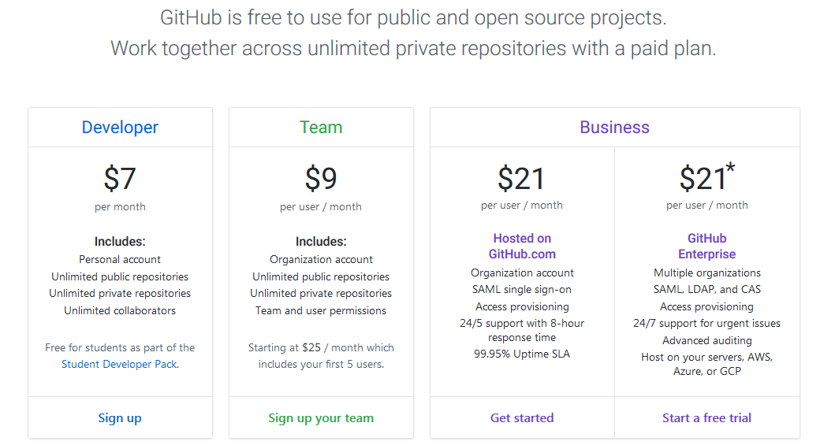
GitHub Price Plans
Source: https://github.com/pricing (as of 4/25/2018)

Slide 27
Oops, I Committed a Huge File!
Pushing a huge file to the remote means its history (and storage footprint) will remain for eternity
But there are things you can do, all of which are messy
If it’s a solo project:
  You can delete the file and rebase to eliminate the commit from history
  It’s rather messy. Seek solutions others have developed and posted online
If it’s a collaboration but no one has fetched from the remote yet:
  Same approach as for a solo project
  Make sure you warn everyone not to clone, fork, fetch, pull, or push
If it’s a collaboration and your collaborators have your change:
  Eek! Rebasing will mess with everyone’s local repository
  You might mess up your collaborator’s changes
  Inform everyone of the problem
  See advice from your git expert friends

