Slide 1
Boston House Pricing Model
2022.5.5

Slide 2
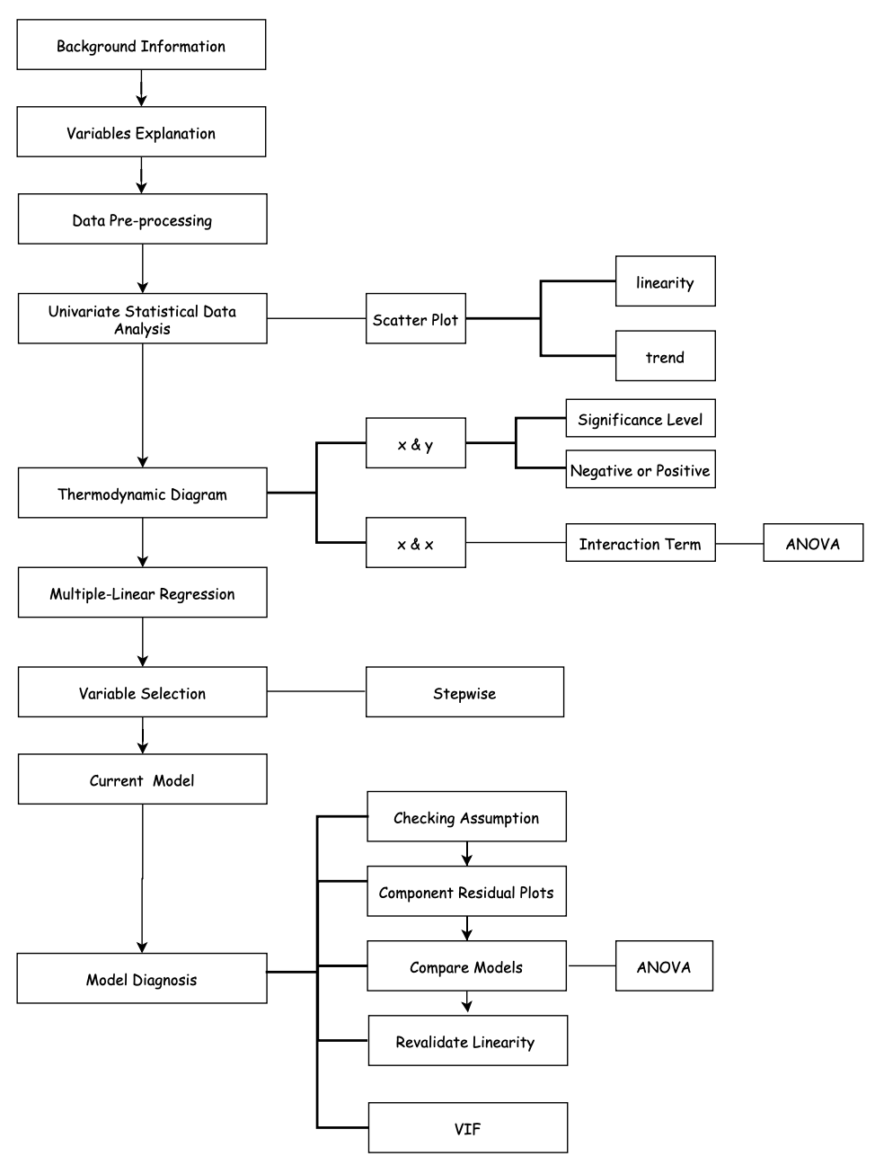
Contents
1) Introduction
2) Describe the Data Set
3) Data Analysis and Model Building
4) Model Diagnosis
5) Conditional Inference Tree
6) Business Suggestions

Slide 3
Introduction

Slide 4

Introduction
Good to Great.
13 variables
506 data
Construct pricing models for real estate agency
Dependent Variable: (MEDV) Median value of owner-occupied homes.（10^3 dollar)

Slide 5
Describe the Data Set

Slide 6
Data Set
Good to Great.
Structural
characteristic attributes in a practical sense
Neighbor-hood
Accessible
Air Pollution

Slide 7
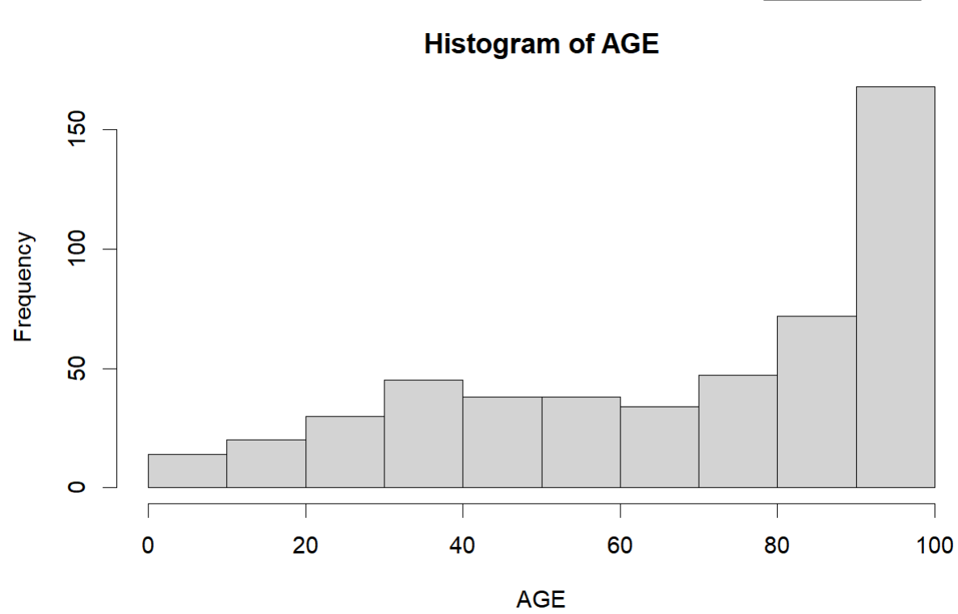
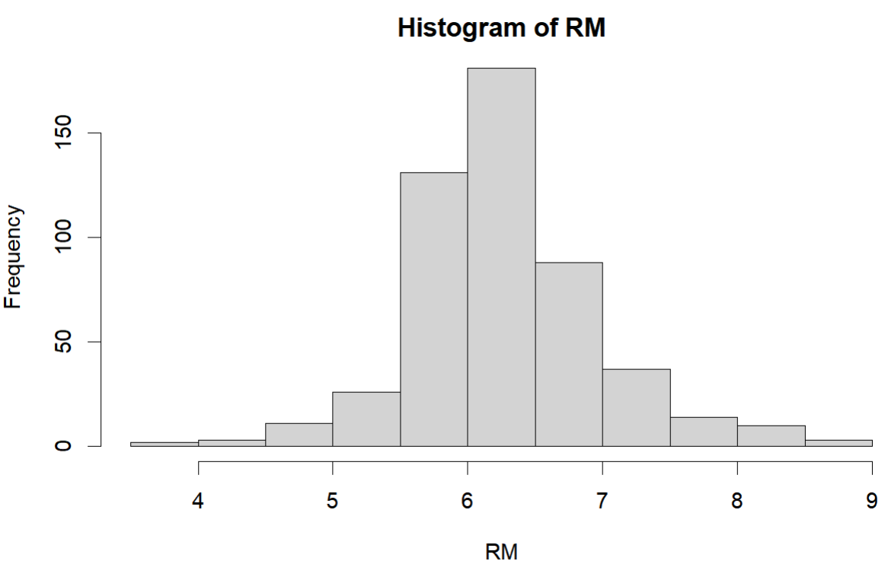
Structural
Good to Great.
RM
Average number of rooms in owner units
RM
AGE
Proportion of owner units built prior to 1940.
AGE

Slide 8
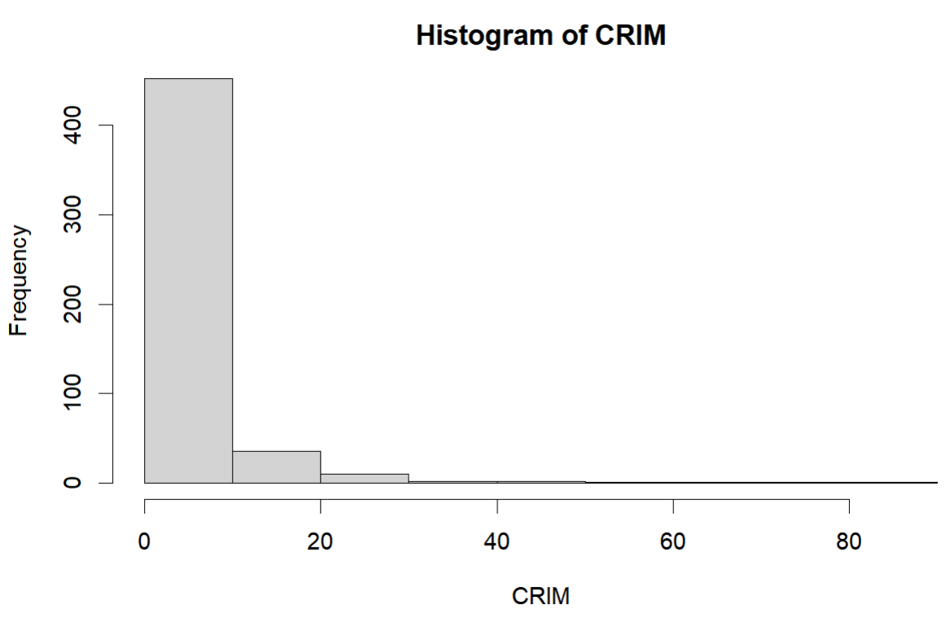
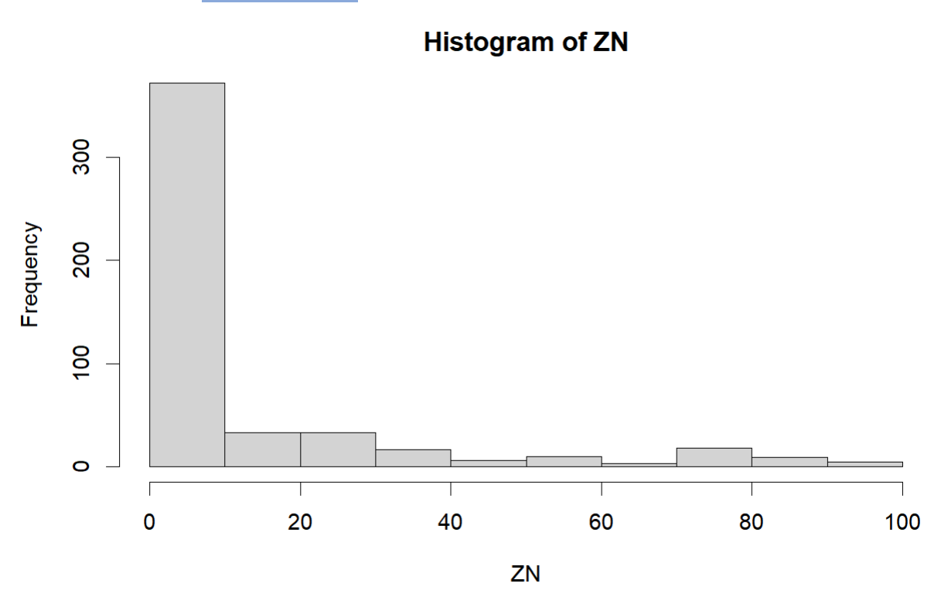
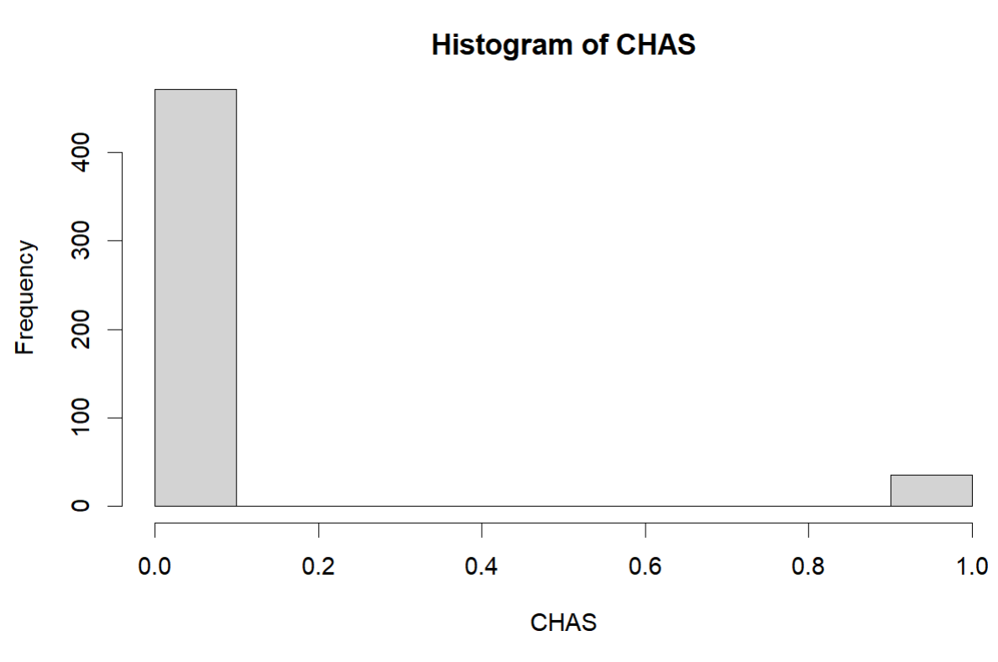
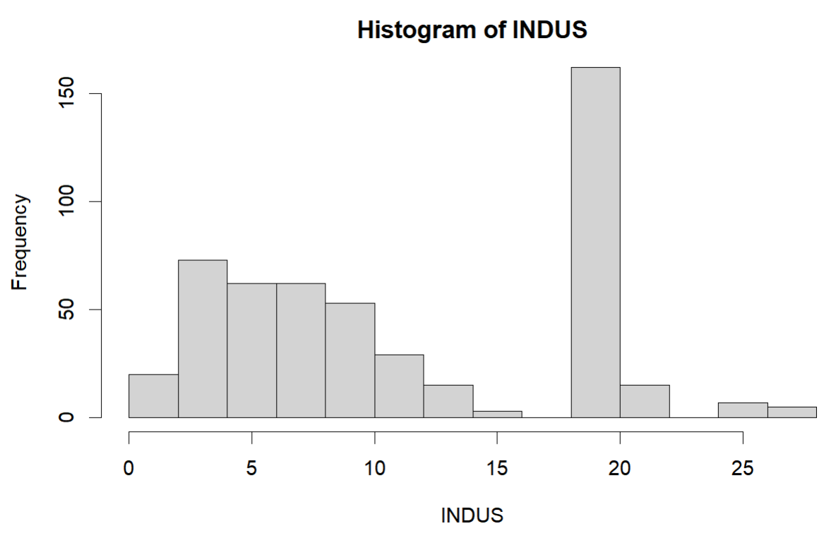
Neighborhood
Good to Great.
CRIM
ZN
CHAS
INDUS
Proportion of a town’s residential land zoned for lots greater than 25000square feet.
If tract bounds the Charles River.
Proportion non-retail business acres per town.
Crime rate by town.

Slide 9
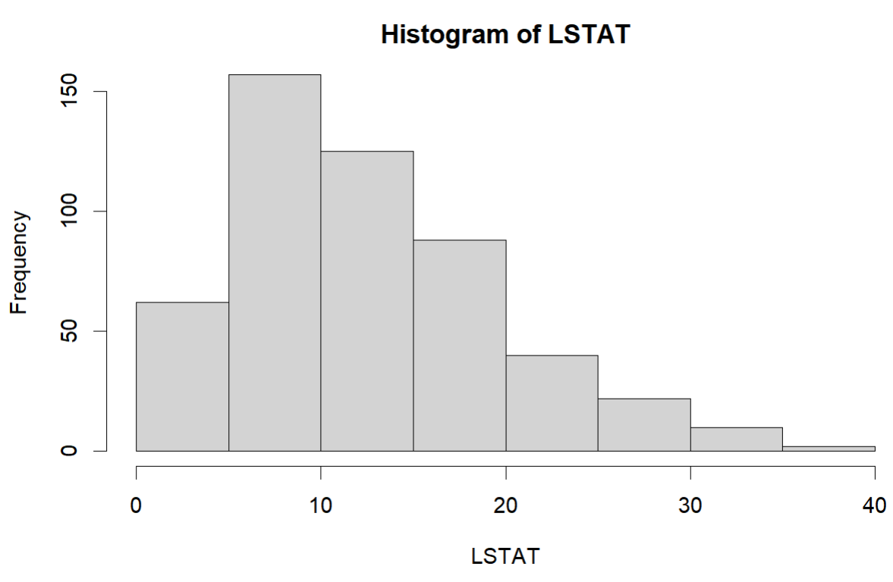
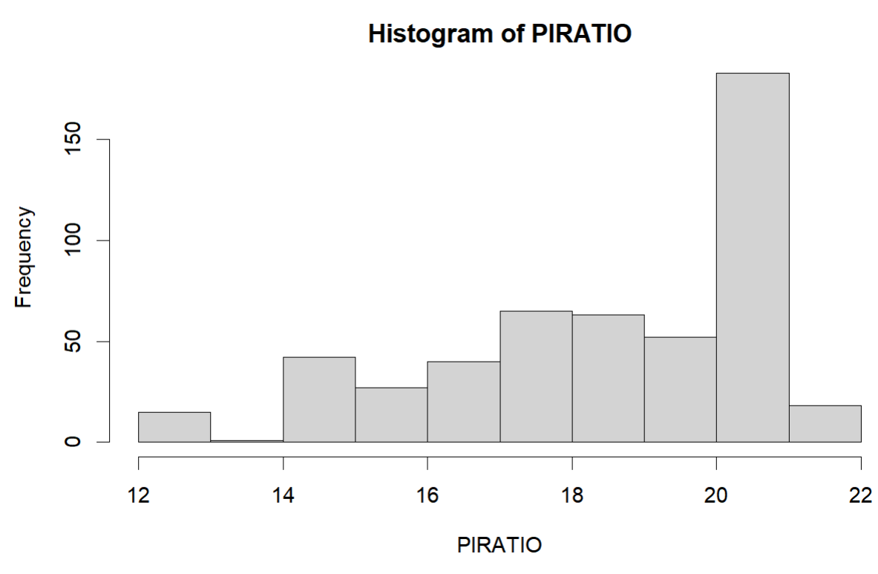
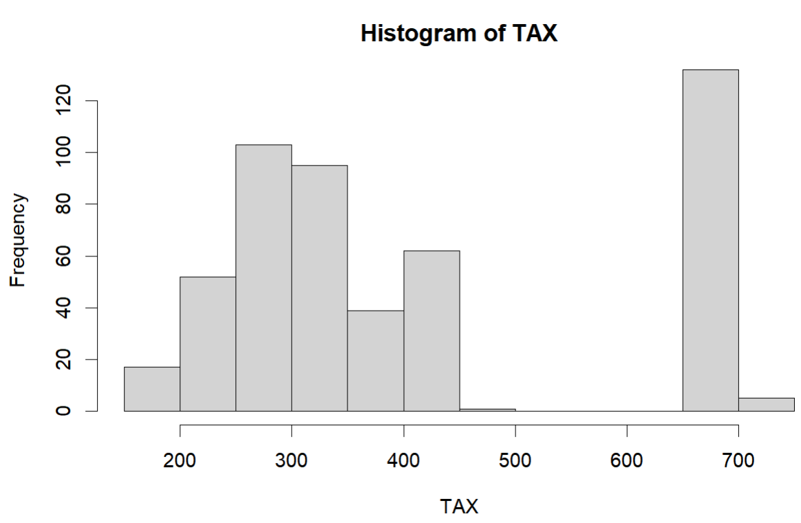
Neighborhood
Good to Great.
TAX
LSTAT
PTRATIO
Pupil-teacher ratio by town school district.
Full value property tax rate ($/$lO,OOO).
Proportion of population that is lower status = 1/2

Slide 10
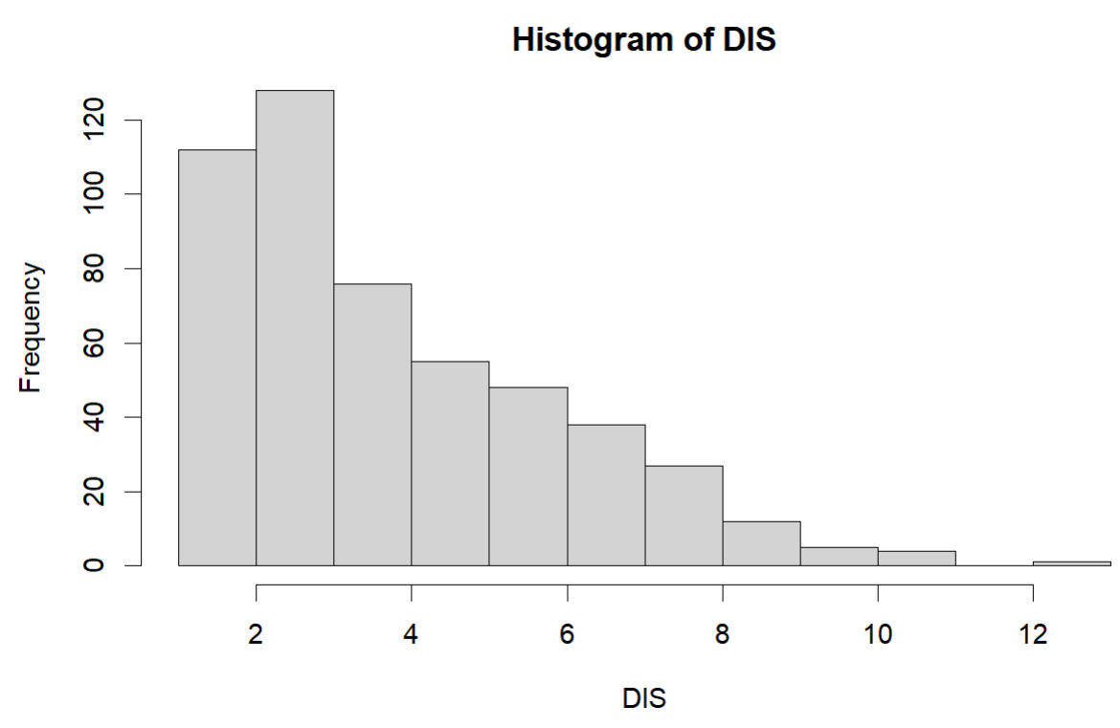
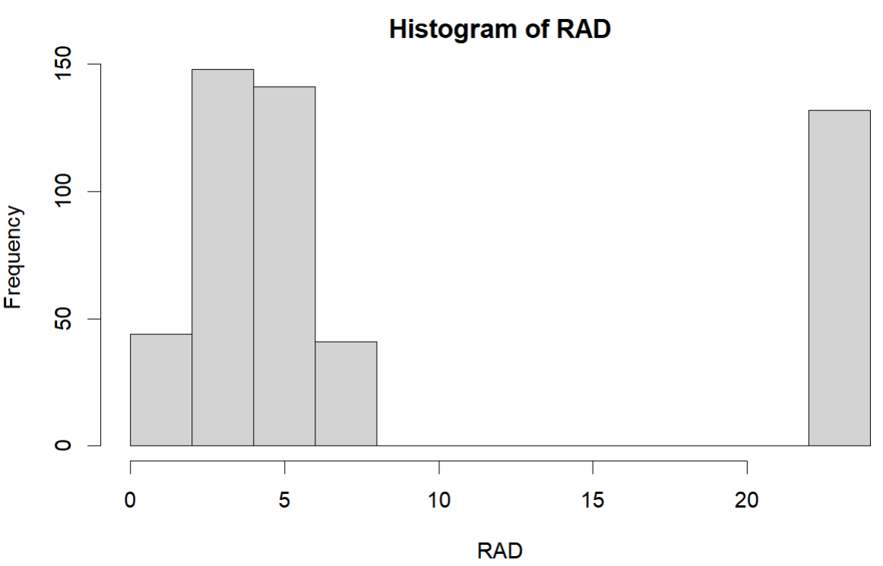
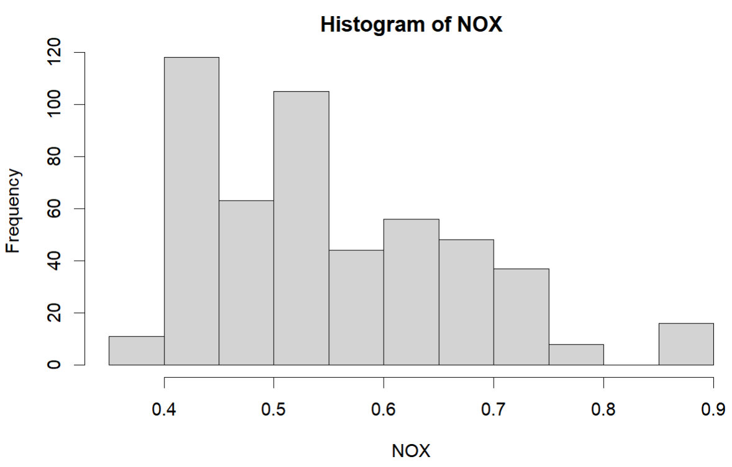
Accessible & Air Pollution
Good to Great.
DIS
Weighted distances to five employment centers in Boston region.
NOX
Nitrogen oxide concentrations (annual average concentration in parts per hundred million).
RAD
Index of accessibility to radial highways.

Slide 11
Data Summary
Good to Great.
 | CRIM | ZN | INDUS | CHAS | NOX | RM | AGE | DIS | RAD | TAX | PTRATIO | LSTAT | MEDV
Min | 0.00632 | 0.00 | 0.46 | 0.00 | 0.385 | 3.561 | 2.90 | 1.13 | 1.00 | 187 | 12.6 | 1.73 | 5.00
Mean | 3.61352 | 11.36 | 11.14 | 0.007 | 0.555 | 6.285 | 68.6 | 3.795 | 9.55 | 408 | 18.46 | 12.65 | 22.53
Max | 88.9762 | 100.00 | 27.74 | 1.00 | 0.871 | 8.780 | 100 | 12.13 | 24.0 | 711 | 22.00 | 37.97 | 50.00

Slide 12
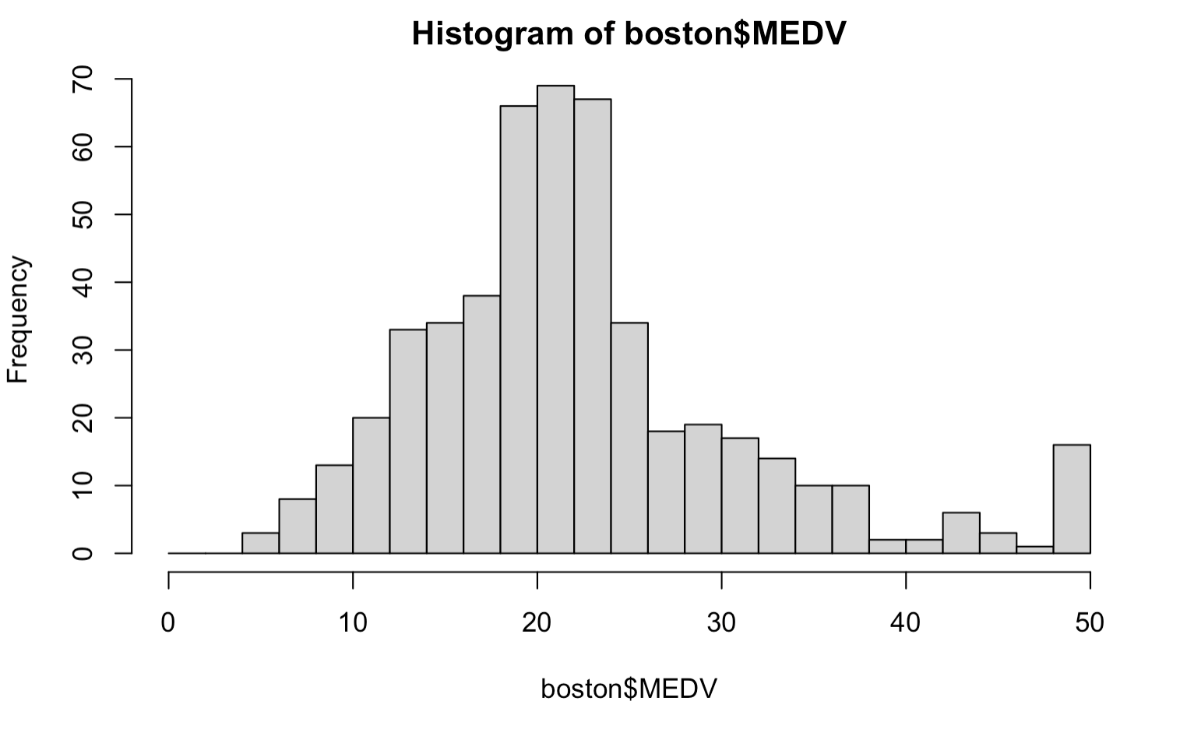
Histogram of MEDV
Good to Great.
Dummy
Title
Dummy
Title
Dummy
Title
Dummy
Title

Slide 13
Data Analysis and Model Building

Slide 14
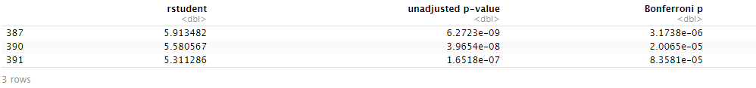
Data Pre-processing
Good to Great.
Check the Outliers
There is no missing value in the data set but there are three outliers.

Slide 15
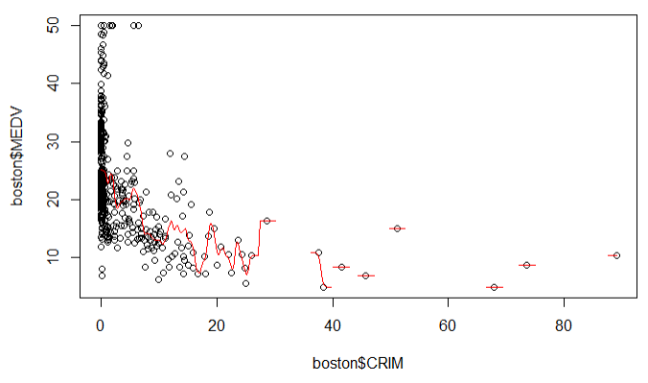
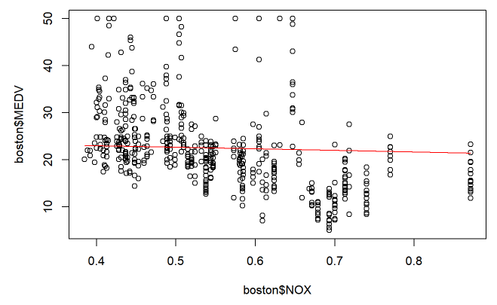
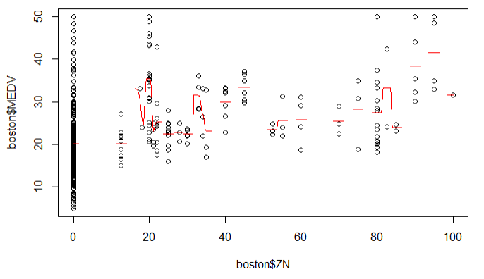
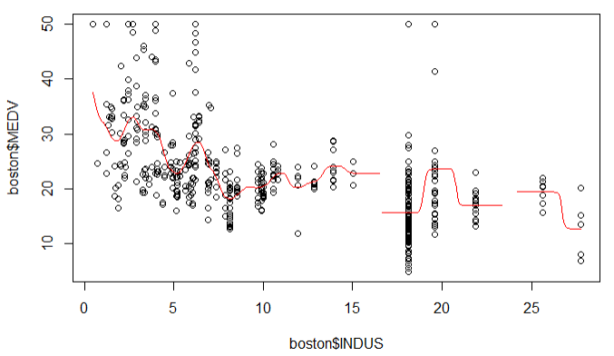
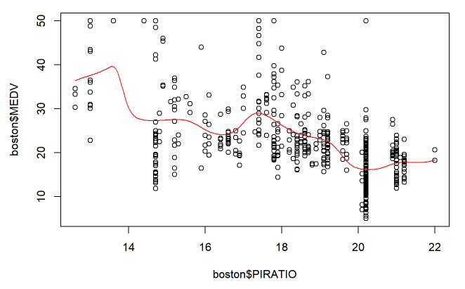
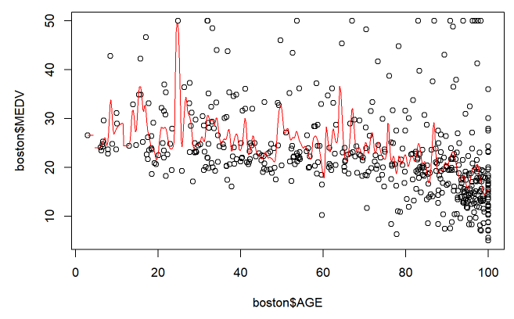
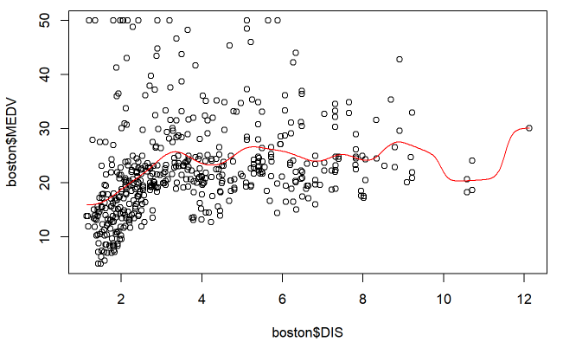
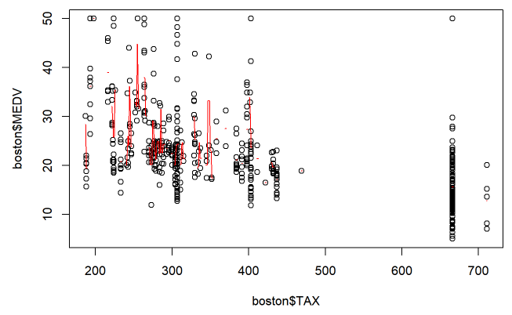
Uni-variate Statistical Data Analysis
Good to Great.
Scatter Plots
CRIM
ZN
INUDS
NOX
PTRATIO
AGE
DIS
TAX

Slide 16
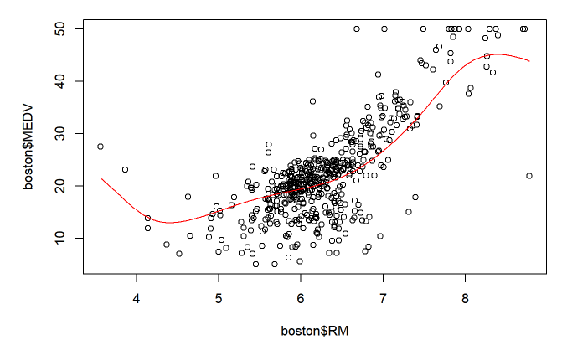
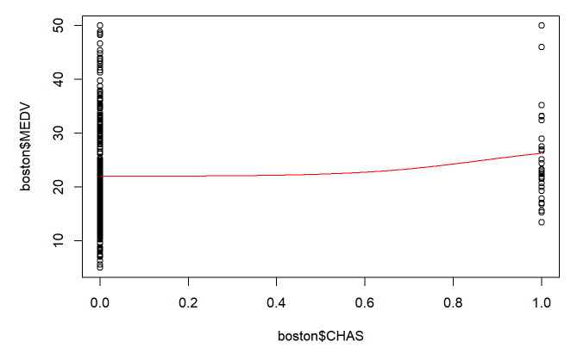
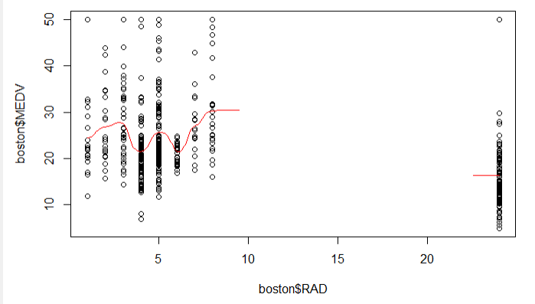
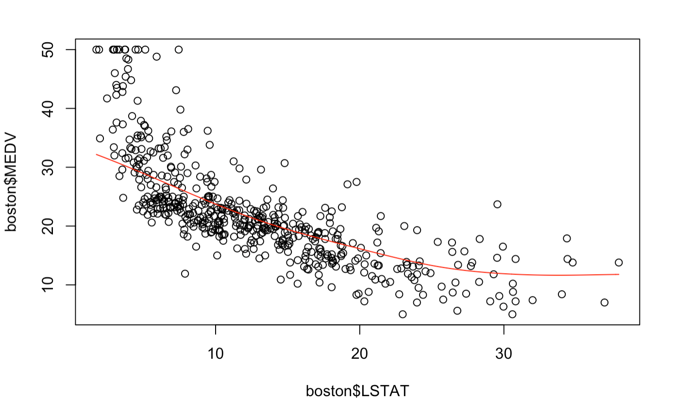
Uni-variate Statistical Data Analysis
Good to Great.
RM
CHAS
RAD
LSTAT
Just a little radian on the left
can be ignored
Categorical Variable
Ordinary Variable
Non-Linear
Multiple-linear Regression
Most of variables have approximate linear relationship

Slide 17
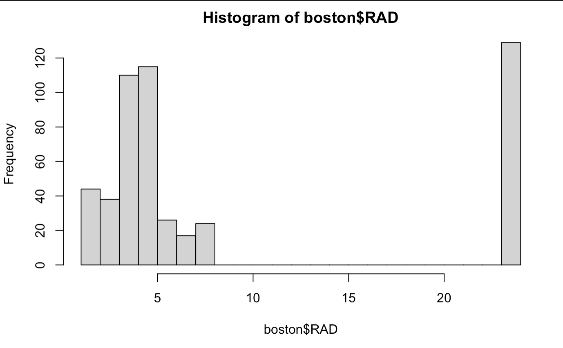
Variable Transformation
Good to Great.
Ⅰ. RAD
1 RAD < 7 (1,2,3,4,5,6)
24
RAD D :=
0 RAD >= 7 (7,8,24)

Slide 18


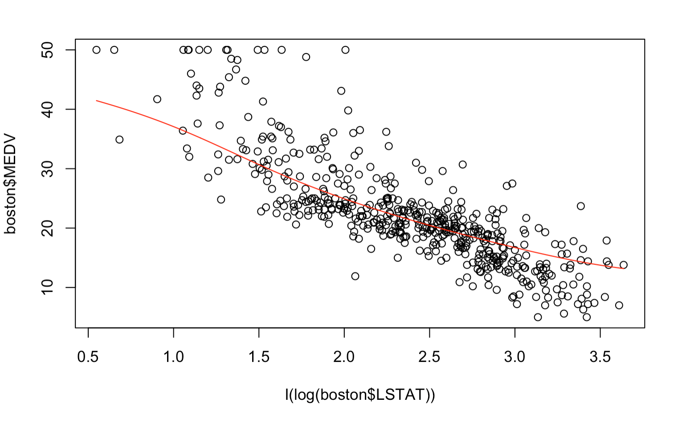

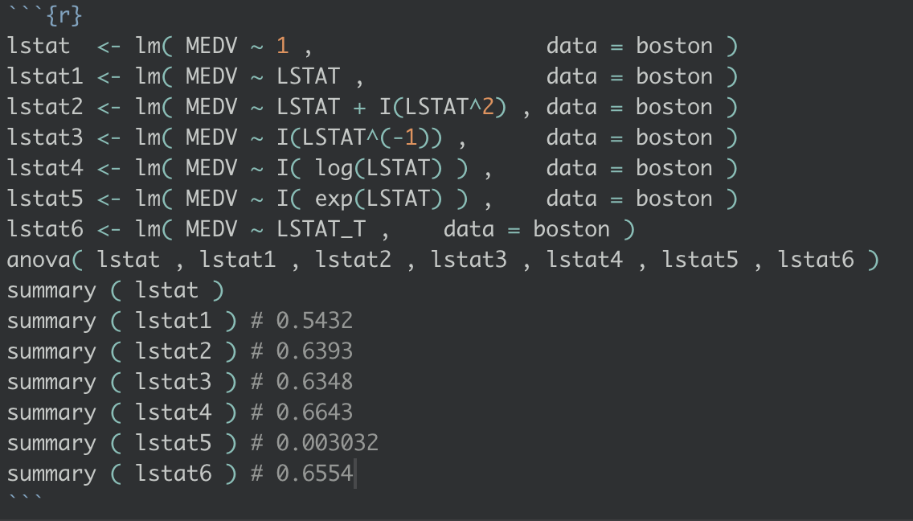
Variable Transformation
Good to Great.
Ⅱ. LSTAT
AIC
After Logarithmic Transformation
Smallest AIC !!
Adjusted R^2
Maximum R square !!

Slide 19
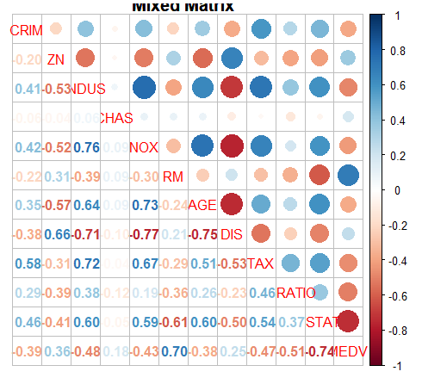
Correlation - X & Y
Good to Great.
Thermodynamic Diagram
X | Correlation Coefficient | Degree of correlation
CHAS | 0.18 | little positive correlated
DIS | 0.25 | little positive correlated
ZN | 0.36 | weak positive correlated
AGE | -0.38 | weak negative correlated
CRIM | -0.39 | weak negative correlated
NOX | -0.43 | weak negative correlated
TAX | -0.47 | intermediate negative correlated
INDUS | -0.48 | intermediate negative correlated
PTRATIO | -0.51 | intermediate negative correlated
RM | 0.7 | strong positive correlated
LSTAT | -0.74 | strong negative correlated

Slide 20
Correlation - X & X
Good to Great.
INDUS and DIS :
relatively highly correlated with other variables.
Interplay
1.Maybe not good variables and will be deleted later.
2. Introduce the interaction terms.

Slide 21
Searching Interaction Terms
Good to Great.
Possible choices:
INDUS and NOX
INDUS and DIS
INDUS and TAX
NOX and AGE
NOX and DIS
AGE and DIS
√ Realistic Meaning

Slide 22
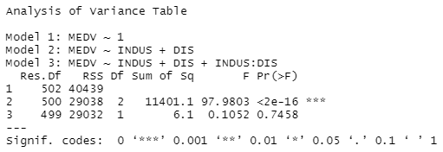
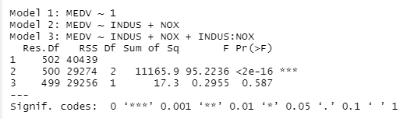
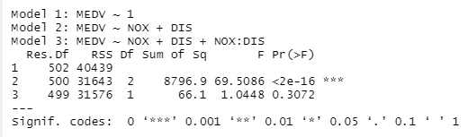

Checking Interaction Variables
Good to Great.
None interaction terms are significant
Do not add them into the model
$$⋮$$

Slide 23
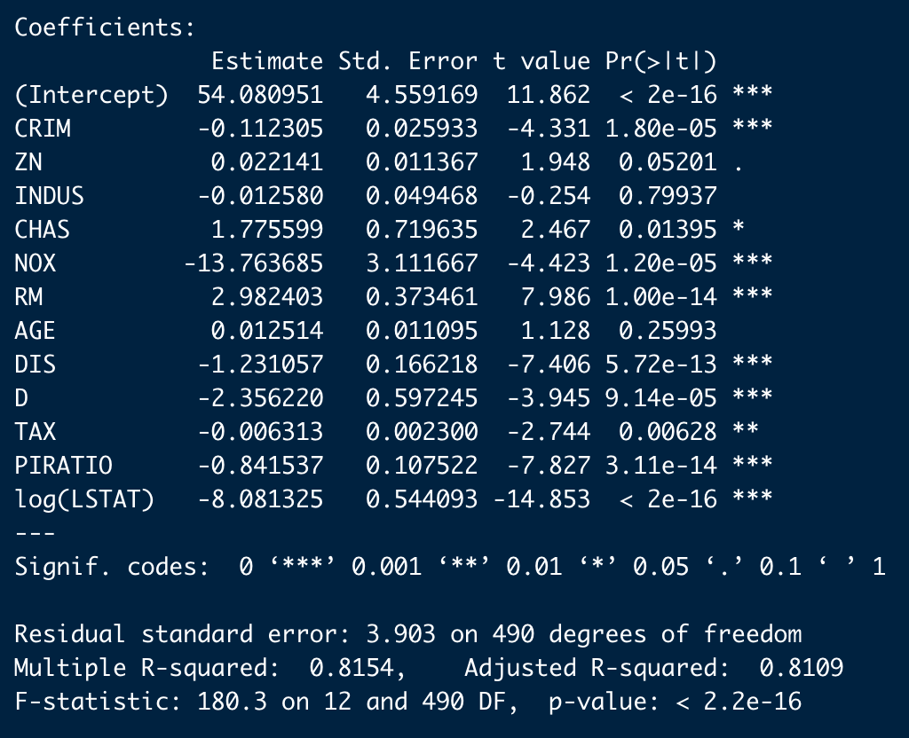
Multiple-linear Regression Model
Good to Great.
MEDV = 54.0810 - 0.1123×CRIM +0.0221×ZN-0.0126×INDUS+1.7756×CHAS -13.7637×NOX +2.9824×RM + 0.0125×AGE -1.2311×DIS -2.3562×D -0.0063×TAX -0.8415×PIRATIO -8.0813×log(LSTAT)

Slide 24
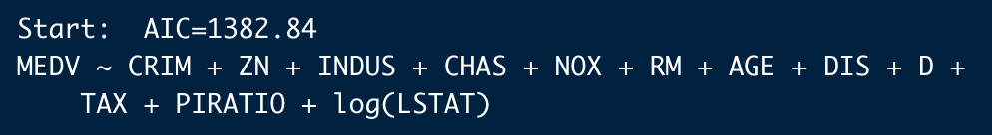
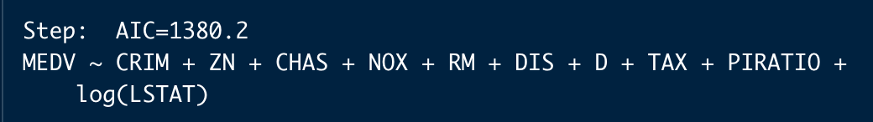
Variables Selection - Stepwise
Good to Great.
Original Model
MEDV = 54.0810 - 0.1123×CRIM +0.0221×ZN-0.0126×INDUS+1.7756×CHAS -13.7637×NOX +2.9824×RM + 0.0125×AGE -1.2311×DIS -2.3562×D -0.0063×TAX -0.8415×PIRATIO -8.0813×log(LSTAT)
New Model
MEDV = 53.4471 - 0.1118×CRIM + 0.0215×ZN + 1.8084×CHAS - 13.0775×NOX + 3.0964×RM - 1.2807×DIS - 2.3802×D - 0.0067×TAX - 0.8384×PIRATIO - 7.8463×log(LSTAT)

Slide 25
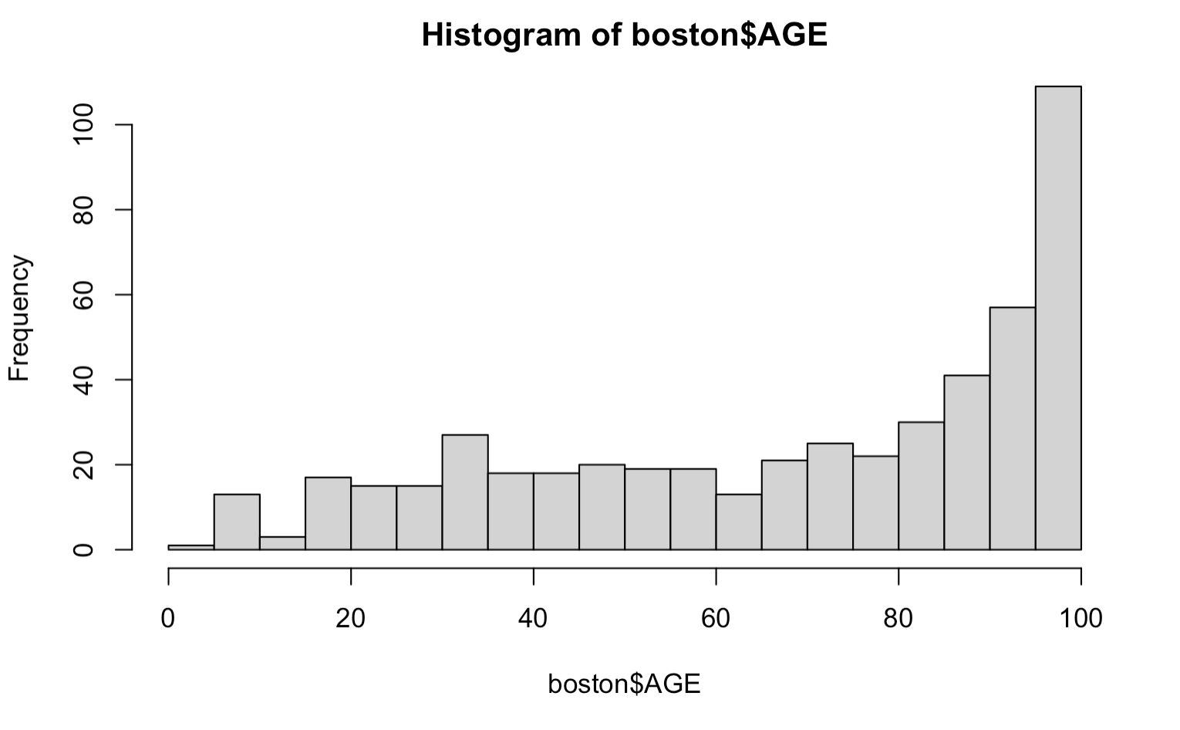
Stepwise - Explanation
Good to Great.
INDUS
AGE

Slide 26
Model Diagnosis

Slide 27
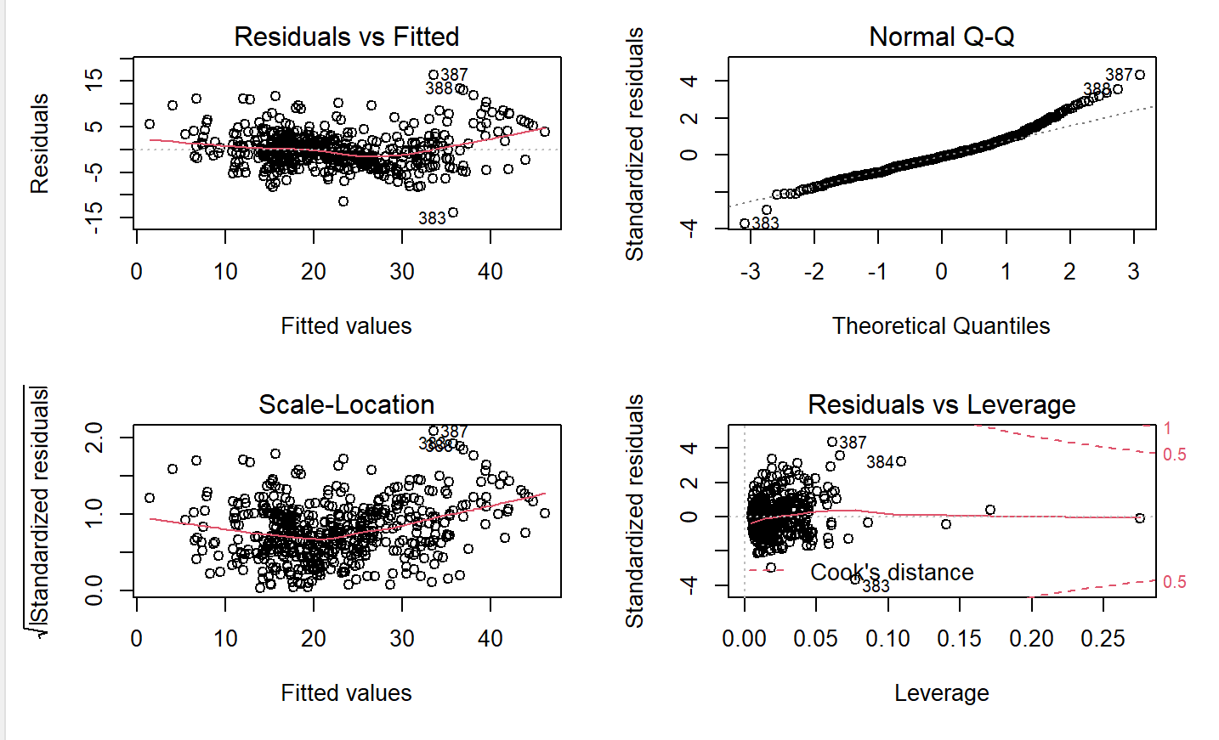
Checking Assumptions
Good to Great.
Residual vs Fitted -Linearity
Normal Q-Q: Normality of Errors
Linear hypothesis: may not be valid.
Red line: quadratic function.
Plot the partial residuals.
Satisfy the normal distribution.
Scattered points: coincide with the straight line.
Residuals vs Leverage- Outlier detection
Scale-Location-Homoscedasticity
Satisfy the homoskedasticity
Trend line is essentially horizontal
No obvious outlier. There is no a point with a distance greater than 0.5 Cook distance.
Independent of Errors
： the data about house price is cross-sectional (assuming the assumption is hold)

Slide 28
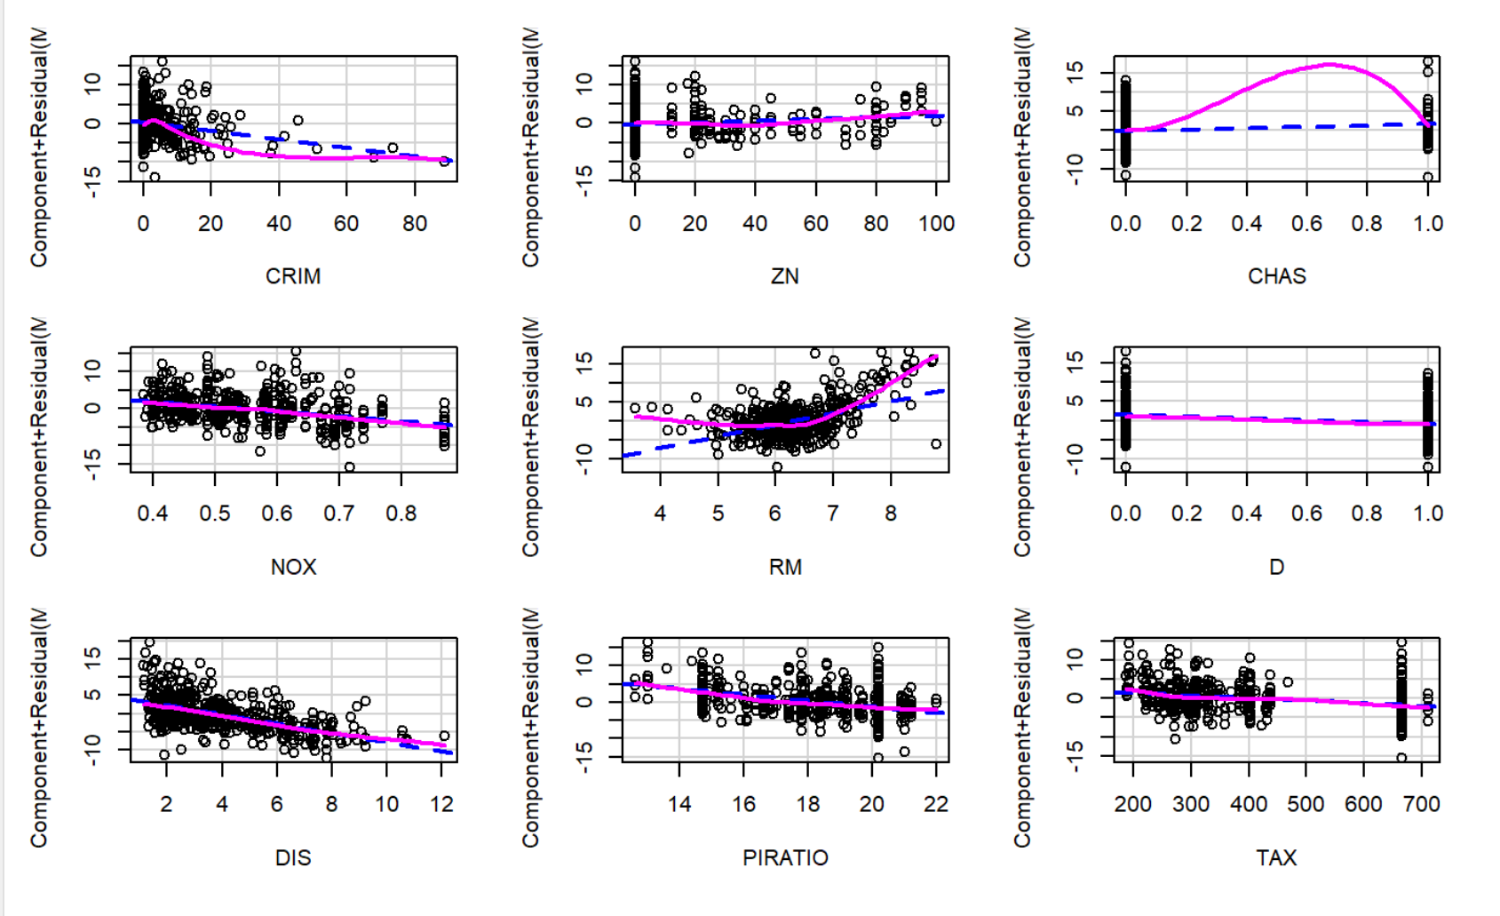
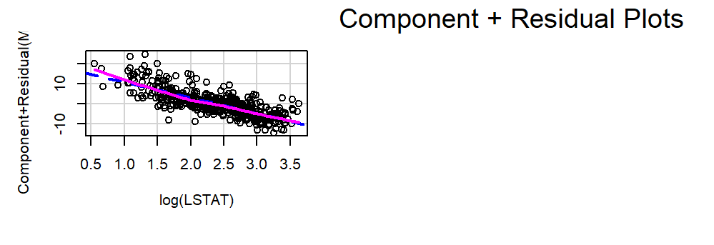
Component Residual Plots
Good to Great.
Quadratic? or cubic?
Use anova to compare models using F-test to check which one makes the model more appropriate.

Slide 29
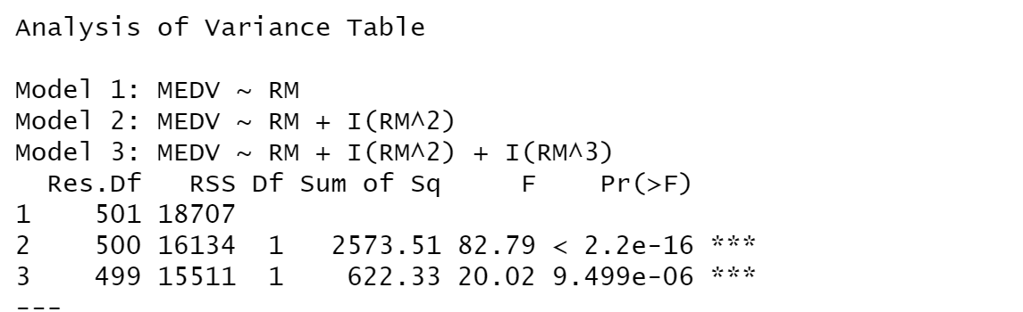
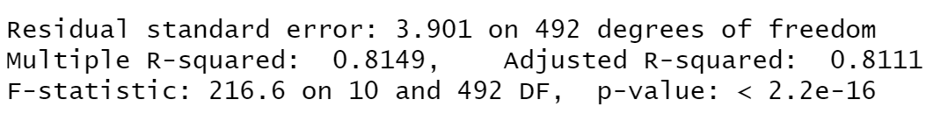

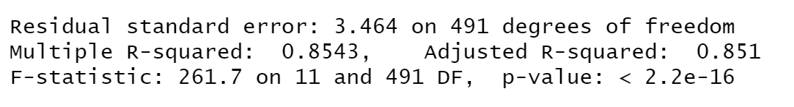

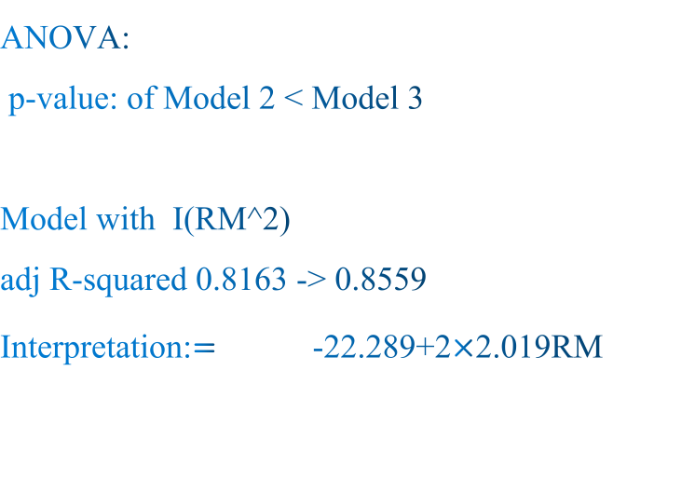

Compare Models using F-test
Good to Great.
ANOVA:
p-value: of Model 2 < Model 3
Model with I(RM^2)
adj R-squared 0.8163 -> 0.8559
Interpretation:$=$ -22.289+2$×$2.019RM

Slide 30
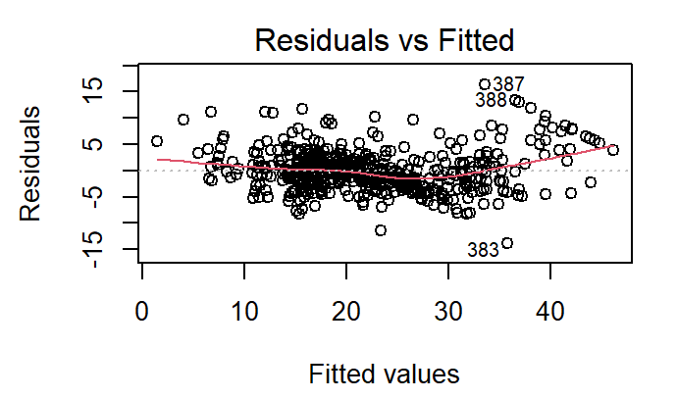
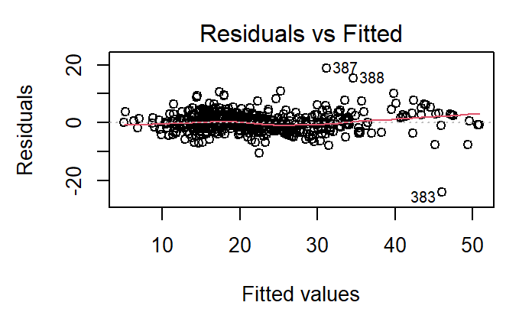
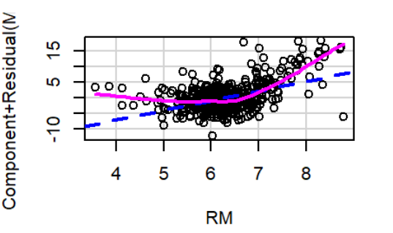
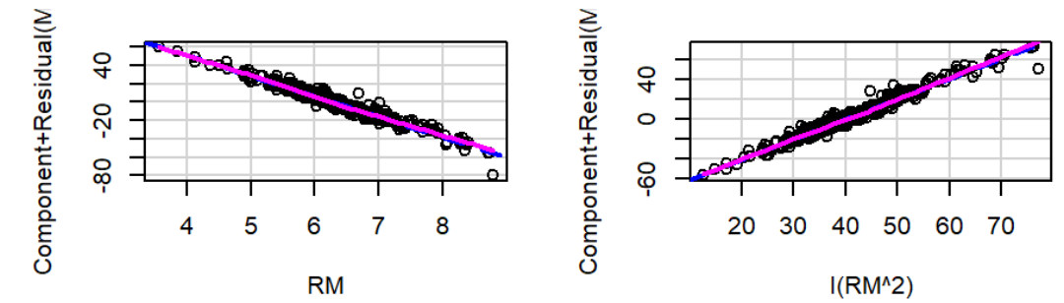
Revalidate Linearity
Good to Great.
More horizontal
More linear

Slide 31
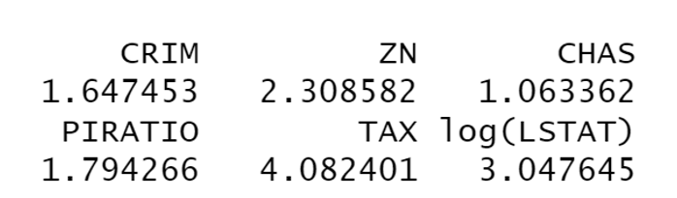




Variance Inflation Factor (VIF)
Good to Great.
Except for RM and I(RM^2), the VIF of other independent variables are less than 10, which means they do not have multicollinearity with other variables.
$${VIF}_{j}=1/(1−R_{j}^{2})$$
As an (arbitrary) rule of thumb, the variance inflation factor should not be larger than 10
Final Model
MEDV=125.5857-0.1316$×$CRIM+0.0118 $×$ZN+1.6790 $×$CHAS-13.8964 $×$ NOX-0.9795 $×$ DIS-1.3879 $×$ D- 0.0050 $×$ TAX- 0.6900 $×$ PIRATIO -6.9594 $×$ log(LSTAT)-22.2997 $×$ RM+2.0187 $×$ ${RM}^{2}$

Slide 32
Conditional Inference Tree

Slide 33
Data Partion
Good to Great.
70% Training Set
Data Set
30% Testing Set

Slide 34

Classify Data
Good to Great.
Quantile | MEDV | Classification
25% | [ 0 , 16.8 ) | A
50% | [16.8 , 21.1) | B
75% | [21.1 , 25 ) | C
100% | [ 25 , 50 ] | D

Slide 35

SWOT analysis
Good to Great.
95%
88%
12%

Slide 36


Check Accuracy
Good to Great.
Predicted Matrix
Accurate Rate = $\frac{9+78+13+12}{506×30\%}=74.172\%$

Slide 37
Comparision
Good to Great.
VS
MEDV = 53.4471 - 0.1118×CRIM + 0.0215×ZN + 1.8084×CHAS - 13.0775×NOX + 3.0964×RM - 1.2807×DIS - 2.3802×D - 0.0067×TAX - 0.8384×PIRATIO - 7.8463×log(LSTAT)
Tree | Regression
4 Variables | 10 Variables
No Calculation | Need Calculation
Possible Interval | Specific Number

Slide 38
Business Suggestions

Slide 39
Bussiness Suggestion - Efficient Price
Good to Great.
Too high:
hard to sell, customers go to rival companies
Too low:
easy to sell but with lower agency fee, lose the profit you could have
Suggestion

Slide 40

Bussiness Suggestion - Response to Changes
Good to Great.
Conclusion:
People do not like to live around highway.
Know Secretly:
A highway will be constructed nearby.
What to do:
Reduce the price and sell it right away. (Slightly lower than e2)
Otherwise you may reduce the price much more later. (e1)
Before
Construction
After
Construction

Slide 41
Thank You

