Slide 1
Project Architecture
Connect Four

Slide 2
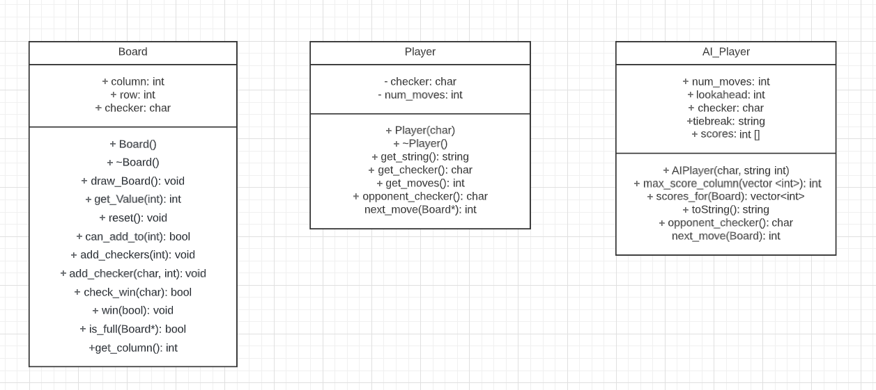
Class Diagram

Slide 3
Board.cpp
Contains the classes for the ASCII graphics.
Contains functions for adding checkers
Contains function for checking if the game has been won or not.

Slide 4
AI_Player.cpp
Contains functions for AI_Player that will analyze the current state of the game and make the next move accordingly
Will then use Board functions to make their move.
Used for identification i.e. or which is the active player.

Slide 5
Player.cpp
Contains basic instructions for the player and how they can interact with the game.
Used also for identifying the active player. Who won … etc.

