Slide 1
Project Architecture
Connect Four

Slide 2
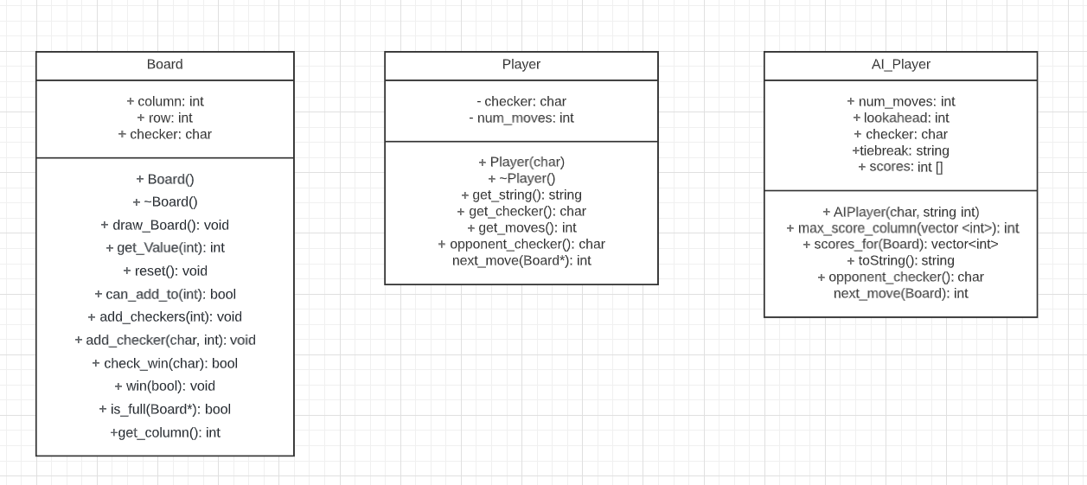
Class Diagram

Slide 3
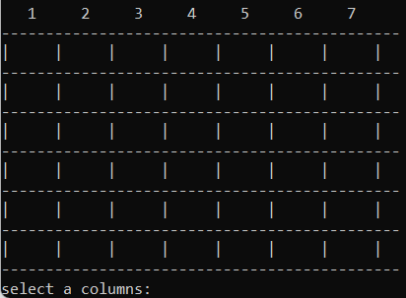
The Board
Contains the classes for the ASCII graphics.
Contains functions for adding checkers
Contains function for checking if the game has been won or not.

Slide 4
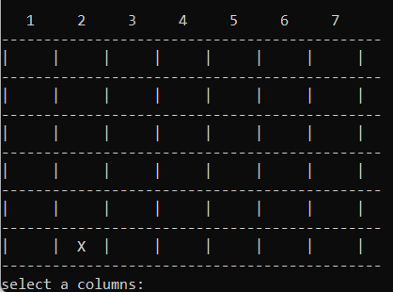
2Player.cpp
Contains basic instructions for the player and how they can interact with the game.
Used also for identifying the active player. Who won … etc.
Board changes when updating showing the move of the Player

Slide 5
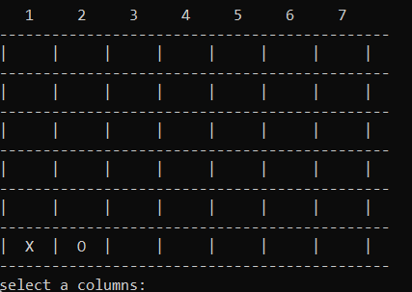
Playing the Game
Board updates with ‘O’ for the second player
Both players play by selecting the row they want to place it in

Slide 6
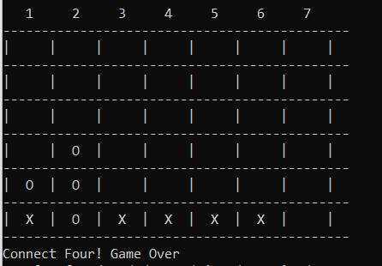
Playing the Game
Game ends when a player make 4 in a row
Can win with 4 in a row vertical, horizontal, or diagonal

Slide 7
How it Works
Everything is run inside of a terminal similar to PA3
Board is drawn at the beginning of the game
Multiple checks are used to make sure that a move is legal
The turns alternate between player X and player O
Once a player selects a column, the checker will be added to lowest available row in the column
If column is full, the checker can’t be added

Slide 8
AI_Player.cpp
Contains functions for AI_Player that will analyze the current state of the game and make the next move accordingly
Will then use Board functions to make their move.
Used for identification i.e. or which is the active player.
This was unfortunately not implemented into the game

