Slide 1
Great job!
Now that you have learned the Oddball Number Game
and its matching and mismatching trials, you will now learn the
Batch Choice Game.

Slide 2
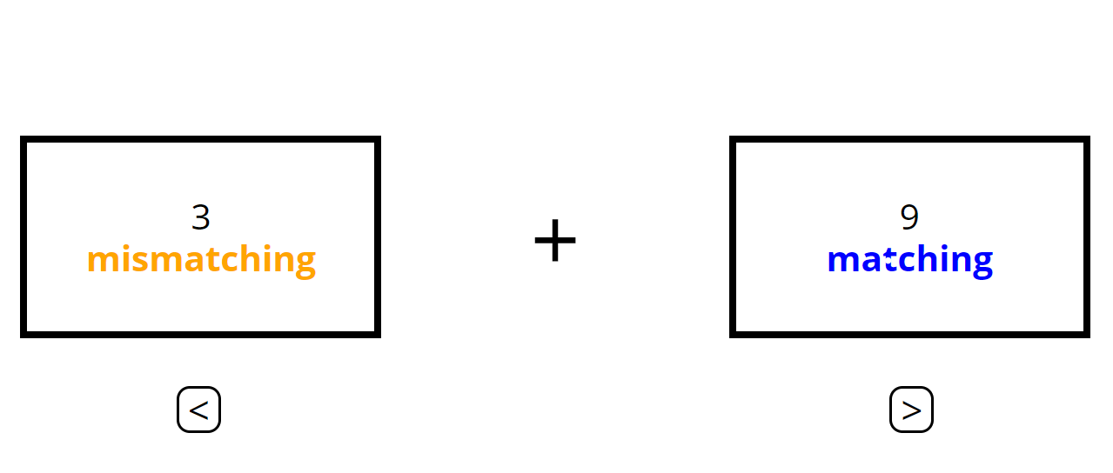
In the Batch Choice Game, you will decide between playing some
number of matching trials, or a mixture of matching and mismatching trials.
+
6
matching
2
mismatching
&
4
matching
+

Slide 3
The overall number of trials will be the same for both options, and
both options will take the same amount of time. So, the game will take
the same amount of time no matter which options you choose.

Slide 4
You will use the left arrow key to choose the option on the left and the
right arrow key to choose the option on the right.
+
6
matching
2
mismatching
&
4
matching
+

Slide 5
Once you make your selection, that batch will become highlighted
in green.
+
6
matching
2
mismatching
&
4
matching
+

Slide 6
Then, the trials for the Oddball Number Game will begin.
In this example, you would play 3 matching trials and 2 mismatching trials.
+
3
matching
&
2
mismatching
5
matching
+

Slide 7

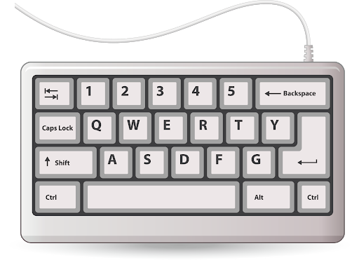
Remember to respond with your left hand for the Oddball Number Game.
+
003

Slide 8
When you choose a batch in the Batch Choice Game, sometimes you must
complete the number of selected trials.
Other times you will not complete the selected trials and will instead
move on to your next choice.

Slide 9
If you do not have to perform the trials, you will see the message below.
You cannot know before you make a choice whether you will have to do the trials.
Please treat every choice like you will have to complete the trials.
+
+
Trials omitted… X

Slide 10
Here are a few more things you should keep in mind:

Slide 11
Please make a batch choice in under 3 seconds. If you do not make a choice,
the computer will automatically make one for you and you will see this message:
+
Too slow… X
4
mismatching
+
4
matching

Slide 12
Please try your best on each trial. If you make 2 errors in a row,
including missing trials, you will see a black dot:
+
+

Slide 13
That is everything you need to know to play this game.
Now you will practice the Batch Choice game.

