Slide 1
Welcome to the Oddball Number Task.
You can move through the instructions by clicking “Next”

Slide 2
In this task, you will see a set of three symbols.
These symbols can be the number 1, 2, 3 or the letter X.

Slide 3
Each symbol will appear in either the first, second, or third position.
Here the “X” symbol is in the first position.
X _ _

Slide 4
Each symbol will appear in either the first, second, or third position.
Here the “X” symbol is in the second position.
_ X _

Slide 5
Each symbol will appear in either the first, second, or third position.
Here the “X” symbol is in the third position.
_ _ X

Slide 6
Here is an example of a trial. Each trial will have an oddball
symbol which is different from the other two symbols.
Your task is to pick out which symbol is the oddball.
1XX

Slide 7

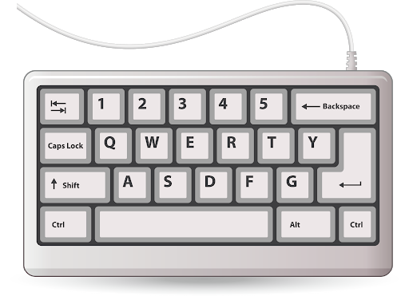
You will respond to the oddball by pressing these keys with your
left hand:
ring finger on the “1” key (for when the oddball is the number 1)
middle finger on the “2” key (for when the oddball is the number 2)
index finger on the “3” key (for when the oddball is the number 3)

Slide 8
For matching trials, the position of the oddball on the screen will
be the same as the location of the key you must press:
1XX

Slide 9
For matching trials, the position of the oddball on the screen will
be the same as the location of the key you must press:
For example, here the number 1 is the oddball AND is in the first position
(The correct response is to press 1)
1XX

Slide 10
For mismatching trials, the position of the oddball on the screen will
be the different from the location of the key you must press:
233

Slide 11
For mismatching trials, the position of the oddball on the screen will
be the different from the location of the key you must press:
For example, here the number 2 is the oddball BUT is in the first position
(The correct response is to press 2)
233

Slide 12
The “+” indicates the start of a new trial that is about to appear on
the screen.
+

Slide 13
Here is an example of a matching trial.
+

Slide 14
Here is an example of a matching trial.
122

Slide 15
Here is an example of a matching trial.
(The correct response is to press 1)
122

Slide 16
Here is an example of a matching trial.
+

Slide 17
Here is an example of a matching trial.
121

Slide 18
Here is an example of a matching trial.
(The correct response is to press 2)
121

Slide 19
Here is an example of a matching trial.
+

Slide 20
Here is an example of a matching trial.
XX3

Slide 21
Here is an example of a matching trial.
(The correct response is to press 3)
XX3

Slide 22
Here is an example of a mismatching trial.
+

Slide 23
Here is an example of a mismatching trial.
131

Slide 24
Here is an example of a mismatching trial.
(The correct response is to press 3)
131

Slide 25
Here is an example of a mismatching trial.
+

Slide 26
Here is an example of a mismatching trial.
331

Slide 27
Here is an example of a mismatching trial.
(The correct response is to press 1)
331

Slide 28
Here is an example of a mismatching trial.
+

Slide 29
Here is an example of a mismatching trial.
XX2

Slide 30
Here is an example of a mismatching trial.
(The correct response is to press 2)
XX2

Slide 31
Now you will practice this task.

Slide 32
[PRACTICE TRIALS]

