Slide 1
Great job!
Now that you have learned the Oddball Number Game
and its matching and mismatching trials, you will now learn the
Batch Choice Game.

Slide 2
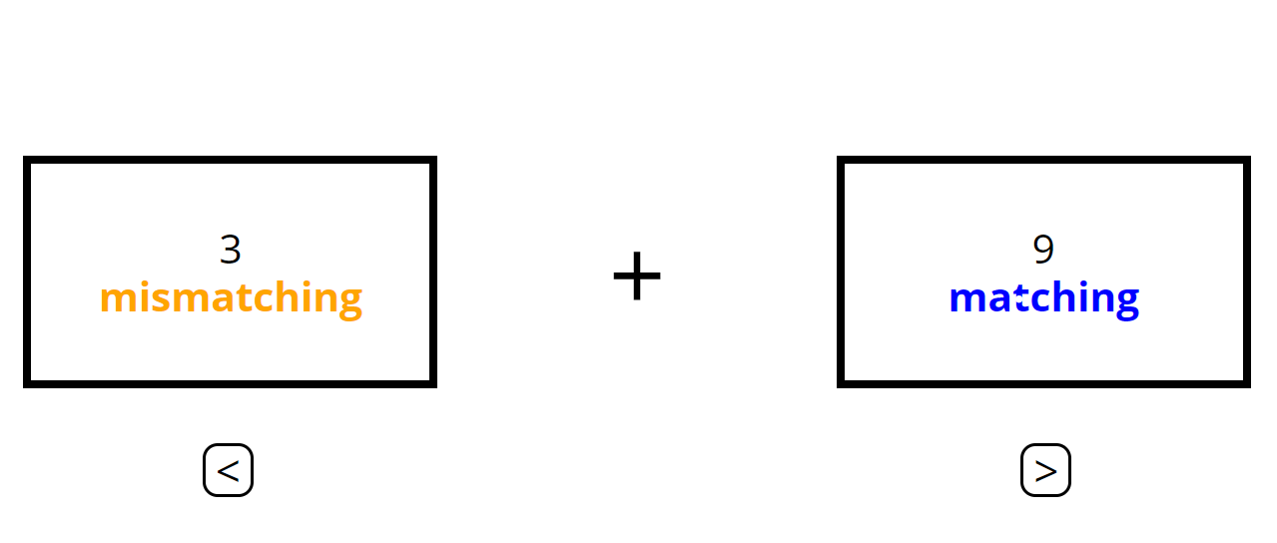
In the Batch Choice Game, you will decide between playing some
number of matching OR mismatching trials.
+
3
mismatching
+
2
matching

Slide 3
You will use the left arrow key to choose the option on the left and the
right arrow key to choose the option on the right.
+
3
mismatching
+
2
matching

Slide 4
Once you make your selection, that batch will become highlighted
in green.
+
3
mismatching
+
2
matching

Slide 5
Then, the trials for the Oddball Number Game will begin.
In this example, you would then play 7 matching trials.
+
7
matching
+
2
mismatching

Slide 6

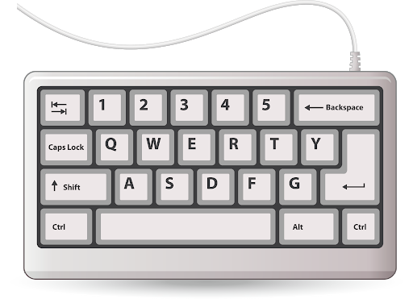
Remember to respond with your left hand for the Oddball Number Game.
+
003

Slide 7
When you choose a batch in the Batch Choice Game, sometimes you must
complete the number of selected trials.
Other times you will not complete the selected trials and will instead
move on to your next choice.

Slide 8
If you do not have to perform the trials, you will see the message below.
Please treat every choice like you will have to complete the trials.
+
Trials omitted… X
+

Slide 9
Here are a few more things you should keep in mind:

Slide 10
Please make a batch choice in under 7 seconds. If you do not make a choice,
the computer will automatically make one for you and you will see this message:
+
Too slow… X
8
matching
+
4
mismatching

Slide 11
Please try your best on each trial. If you make 2 errors in a row,
including missing trials, you will see a black dot:
+
+

Slide 12
If you select the batch with fewer trials, there will be a wait period before
and after the trials. So the game will take the same amount of time regardless
of which batch you choose.
+
8
matching
+
4
mismatching

Slide 13
During a wait period you will see this screen:
+
… X

Slide 14
That is everything you need to know to play this game.
Now you will practice the Batch Choice game.

