Slide 1
Great job!
Now that you have learned the Oddball Number Task
and its matching and mismatching trials, you will now learn the
Demand Selection Task.

Slide 2
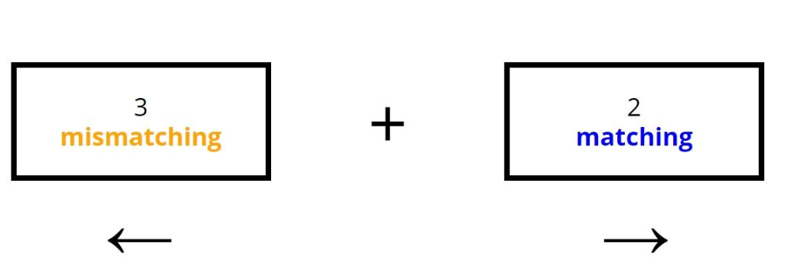
In the Demand Selection Task, you will decide between performing X number
of matching or Y number of mismatching trials.
(Here you would press the → button to perform 2 matching trials
or the ← button to perform 3 mismatching trials)
X

Slide 3
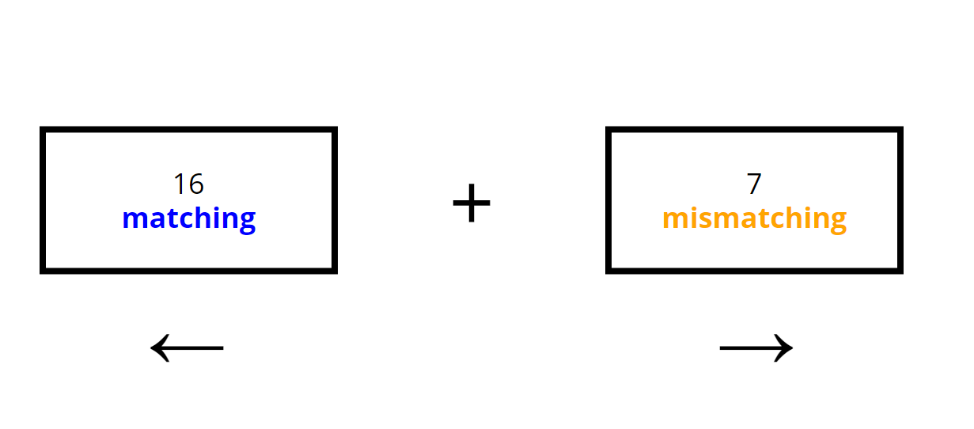
In the Demand Selection Task, you will decide between performing X number
of matching or Y number of mismatching trials.
(Here you would press the ← button to perform 16 matching trials
or the → button to perform 7 mismatching trials)
X

Slide 4
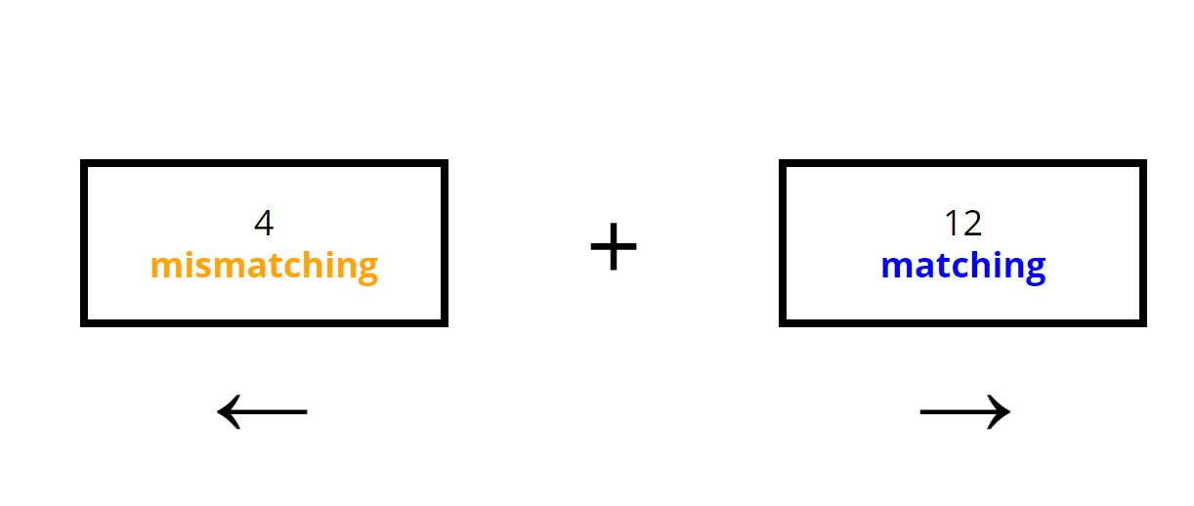
In the Demand Selection Task, you will decide between performing X number
of matching or Y number of mismatching trials.
(Here you would press the → button to perform 12 matching trials
or the ← button to perform 4 mismatching trials)
X

Slide 5
Sometimes you will have to complete the number of selected trials,
and other times you will only have to decide on which trials (X matching
or Y mismatching ) you would perform in that scenario.
If you must perform the trials, and chose the matching option, you will see the
screen above and will play the Oddball Number Task for that number of trials.
matching 3

Slide 6
Sometimes you will have to complete the number of selected trials,
and other times you will only have to decide on which trials (X matching
or Y mismatching ) you would perform in that scenario.
If you must perform the trials, and chose the mismatching option, you will see
the screen above and will play the Oddball Number Task for that number of trials.
mismatching 3

Slide 7
Sometimes you will have to complete the number of selected trials,
and other times you will only have to decide on which trials (X matching
or Y mismatching ) you would perform in that scenario.
If you do not have to perform the trials, you will see the screen
above before moving on to the new pair of choices to choose between.
Trials omitted. X

Slide 8
In all cases, it is important to make your choices as if you would have to
complete the trials.
You will not know if you will actually have to complete the trials until
you have made your decision.

Slide 9
Now you will practice the Demand Selection Task.

